Slide 1

School of Technology, Design and Computer Application Silver Oak College of Computer Application Department of Computer Application
A PROJECT PRESENTATION ON [ AI LEGAL BOT ]
Submitted By
Kishan Rathod (En. No.: 2204030102471)
Keyur Bhoi (En. No.: 2204030101651)
Priya Parmar (En. No.: 2204030102182)
Deep Shah (En. No.: 2204030102535)
Drashti Chandarana(En. No.: 2204030101667)
Bachelor of Computer Application
Semester VI
MAJOR PROJECT Group No: [ 359 ]
Guide
Prof. Khush Jain
Submitted To
Department of Computer Application
Silver Oak University, Gota, Ahmedabad, 382481
Academic Year 2024-2025

Slide 2
[1] PROJECT PROFILE
Project Profile: | AI Law Legal Bot
Objective: | The AI Legal Law Bot, powered by Gemini AI (Model 2.0), is a multilingual, AI-driven legal assistant tailored to the Indian legal system. It offers accurate legal guidance, multilingual support, and instant insights from legal databases.
Platform of Application: | Web base Application
Front End Tool: | HTML / CSS / JS / TAILWIND CSS
Back End Tool: | MONGODB / FLASK / PYTHON
Project Duration : | 6 Months
Project Guide : | Mr. Khush Jain
Submitted By : | Rathod Kishan (2204030102471)
Submitted To : | Department Of Computer Application

Slide 3
[2] EXISTING SYSTEM
Manual Legal Help
People go to lawyers or talk on phone for help.
It takes time and can be costly.
Sometimes lawyers are not available when needed.
Legal Websites
Some websites give legal info and FAQs.
But users have to read and search everything themselves.
No one to chat with or ask questions directly.
Simple Chatbots
Few sites have basic chatbots.
They only give fixed answers.
They can't handle real legal problems or give detailed help.

Slide 4
[3] NEED FOR NEW SYSTEM
To Save Time
Users can get legal help quickly without waiting for a lawyer.
No need to search for hours or visit offices.
To Make Legal Help Easy
Not everyone understands legal terms.
The bot will give answers in simple language.
To Give 24/7 Support
People can ask questions anytime.
No time limits like office hours.
To Solve Common Legal Problems
The bot can help with basic issues like legal rights, documents, and processes.
To Make It Affordable
Many people can’t afford legal advice.
This system gives free or low-cost help.

Slide 5
[3] NEED FOR NEW SYSTEM
Platform/Service | Real-Time Chat | Easy to Use | 24/7 Support | Personalized Help | Free to Use | Multilingual | Secure
Manual Legal Help | ✘ | ✘ | ✘ | ✔ | ✘ | ✘ | ✔
Legal Websites | ✘ | ✔ | ✔ | ✘ | ✔ | ✘ | ✘
Basic Legal Chatbots | ✔ | ✔ | ✔ | ✘ | ✔ | ✘ | ✔
Stark AI Legal Bot | ✔ | ✔ | ✔ | ✔ | ✔ | ✔ | ✔

Slide 6
[4] FUNCTIONAL SPECIFICATION
(4.1) User of the system
Individuals: Seeking legal advice, document templates, or general legal information.
Small Businesses: Needing cost-effective legal assistance for contracts, compliance, and other legal matters.
Legal Professionals: Using the bot for quick reference to legal resources or assistance in routine tasks.
Organizations: Requiring automation for common legal processes (e.g., employee contracts, privacy policies).
Students/Researchers: Looking for legal research assistance or information on case law and statutes.

Slide 7
[4] FUNCTIONAL SPECIFICATION
(4.2) Module of the system
User Authentication Module
Signup, Login, Logout functionality.
Manages user identity and data.
Chatbot Module
Main feature for chatting with users in real-time.
Responds in multiple language
Legal Knowledge Base
Contains legal rules, rights, and FAQs.
Continuously updated to stay relevant.
Chat History Module
Stores past conversations for user reference.
Sidebar Navigation Module
Allows easy switching between chat, profile, and other pages.
Security Module
Keeps user data safe and private.
Protects against unauthorized access.

Slide 8
[5] SYSTEM REQUIREMENTS
Server Side Requirement
Component | Minimum Requirement
Processor | 2.8 GHz (Dual Core or higher)
RAM | 2 GB
Hard Disk | 4 GB Free Space
Operating System | Windows / Linux / macOS
Backend Language | Python
Framework | Flask
Database | MongoDB
IDE / Editor | VS Code

Slide 9
[5] SYSTEM REQUIREMENTS
Client Side Requirement
Component | Minimum Requirement
Processor | 1.33 GHz
RAM | 2 GB
Hard Disk | 4 GB Free Space
Operating System | Windows / Linux / macOS
Web Browser | Google Chrome / Firefox / Safari
Frontend Tech | HTML, CSS, JavaScript
Text Editor | VS Code

Slide 10
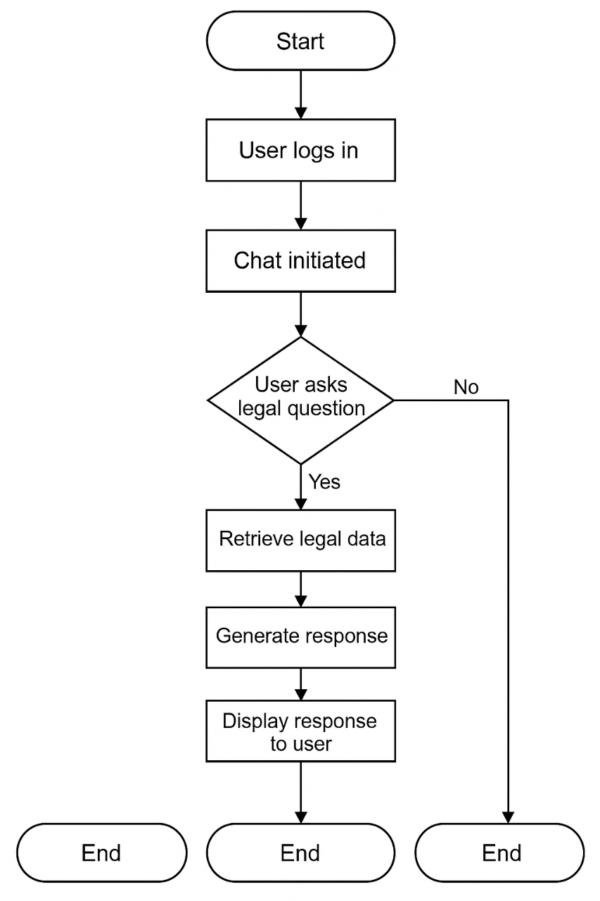
[6] SYSTEM FLOWCHART

Slide 11
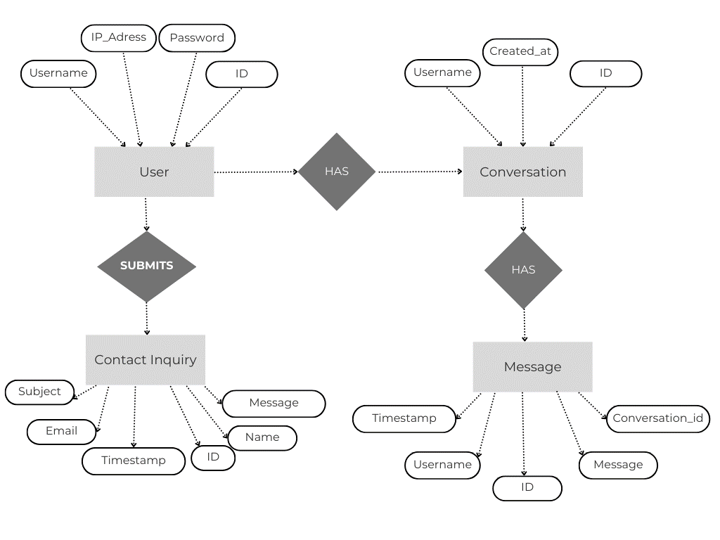
[7] ER DIAGRAM

Slide 12
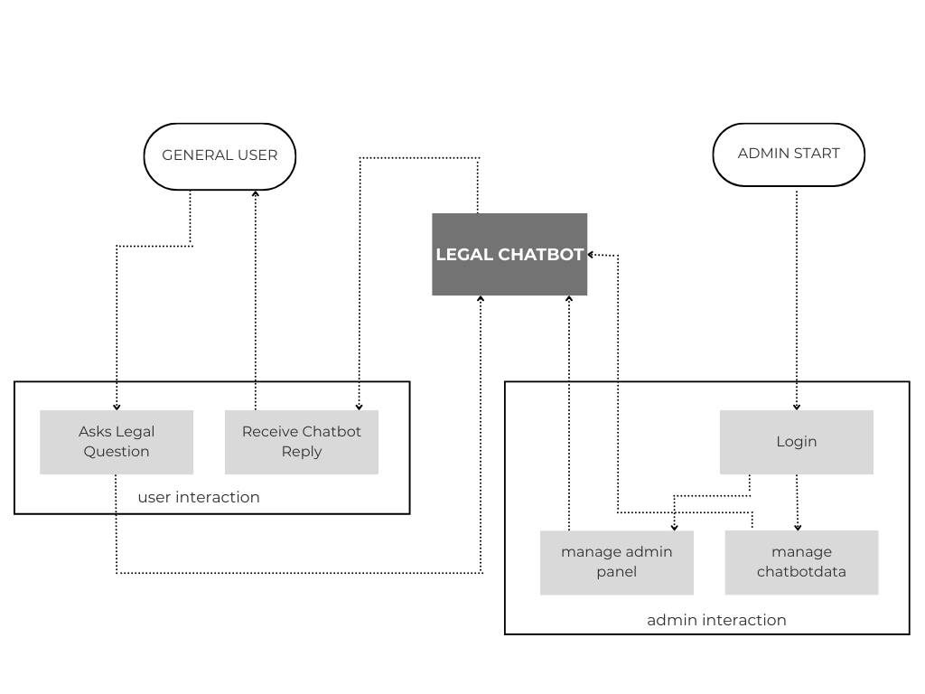
[8] DATAFLOW DIAGRAM
[ Zero Level DFD ]

Slide 13
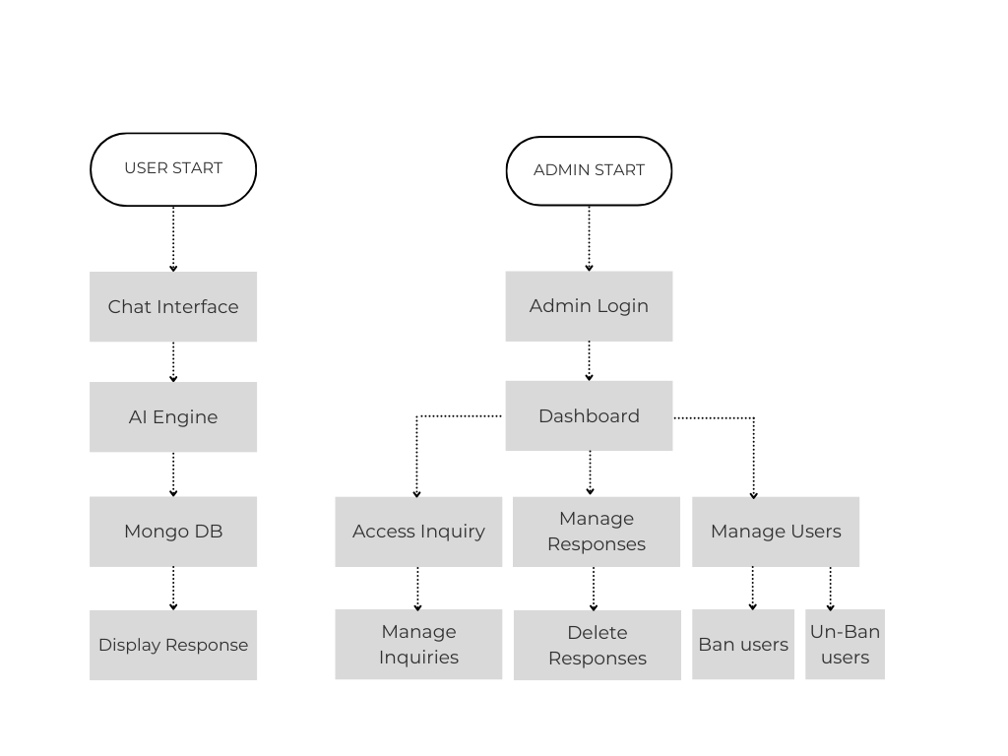
[9] DATA DICTIONARY
[ First Level DFD ]

Slide 14
[9] DATA DICTIONARY
Field Name | Data Type | Description
user_id | Integer | Unique ID assigned to each user
username | Varchar | Name chosen by the user
email | Varchar | User’s email for login and communication
password | Varchar | Encrypted user password
message_id | Integer | Unique ID for each chat message
user_message | Text | Question or input typed by the user
bot_response | Text | Reply generated by the chatbot
timestamp | DateTime | Time when the message was sent or received
chat_session_id | Integer | Identifies a particular chat session
legal_topic | Varchar | Legal category related to the query (e.g., IPC, Rights)
feedback | Text | User's optional feedback after using the bot

Slide 15
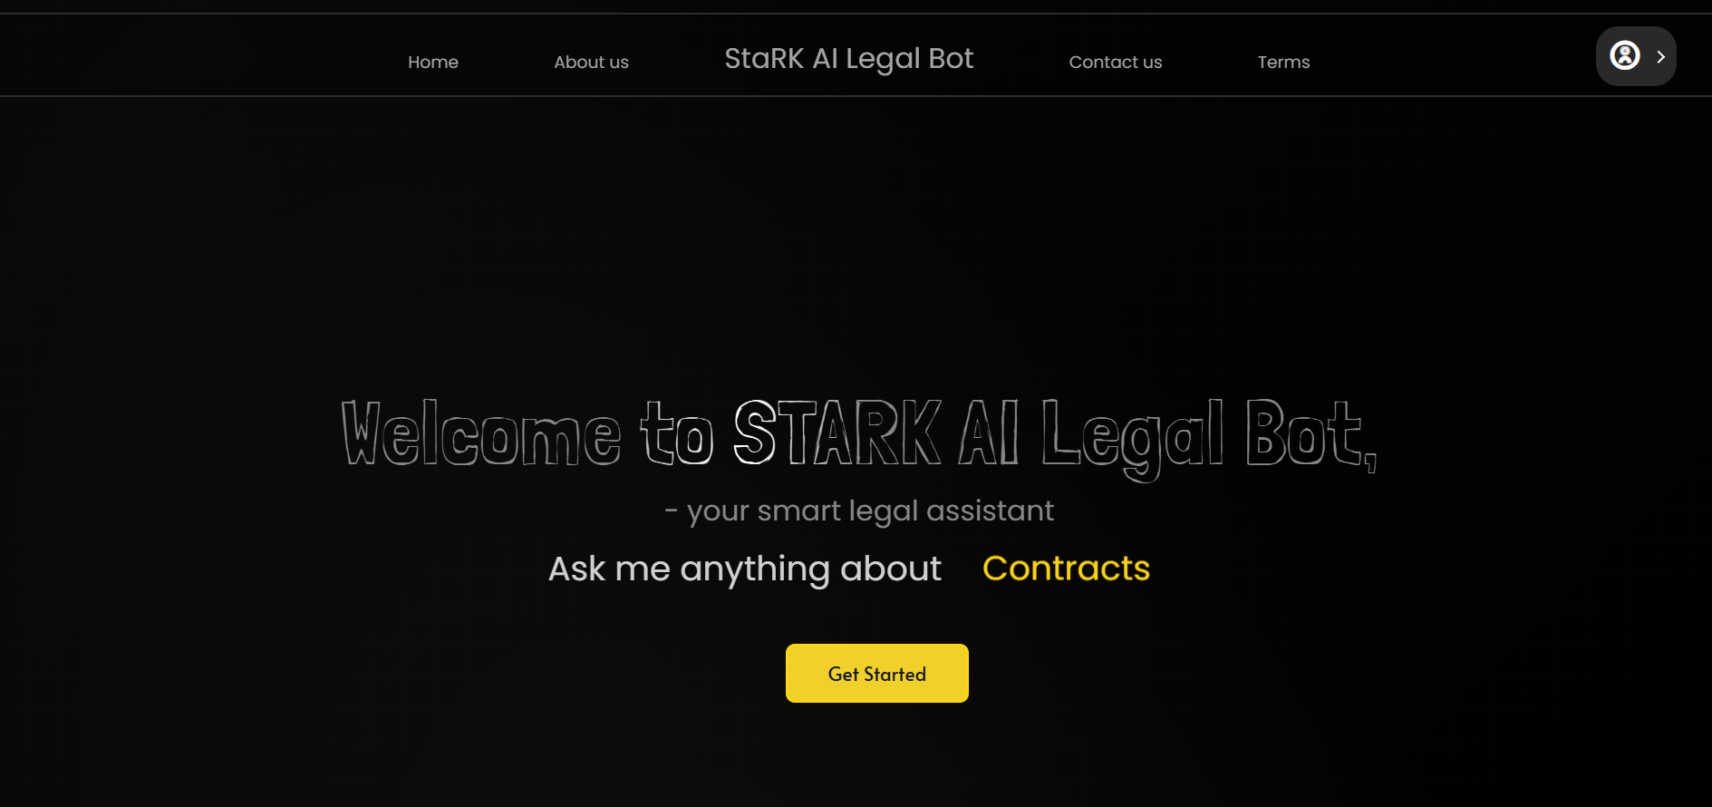
[10] INPUT DESIGN
[ Landing Page ]

Slide 16

[10] INPUT DESIGN
[ Footer ]

Slide 17
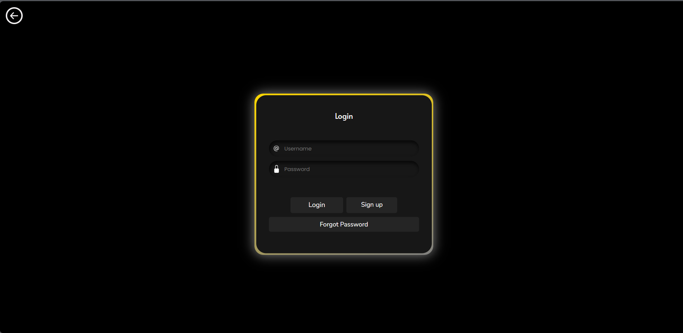
[10] INPUT DESIGN
[ Login Page ]

Slide 18
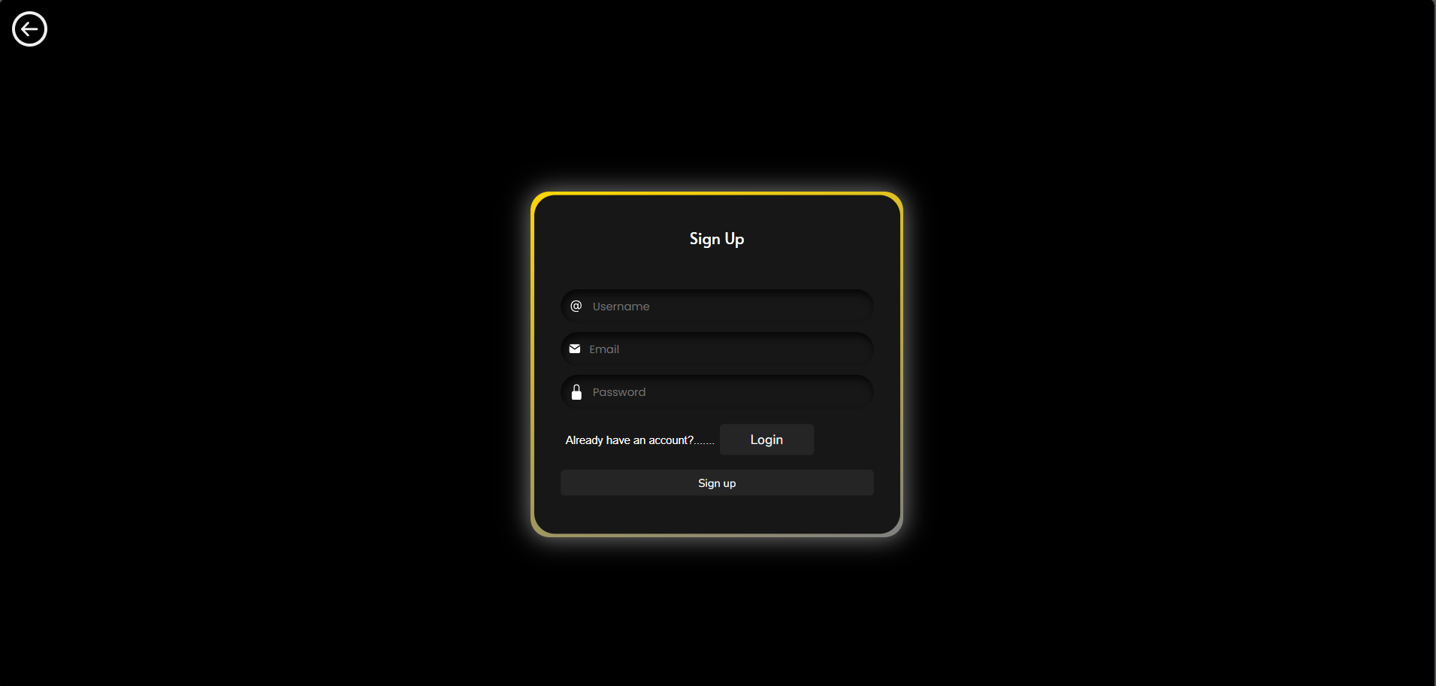
[10] INPUT DESIGN
[ Signup Page ]

Slide 19
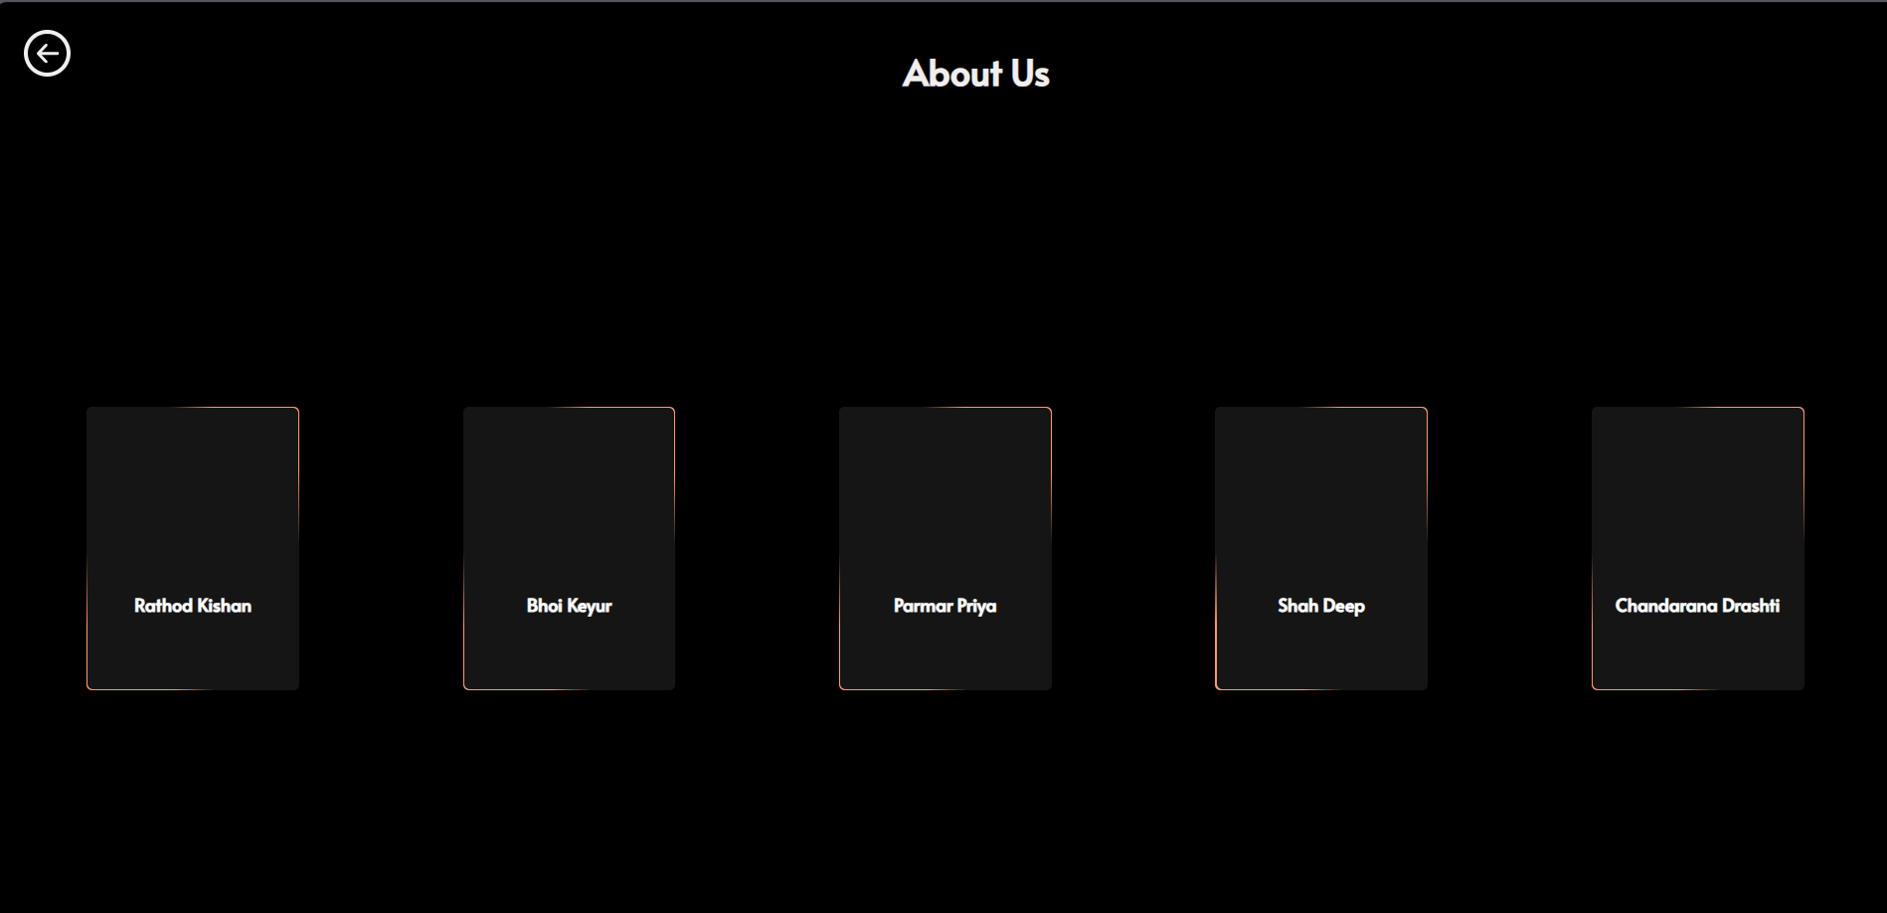
[10] INPUT DESIGN
[ About Us Page ]

Slide 20
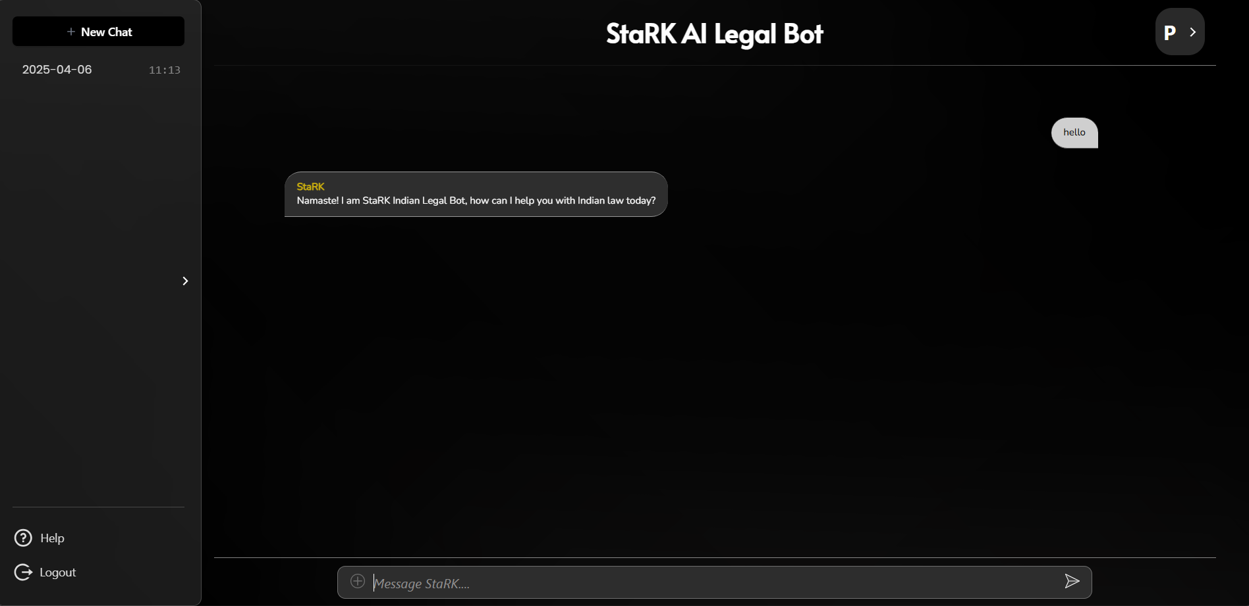
[10] INPUT DESIGN
[ Client Side ]
[ Chat Screen ]

Slide 21
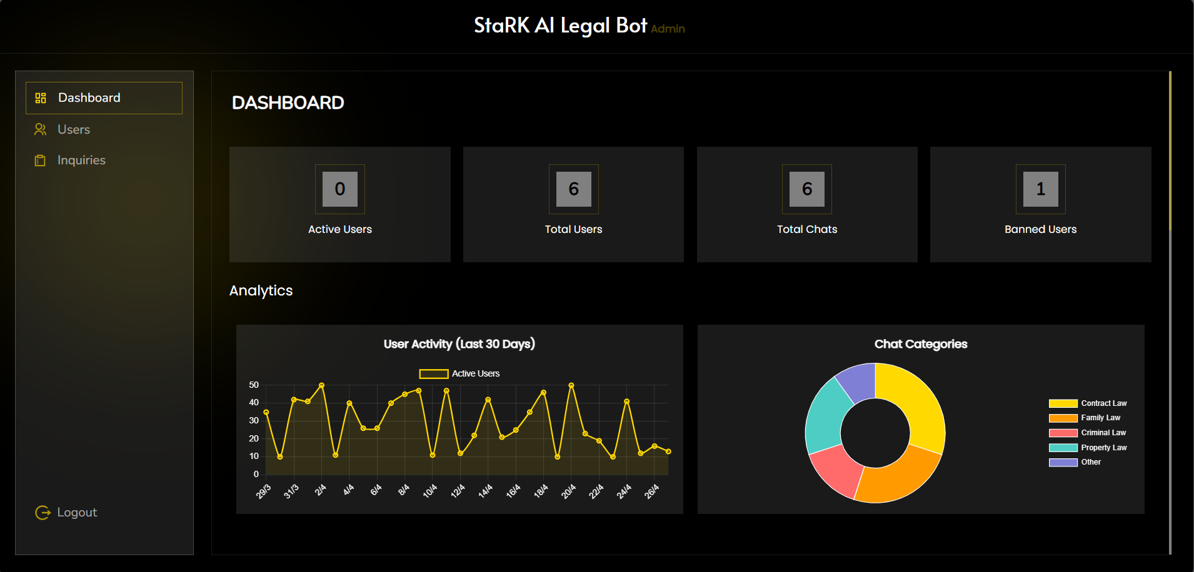
[10] INPUT DESIGN
[ Admin Side ]
[ Admin Panel ]
[ Dashboard ]

Slide 22
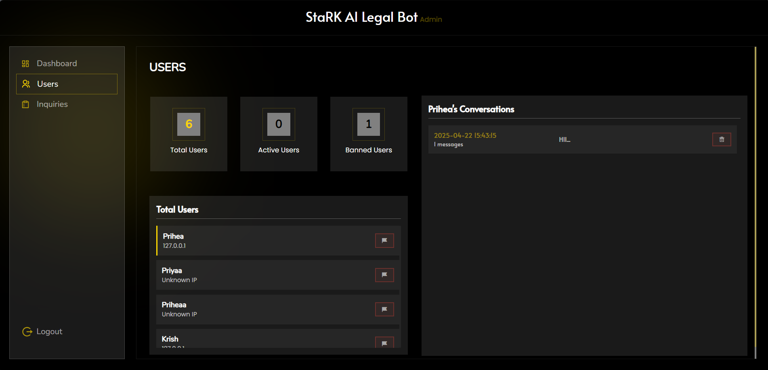
[10] INPUT DESIGN
[ Admin Side ]
[ Admin Panel ]
[ Users ]

Slide 23
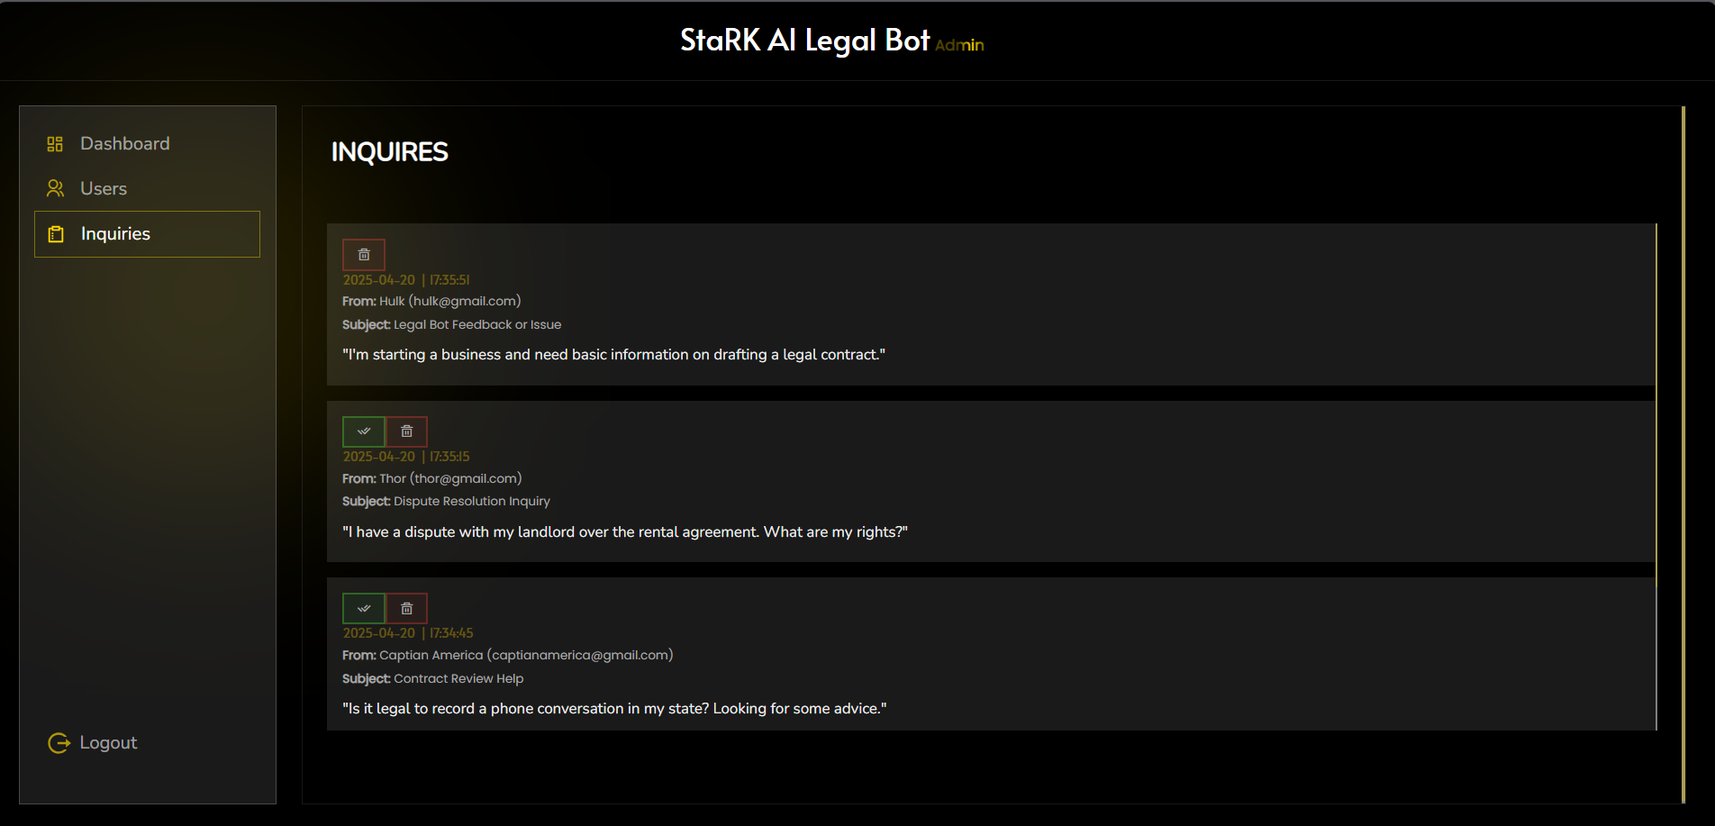
[10] INPUT DESIGN
[ Admin Side ]
[ Admin Panel ]
[ Inquiries ]

Slide 24
[12] TESTING
Unit Testing : Each module like Chatbot, login, and chat history was tested individually.
Integration Testing : Verified that all modules work smoothly together as a complete system.
Functional Testing : Ensured the bot responds correctly to user queries.
UI/UX Testing : Tested the interface for responsiveness, design flow, and user-friendliness.
Performance Testing : Checked the speed and response time of chatbot replies.
Security Testing : Verified that user data (login, messages) remains safe and encrypted.
Types of Testing Performed

Slide 25
[13] FUTURE ENHANCEMENT
Voice Support : Users can talk to the bot using voice.
Case Links : Show real case examples for better understanding.
Chat with Lawyers : Add feature to connect users with real lawyers.
Mobile App : Make a mobile version for easy access.
Smarter Bot :Use AI to give better and more accurate answers.

Slide 26
[14] BIBLIOGRAPHY
Python Official Docs – https://docs.python.org
Flask Framework – https://flask.palletsprojects.com
W3Schools (HTML, CSS, JS) – https://www.w3schools.com
MongoDB Documentation – https://www.mongodb.com/docs
OpenAI Chatbot Reference – https://platform.openai.com
GeeksforGeeks – https://www.geeksforgeeks.org
Stack Overflow – For code help and issue fixing

Slide 27
THANK YOU

