Slide 1
Know Your Resume Rating
Batch 9
21N31A0579
21N31A0583
21N31A0589

Slide 2
Table of contents
01
02
03
ABSTRACT
PROJECT TITLE JUSTIFICATION
OBJECTIVE AND SCOPE
04
05
06
ANALYSIS AND EXPLANATION
Literature review
Data collection

Slide 3
ABSTRACT
Making a standout CV is essential for job seekers in the cutthroat job market of today to land coveted employment chances. The "Know Your Resume Rating" initiative seeks to create a cutting-edge and user-friendly application that provides people with insightful information about the efficacy of their resumes. The tool will examine important aspects of a resume such content, structure, keywords, and formatting by utilizing cutting-edge natural language processing (NLP) methods and machine learning algorithms. The main goal of the project is to give users a quantitative and qualitative evaluation of their resumes so they can see where they excel and where they need to improve.

Slide 4
The tool will provide tailored advice on how to improve content's visual appeal, job role specificity, and optimization. In order to increase job seekers' chances of landing interviews and ultimately accomplishing their professional goals, this project aims to provide them with a better understanding of the strengths and shortcomings of their CV. The "Know Your Resume Rating" project's user-centric strategy seeks to close the gap between job seekers and potential employers, fostering more fruitful and valuable contacts in the labour market.

Slide 5
PROJECT TITLE JUSTIFICATION
Why is your project required?
Most applicants don't write a quality CV, thus they are disqualified right away.
The majority of businesses use application tracking systems (ATS) to sort resumes.
Usually, we aren't sure if this resume is the best one for the job we're looking for.
What advantages will the project offer?
You can evaluate your level of familiarity with modern technologies.
It grades your resume and identifies your areas of weakness.

Slide 6
Objective and Scope of the Project
Objective:
Project resume rating's main goal is to systematically evaluate and assess applicants' qualifications, abilities, and suitability based on their resumes so that decision-makers can decide whether they would be a good fit for employment, teamwork, or participation in a particular project or role.
With as little bias and subjectivity as possible, this procedure seeks to find the most qualified and eligible applicants.

Slide 7
Objective and Scope of the Project
SCOPE:
Defining criteria and techniques for candidate resume evaluation, reducing biases, implementing technology for effective assessment, addressing ethical issues, and taking into account holistic assessment approaches are all part of the scope of a resume rating project.
The goal of the project is to assist successful outcomes by improving the objectivity, fairness, and general caliber of applicant evaluation.

Slide 8
BASIC CONCEPTS
We will be using the following Softwares:
Python/R
Python NLP(Natural Language Processing)
Jupyter Notebook
PDFminer
PyResparser

Slide 9
ANALYSIS AND EXPLANATION:
FEATURES:
User's & Admin Section
Resume Score
Career Recommendations
Resume writing Tips suggestions
Courses Recommendations
Skills Recommendations
Youtube video recommendations

Slide 10
Literature Review
An important step in hiring and project selection is resume rating, which involves assessing individuals' skills and expertise based solely on their resumes. Key elements of resume grading are briefly summarized in this literature study.
1. Evaluation Criteria
a) Credentials and Education
b) Experience's Relevance
c) Keywords and Skills
2) Rating Techniques
a) Human Assessment
b) Automated Evaluation

Slide 11
DATA COLLECTION
The "Know Your Resume Rating" project's data collection procedure is an essential part of the effort. We will compile a varied collection of resumes and related evaluations in order to create an efficient resume rating system.
Resume gathering
Data Anonymization and Privacy
Creation of the Rating Dataset
Development of the Rating Criteria
Constant Data Gathering
Data verification
Data enhancement

Slide 12
Requirement specifications
System Requirements:
python
Pip
XAMP
To run app, write following command in CMD. or use any IDE.
streamlit run App.py
PyResparser
Notes:
hi;

Slide 13
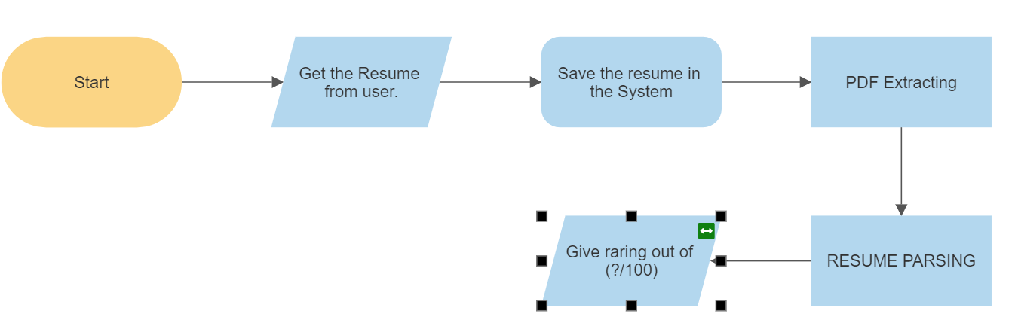
Architecture diagram

Slide 14
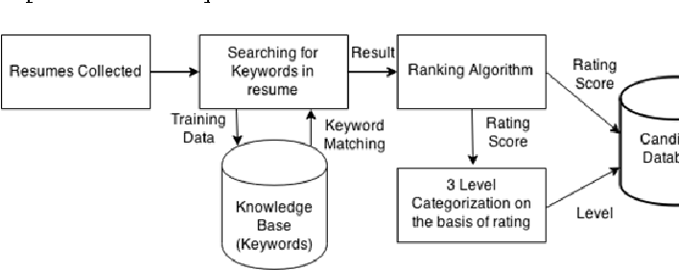
DATA FLOW DIAGRAM

Slide 15
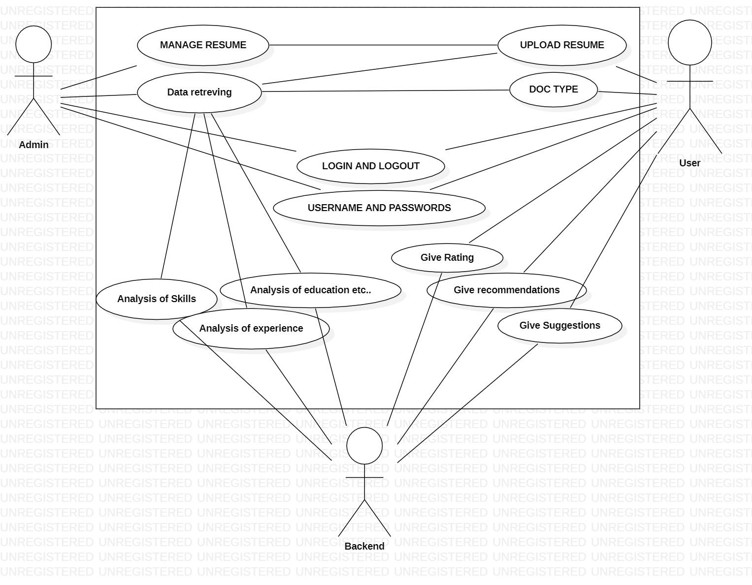
USE CASE
DIAGRAM

Slide 16
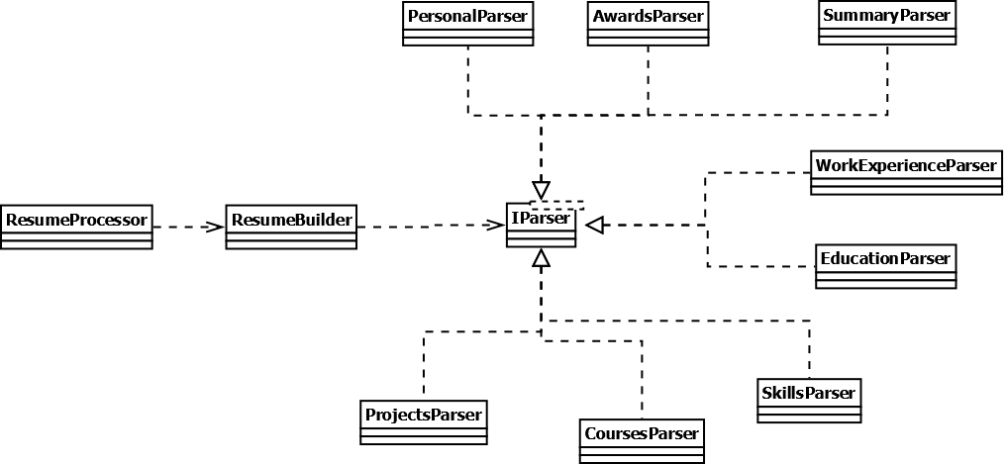
ClASS DIAGRAM

Slide 17
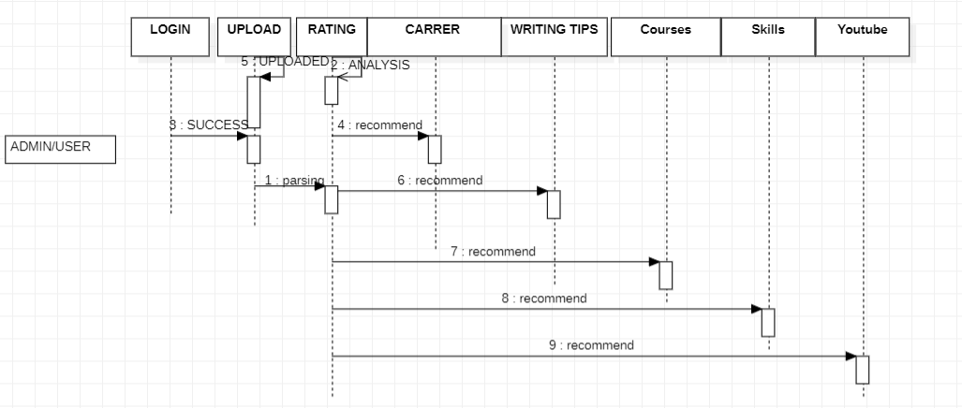
SEQUENCE DIAGRAM

Slide 18
Thank you!

