Slide 1
C
CampusPulse AI
An intelligent academic companion powered by AI agents and MCP tools
Build with AI Hackathon 2026 · GDG Astana

Slide 2
CAMPUSPULSE / AI
Student life is fragmented
One student. Multiple courses. Many moving deadlines.
Information overload
Time pressure
Too many manual steps
Schedules, assignments, grades and course materials often live in separate views.
Students need to understand priorities and prepare around their real timetable.
Finding information and building an actionable weekly plan takes effort.
Our opportunity: turn academic data into clear, personalized next actions.
02

Slide 3
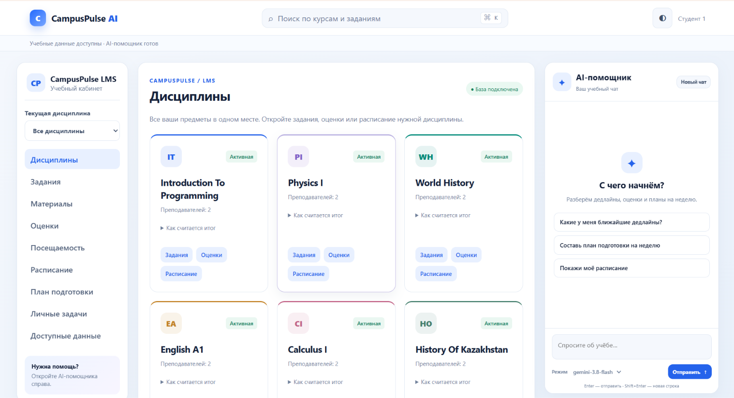
CAMPUSPULSE / AI
One workspace. One AI assistant.
CampusPulse combines a student LMS with an action-oriented assistant.
Academic hub
• Courses & tasks
• Schedule
• Grades & attendance
• Study materials
• Study planning
• AI chat
03

Slide 4
CAMPUSPULSE / AI
How the AI agent works
A structured tool-using workflow, from intent to answer.
Student query
AI agent
MCP tools
LMS + Firestore
Response
→
→
→
→
Natural-language request
Selects the next action
Reads authorized data
Academic records
Useful, grounded result
Reasoning loop: interpret → choose tool → execute → use result → respond
04

Slide 5
CAMPUSPULSE / AI
MCP: tools that do real work
The assistant can query different parts of the academic system.
Timetable
Deadlines
Performance
get_schedule
get_assignments
get_grades / get_attendance
Materials
Planning
Data access
read_materials
plan_study / prepare_study_plan
list_data_resources / query_data
MCP connects the agent with structured, purpose-built academic tools.
05

Slide 6
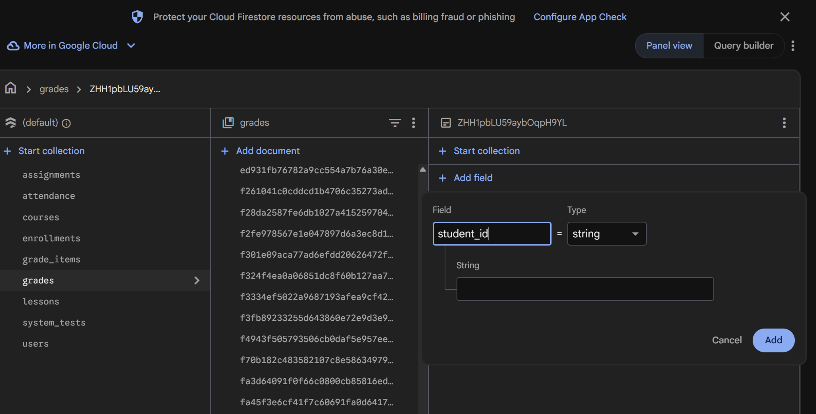
CAMPUSPULSE / AI
Academic data with Firestore
A unified source for student-facing information.
Structured collections
Courses, enrollments, assignments, lessons, grades, attendance and users form the academic data layer.
The agent retrieves relevant information through the LMS tool layer.
06

Slide 7
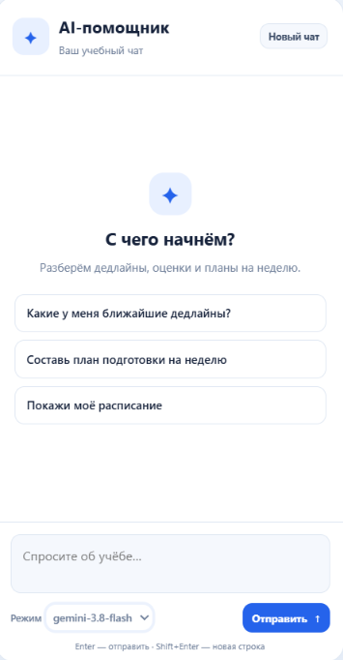
CAMPUSPULSE / AI
Designed around student workflows
A usable LMS and an AI chat available in the same interface.
Browse course data, then ask the assistant to turn it into a plan.
07

Slide 8
CAMPUSPULSE / AI
Three questions. Clear academic actions.
Demo scenarios showcasing the agent’s tool selection.
What are my nearest deadlines?
01
Retrieve assignments and order by due date.
Build my study plan for this week.
02
Combine timetable and workload into a practical plan.
How am I doing in Calculus?
03
Use performance and attendance records to explain progress.
08

Slide 9
CAMPUSPULSE / AI
Architecture & technology
Modular design connecting frontend, APIs, tools and data.
Web LMS
Python backend
AI orchestration
FastMCP
Firestore
→
→
→
→
Student UI + AI chat
API and access rules
Gemini / function calling
Academic tool endpoints
Structured records
Separation of concerns: interface • agent • MCP • LMS services • database
09

Slide 10
CampusPulse AI
From academic information to intelligent action.
One student workspace • Real academic tools • Personalized guidance
Thank you!

