Slide 1
Project Presentation of Co-Op Project at Industry (Module-2)
On
A Data-Driven Analysis of Customer Purchase Behavior in E-Commerce Platforms
Submitted By:-
Prikshit - 2210992087
Supervised By:-
Dr. Gurpreet Singh
Department of Computer Science and Engineering,
Chitkara University, Punjab

Slide 2
Contents
Introduction
Problem Statement
Objectives
Key Features
Dataset Description
Methodology
Algorithms Used
Results and Discussion
Conclusion
Future Scope
References

Slide 3
Introduction
The Core Problem
The Digital Shift: E-commerce is no longer just an alternative way to shop; it is the primary economic infrastructure where consumers constantly research, compare, and buy products.
The Data Opportunity: Every click, product view, and abandoned cart leaves behind a digital footprint. The challenge for businesses isn't a lack of data-- it is knowing how to translate these massive data signals into actionable strategies.
The Objective of This Study
Moving Beyond Intuition: Commercially viable retail decisions must be anchored in empirical behavioral evidence, not guesswork or gut feelings.
The Analytical Lens: This research systematically analyzes how variables like discount strategies, review scores, session lengths, and device types directly influence final conversion outcomes.
The Business Goal: The ultimate aim is to give businesses a data-driven blueprint to build smarter acquisition funnels, reduce cart abandonment, and maximize long-term customer lifetime value.

Slide 4
Problem Statement
The traditional e-commerce ecosystem faces several challenges:
Over-reliance on intuition: Commercially critical business decisions are frequently anchored in guesswork rather than empirical behavioral evidence.
Conversion leaks in the customer journey: High cart abandonment rates persist due to friction points like mobile-to-desktop navigation gaps and checkout complexity.
Inefficient promotional architectures: Platforms often deploy aggressive, blanket discounts that trigger severe margin compression and attract low-value, high-return customer segments.
Trust deficits and review manipulation: Consumers increasingly struggle to evaluate product quality due to non-transparent ratings and suspected review manipulation.
Lack of actionable customer intelligence: Businesses fail to systematically partition diverse user bases into behaviorally coherent segments, leading to generic, ineffective marketing interventions.

Slide 5
Objectives
Explore the role of data analytics frameworks in understanding online consumer tendencies across digital platforms.
Analyze behavioral variables such as session-level browsing activity, dynamic pricing, and user ratings to identify their impact on transactional outcomes.
Study and compare different customer segments using a structured RFM clustering framework based on their value and purchase habits.
Evaluate the performance and benefits of optimization strategies in critical areas such as mobile conversion, cart abandonment recovery, and seasonal forecasting.
Support e-commerce practitioners in improving strategic decision-making, deployment of personalization, and long-term customer retention.

Slide 6
Key Features
Data Analytics Infrastructure: Utilizes secondary e-commerce transaction repositories and aggregated digital behavioral metrics to analyze consumer actions.
Empirical Behavioral Analysis: Evaluates statistical relationships between behavioral predictors—like discount depth, review scores, and session lengths—and final conversion outcomes.
Advanced Customer Segmentation: Applies an RFM (Recency, Frequency, Monetary) clustering framework to systematically partition the user base into distinct behavioral groups.
Temporal and Friction Tracking: Decomposes transaction timestamps to identify seasonal cycles and maps page sequences to uncover cart abandonment dynamics.
Optimized Business Interventions: Identifies high-return optimization opportunities, such as mobile checkout simplification and automated engagement triggers, to reduce friction.
Future Retail Innovation: Promotes empirical, data-driven decision-making architectures that improve retention mechanisms and deploy personalization at scale.

Slide 7
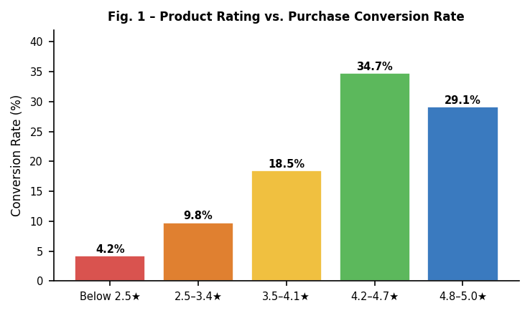
Costumer Purcharse behaviour On basis of Ratings
Fig. 1

Slide 8
Dataset Description
Data Sourcing: Utilizes public secondary e-commerce transaction repositories and aggregated digital behavioral data from verified industry research reports.
Diversity & Scope: The transaction data spans diverse product categories and multiple geographic markets, ensuring highly generalizable results.
Data Preprocessing: Cleaned the data via contextual imputation, using median substitution for continuous variables and modal imputation for categorical fields to preserve dataset integrity.
Outlier Management: Identified anomalies through z-score thresholding and interquartile range (IQR) fencing to keep the analytics accurate.
Feature Scaling: Applied variable normalization across continuous predictors to completely eliminate scale asymmetry before running the models.
Privacy & Ethics: The dataset is entirely aggregated and anonymized, ensuring zero collection or retention of personally identifiable information.

Slide 9
Methodology
Data Sourcing Framework: Utilized secondary transaction logs, behavioral data, and industry clickstream metrics to ensure a multi-dimensional view of consumer habits.
Empirical Behavior Analysis: Modeled statistical relationships between key independent variables (discount depth, ratings, session length) and final purchase decisions.
RFM Customer Segmentation: Applied a K-Means clustering algorithm to group users into behaviorally coherent segments based on Recency, Frequency, and Monetary metrics.
Friction & Abandonment Mapping: Dissected sequential user session pathways to pinpoint exactly where cart abandonment and checkout dropping happen.
Temporal Demand Forecasting: Analyzed transaction timestamps to map out seasonal traffic cycles and track early-intent browsing signals.

Slide 10
Algorithms Used
K-Means Clustering: Groups customers into 4 distinct segments based on their buying habits.
Elbow & Silhouette Methods: Mathematically proved that 4 customer groups was the perfect setup.
Logistic Regression: The baseline model used to quickly predict if a user will buy or leave.
Random Forest Classifier: Ranks which features (like session time or ratings) matter most to a buyer.
Time-Series Decomposition: Separates daily random traffic from major holiday sales peaks.

Slide 11
Results & Discussion
The Rating Paradox: Sales peak between 4.2 and 4.7 stars (34.7% conversion). Perfect 5.0 ratings actually drop conversion because buyers suspect fake reviews.
The Discount Sweet Spot: Maximum profitable volume happens at 20% to 35% discounts. Going past 50% kills profit margins and attracts low-value bargain hunters.
The Mobile Traffic Trap: Mobile devices bring in 58% of all traffic but only finish 34% of actual sales. The major sales are still completed on desktops due to mobile checkout friction.
Browsing Triggers: A sharp increase in user session lengths during a 14-day window is a highly predictable indicator of a coming purchase wave.

Slide 12
Conclusion
Data Over Guesswork: Proves that digital consumer behavior follows predictable patterns that can be mapped using data rather than business intuition.
Trust Drives Value: Confirms that maintaining transparent, high-volume review systems (4.2–4.7 stars) is more profitable than chasing fake 5.0 ratings.
Fixing Mobile Friction: Highlights that redesigning the mobile checkout path is the highest-return opportunity to stop cart abandonment.
Precision Over Mass Marketing: Demonstrates that dividing users into behavioral clusters allows platforms to replace spam with high-converting, personalized experiences.
Long-Term Growth: Shows that investing in customer retention creates a much more stable and profitable business than constantly spending money to find new shoppers.
Future Technology: Opens the door for adding advanced Artificial Intelligence (AI) to track consumer behavior in real-time and predict trends before they happen.

Slide 13
Future Scope
Real-Time Predictive AI: Transition from historical data analysis to deploying live AI models that predict user purchase intent mid-session.
Hyper-Personalized Recommendation Engines: Integrate deep learning algorithms to suggest products based on immediate visual searches and real-time click patterns.
Omnichannel Data Integration: Expand the analytical framework to connect online e-commerce website behavior with physical, in-store retail touchpoints.
Automated Dynamic Pricing: Build machine learning pipelines that automatically adjust discount levels in real-time based on live competitor prices and inventory levels.
Privacy-First Web Analytics: Adapt the data tracking systems to thrive in a cookie-less digital ecosystem using advanced privacy-preserving machine learning.

Slide 14
References
[1] Amazon Consumer Reports (2023): "The Impact of Customer Reviews on Digital Purchase Decisions" — Case study on how star ratings directly control shopping trust.
[2] Flipkart Engineering Blog (2024): "Optimizing Mobile Checkout Path Friction" — Tech analysis on how one-click checkout stops cart abandonment on phones.
[3] Amazon Web Services (AWS) Case Studies: "Using K-Means Clustering for Real-Time Customer Segmentation" — Industry guide on dividing buyers into dynamic target groups.
[4] Flipkart Big Billion Days Data Review (2025): "Managing Traffic and Demand Waves During Mega Sales" — Operational breakdown of handling seasonal spikes and holiday trends.
[5] Harvard Business Review (2022): "The Power of Customer Retention," HBR Analytics — An industry report on why keeping old customers is cheaper than finding new ones.
[6] Google Analytics Reports (2024): "Global E-Commerce Benchmarks and Mobile Trends" — A data report showing mobile traffic versus desktop sales.

Slide 15
Thank You

