Slide 1
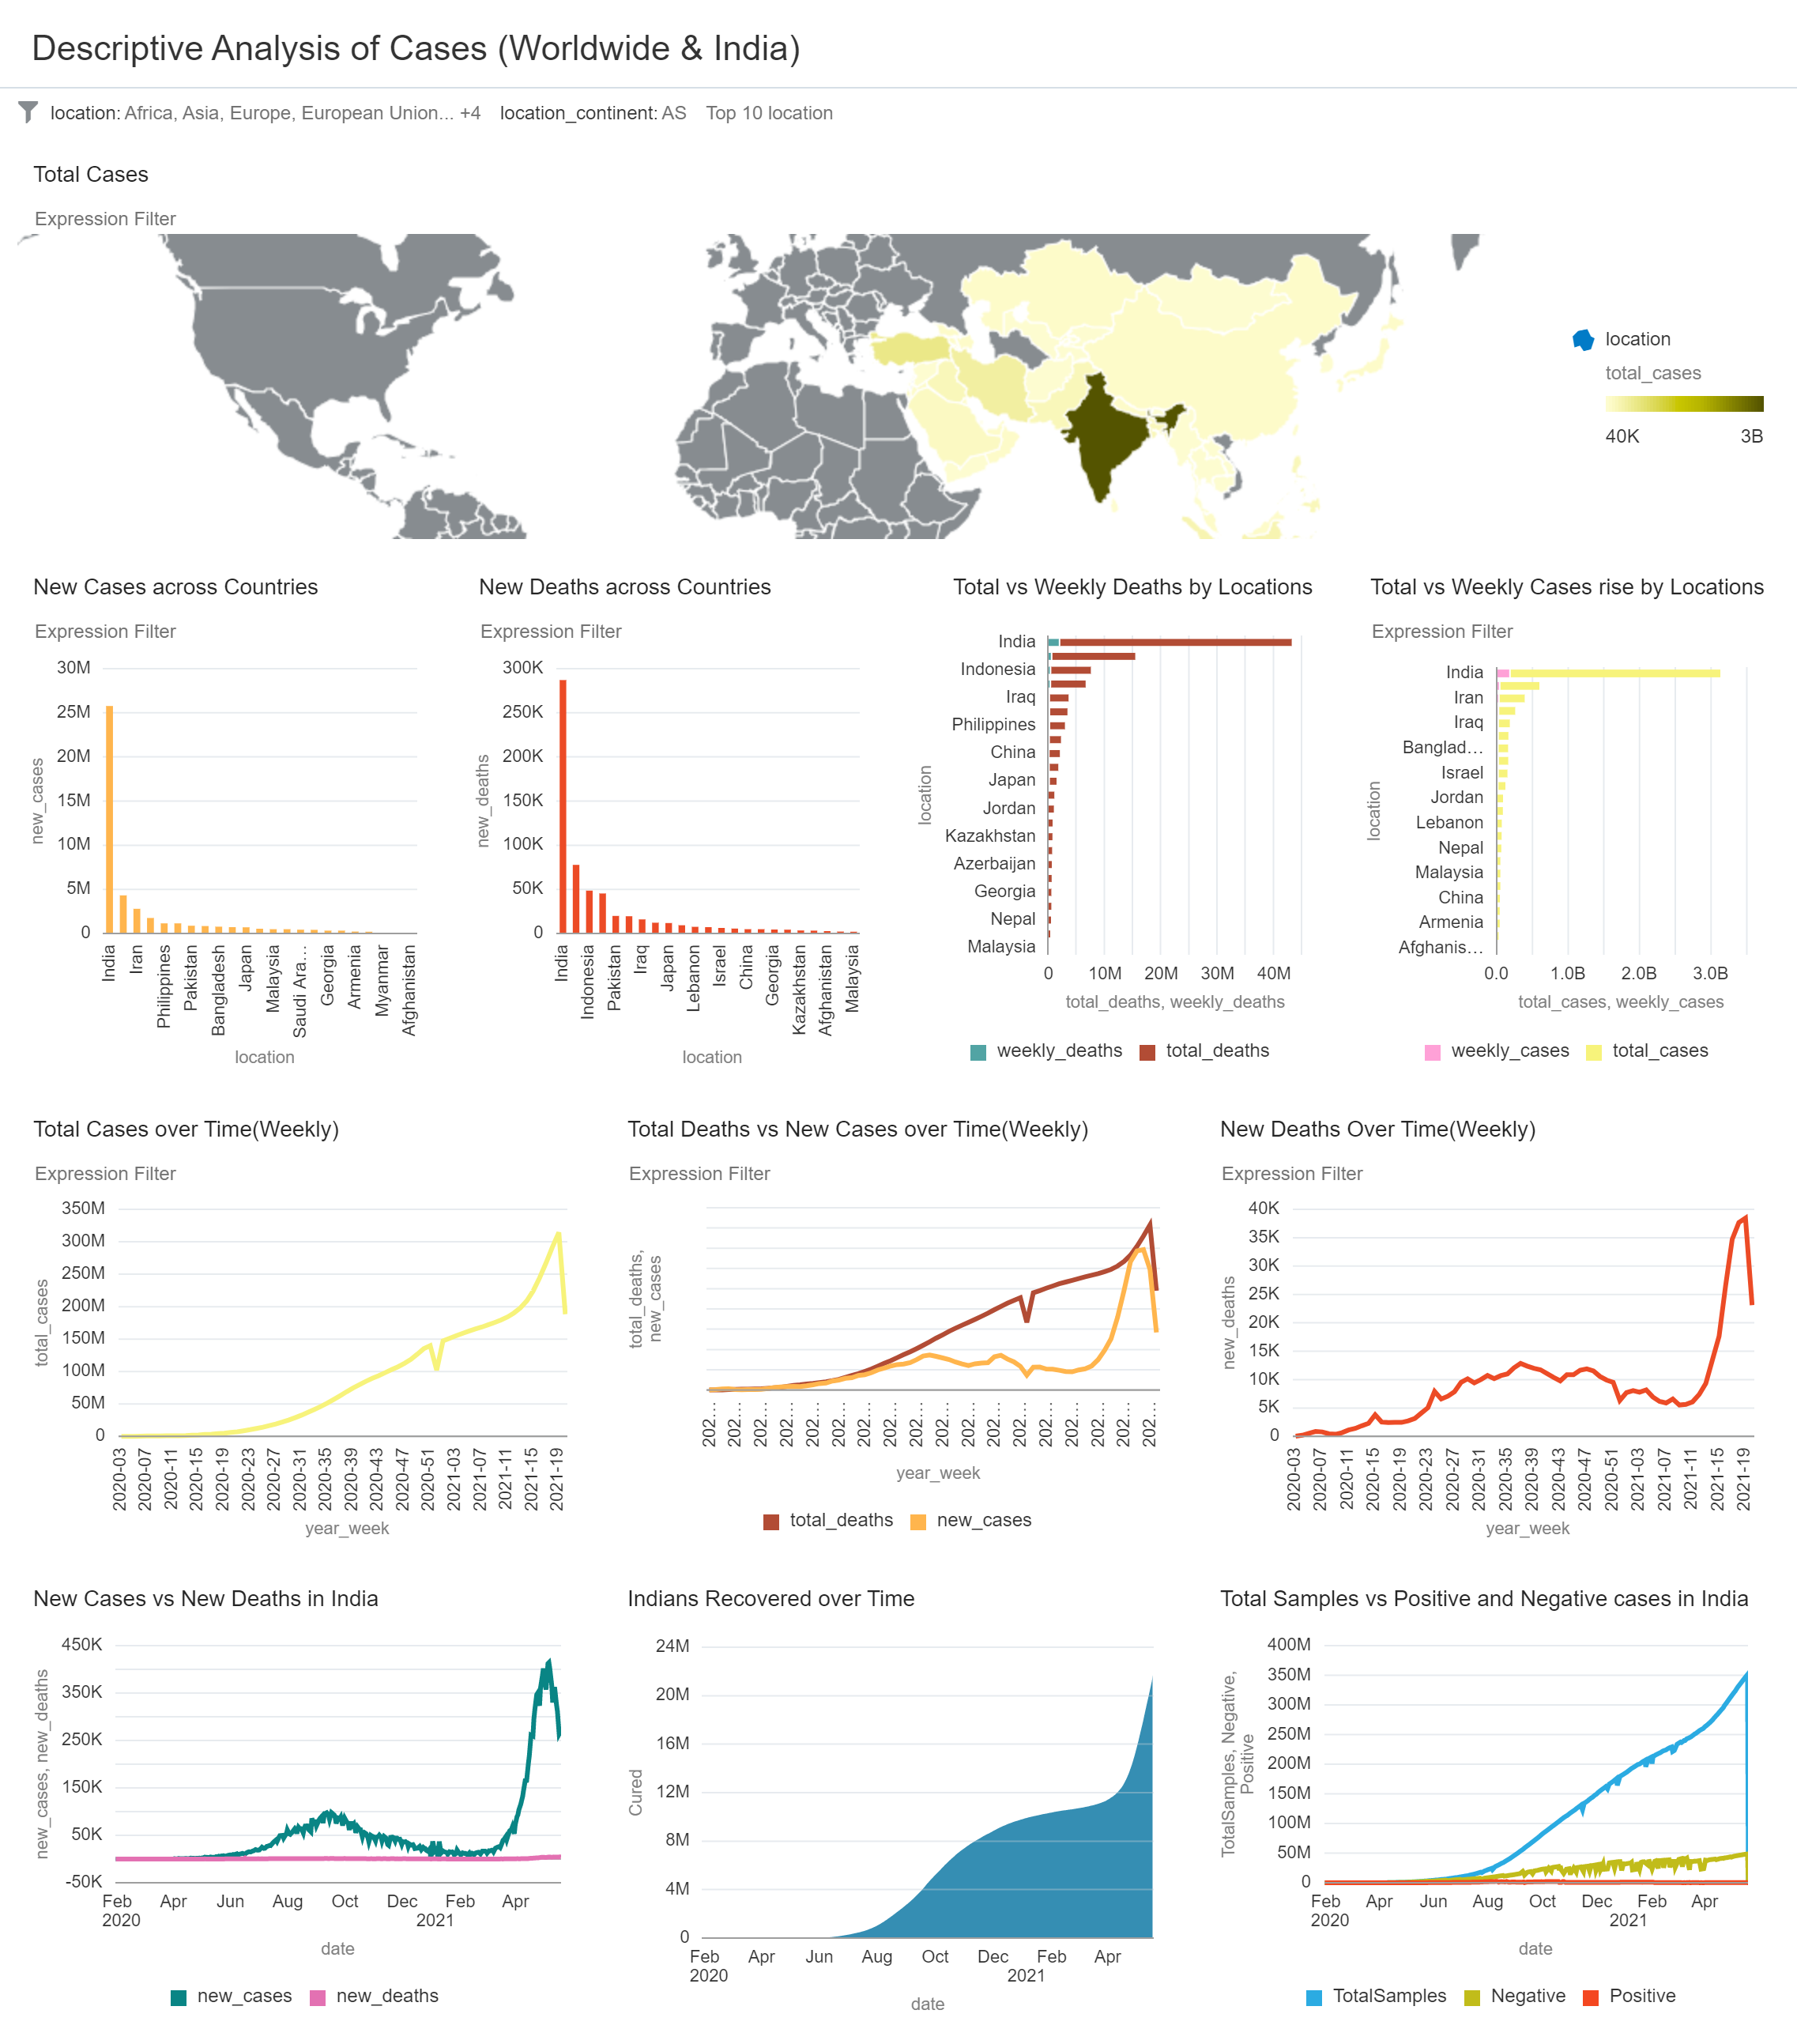
covid_viz - Descriptive Analysis of Cases (Worldwide & India)

Slide 2
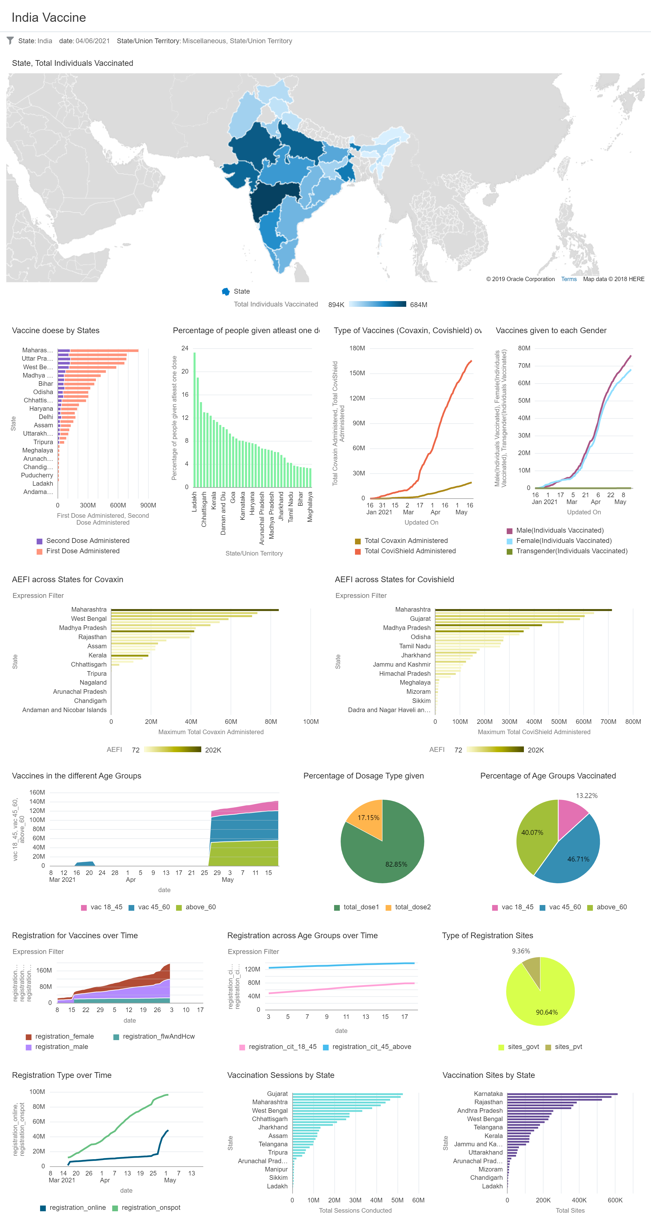
covid_viz - India Vaccine

Slide 3
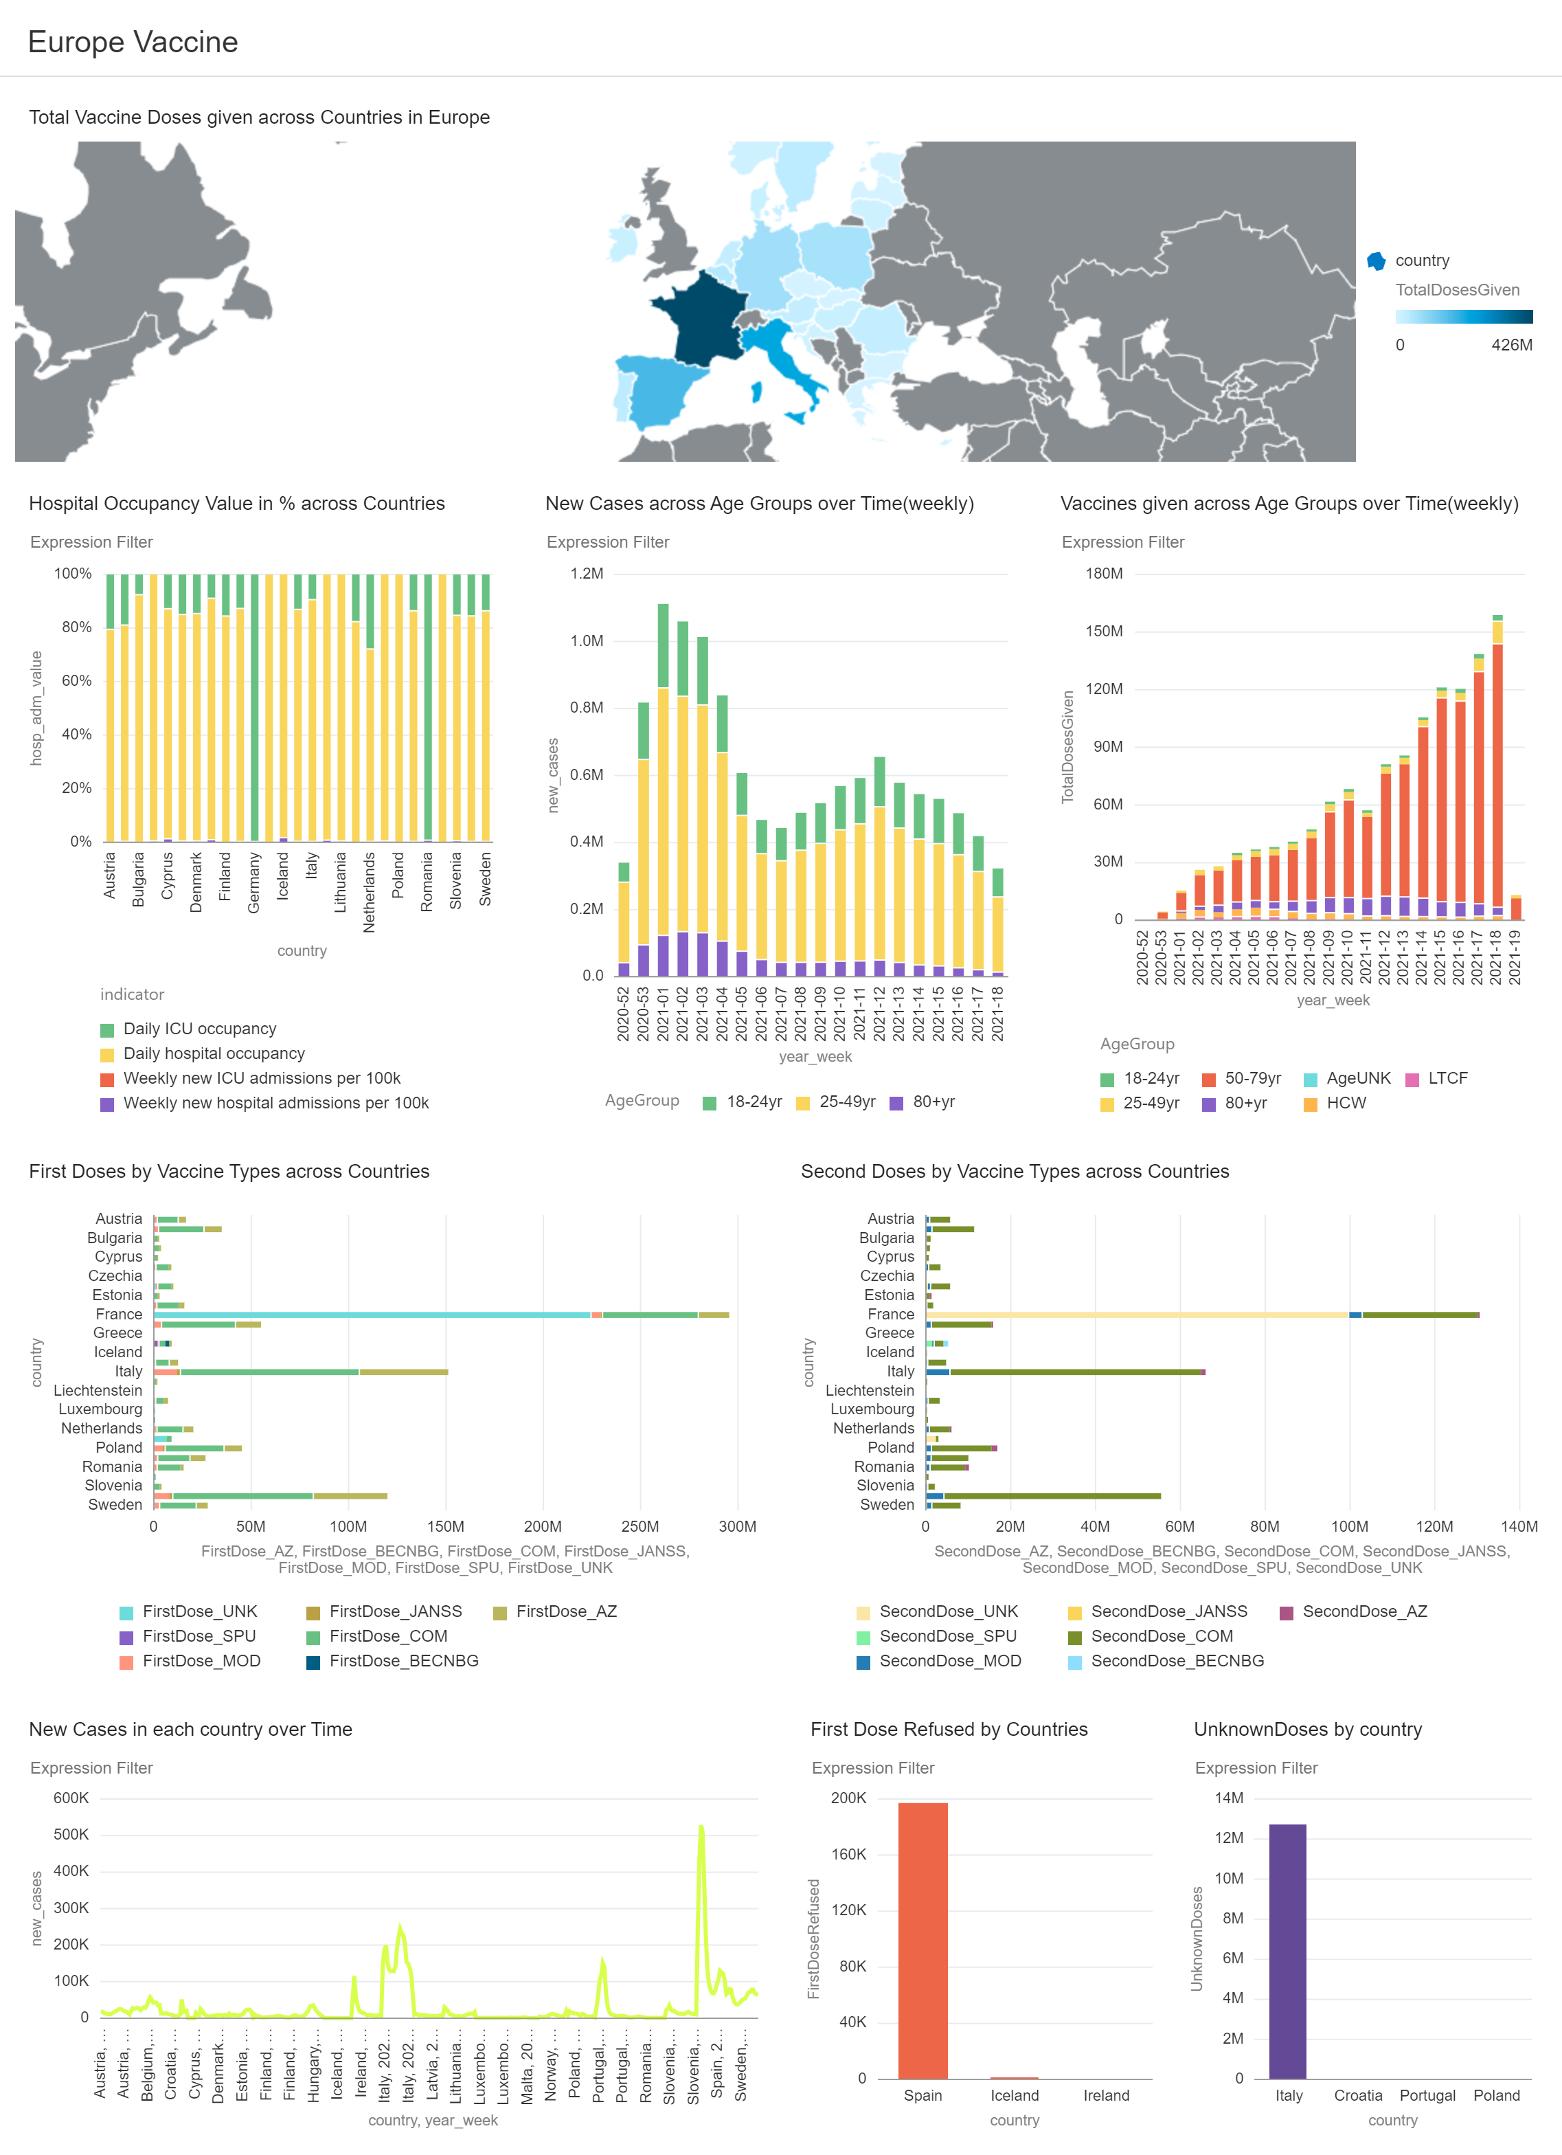
covid_viz - Europe Vaccine

