Slide 1
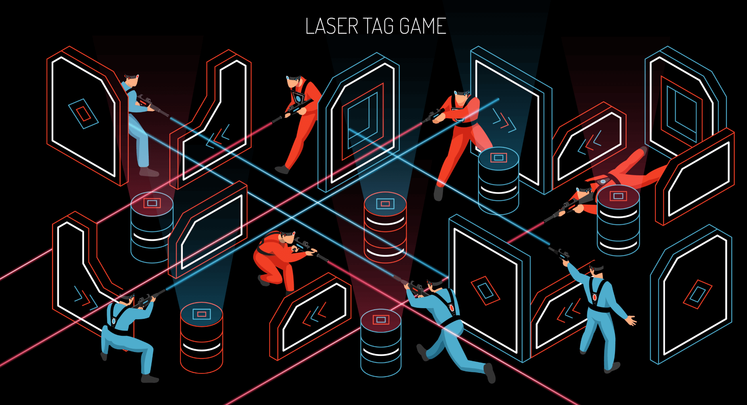
Final Project Presentation
Laser Tag System by Gaël Chauvet

Slide 2

Project and system description

Slide 3
Choice of communication Technology

Slide 4
Choice of communication Technology 2
IR
Laser

Slide 5
Devellopement of communication Technology

Slide 6
Server stored data

Slide 7
RGB LEDs
Notes:
.

Slide 8
Video of functionnality
feasibility of projet
(Describing what is happening on the screen)

Slide 9
Thank you for your attention

Slide 10
Exemple of code #1

Slide 11
Exemple of code #2

Slide 12
Exemple of code #3

