Slide 1
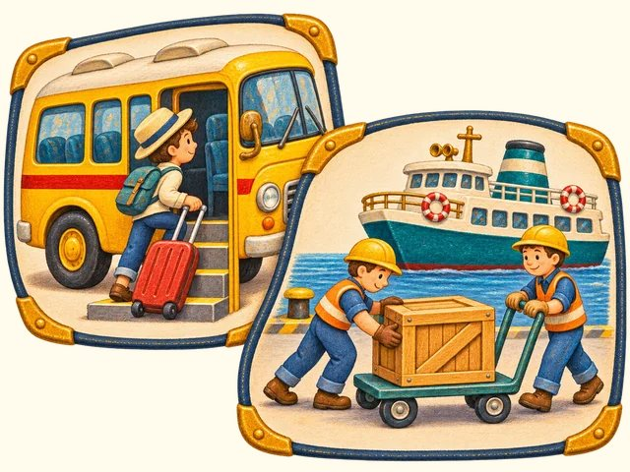
TRANSPORT TOWN
Journey actions
Transport Town

Slide 2
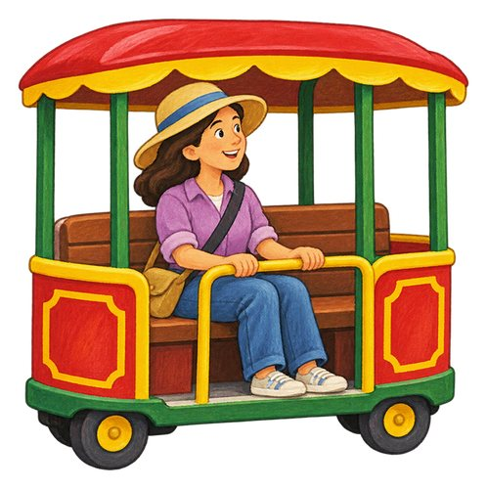
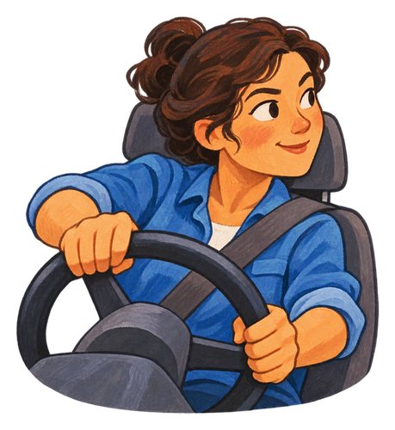
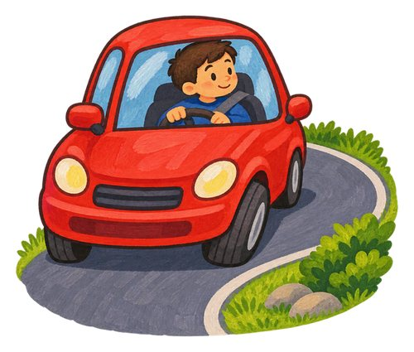
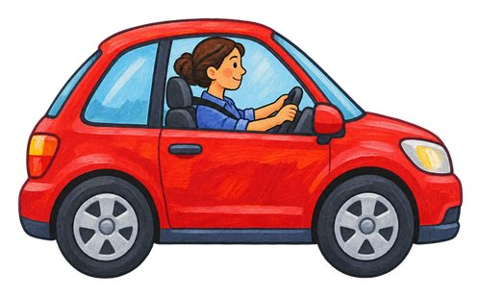
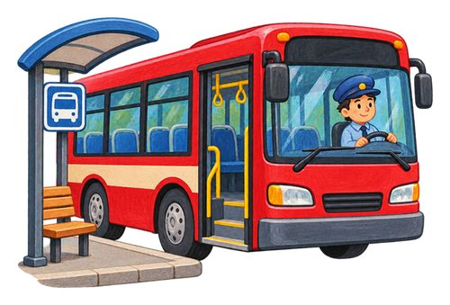
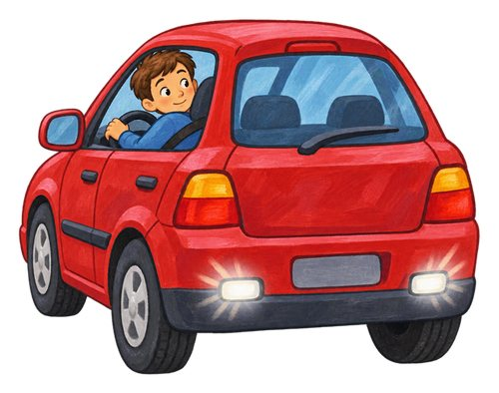
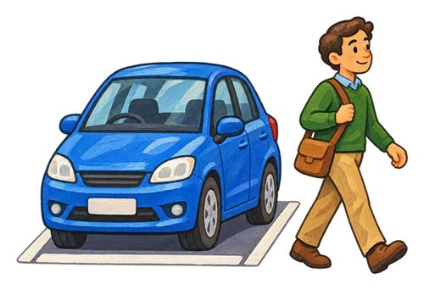
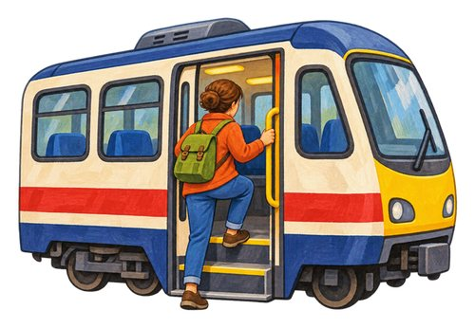
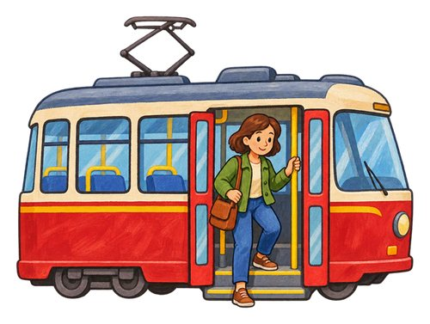
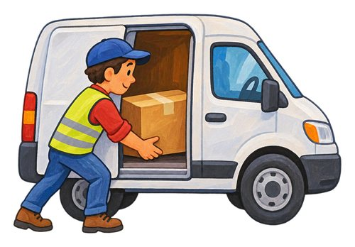
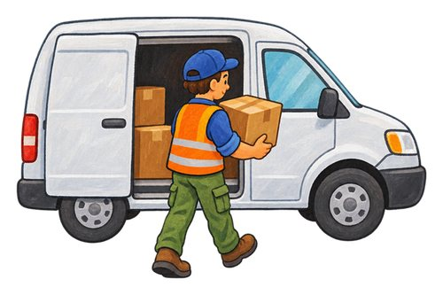
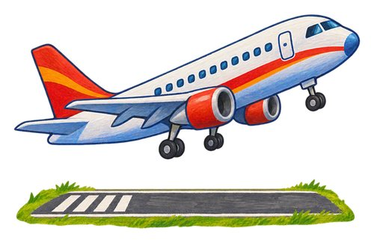
In this lesson
ride
drive
steer
stop
turn
reverse
park
get on
get off
load
unload
take off

Slide 3
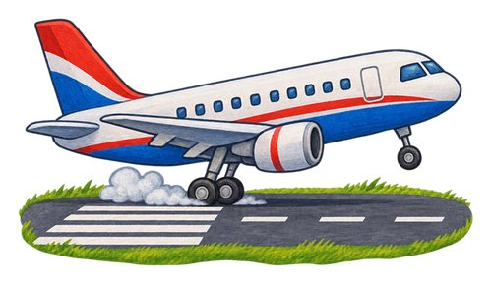
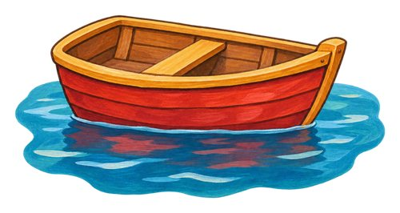
In this lesson
land
float

Slide 4

ride
Travel in or on a vehicle. This passenger is riding on a bus.
We ride on the bus to school.

Slide 5

drive
To control a moving road vehicle.
The adult drives the car.

Slide 6

steer
Control the direction a vehicle travels.
The driver steers around the bend.

Slide 7
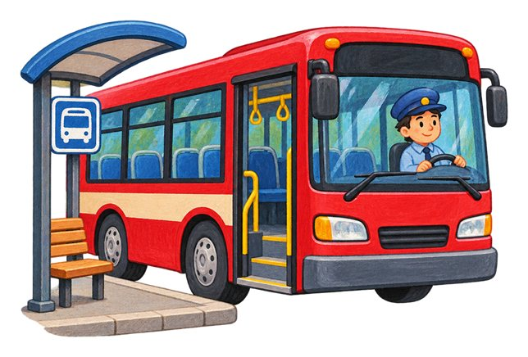
stop
To finish moving and stay still.
The bus stops at the bus stop.

Slide 8

turn
To change the direction you are facing or moving.
The car turns into another road.

Slide 9

reverse
To move backwards.
The adult checks carefully before reversing the car.

Slide 10
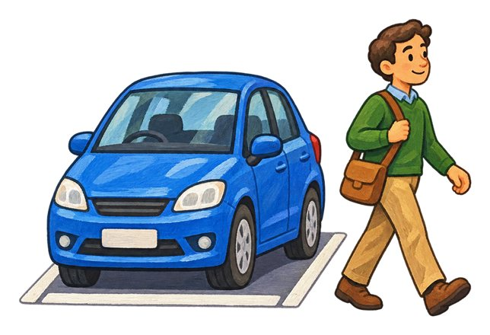
park
Bring a vehicle to a stop in a place where it can stay.
The driver parks in a marked space.

Slide 11

get on
Move from the pavement up into a stopped bus.
We wait for the bus to stop before we get on.

Slide 12

get off
Leave a vehicle after it has stopped.
We get off the stopped bus onto the pavement.

Slide 13

load
To put things into or onto a vehicle for carrying.
The worker loads boxes into the van.

Slide 14

unload
To take carried things off or out of a vehicle.
The worker unloads parcels from the van.

Slide 15
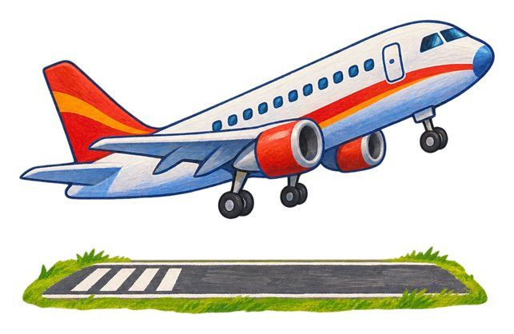
take off
To leave the ground and begin flying.
The airplane takes off from the runway.

Slide 16

land
To return to the ground or another landing surface from flight.
The helicopter lands on its landing pad.

Slide 17

float
Stay at the surface of water. You can see this boat floating at the waterline.
The boat floats on the water.

Slide 18
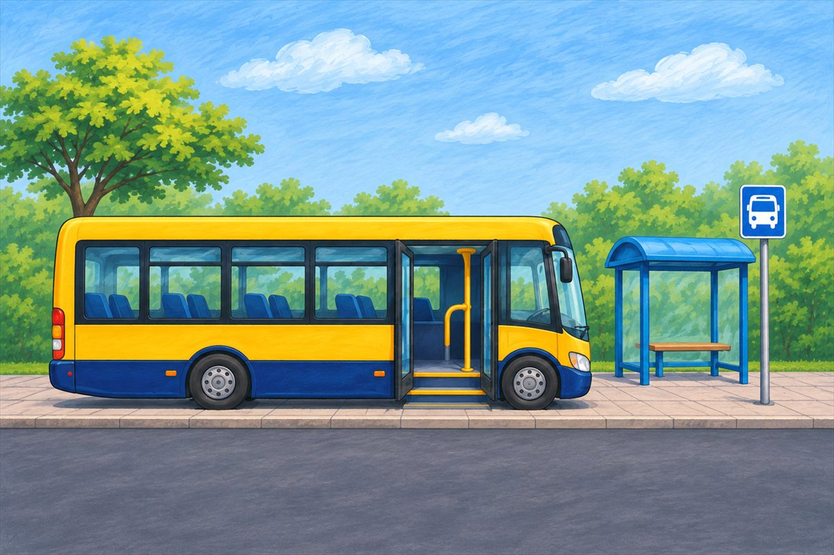
Bus at the bus stop
Handrail Hold the handrail for support when using the steps.
Bus A bus carries passengers along roads.
Bus stop The shelter and bus sign show where passengers wait.
Door Passengers use the open doorway to get on and off.

Slide 19
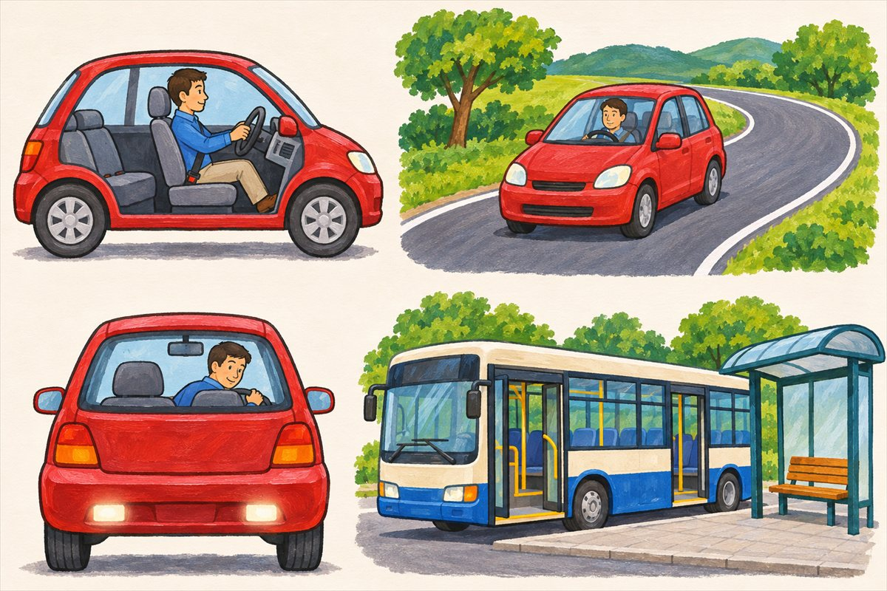
Driving and stopping
Drive To control a moving road vehicle.
Steer Control the direction a vehicle travels.
Turn To change the direction you are facing or moving.
Reverse To move backwards.

Slide 20
Can you name them?

Slide 21
Did you get them?
get on
float
land
park
ride
stop

Slide 22

Well done!
You learned about journey actions.

