Slide 1
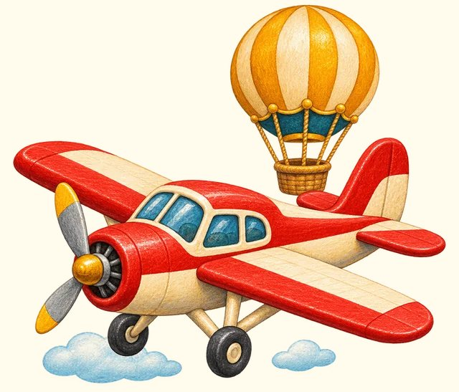
TRANSPORT TOWN
Air travel
Transport Town

Slide 2
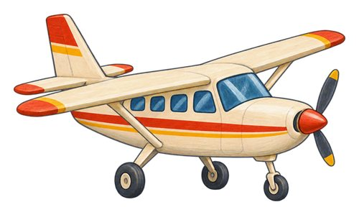
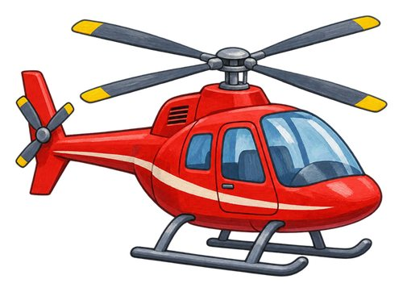
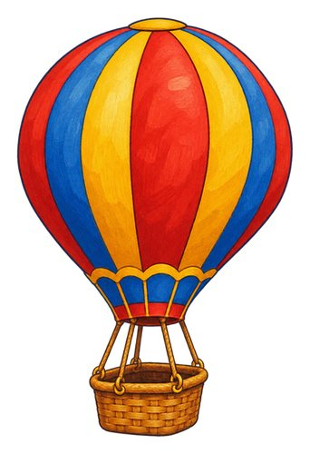
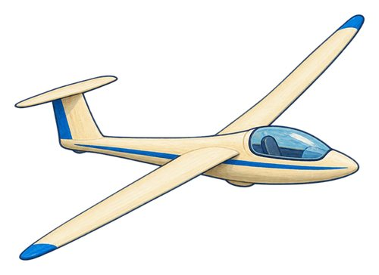
In this lesson
airplane
helicopter
hot air balloon
glider

Slide 3

airplane
An aircraft with fixed wings that is moved through the air by an engine.
The airplane uses its wings to fly.

Slide 4

helicopter
An aircraft lifted by turning rotor blades above its body.
The helicopter rotor blades turn above the cabin.

Slide 5

hot air balloon
A large balloon lifted by warm air, with a basket underneath.
The basket hangs below the hot air balloon.

Slide 6
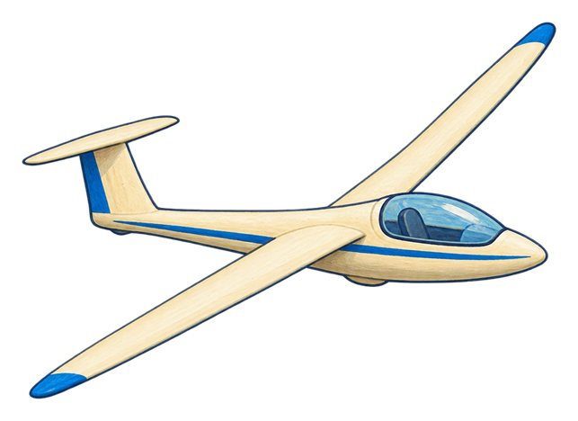
glider
An aircraft designed to glide through the air without engine power.
The glider moves through the air without engine power.

Slide 7
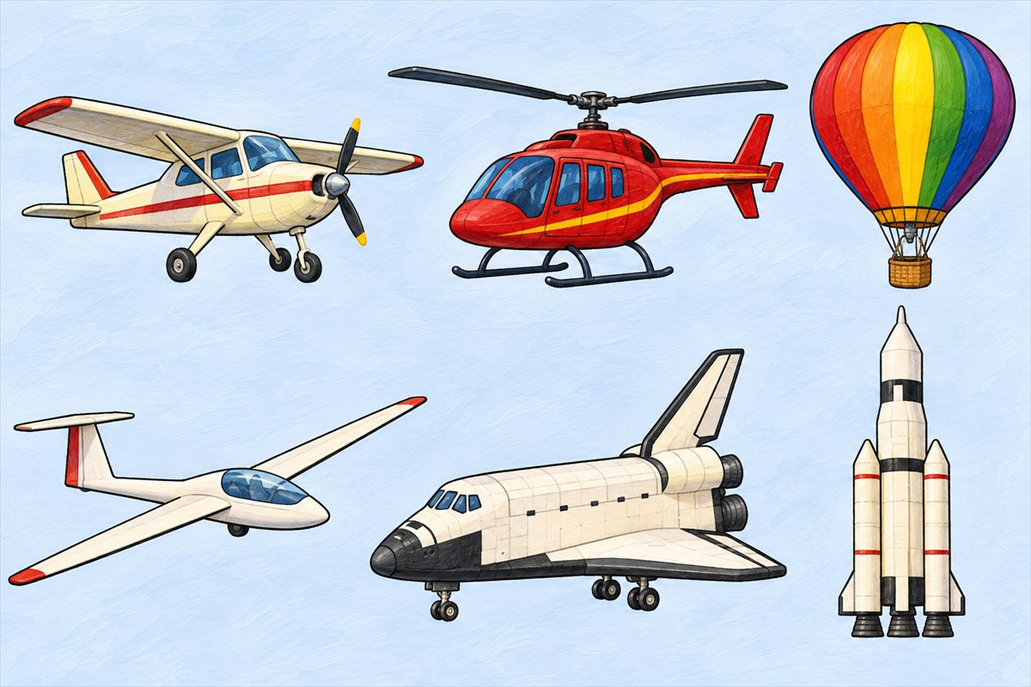
Aircraft and spacecraft
Airplane An aircraft with fixed wings that is moved through the air by an engine.
Helicopter An aircraft lifted by turning rotor blades above its body.
Hot air balloon A large balloon lifted by warm air, with a basket underneath.
Glider An aircraft designed to glide through the air without engine power.

Slide 8
Can you name them?

Slide 9
Did you get them?
airplane
glider
helicopter
hot air balloon

Slide 10

Well done!
You learned about air travel.

