Slide 1
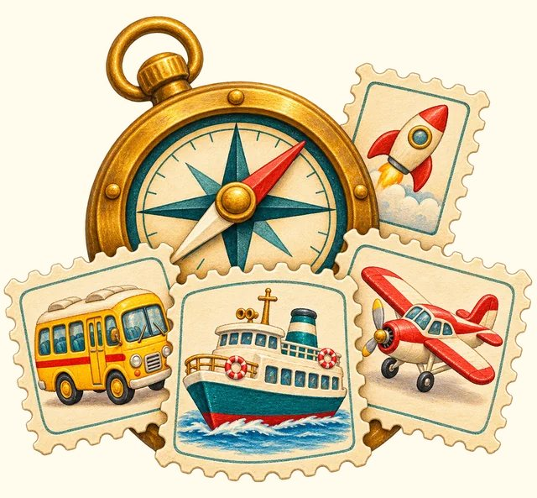
TRANSPORT TOWN
All about transport
Transport Town

Slide 2
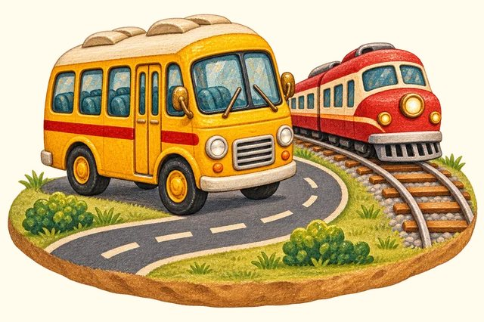
NEXT UP
Land travel
29 words

Slide 3
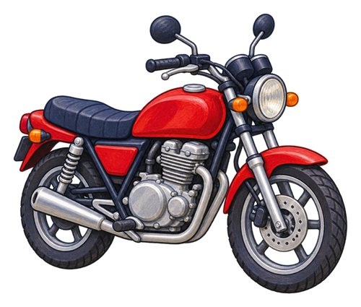
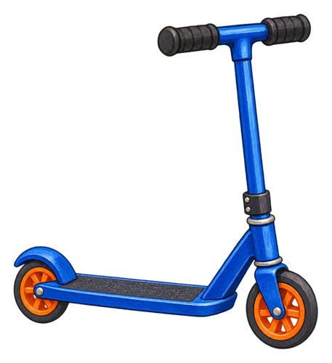
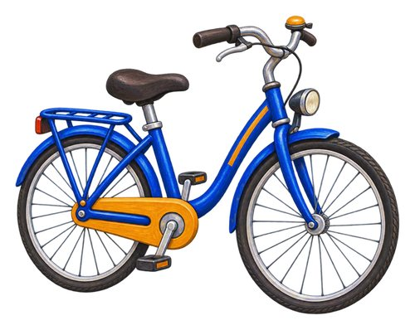
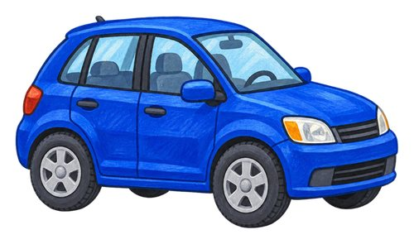
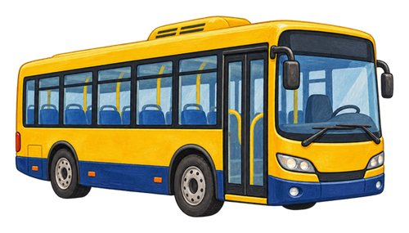
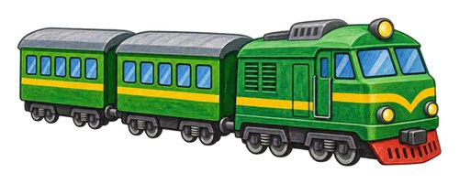
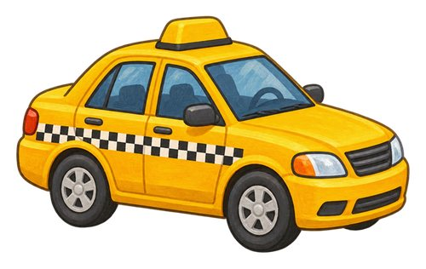
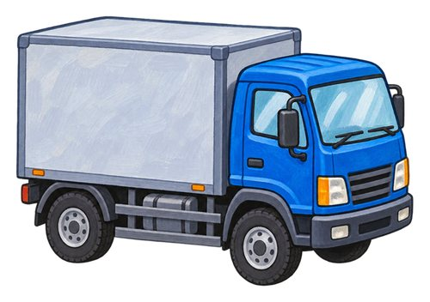
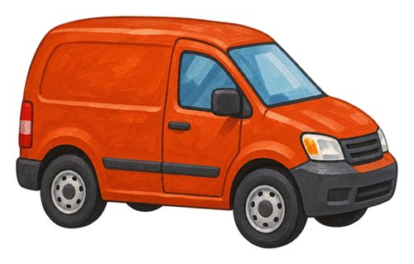
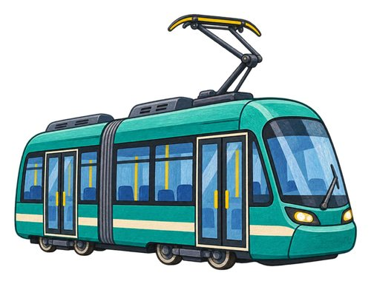
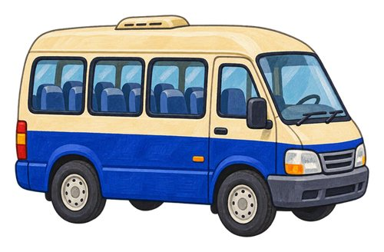
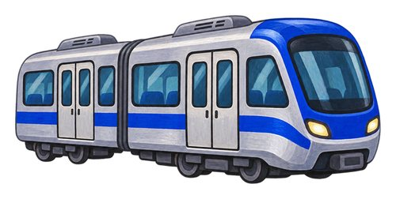
In this lesson
car
bus
bicycle
motorcycle
kick scooter
train
metro train
taxi
truck
van
tram
minibus

Slide 4
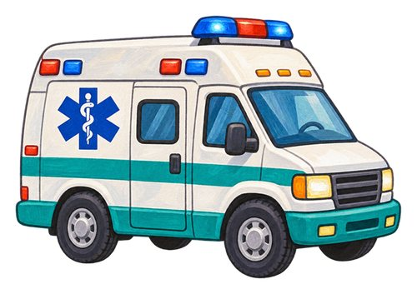
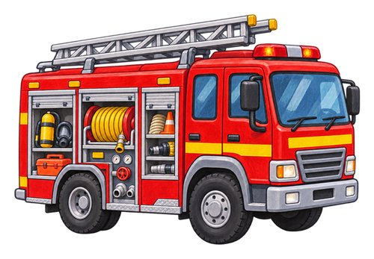
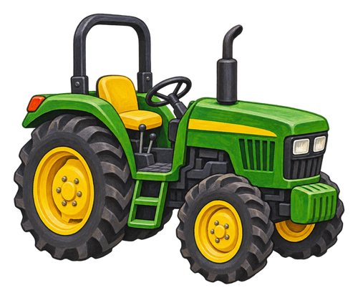
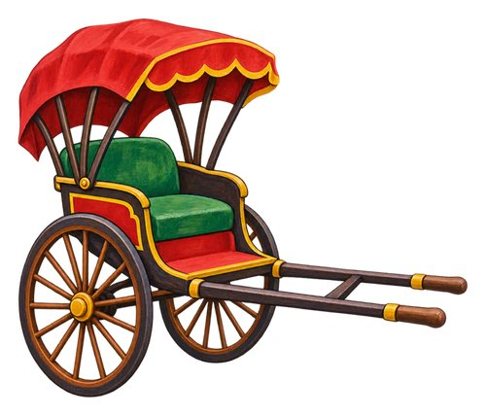
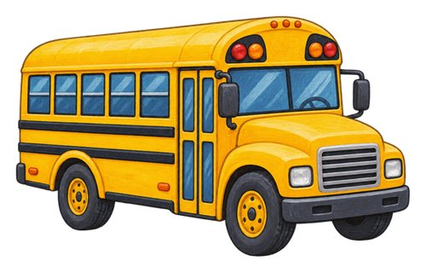
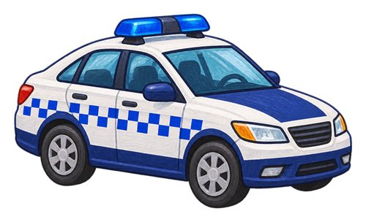
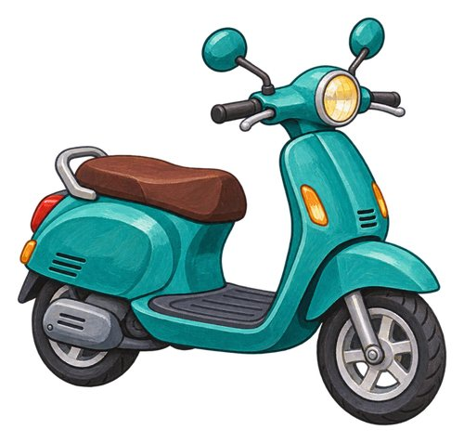
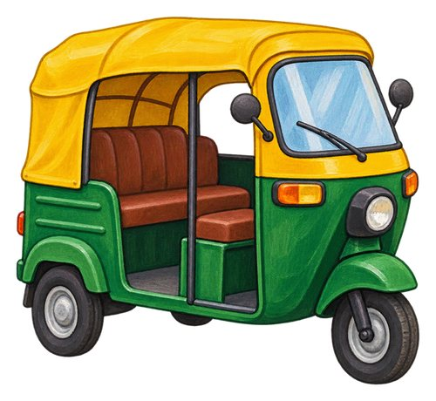
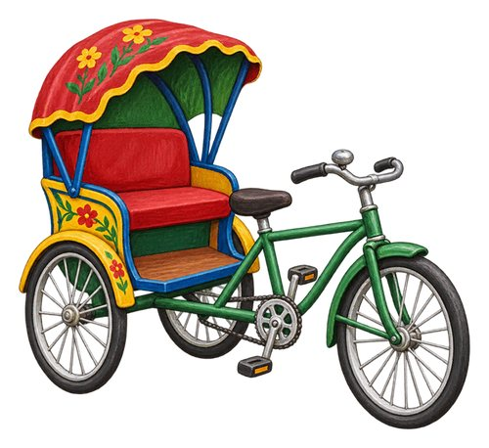
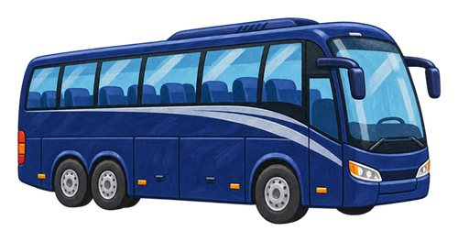
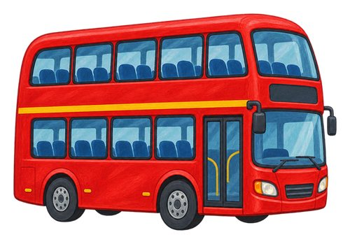
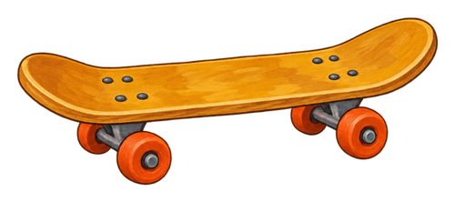
In this lesson
school bus
police car
ambulance
fire engine
tractor
pulled rickshaw
skateboard
motor scooter
auto-rickshaw
cycle rickshaw
coach
double-decker bus

Slide 5
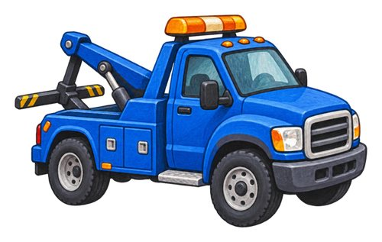
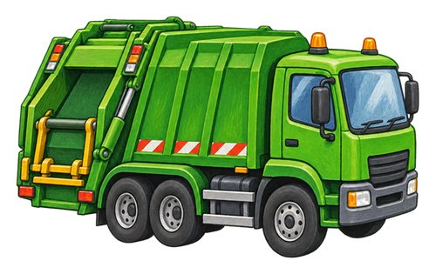
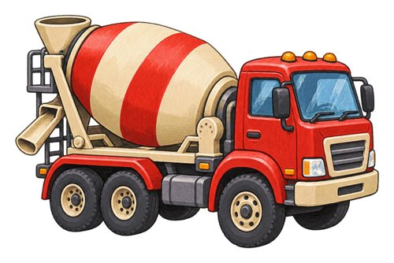
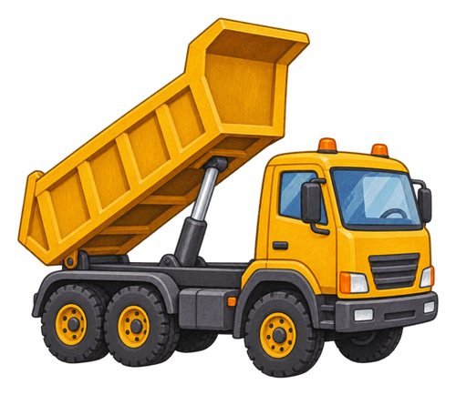
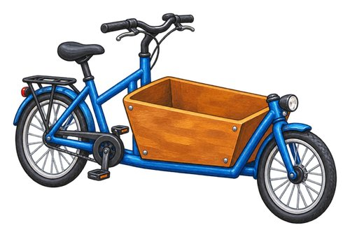
In this lesson
tow truck
refuse truck
concrete mixer truck
tipper truck
cargo bicycle

Slide 6

car
A vehicle with four wheels that carries a small group of people.
We ride in a car to visit a friend.

Slide 7

bus
A large road vehicle that carries many passengers.
Passengers wait at the bus stop.

Slide 8

bicycle
A vehicle with two wheels that a rider moves by pedalling.
The rider pushes the bicycle pedals.

Slide 9

motorcycle
A motor vehicle with two wheels that a rider sits on.
The motorcycle rider wears a helmet.

Slide 10

kick scooter
A small vehicle with a standing deck and handlebars, pushed along with one foot.
Push with one foot to move the kick scooter.

Slide 11

train
A rail vehicle, or connected rail vehicles, that carries people or goods along tracks.
The train carries passengers along the railway.

Slide 12

metro train
A city train that often travels through underground tunnels.
We take a metro train across the city.

Slide 13

taxi
A car with a driver that passengers pay to take them somewhere.
The taxi driver takes a passenger to the station.

Slide 14
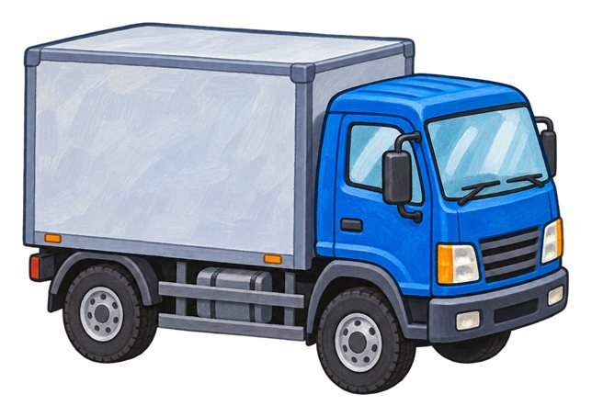
truck
A road vehicle used to carry goods.
The truck carries boxes to a shop.

Slide 15

van
A road vehicle with an enclosed space for goods or passengers.
The van carries parcels to our street.

Slide 16

tram
A passenger vehicle that runs on rails, often along city streets.
The tram follows rails through the city.

Slide 17

minibus
A passenger vehicle that is smaller than a full-sized bus.
A small group travels in the minibus.

Slide 18

school bus
A bus used to take children to and from school.
The school bus takes children to school.

Slide 19

police car
A car used by police officers as they do their work.
Police officers travel in the police car.

Slide 20

ambulance
A vehicle equipped to help take ill or injured people for medical care.
The ambulance takes someone for medical care.

Slide 21

fire engine
A vehicle that carries firefighters and firefighting equipment.
Firefighters carry their equipment on the fire engine.

Slide 22
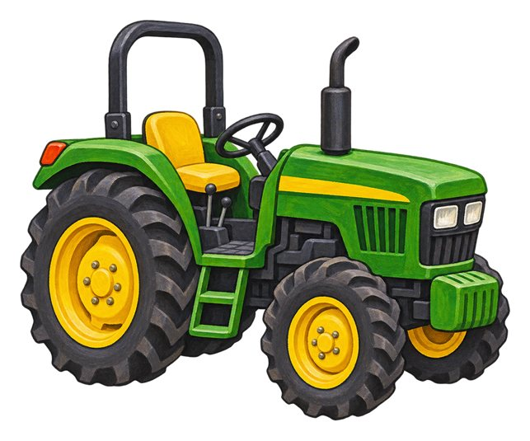
tractor
A strong vehicle used to pull farm equipment or loads.
The tractor pulls farm equipment.

Slide 23

pulled rickshaw
A small passenger cart pulled by a person on foot.
A person pulls the rickshaw using its long handles.

Slide 24

skateboard
A board with four small wheels that a rider stands on.
The rider stands on the skateboard.

Slide 25

motor scooter
A motor vehicle with a seat and a platform for the rider's feet.
The rider sits on the motor scooter.

Slide 26
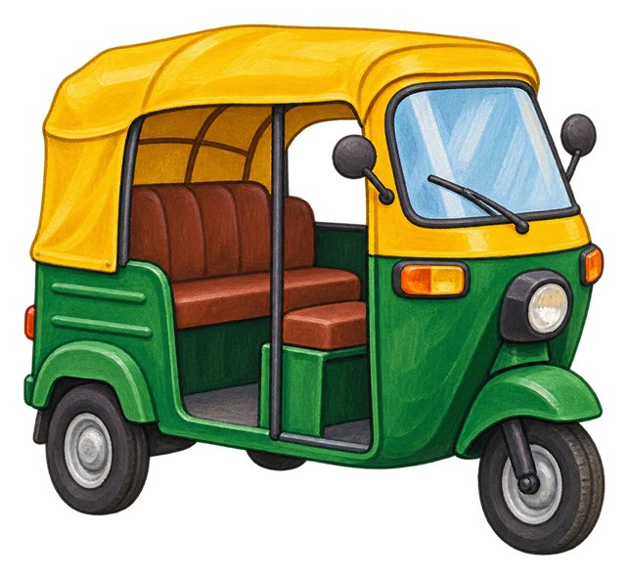
auto-rickshaw
A small motor vehicle with three wheels that can carry passengers.
Passengers sit behind the auto-rickshaw driver.

Slide 27
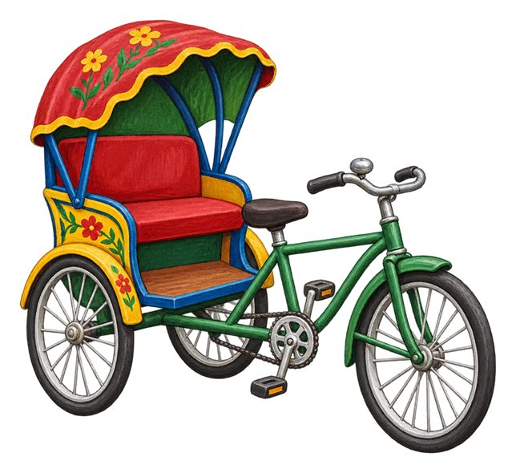
cycle rickshaw
A passenger vehicle moved by a person pedalling.
The rider pedals the cycle rickshaw.

Slide 28

coach
A large passenger vehicle often used for longer road journeys.
Our group travels to another town by coach.

Slide 29

double-decker bus
A bus with passenger seats on two levels.
The double-decker bus has an upper deck.

Slide 30

tow truck
A truck used to carry or pull a vehicle that needs help.
The tow truck carries a broken-down car.

Slide 31

refuse truck
A truck that collects and carries rubbish.
The refuse truck collects rubbish from our street.

Slide 32

concrete mixer truck
A truck with a turning drum that carries and mixes concrete.
The concrete mixer truck brings concrete to the building site.

Slide 33

tipper truck
A truck with a container that can lift to tip out a load.
The tipper truck unloads a pile of gravel.

Slide 34

cargo bicycle
A bicycle built with space to carry a load.
The cargo bicycle carries parcels.

Slide 35
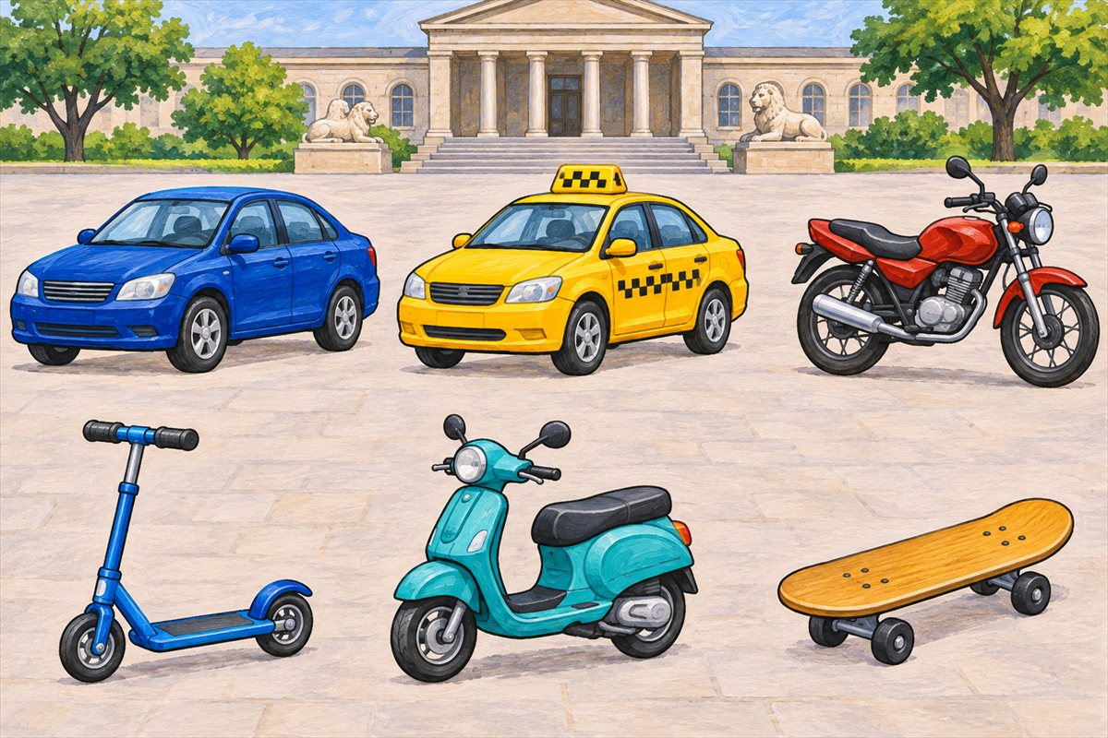
Road vehicles
Car A vehicle with four wheels that carries a small group of people.
Taxi A car with a driver that passengers pay to take them somewhere.
Motorcycle A motor vehicle with two wheels that a rider sits on.
Kick scooter A small vehicle with a standing deck and handlebars, pushed along with one foot.

Slide 36
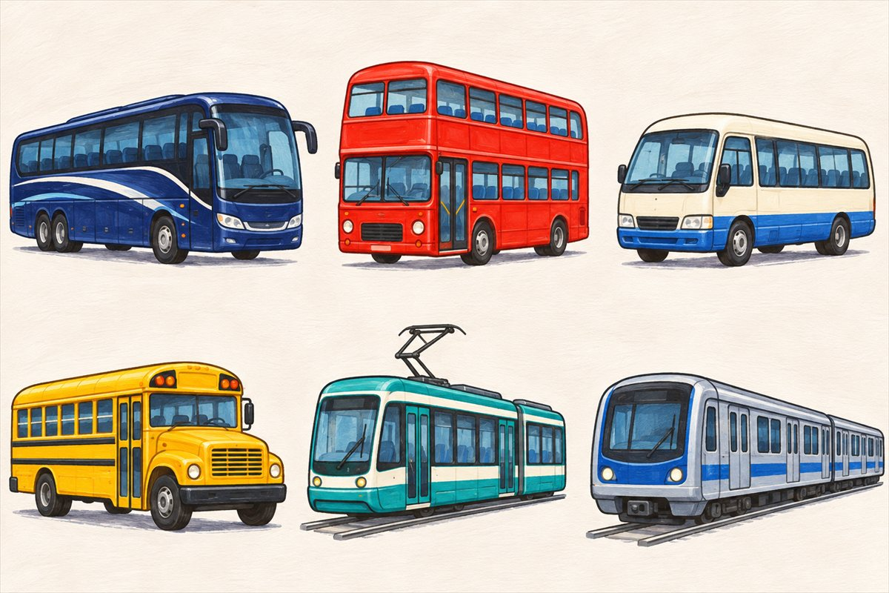
Passenger vehicles
Coach A large passenger vehicle often used for longer road journeys.
Double-decker bus A bus with passenger seats on two levels.
Minibus A passenger vehicle that is smaller than a full-sized bus.
School bus A bus used to take children to and from school.

Slide 37
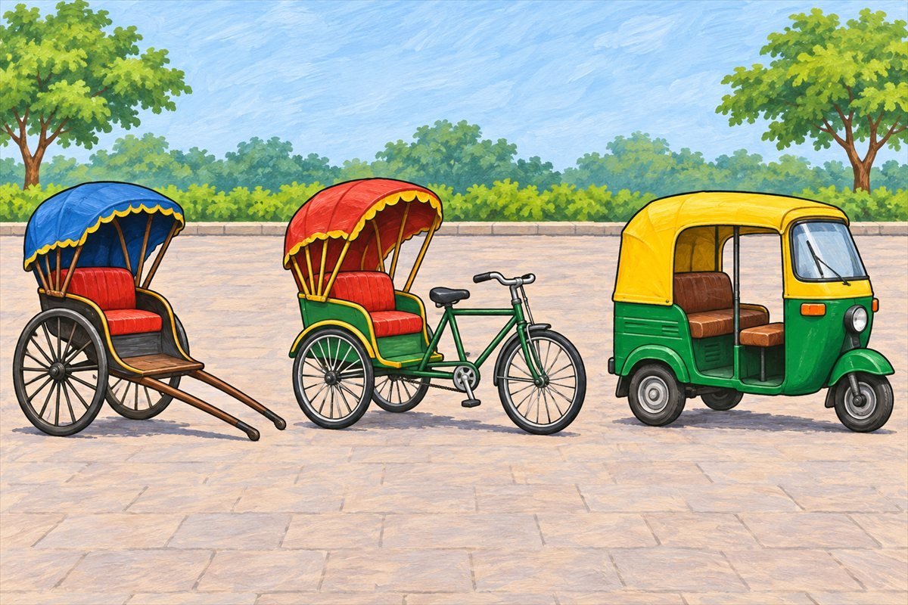
Three kinds of rickshaw
Pulled rickshaw A small passenger cart pulled by a person on foot.
Cycle rickshaw A passenger vehicle moved by a person pedalling.
Auto-rickshaw A small motor vehicle with three wheels that can carry passengers.

Slide 38
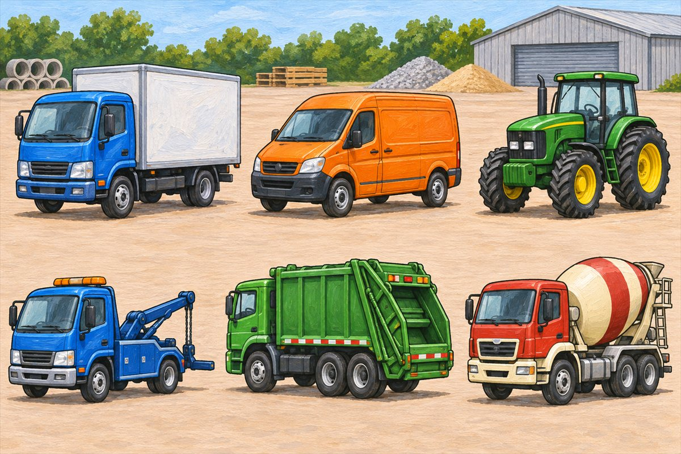
Vehicles that carry and help
Truck A road vehicle used to carry goods.
Van A road vehicle with an enclosed space for goods or passengers.
Tractor A strong vehicle used to pull farm equipment or loads.
Tow truck A truck used to carry or pull a vehicle that needs help.

Slide 39
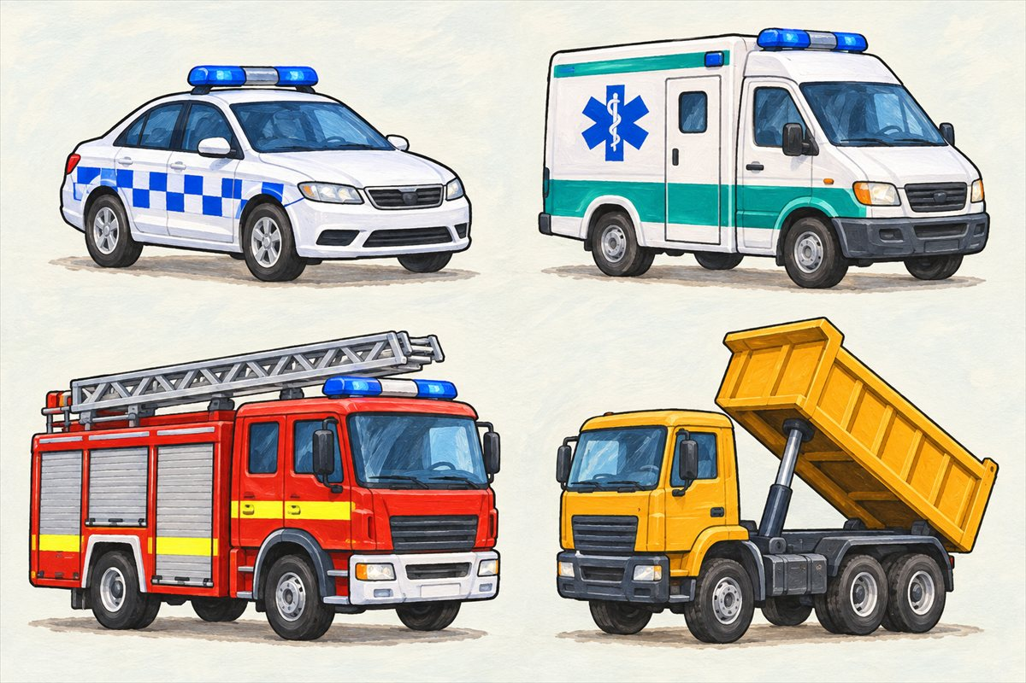
Emergency vehicles and tipping loads
Police car A car used by police officers as they do their work.
Ambulance A vehicle equipped to help take ill or injured people for medical care.
Fire engine A vehicle that carries firefighters and firefighting equipment.
Tipper truck A truck with a container that can lift to tip out a load.

Slide 40
Can you name them?

Slide 41
Did you get them?
ambulance
car
cycle rickshaw
motor scooter
pulled rickshaw
metro train

Slide 42
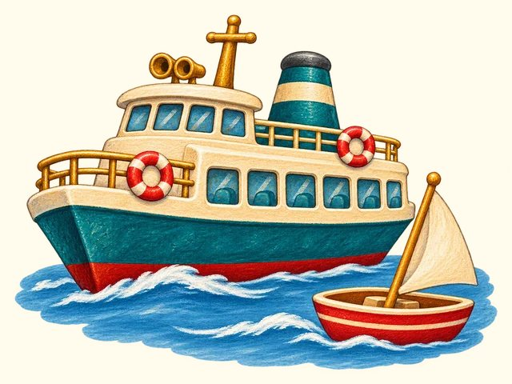
NEXT UP
Water travel
11 words

Slide 43
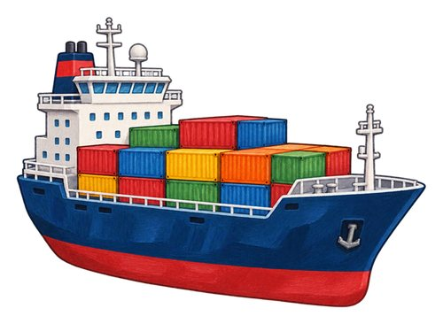
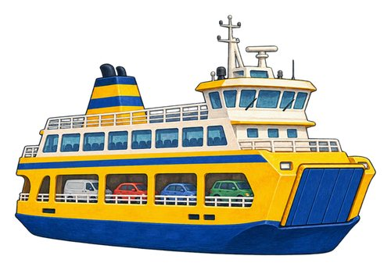
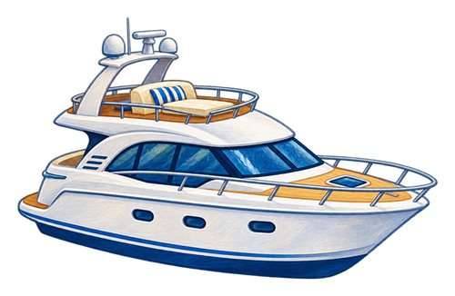
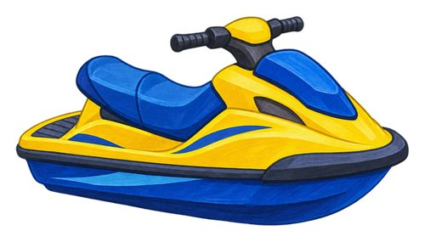
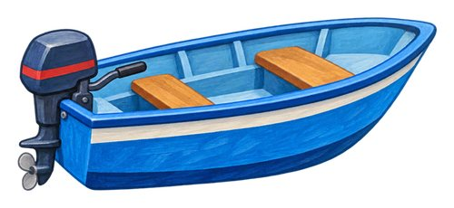
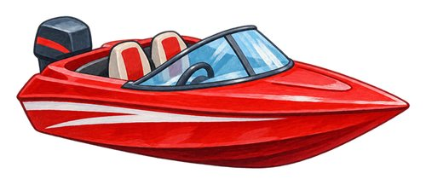
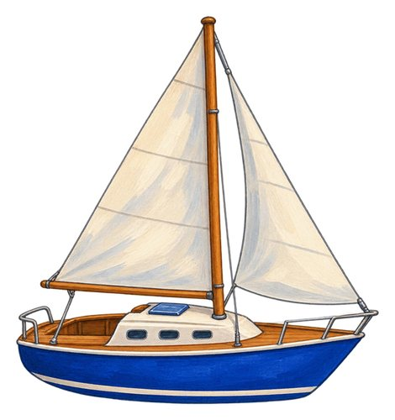
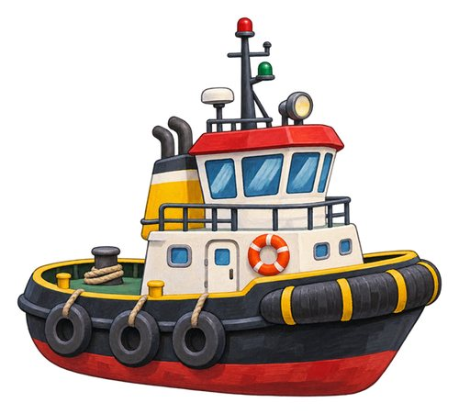
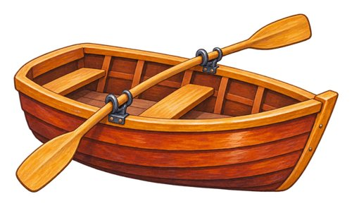


In this lesson
boat
ship
ferry
speedboat
yacht
jet ski
rowboat
sailboat
canoe
kayak
tugboat

Slide 44

boat
A water vehicle used to carry people or things.
We travel across the water in a boat.

Slide 45

ship
A large water vehicle that carries people or goods.
The ship carries a large load across the sea.

Slide 46

ferry
A boat or ship that carries passengers, and sometimes vehicles, between stopping places.
The ferry carries passengers between stopping places.

Slide 47

speedboat
A motorboat designed to travel quickly on water.
The speedboat moves quickly across the water.

Slide 48

yacht
A boat used for leisure, powered by sails or an engine.
The family takes a leisure trip on a yacht.

Slide 49

jet ski
A small powered watercraft that a rider sits or stands on.
A rider steers the jet ski with its handlebars.

Slide 50

rowboat
A small boat moved using oars.
A person uses oars to move the rowboat.

Slide 51

sailboat
A boat that can use wind in its sails to move.
Wind fills the sailboat's sail.

Slide 52

canoe
An open boat. This canoe is shown with a paddle that has one blade.
The paddler moves the canoe across calm water.

Slide 53

kayak
A narrow boat with a low seat. This kayak is shown with a paddle that has a blade at each end.
The kayaker uses a double-bladed paddle.

Slide 54

tugboat
A strong boat that helps move other boats or ships.
The tugboat helps a ship near the harbour.

Slide 55

Watercraft comparison
Boat A water vehicle used to carry people or things.
Ship A large water vehicle that carries people or goods.
Ferry A boat or ship that carries passengers, and sometimes vehicles, between stopping places.
Speedboat A motorboat designed to travel quickly on water.

Slide 56

Boats and paddles
Rowboat A small boat moved using oars.
Sailboat A boat that can use wind in its sails to move.
Canoe An open boat. This canoe is shown with a paddle that has one blade.
Kayak A narrow boat with a low seat. This kayak is shown with a paddle that has a blade at each end.

Slide 57
Can you name them?

Slide 58
Did you get them?
boat
canoe
ferry
jet ski
kayak
rowboat

Slide 59

NEXT UP
Air travel
4 words

Slide 60




In this lesson
airplane
helicopter
hot air balloon
glider

Slide 61

airplane
An aircraft with fixed wings that is moved through the air by an engine.
The airplane uses its wings to fly.

Slide 62

helicopter
An aircraft lifted by turning rotor blades above its body.
The helicopter rotor blades turn above the cabin.

Slide 63

hot air balloon
A large balloon lifted by warm air, with a basket underneath.
The basket hangs below the hot air balloon.

Slide 64

glider
An aircraft designed to glide through the air without engine power.
The glider moves through the air without engine power.

Slide 65

Aircraft and spacecraft
Airplane An aircraft with fixed wings that is moved through the air by an engine.
Helicopter An aircraft lifted by turning rotor blades above its body.
Hot air balloon A large balloon lifted by warm air, with a basket underneath.
Glider An aircraft designed to glide through the air without engine power.

Slide 66
Can you name them?

Slide 67
Did you get them?
airplane
glider
helicopter
hot air balloon

Slide 68

NEXT UP
Space travel
2 words

Slide 69


In this lesson
space shuttle
rocket

Slide 70

space shuttle
A reusable spacecraft whose winged orbiter returned to Earth and landed on a runway.
The space shuttle orbiter returned to a runway.

Slide 71

rocket
A vehicle whose engines push it upwards and can carry things into space.
The rocket lifts away from its launch pad.

Slide 72
Can you name them?

Slide 73
Did you get them?
rocket
space shuttle

Slide 74

NEXT UP
Vehicle parts
20 words

Slide 75












In this lesson
wheel
tyre
pedal
handlebars
steering wheel
brake
engine
seat
seat belt
door
window
headlight

Slide 76








In this lesson
indicator
vehicle mirror
wing
rotor
propeller
sail
anchor
train carriage

Slide 77

wheel
A round part that turns to help a vehicle move.
The car's wheels turn as it moves.

Slide 78

tyre
The outer covering around many vehicle wheels.
The bicycle tyre touches the ground.

Slide 79

pedal
A part that you push with your foot to work a bicycle or another machine.
The cyclist pushes the bicycle pedals.

Slide 80

handlebars
The bars a rider holds to steer a bicycle or similar vehicle.
The rider holds the handlebars with both hands.

Slide 81

steering wheel
A wheel-shaped control used to steer many vehicles.
The driver turns the steering wheel.

Slide 82

brake
A brake slows or stops a vehicle. On this bicycle the hand lever operates the brake at the wheel.
The bicycle brake helps slow the wheel.

Slide 83

engine
A machine that supplies power to move many vehicles.
The engine powers the truck.

Slide 84

seat
A place made for a person to sit.
The passenger sits on a bus seat.

Slide 85

seat belt
A belt that helps hold a person in their seat. An adult checks the right belt or restraint for a child.
An adult checks the passenger's seat belt.

Slide 86

door
A movable part that opens and closes an entrance.
The bus door opens at the stop.

Slide 87

window
An opening with glass or another clear material that lets us see through.
We look through the train window.

Slide 88

headlight
A light on the front of a vehicle that helps light the way.
The car's headlights shine ahead.

Slide 89

indicator
A light that flashes to tell others a driver intends to turn or change lanes.
The driver signals with an indicator before turning.

Slide 90

vehicle mirror
A mirror that helps a driver or rider see around or behind a vehicle.
The driver checks the vehicle mirror.

Slide 91

wing
A shaped part of an aircraft that helps support it in flight.
The airplane has a wing on each side.

Slide 92

rotor
The set of turning blades above a helicopter that helps lift it.
The helicopter's main rotor turns above its cabin.

Slide 93

propeller
A set of turning blades that push air to move this airplane forwards.
The airplane's propeller turns at the front.

Slide 94

sail
A large sheet of strong material that catches wind to help move a boat.
Wind pushes against the sail.

Slide 95

anchor
A heavy object lowered from a boat to help hold it in place.
The boat lowers its anchor.

Slide 96

train carriage
A connected section of a train that can carry passengers.
Passengers sit in the train carriage.

Slide 97

Bicycle parts
Bell The bell makes a sound to alert people nearby.
Bicycle You ride a bicycle by pushing its pedals.
Wheel The whole wheel includes the hub, spokes, rim and tyre.
Tyre The tyre is the dark rubber ring around the wheel.

Slide 98

Inside a parked car
Steering wheel A wheel-shaped control used to steer many vehicles.
Engine A machine that supplies power to move many vehicles.
Seat belt A belt that helps hold a person in their seat. An adult checks the right belt or restraint for a child.
Child car seat A seat designed to protect a child travelling in a car. An adult checks the child's restraint.

Slide 99

Car lights and mirrors
Headlight A light on the front of a vehicle that helps light the way.
Indicator A light that flashes to tell others a driver intends to turn or change lanes.
Vehicle mirror A mirror that helps a driver or rider see around or behind a vehicle.

Slide 100
Can you name them?

Slide 101
Did you get them?
anchor
door
headlight
pedal
sail
steering wheel

Slide 102

NEXT UP
Journey places
20 words

Slide 103












In this lesson
road
pavement
cycle lane
pedestrian crossing
junction
roundabout
bridge
tunnel
railway
train station
platform
bus stop

Slide 104








In this lesson
airport
runway
harbour
ferry dock
canal
car park
repair garage
fuel station

Slide 105

road
A way made for vehicles to travel along.
The bus travels along the road.

Slide 106

pavement
A path beside a road for people to walk along.
We walk with an adult on the pavement.

Slide 107

cycle lane
A marked part of a road or route for people riding bicycles.
A cyclist follows the marked cycle lane.

Slide 108

pedestrian crossing
A place marked for people to cross a road.
We find a crossing with a trusted adult.

Slide 109

junction
A place where roads meet.
The car slows near the road junction.

Slide 110

roundabout
A road junction where vehicles travel around a central area.
Vehicles move around the roundabout.

Slide 111

bridge
A structure that carries a route over a gap, water or another route.
The train crosses the bridge.

Slide 112

tunnel
A passage through or under something, such as a hill.
The train goes through a tunnel.

Slide 113

railway
A route with tracks for trains.
The train follows the railway tracks.

Slide 114

train station
A place where trains stop for passengers to get on or off.
We wait for our train at the station.

Slide 115

platform
The raised area beside a railway track where passengers wait, get on or get off.
We wait back from the edge of the platform.

Slide 116

bus stop
A marked place where buses stop for passengers.
We wait at the bus stop.

Slide 117

airport
A place where aircraft take off and land and passengers begin or end flights.
The family arrives at the airport.

Slide 118

runway
A long prepared strip where aircraft take off or land.
The airplane lands on the runway.

Slide 119

harbour
A sheltered area of water where boats and ships can stay.
The boats rest in the harbour.

Slide 120

ferry dock
A place beside the water where a ferry ties up so people can get on or off.
The ferry stops beside the dock.

Slide 121

canal
A waterway made or changed by people for boats or water to pass along.
The boat travels along the canal.

Slide 122

car park
An area where vehicles can be parked.
The driver parks in a marked car-park space.

Slide 123

repair garage
A place where people repair vehicles.
The mechanic works in a vehicle garage.

Slide 124

fuel station
A place where vehicles can receive fuel.
The driver stops at the fuel station.

Slide 125

Train at the platform
Window Passengers can look outside through this carriage window.
Train The whole train includes the engine and the carriage joined behind it.
Carriage The carriage has seats and windows for passengers.
Railway The railway has rails and sleepers that support the track.

Slide 126

Street and crossing
Road A way made for vehicles to travel along.
Pavement A path beside a road for people to walk along.
Cycle lane A marked part of a road or route for people riding bicycles.
Pedestrian crossing A place marked for people to cross a road.

Slide 127

Ways through town
Junction A place where roads meet.
Roundabout A road junction where vehicles travel around a central area.
Bridge A structure that carries a route over a gap, water or another route.
Tunnel A passage through or under something, such as a hill.

Slide 128

Parking, repair and refuelling
Car park An area where vehicles can be parked.
Repair garage A place where people repair vehicles.
Fuel station A place where vehicles can receive fuel.
Park Bring a vehicle to a stop in a place where it can stay.

Slide 129

Harbour and canal
Harbour A sheltered area of water where boats and ships can stay.
Ferry dock A place beside the water where a ferry ties up so people can get on or off.
Canal A waterway made or changed by people for boats or water to pass along.
Tugboat A strong boat that helps move other boats or ships.

Slide 130

Airport and runway
Airport A place where aircraft take off and land and passengers begin or end flights.
Runway A long prepared strip where aircraft take off or land.
Take off To leave the ground and begin flying.
Land To return to the ground or another landing surface from flight.

Slide 131
Can you name them?

Slide 132
Did you get them?
airport
canal
ferry dock
harbour
pedestrian crossing
road

Slide 133

NEXT UP
People and roles
10 words

Slide 134










In this lesson
passenger
driver
cyclist
pedestrian
pilot
boat captain
train conductor
mechanic
delivery worker
firefighter

Slide 135

passenger
A person travelling in a vehicle who is not operating it.
The passenger sits in a bus seat.

Slide 136

driver
A person who controls a road vehicle.
The driver steers the bus.

Slide 137

cyclist
A person riding a bicycle.
The cyclist pedals along the path.

Slide 138

pedestrian
A person travelling along a route on foot or using a mobility aid.
The pedestrians walk along the pavement.

Slide 139

pilot
A person trained to control an aircraft.
The pilot controls the airplane.

Slide 140

boat captain
The person in charge of a boat, such as a ferry.
The boat captain guides the ferry.

Slide 141

train conductor
A member of the train crew who helps passengers. On some trains they check tickets.
The train conductor checks a passenger's ticket.

Slide 142

mechanic
A person who maintains or repairs machines such as vehicles.
The mechanic repairs the bicycle.

Slide 143

delivery worker
A person who brings parcels or other goods to people.
The delivery worker carries a parcel to the door.

Slide 144

firefighter
A person trained to help put out fires and rescue people.
The firefighter takes equipment from the fire engine.

Slide 145

People aboard
Driver A person who controls a road vehicle.
Passenger A person travelling in a vehicle who is not operating it.
Seat A place made for a person to sit.
Ride Travel in or on a vehicle. This passenger is riding on a bus.

Slide 146

Loading and helping
Delivery worker A person who brings parcels or other goods to people.
Load To put things into or onto a vehicle for carrying.
Unload To take carried things off or out of a vehicle.
Firefighter A person trained to help put out fires and rescue people.

Slide 147
Can you name them?

Slide 148
Did you get them?
boat captain
cyclist
delivery worker
driver
firefighter
mechanic

Slide 149

NEXT UP
Journey actions
14 words

Slide 150












In this lesson
ride
drive
steer
stop
turn
reverse
park
get on
get off
load
unload
take off

Slide 151


In this lesson
land
float

Slide 152

ride
Travel in or on a vehicle. This passenger is riding on a bus.
We ride on the bus to school.

Slide 153

drive
To control a moving road vehicle.
The adult drives the car.

Slide 154

steer
Control the direction a vehicle travels.
The driver steers around the bend.

Slide 155

stop
To finish moving and stay still.
The bus stops at the bus stop.

Slide 156

turn
To change the direction you are facing or moving.
The car turns into another road.

Slide 157

reverse
To move backwards.
The adult checks carefully before reversing the car.

Slide 158

park
Bring a vehicle to a stop in a place where it can stay.
The driver parks in a marked space.

Slide 159

get on
Move from the pavement up into a stopped bus.
We wait for the bus to stop before we get on.

Slide 160

get off
Leave a vehicle after it has stopped.
We get off the stopped bus onto the pavement.

Slide 161

load
To put things into or onto a vehicle for carrying.
The worker loads boxes into the van.

Slide 162

unload
To take carried things off or out of a vehicle.
The worker unloads parcels from the van.

Slide 163

take off
To leave the ground and begin flying.
The airplane takes off from the runway.

Slide 164

land
To return to the ground or another landing surface from flight.
The helicopter lands on its landing pad.

Slide 165

float
Stay at the surface of water. You can see this boat floating at the waterline.
The boat floats on the water.

Slide 166

Bus at the bus stop
Handrail Hold the handrail for support when using the steps.
Bus A bus carries passengers along roads.
Bus stop The shelter and bus sign show where passengers wait.
Door Passengers use the open doorway to get on and off.

Slide 167

Driving and stopping
Drive To control a moving road vehicle.
Steer Control the direction a vehicle travels.
Turn To change the direction you are facing or moving.
Reverse To move backwards.

Slide 168
Can you name them?

Slide 169
Did you get them?
get on
float
land
park
ride
stop

Slide 170

NEXT UP
Safe journeys
11 words

Slide 171











In this lesson
helmet
life jacket
child car seat
traffic light
stop sign
crossing signal
reflector
reflective vest
bicycle bell
barrier
handrail

Slide 172

helmet
A strong covering worn to help protect the head.
An adult checks the rider's helmet fits.

Slide 173

life jacket
A jacket designed to help keep a person afloat in water.
An adult checks the child's life jacket before the boat trip.

Slide 174

child car seat
A seat designed to protect a child travelling in a car. An adult checks the child's restraint.
A trusted adult checks the child's car seat.

Slide 175

traffic light
A set of coloured lights that gives signals to road users.
The driver stops when the traffic light shows red.

Slide 176

stop sign
A road sign telling drivers to stop.
The driver stops at the stop sign.

Slide 177

crossing signal
A signal for people crossing the road. This red figure means wait.
We check the crossing signal with an adult.

Slide 178

reflector
A piece that sends light back towards where it came from.
The bicycle reflector shines in the car's lights.

Slide 179

reflective vest
A vest with strips that reflect light and help people see the wearer.
The worker's reflective vest catches the light.

Slide 180

bicycle bell
A small bell used by a cyclist to make a warning sound.
The cyclist rings the bicycle bell.

Slide 181

barrier
An arm or fence that closes a route. This barrier closes the road at a railway crossing.
We wait behind the closed barrier.

Slide 182

handrail
A rail that people can hold for support.
The passenger holds the handrail on the steps.

Slide 183

Cycling equipment
Cyclist A person riding a bicycle.
Brake A brake slows or stops a vehicle. On this bicycle the hand lever operates the brake at the wheel.
Helmet A strong covering worn to help protect the head.
Reflector A piece that sends light back towards where it came from.

Slide 184

A safe trip on the water
Life jacket A jacket designed to help keep a person afloat in water.
Anchor A heavy object lowered from a boat to help hold it in place.
Float Stay at the surface of water. You can see this boat floating at the waterline.

Slide 185

Waiting at the railway crossing
Barrier An arm or fence that closes a route. This barrier closes the road at a railway crossing.

Slide 186
Can you name them?

Slide 187
Did you get them?
barrier
bicycle bell
child car seat
crossing signal
handrail
helmet

Slide 188

Well done!
You learned all about transport.

