Slide 1
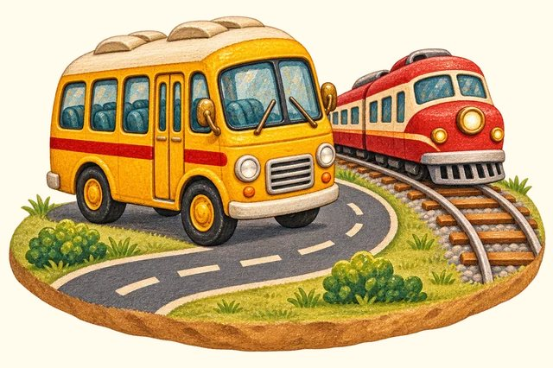
TRANSPORT TOWN
Land travel
Transport Town

Slide 2
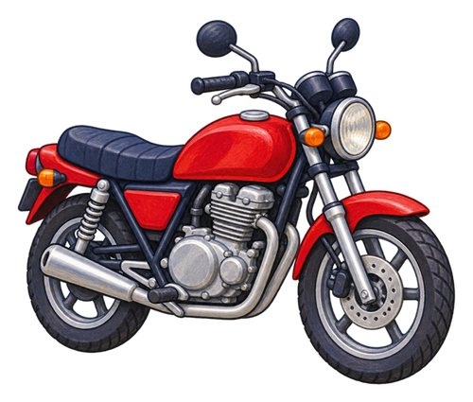
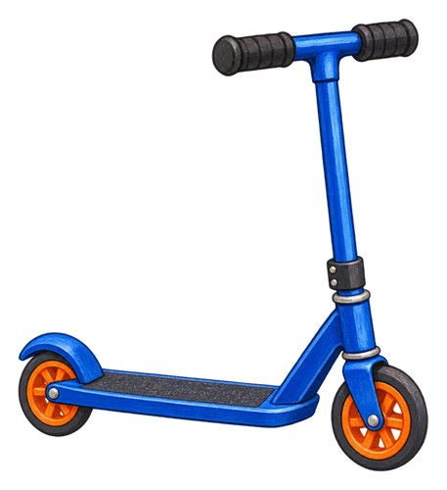
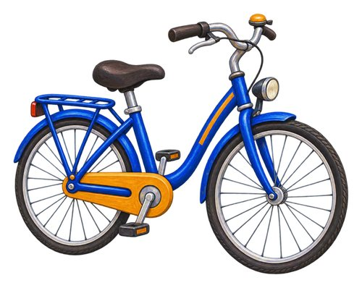
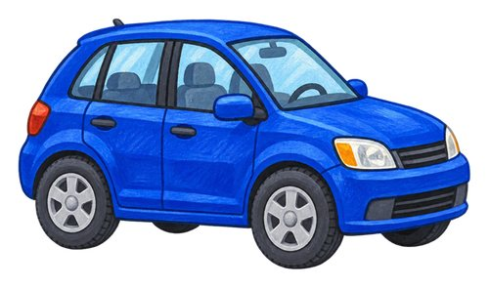
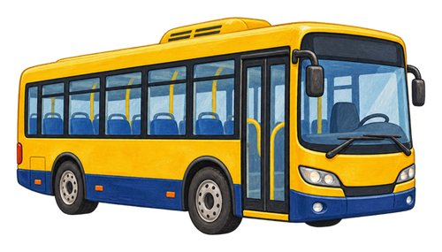
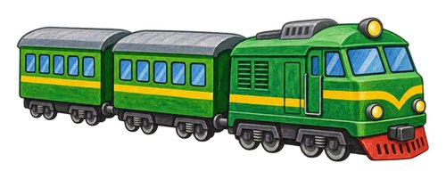
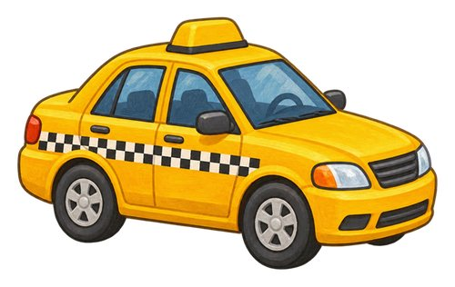
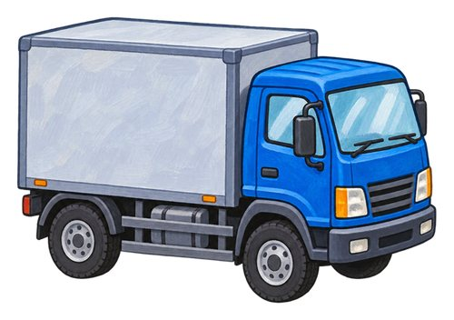
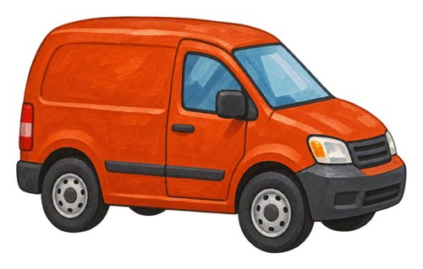
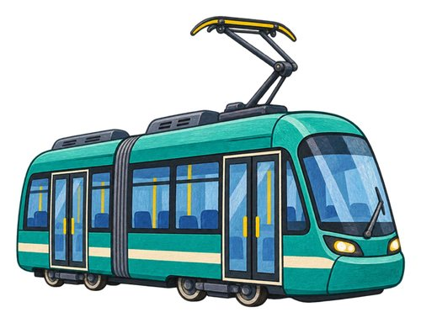
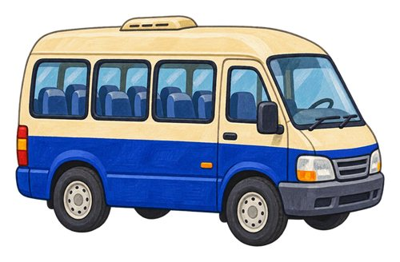
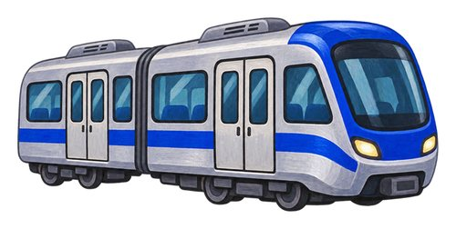
In this lesson
car
bus
bicycle
motorcycle
kick scooter
train
metro train
taxi
truck
van
tram
minibus

Slide 3
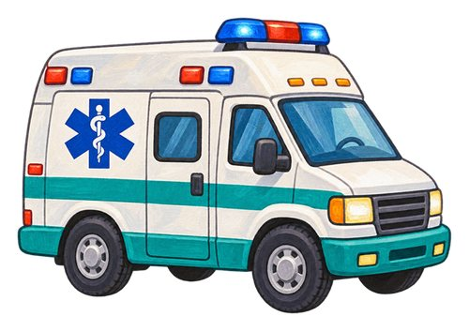
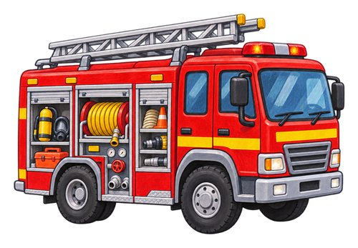
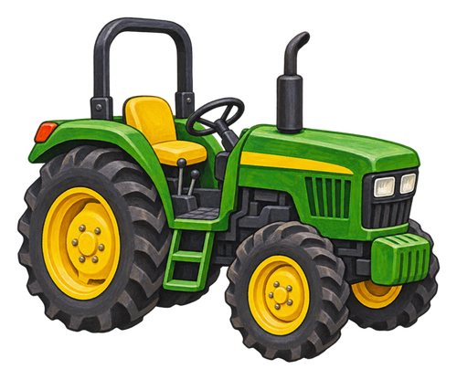
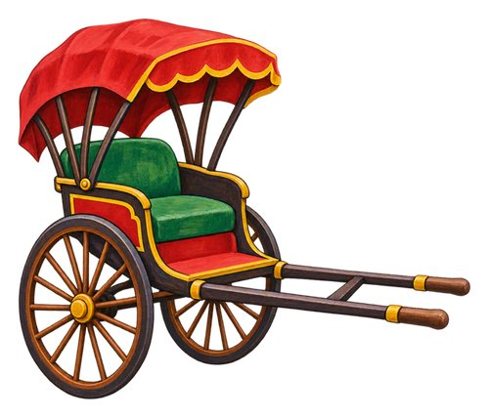
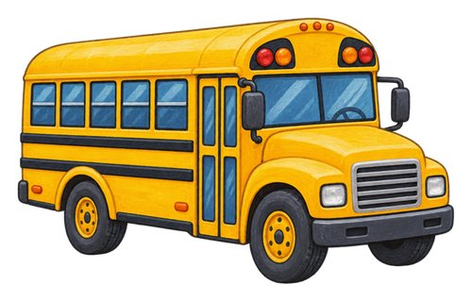
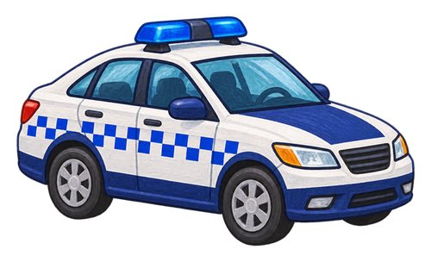
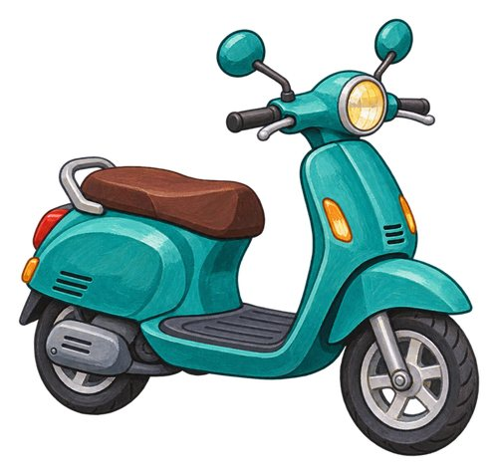
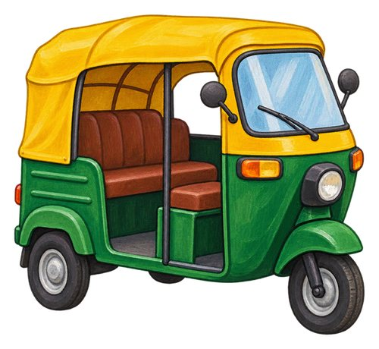
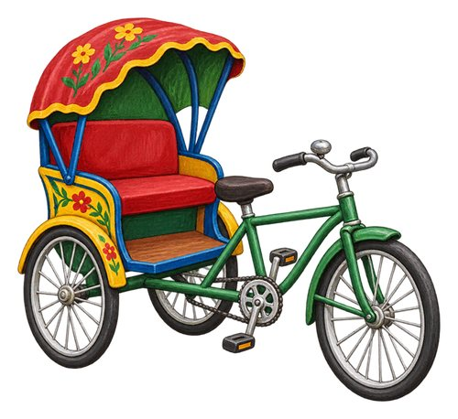
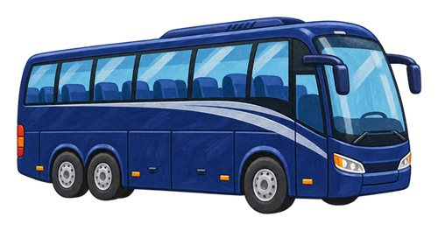
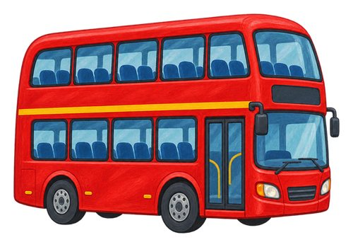
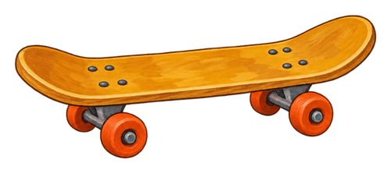
In this lesson
school bus
police car
ambulance
fire engine
tractor
pulled rickshaw
skateboard
motor scooter
auto-rickshaw
cycle rickshaw
coach
double-decker bus

Slide 4
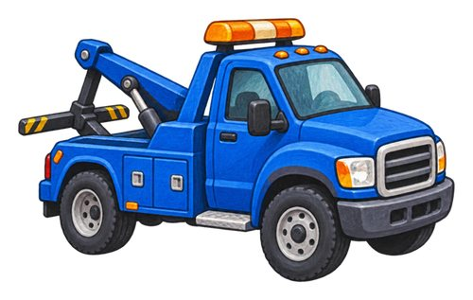
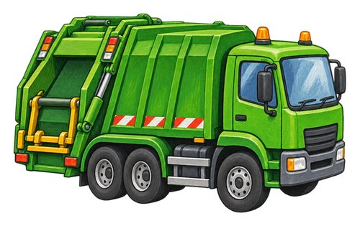
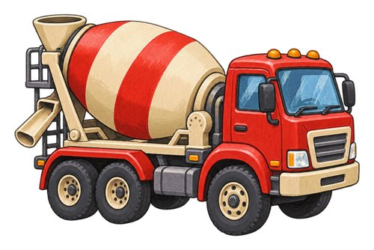
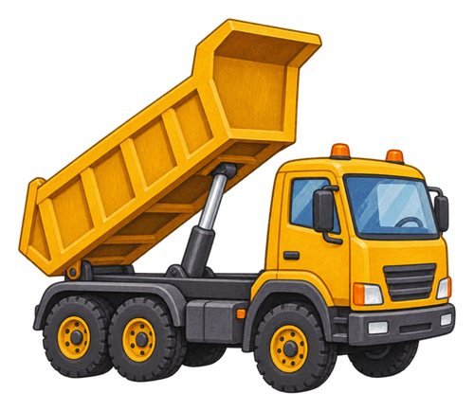
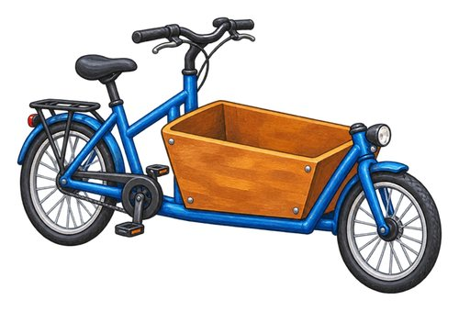
In this lesson
tow truck
refuse truck
concrete mixer truck
tipper truck
cargo bicycle

Slide 5

car
A vehicle with four wheels that carries a small group of people.
We ride in a car to visit a friend.

Slide 6

bus
A large road vehicle that carries many passengers.
Passengers wait at the bus stop.

Slide 7

bicycle
A vehicle with two wheels that a rider moves by pedalling.
The rider pushes the bicycle pedals.

Slide 8

motorcycle
A motor vehicle with two wheels that a rider sits on.
The motorcycle rider wears a helmet.

Slide 9

kick scooter
A small vehicle with a standing deck and handlebars, pushed along with one foot.
Push with one foot to move the kick scooter.

Slide 10

train
A rail vehicle, or connected rail vehicles, that carries people or goods along tracks.
The train carries passengers along the railway.

Slide 11

metro train
A city train that often travels through underground tunnels.
We take a metro train across the city.

Slide 12

taxi
A car with a driver that passengers pay to take them somewhere.
The taxi driver takes a passenger to the station.

Slide 13
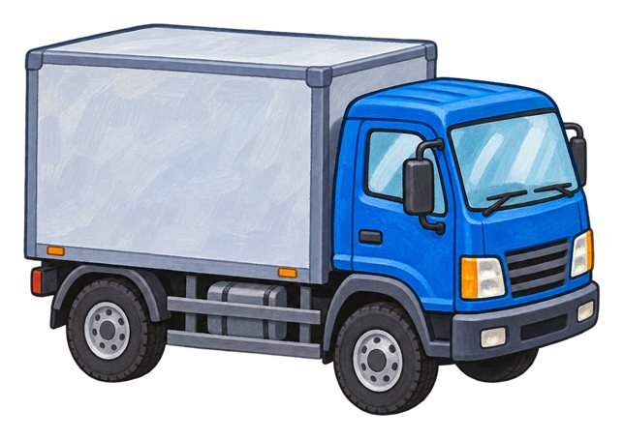
truck
A road vehicle used to carry goods.
The truck carries boxes to a shop.

Slide 14

van
A road vehicle with an enclosed space for goods or passengers.
The van carries parcels to our street.

Slide 15

tram
A passenger vehicle that runs on rails, often along city streets.
The tram follows rails through the city.

Slide 16

minibus
A passenger vehicle that is smaller than a full-sized bus.
A small group travels in the minibus.

Slide 17

school bus
A bus used to take children to and from school.
The school bus takes children to school.

Slide 18

police car
A car used by police officers as they do their work.
Police officers travel in the police car.

Slide 19

ambulance
A vehicle equipped to help take ill or injured people for medical care.
The ambulance takes someone for medical care.

Slide 20

fire engine
A vehicle that carries firefighters and firefighting equipment.
Firefighters carry their equipment on the fire engine.

Slide 21
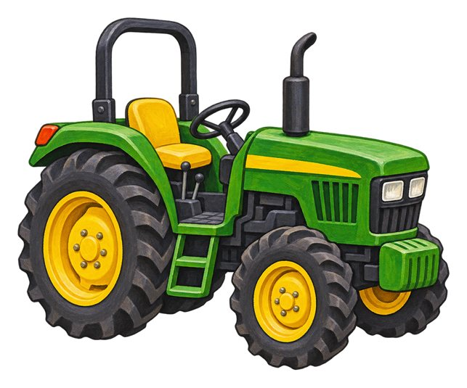
tractor
A strong vehicle used to pull farm equipment or loads.
The tractor pulls farm equipment.

Slide 22

pulled rickshaw
A small passenger cart pulled by a person on foot.
A person pulls the rickshaw using its long handles.

Slide 23

skateboard
A board with four small wheels that a rider stands on.
The rider stands on the skateboard.

Slide 24

motor scooter
A motor vehicle with a seat and a platform for the rider's feet.
The rider sits on the motor scooter.

Slide 25
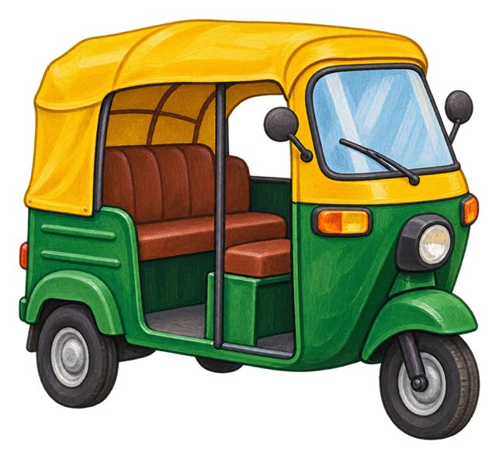
auto-rickshaw
A small motor vehicle with three wheels that can carry passengers.
Passengers sit behind the auto-rickshaw driver.

Slide 26
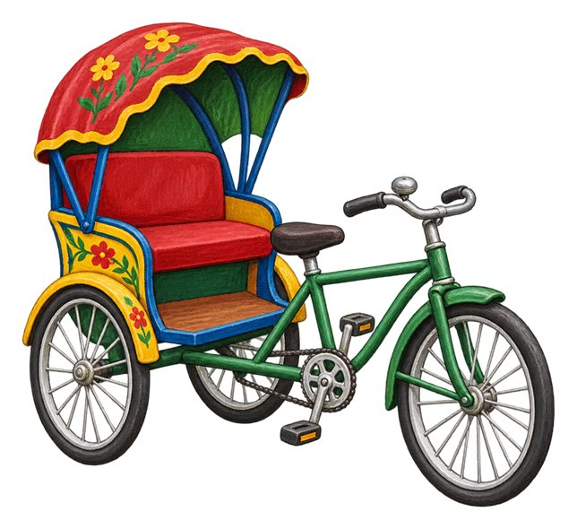
cycle rickshaw
A passenger vehicle moved by a person pedalling.
The rider pedals the cycle rickshaw.

Slide 27

coach
A large passenger vehicle often used for longer road journeys.
Our group travels to another town by coach.

Slide 28

double-decker bus
A bus with passenger seats on two levels.
The double-decker bus has an upper deck.

Slide 29

tow truck
A truck used to carry or pull a vehicle that needs help.
The tow truck carries a broken-down car.

Slide 30

refuse truck
A truck that collects and carries rubbish.
The refuse truck collects rubbish from our street.

Slide 31

concrete mixer truck
A truck with a turning drum that carries and mixes concrete.
The concrete mixer truck brings concrete to the building site.

Slide 32

tipper truck
A truck with a container that can lift to tip out a load.
The tipper truck unloads a pile of gravel.

Slide 33

cargo bicycle
A bicycle built with space to carry a load.
The cargo bicycle carries parcels.

Slide 34
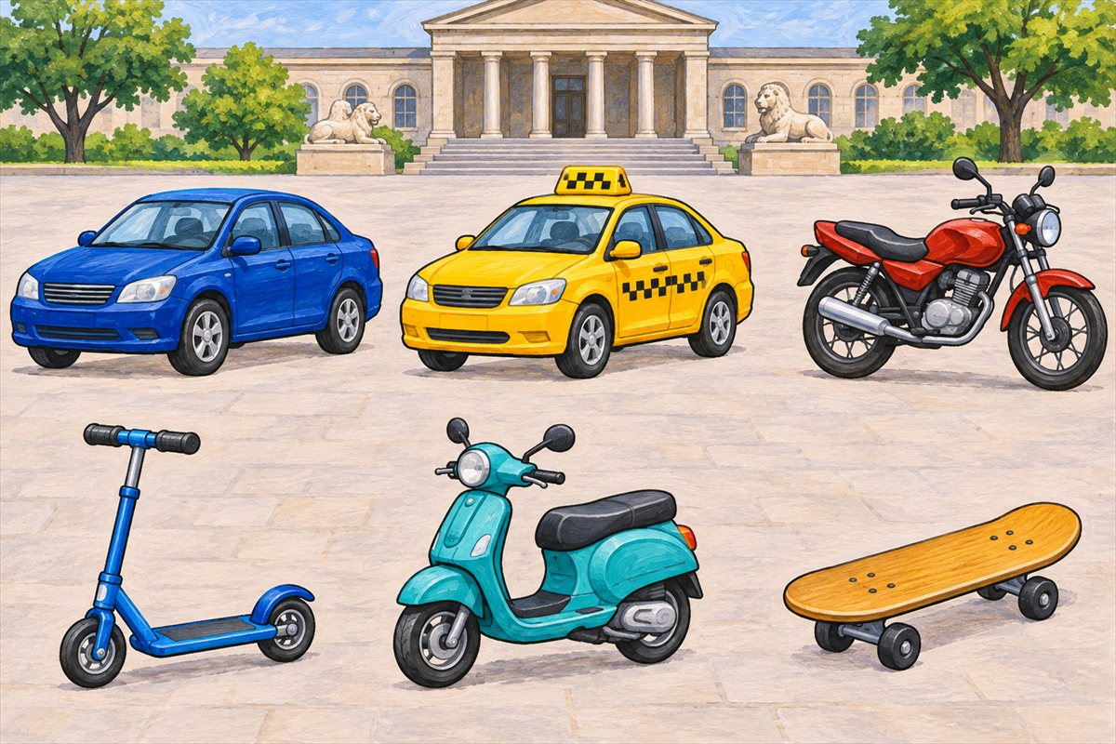
Road vehicles
Car A vehicle with four wheels that carries a small group of people.
Taxi A car with a driver that passengers pay to take them somewhere.
Motorcycle A motor vehicle with two wheels that a rider sits on.
Kick scooter A small vehicle with a standing deck and handlebars, pushed along with one foot.

Slide 35
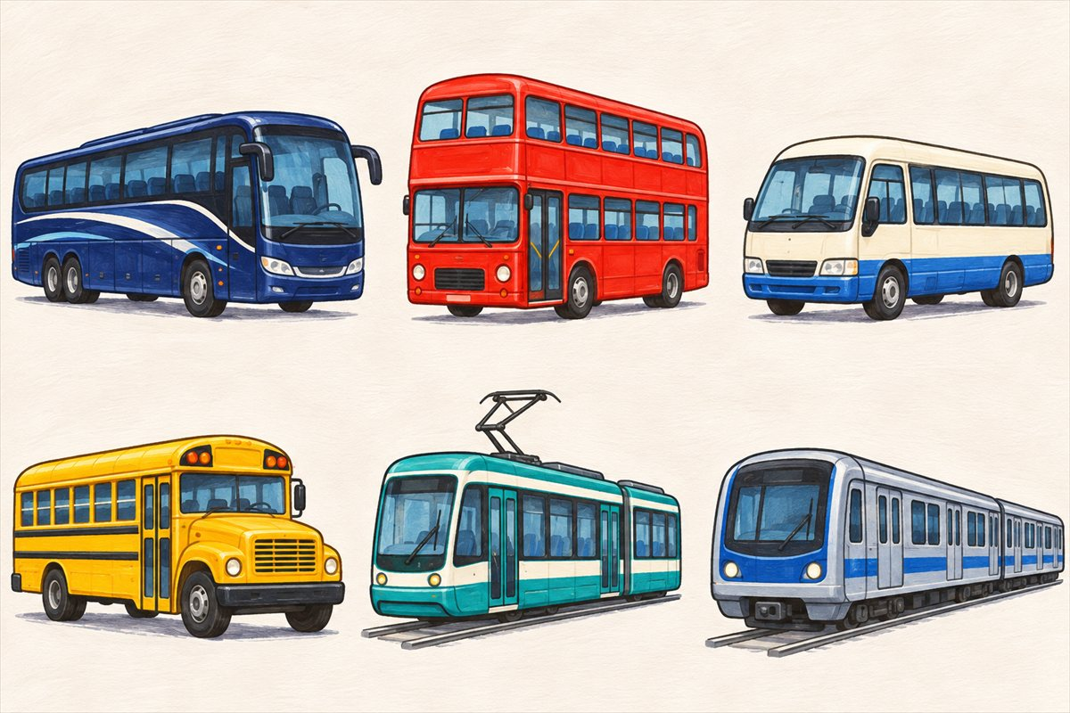
Passenger vehicles
Coach A large passenger vehicle often used for longer road journeys.
Double-decker bus A bus with passenger seats on two levels.
Minibus A passenger vehicle that is smaller than a full-sized bus.
School bus A bus used to take children to and from school.

Slide 36
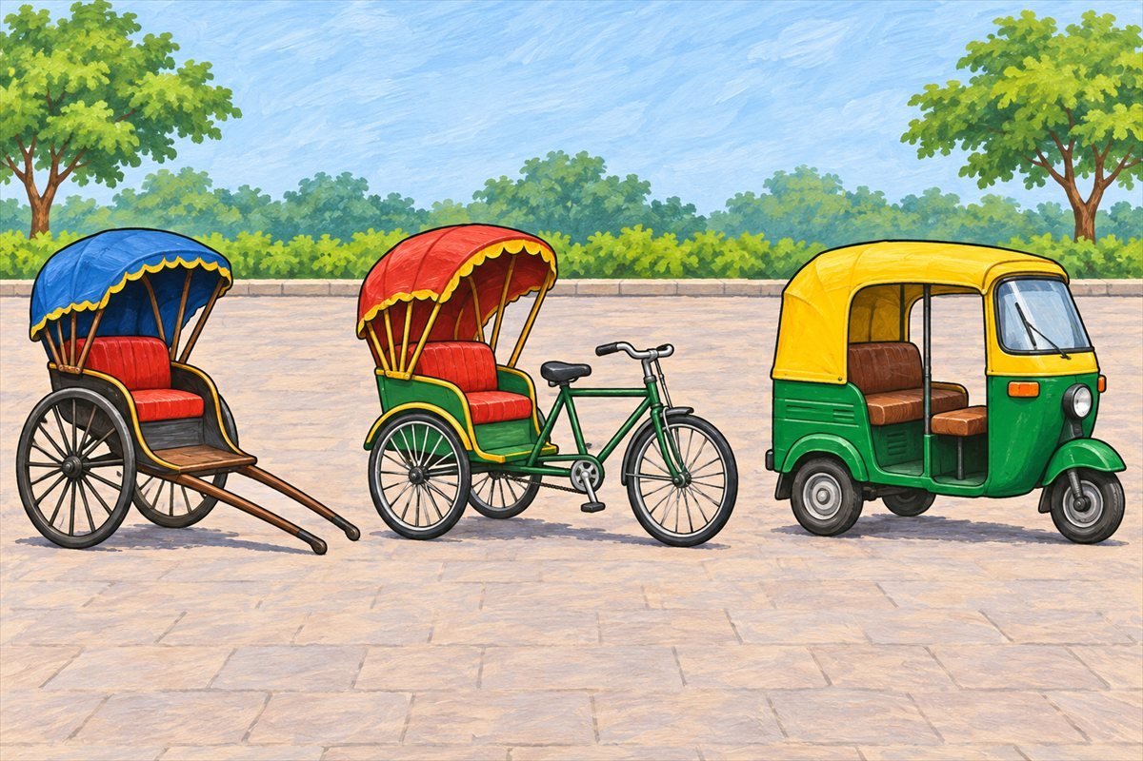
Three kinds of rickshaw
Pulled rickshaw A small passenger cart pulled by a person on foot.
Cycle rickshaw A passenger vehicle moved by a person pedalling.
Auto-rickshaw A small motor vehicle with three wheels that can carry passengers.

Slide 37
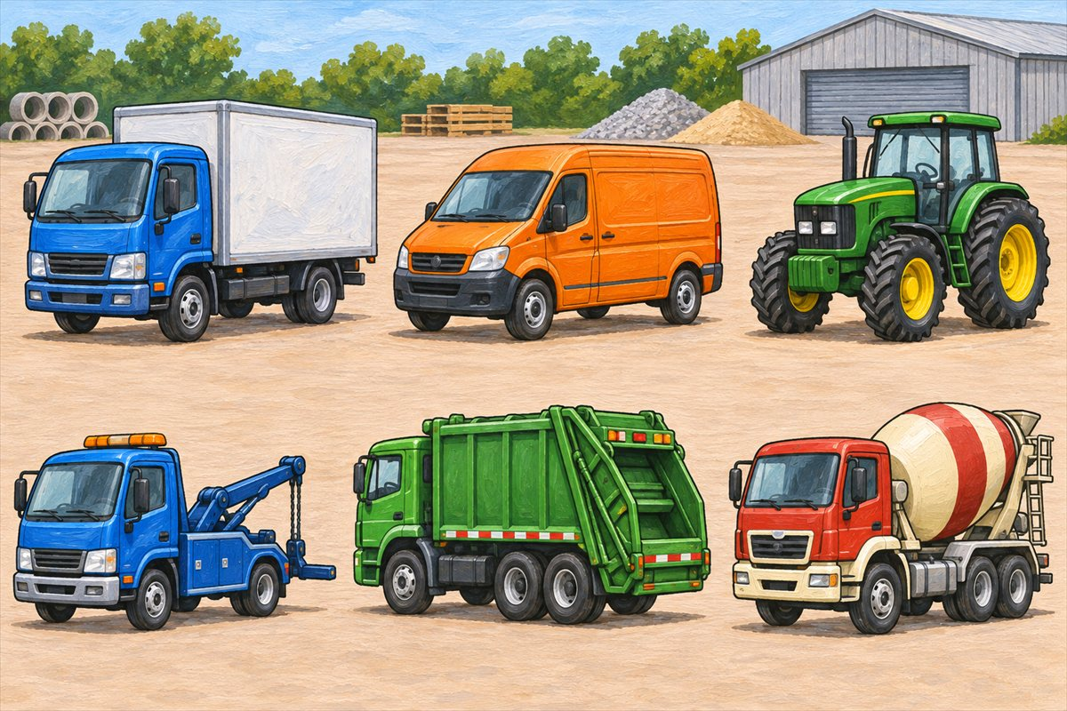
Vehicles that carry and help
Truck A road vehicle used to carry goods.
Van A road vehicle with an enclosed space for goods or passengers.
Tractor A strong vehicle used to pull farm equipment or loads.
Tow truck A truck used to carry or pull a vehicle that needs help.

Slide 38
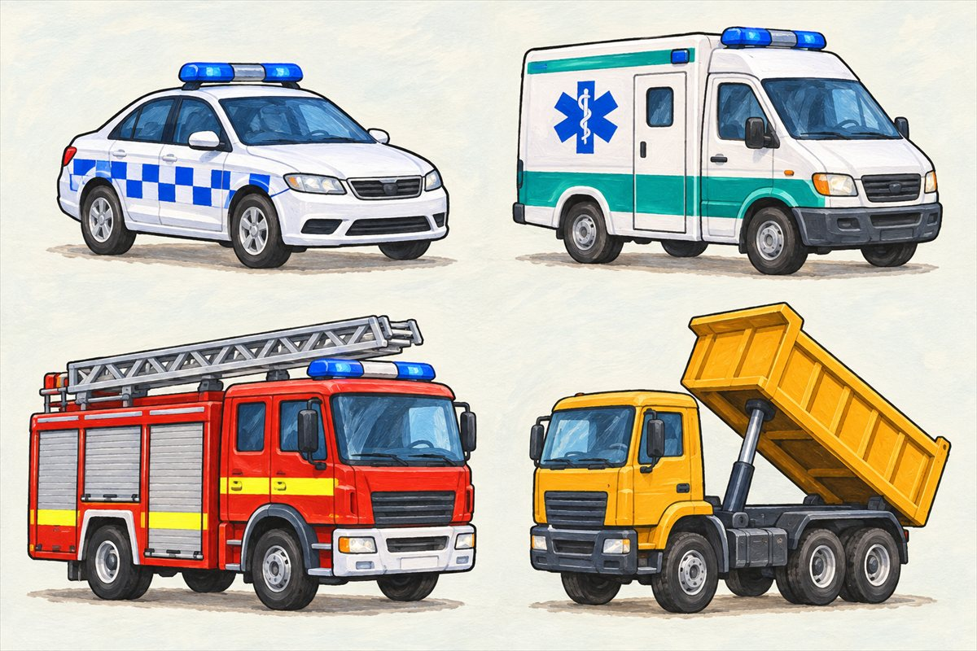
Emergency vehicles and tipping loads
Police car A car used by police officers as they do their work.
Ambulance A vehicle equipped to help take ill or injured people for medical care.
Fire engine A vehicle that carries firefighters and firefighting equipment.
Tipper truck A truck with a container that can lift to tip out a load.

Slide 39
Can you name them?

Slide 40
Did you get them?
ambulance
car
cycle rickshaw
motor scooter
pulled rickshaw
metro train

Slide 41

Well done!
You learned about land travel.

