Slide 1
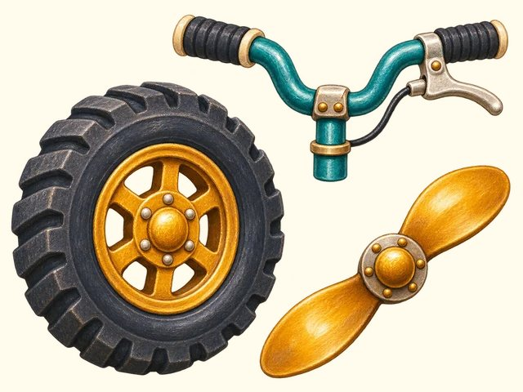
TRANSPORT TOWN
Vehicle parts
Transport Town

Slide 2
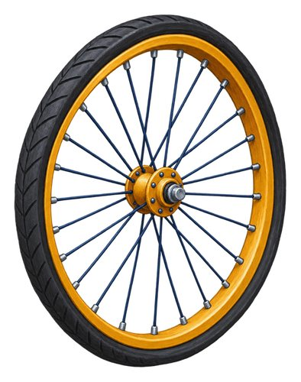
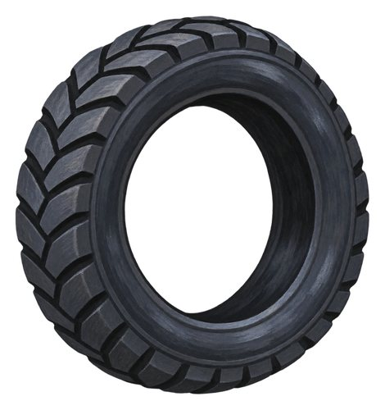
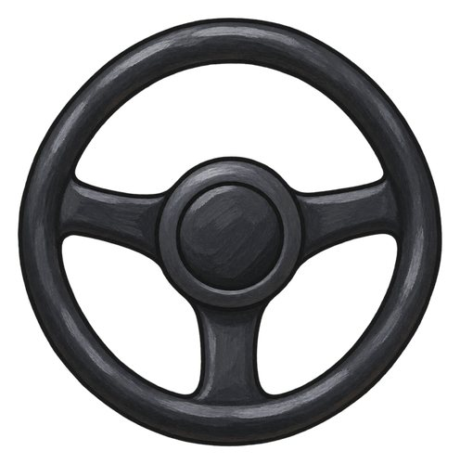
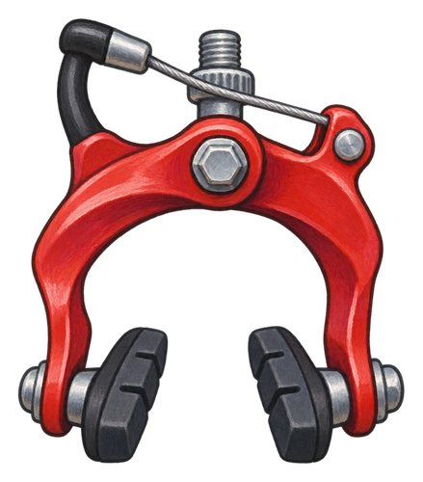
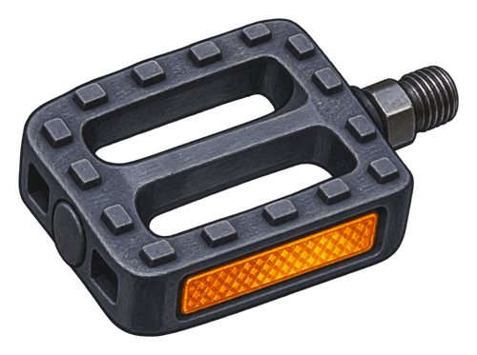
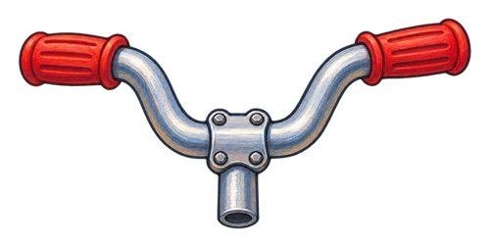
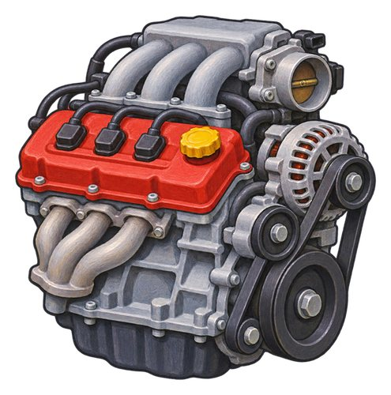
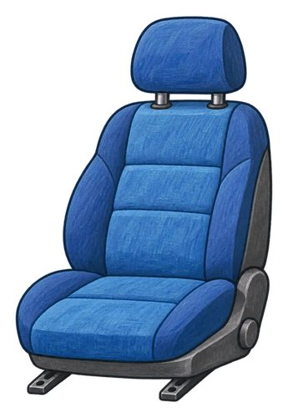
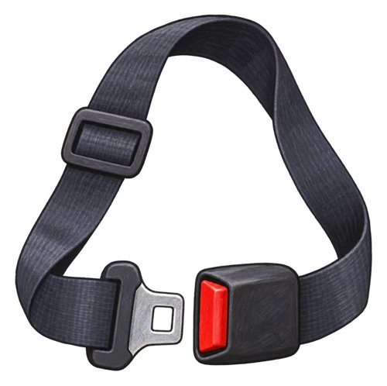
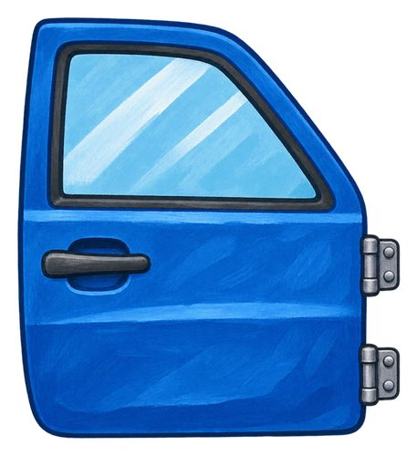
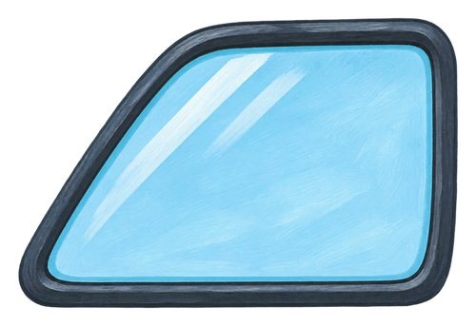
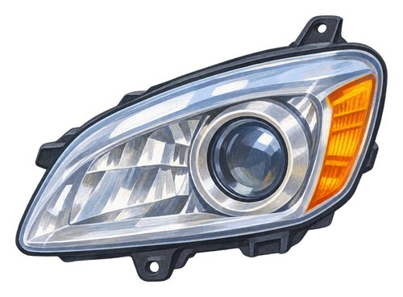
In this lesson
wheel
tyre
pedal
handlebars
steering wheel
brake
engine
seat
seat belt
door
window
headlight

Slide 3
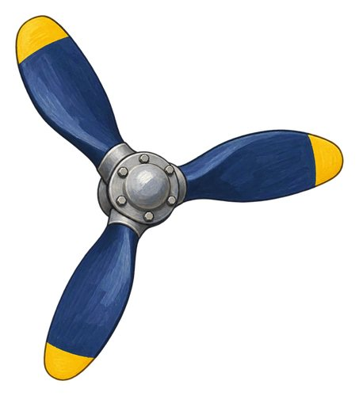
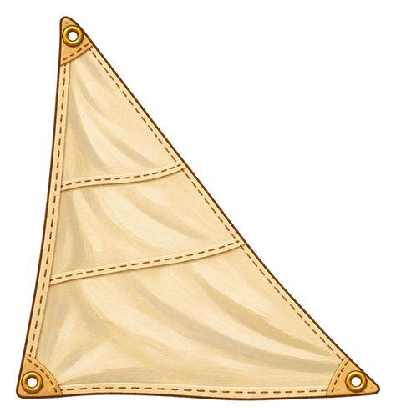
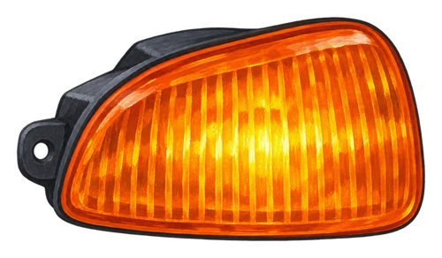
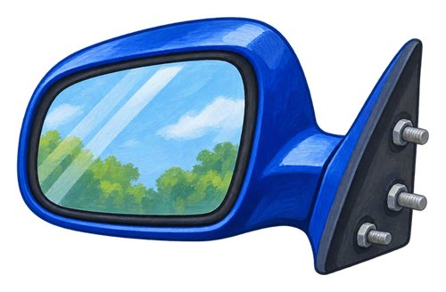
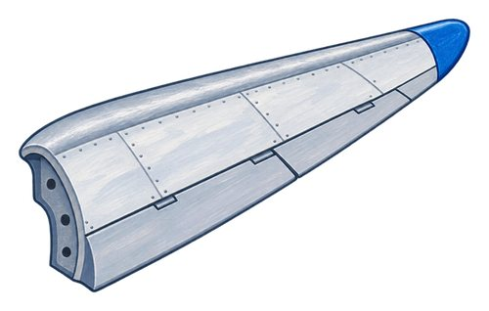
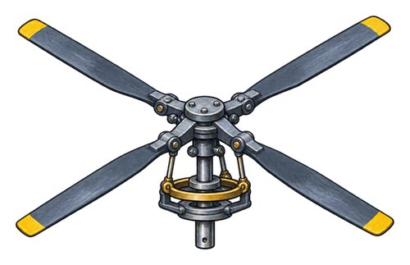
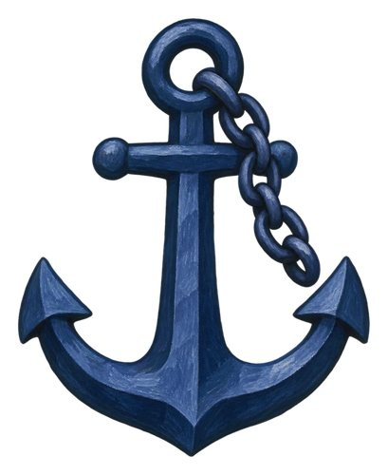
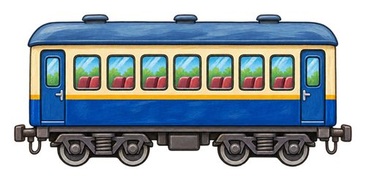
In this lesson
indicator
vehicle mirror
wing
rotor
propeller
sail
anchor
train carriage

Slide 4

wheel
A round part that turns to help a vehicle move.
The car's wheels turn as it moves.

Slide 5
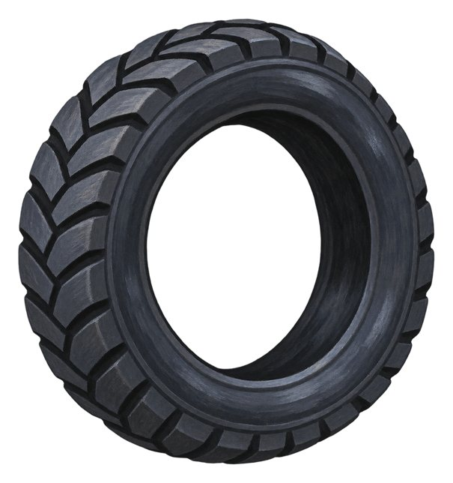
tyre
The outer covering around many vehicle wheels.
The bicycle tyre touches the ground.

Slide 6
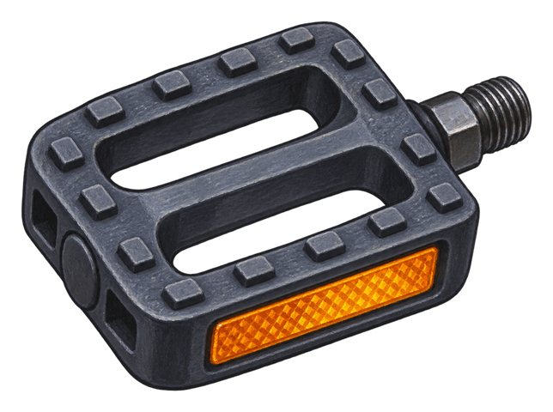
pedal
A part that you push with your foot to work a bicycle or another machine.
The cyclist pushes the bicycle pedals.

Slide 7

handlebars
The bars a rider holds to steer a bicycle or similar vehicle.
The rider holds the handlebars with both hands.

Slide 8
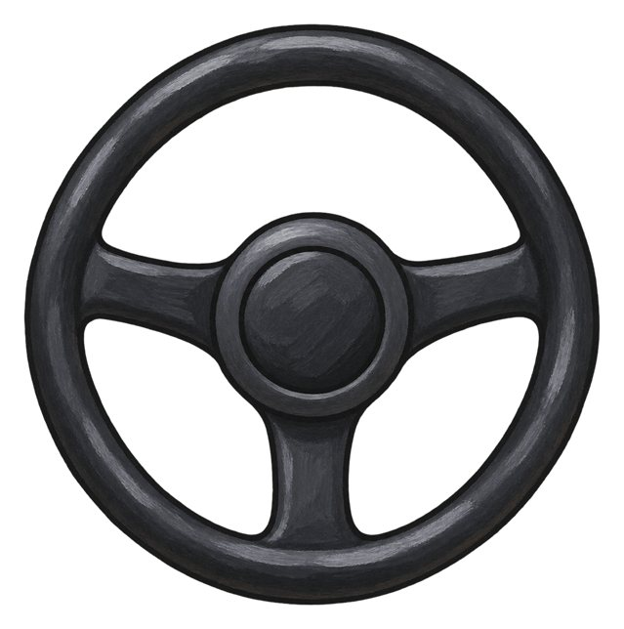
steering wheel
A wheel-shaped control used to steer many vehicles.
The driver turns the steering wheel.

Slide 9
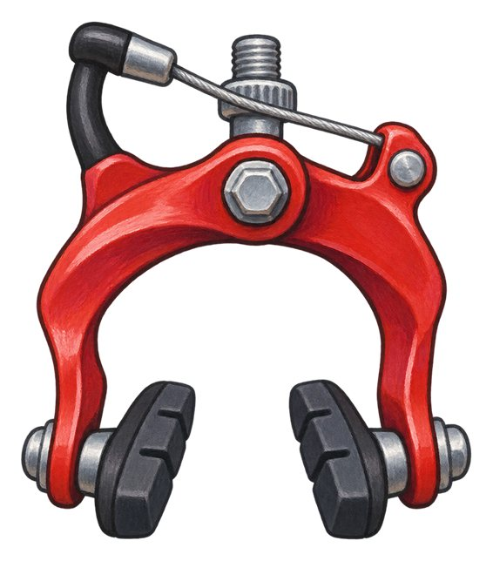
brake
A brake slows or stops a vehicle. On this bicycle the hand lever operates the brake at the wheel.
The bicycle brake helps slow the wheel.

Slide 10

engine
A machine that supplies power to move many vehicles.
The engine powers the truck.

Slide 11

seat
A place made for a person to sit.
The passenger sits on a bus seat.

Slide 12
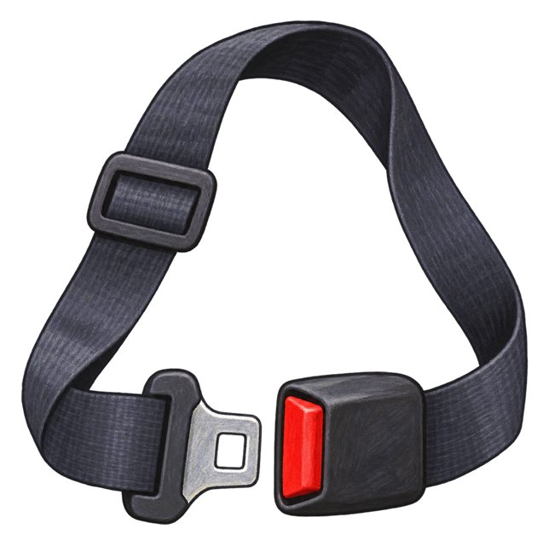
seat belt
A belt that helps hold a person in their seat. An adult checks the right belt or restraint for a child.
An adult checks the passenger's seat belt.

Slide 13

door
A movable part that opens and closes an entrance.
The bus door opens at the stop.

Slide 14

window
An opening with glass or another clear material that lets us see through.
We look through the train window.

Slide 15

headlight
A light on the front of a vehicle that helps light the way.
The car's headlights shine ahead.

Slide 16

indicator
A light that flashes to tell others a driver intends to turn or change lanes.
The driver signals with an indicator before turning.

Slide 17

vehicle mirror
A mirror that helps a driver or rider see around or behind a vehicle.
The driver checks the vehicle mirror.

Slide 18

wing
A shaped part of an aircraft that helps support it in flight.
The airplane has a wing on each side.

Slide 19
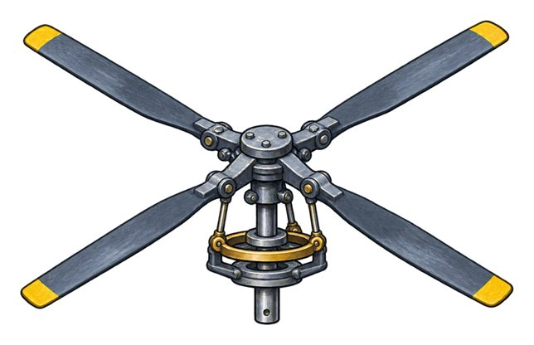
rotor
The set of turning blades above a helicopter that helps lift it.
The helicopter's main rotor turns above its cabin.

Slide 20
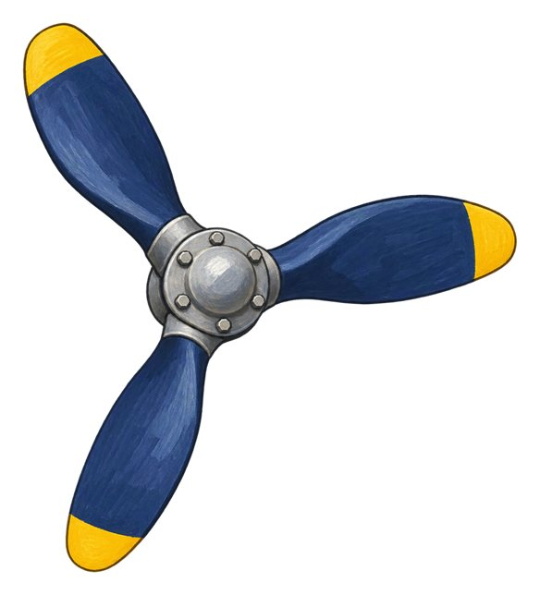
propeller
A set of turning blades that push air to move this airplane forwards.
The airplane's propeller turns at the front.

Slide 21
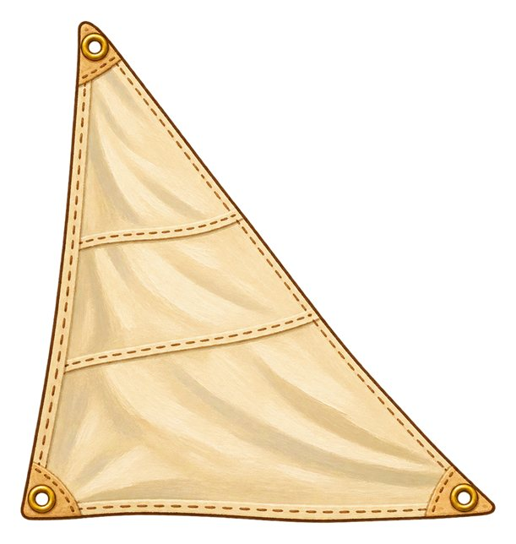
sail
A large sheet of strong material that catches wind to help move a boat.
Wind pushes against the sail.

Slide 22

anchor
A heavy object lowered from a boat to help hold it in place.
The boat lowers its anchor.

Slide 23
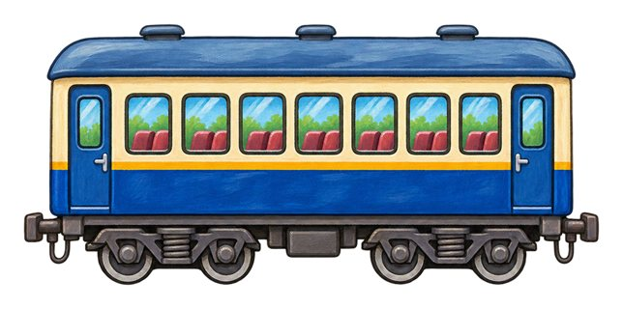
train carriage
A connected section of a train that can carry passengers.
Passengers sit in the train carriage.

Slide 24
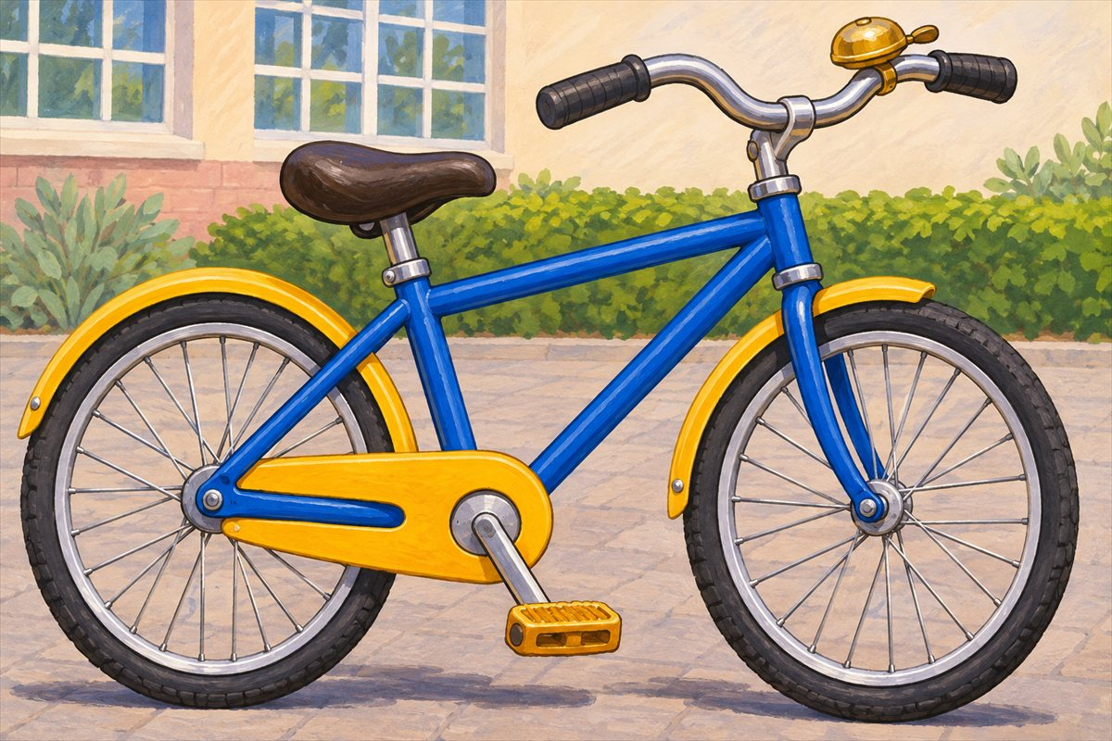
Bicycle parts
Bell The bell makes a sound to alert people nearby.
Bicycle You ride a bicycle by pushing its pedals.
Wheel The whole wheel includes the hub, spokes, rim and tyre.
Tyre The tyre is the dark rubber ring around the wheel.

Slide 25
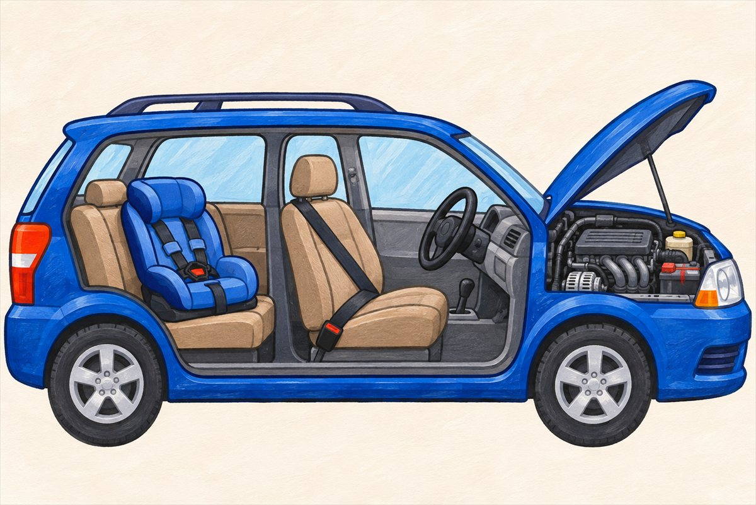
Inside a parked car
Steering wheel A wheel-shaped control used to steer many vehicles.
Engine A machine that supplies power to move many vehicles.
Seat belt A belt that helps hold a person in their seat. An adult checks the right belt or restraint for a child.
Child car seat A seat designed to protect a child travelling in a car. An adult checks the child's restraint.

Slide 26
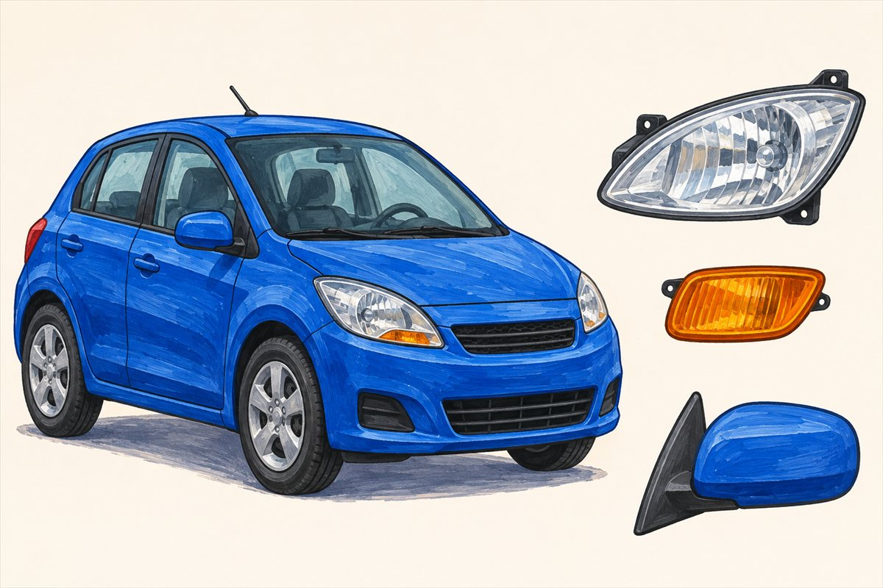
Car lights and mirrors
Headlight A light on the front of a vehicle that helps light the way.
Indicator A light that flashes to tell others a driver intends to turn or change lanes.
Vehicle mirror A mirror that helps a driver or rider see around or behind a vehicle.

Slide 27
Can you name them?

Slide 28
Did you get them?
anchor
door
headlight
pedal
sail
steering wheel

Slide 29

Well done!
You learned about vehicle parts.

