Slide 1
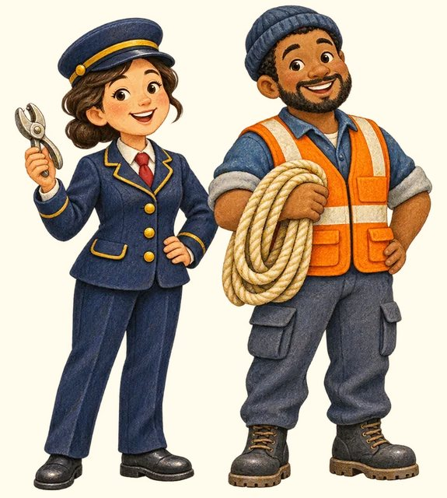
TRANSPORT TOWN
People and roles
Transport Town

Slide 2
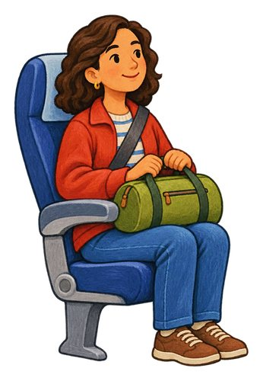
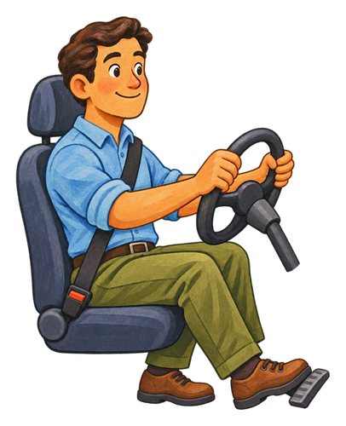
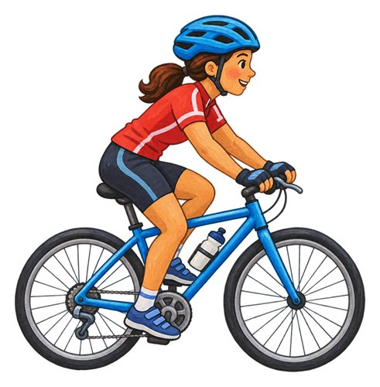
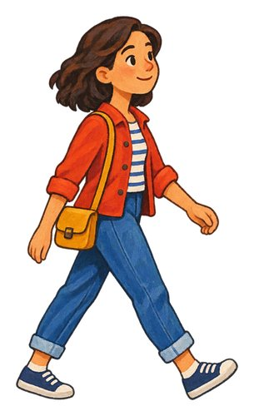
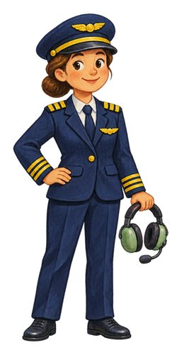
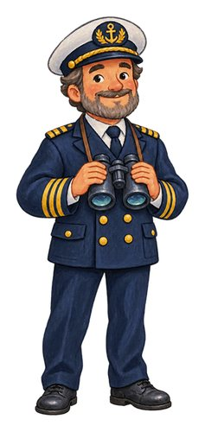
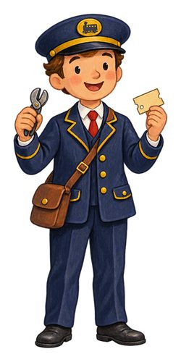
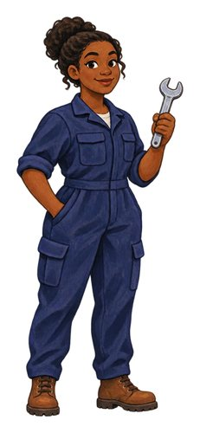
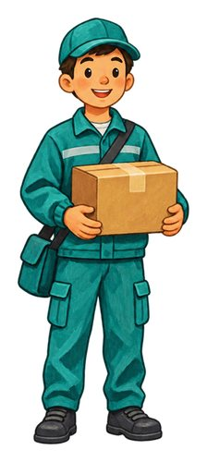
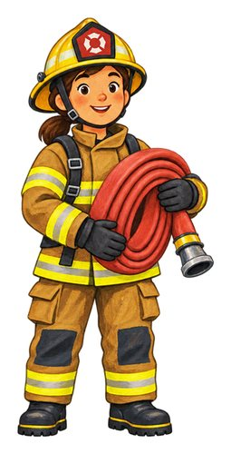
In this lesson
passenger
driver
cyclist
pedestrian
pilot
boat captain
train conductor
mechanic
delivery worker
firefighter

Slide 3

passenger
A person travelling in a vehicle who is not operating it.
The passenger sits in a bus seat.

Slide 4

driver
A person who controls a road vehicle.
The driver steers the bus.

Slide 5

cyclist
A person riding a bicycle.
The cyclist pedals along the path.

Slide 6

pedestrian
A person travelling along a route on foot or using a mobility aid.
The pedestrians walk along the pavement.

Slide 7

pilot
A person trained to control an aircraft.
The pilot controls the airplane.

Slide 8

boat captain
The person in charge of a boat, such as a ferry.
The boat captain guides the ferry.

Slide 9

train conductor
A member of the train crew who helps passengers. On some trains they check tickets.
The train conductor checks a passenger's ticket.

Slide 10

mechanic
A person who maintains or repairs machines such as vehicles.
The mechanic repairs the bicycle.

Slide 11

delivery worker
A person who brings parcels or other goods to people.
The delivery worker carries a parcel to the door.

Slide 12

firefighter
A person trained to help put out fires and rescue people.
The firefighter takes equipment from the fire engine.

Slide 13
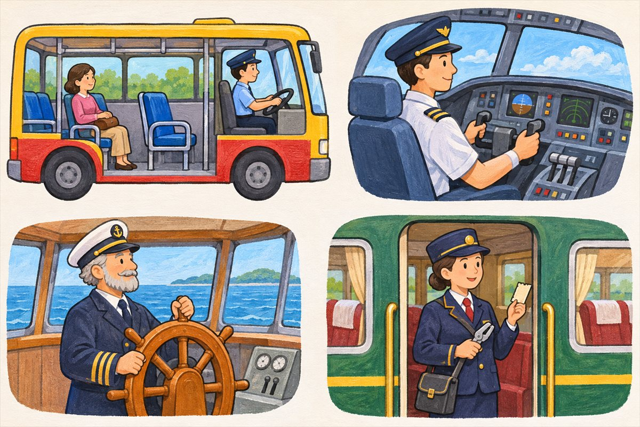
People aboard
Driver A person who controls a road vehicle.
Passenger A person travelling in a vehicle who is not operating it.
Seat A place made for a person to sit.
Ride Travel in or on a vehicle. This passenger is riding on a bus.

Slide 14
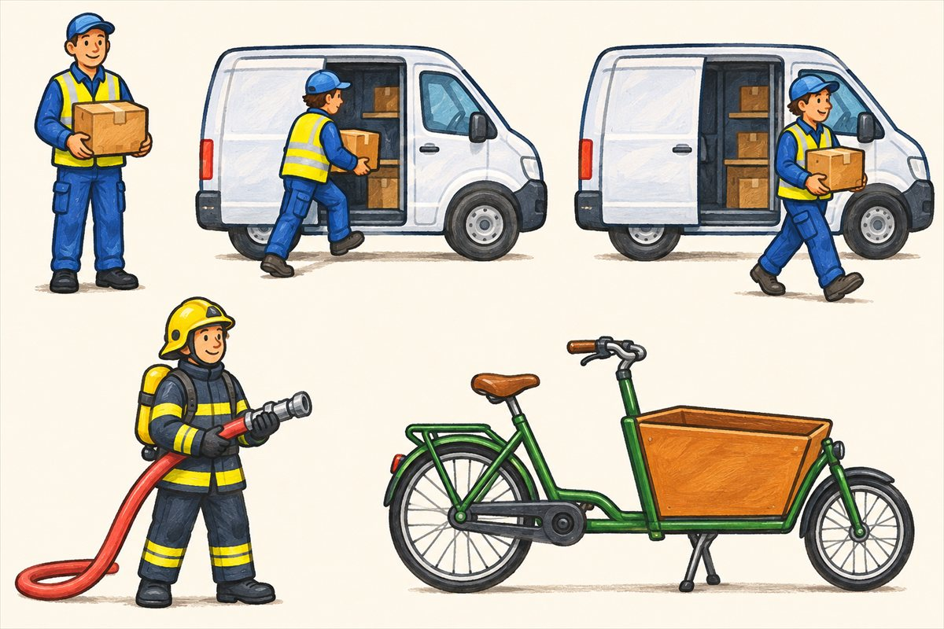
Loading and helping
Delivery worker A person who brings parcels or other goods to people.
Load To put things into or onto a vehicle for carrying.
Unload To take carried things off or out of a vehicle.
Firefighter A person trained to help put out fires and rescue people.

Slide 15
Can you name them?

Slide 16
Did you get them?
boat captain
cyclist
delivery worker
driver
firefighter
mechanic

Slide 17

Well done!
You learned about people and roles.

