Slide 1
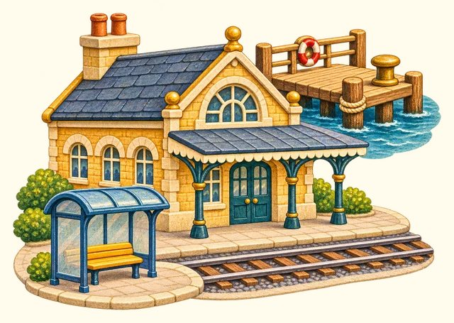
TRANSPORT TOWN
Journey places
Transport Town

Slide 2
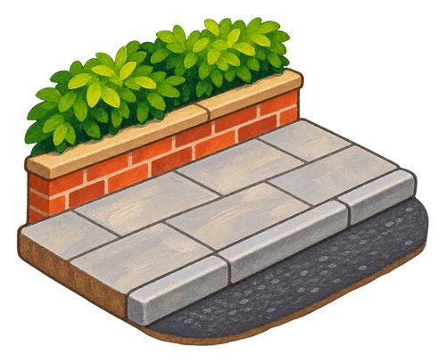
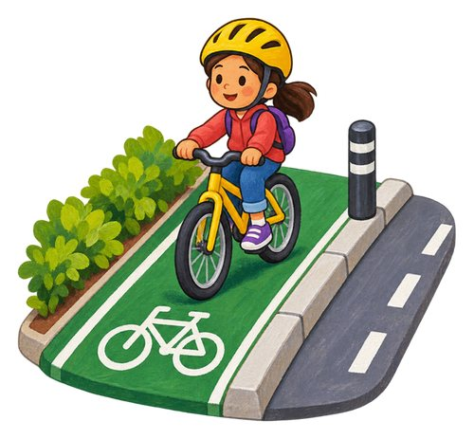
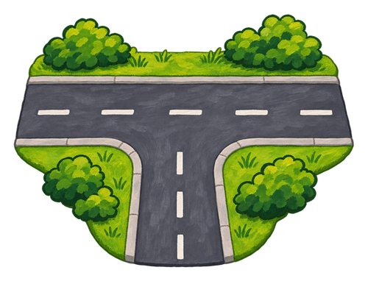
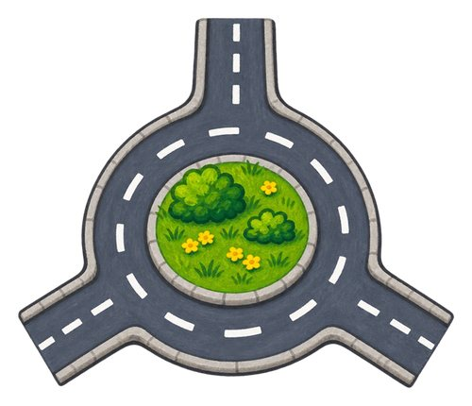
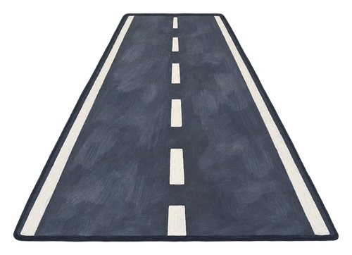
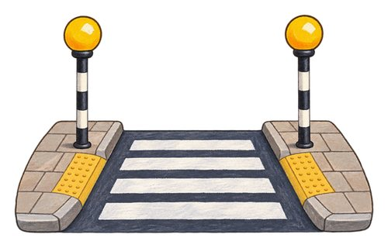
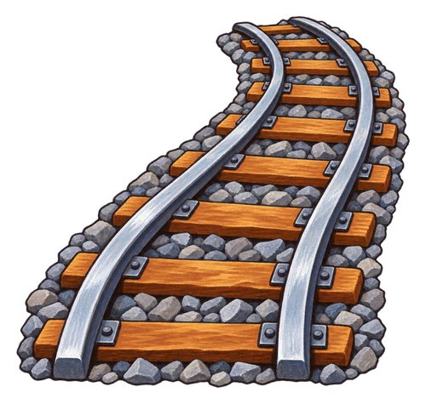
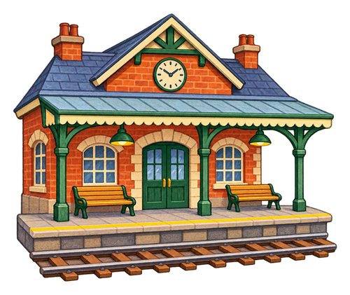
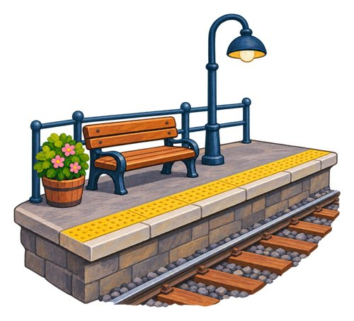
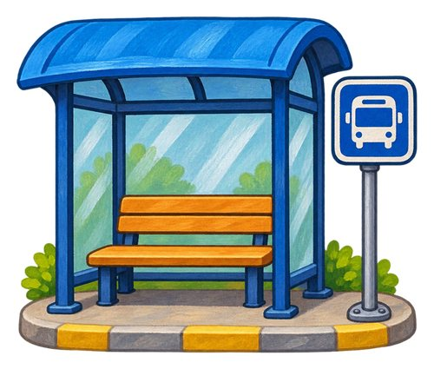
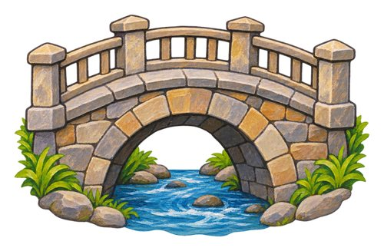
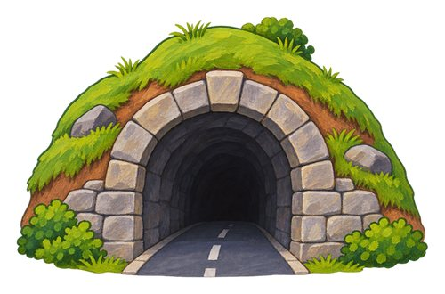
In this lesson
road
pavement
cycle lane
pedestrian crossing
junction
roundabout
bridge
tunnel
railway
train station
platform
bus stop

Slide 3
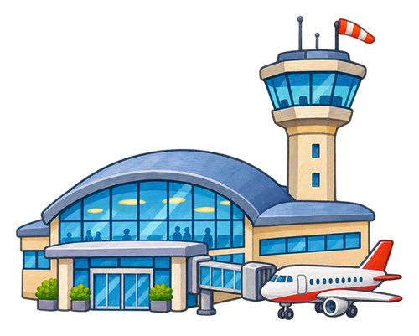
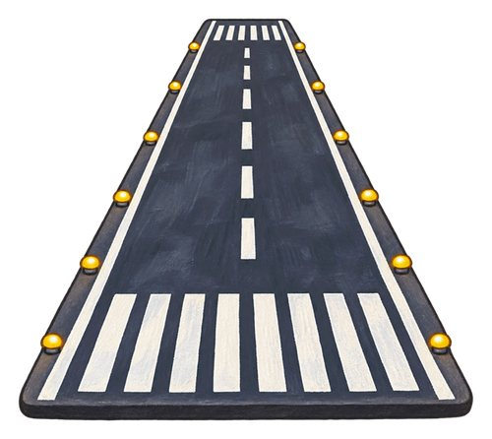
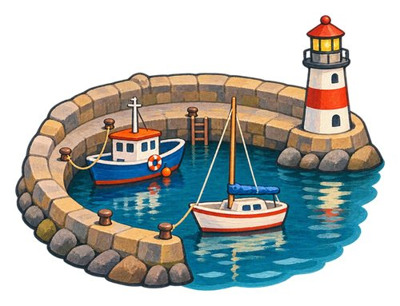
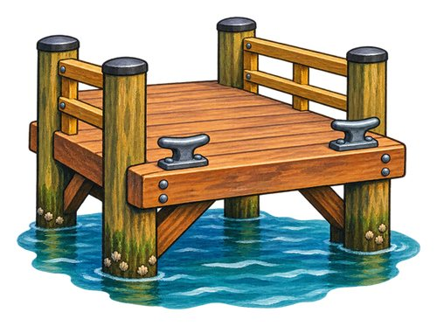
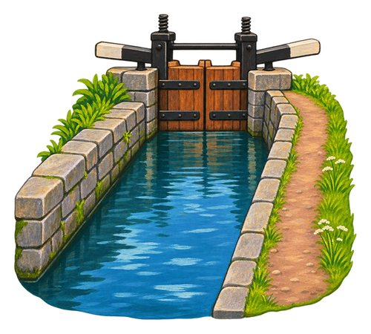
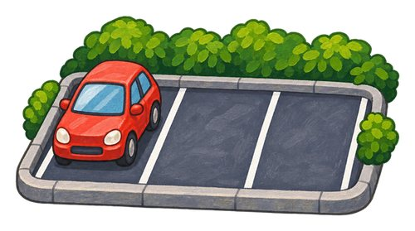
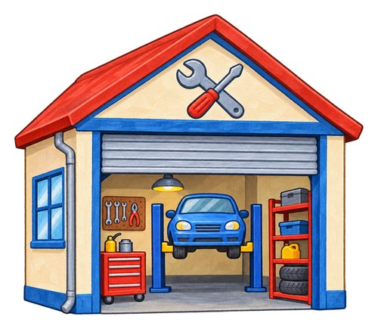
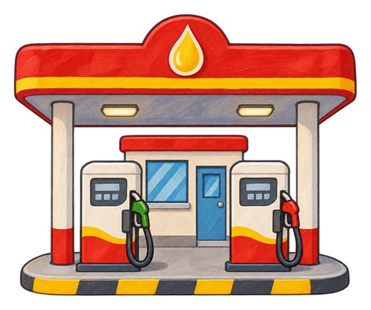
In this lesson
airport
runway
harbour
ferry dock
canal
car park
repair garage
fuel station

Slide 4
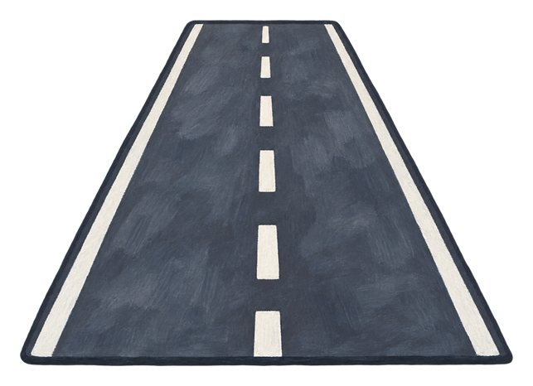
road
A way made for vehicles to travel along.
The bus travels along the road.

Slide 5

pavement
A path beside a road for people to walk along.
We walk with an adult on the pavement.

Slide 6

cycle lane
A marked part of a road or route for people riding bicycles.
A cyclist follows the marked cycle lane.

Slide 7
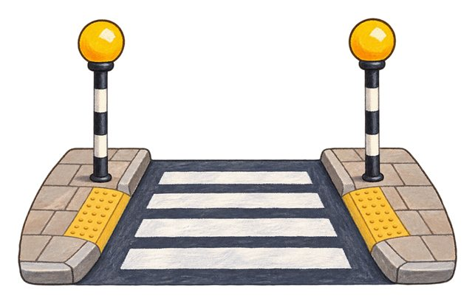
pedestrian crossing
A place marked for people to cross a road.
We find a crossing with a trusted adult.

Slide 8
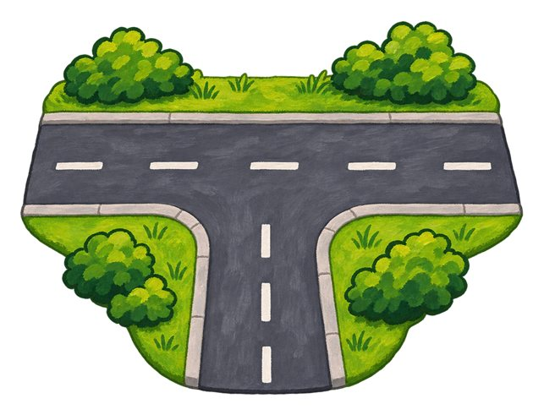
junction
A place where roads meet.
The car slows near the road junction.

Slide 9

roundabout
A road junction where vehicles travel around a central area.
Vehicles move around the roundabout.

Slide 10

bridge
A structure that carries a route over a gap, water or another route.
The train crosses the bridge.

Slide 11

tunnel
A passage through or under something, such as a hill.
The train goes through a tunnel.

Slide 12

railway
A route with tracks for trains.
The train follows the railway tracks.

Slide 13
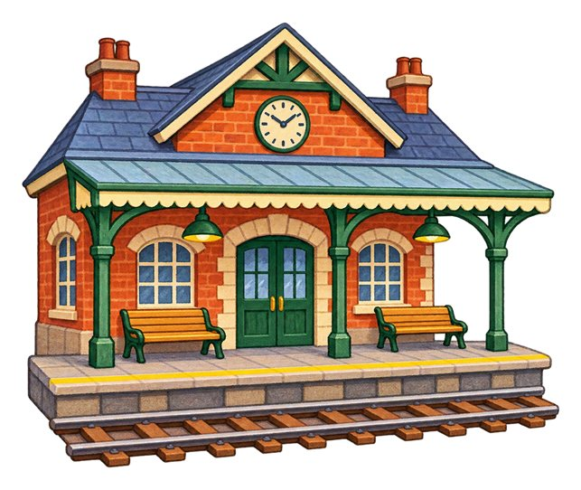
train station
A place where trains stop for passengers to get on or off.
We wait for our train at the station.

Slide 14

platform
The raised area beside a railway track where passengers wait, get on or get off.
We wait back from the edge of the platform.

Slide 15

bus stop
A marked place where buses stop for passengers.
We wait at the bus stop.

Slide 16

airport
A place where aircraft take off and land and passengers begin or end flights.
The family arrives at the airport.

Slide 17
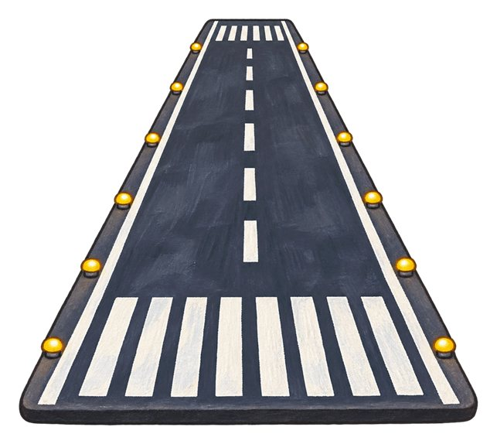
runway
A long prepared strip where aircraft take off or land.
The airplane lands on the runway.

Slide 18

harbour
A sheltered area of water where boats and ships can stay.
The boats rest in the harbour.

Slide 19
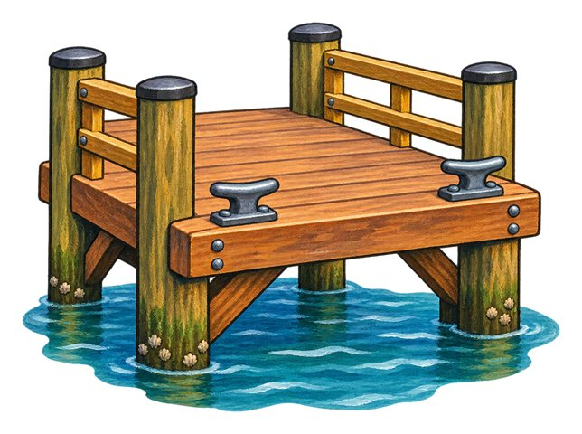
ferry dock
A place beside the water where a ferry ties up so people can get on or off.
The ferry stops beside the dock.

Slide 20

canal
A waterway made or changed by people for boats or water to pass along.
The boat travels along the canal.

Slide 21

car park
An area where vehicles can be parked.
The driver parks in a marked car-park space.

Slide 22

repair garage
A place where people repair vehicles.
The mechanic works in a vehicle garage.

Slide 23

fuel station
A place where vehicles can receive fuel.
The driver stops at the fuel station.

Slide 24
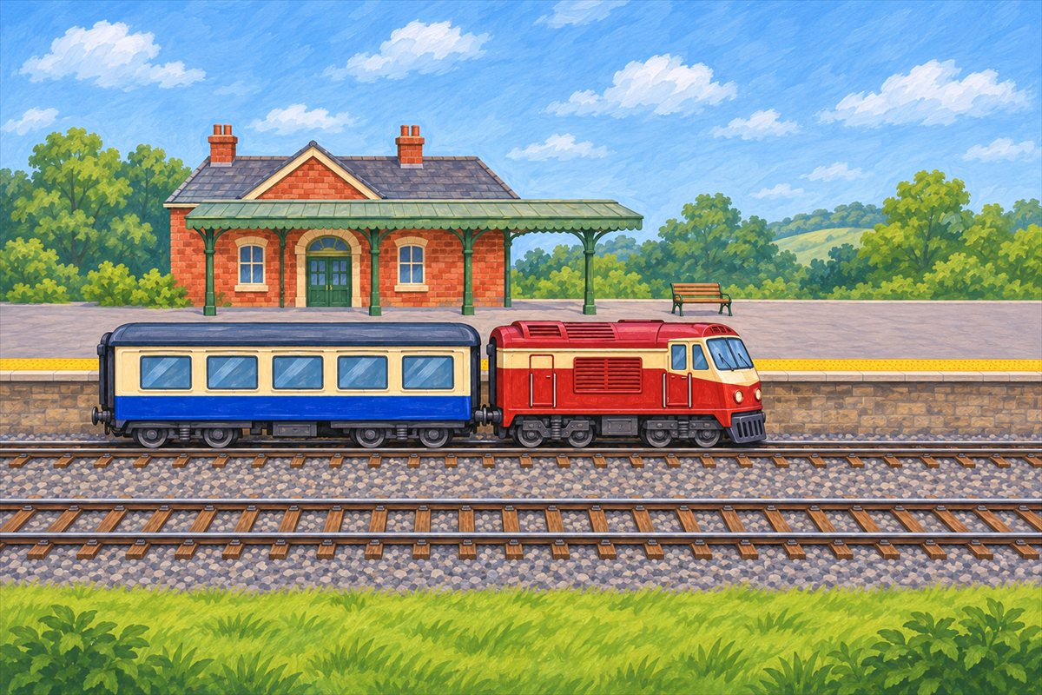
Train at the platform
Window Passengers can look outside through this carriage window.
Train The whole train includes the engine and the carriage joined behind it.
Carriage The carriage has seats and windows for passengers.
Railway The railway has rails and sleepers that support the track.

Slide 25
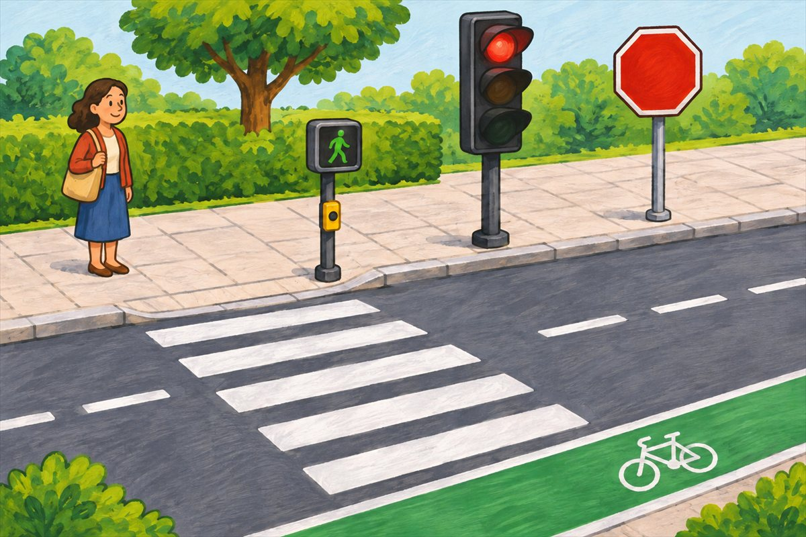
Street and crossing
Road A way made for vehicles to travel along.
Pavement A path beside a road for people to walk along.
Cycle lane A marked part of a road or route for people riding bicycles.
Pedestrian crossing A place marked for people to cross a road.

Slide 26
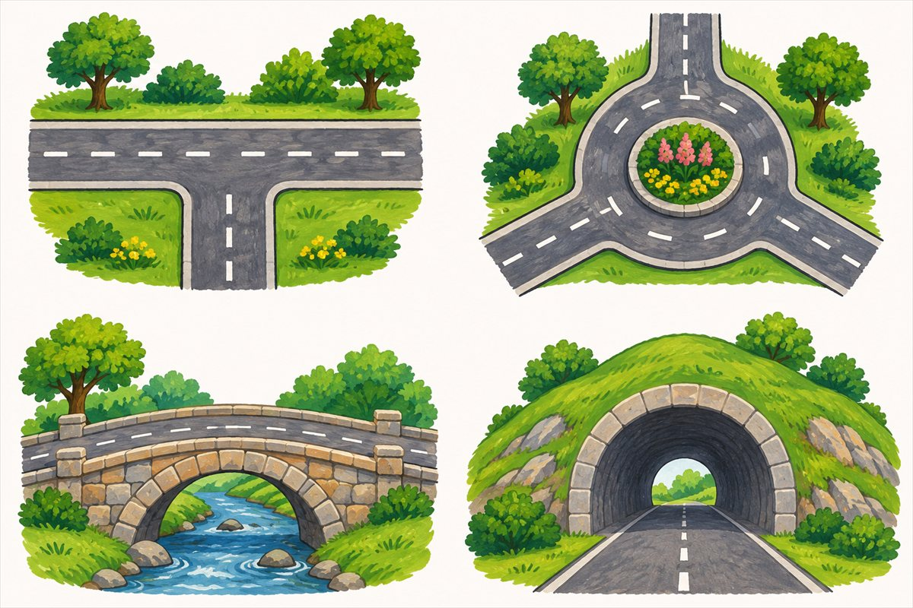
Ways through town
Junction A place where roads meet.
Roundabout A road junction where vehicles travel around a central area.
Bridge A structure that carries a route over a gap, water or another route.
Tunnel A passage through or under something, such as a hill.

Slide 27
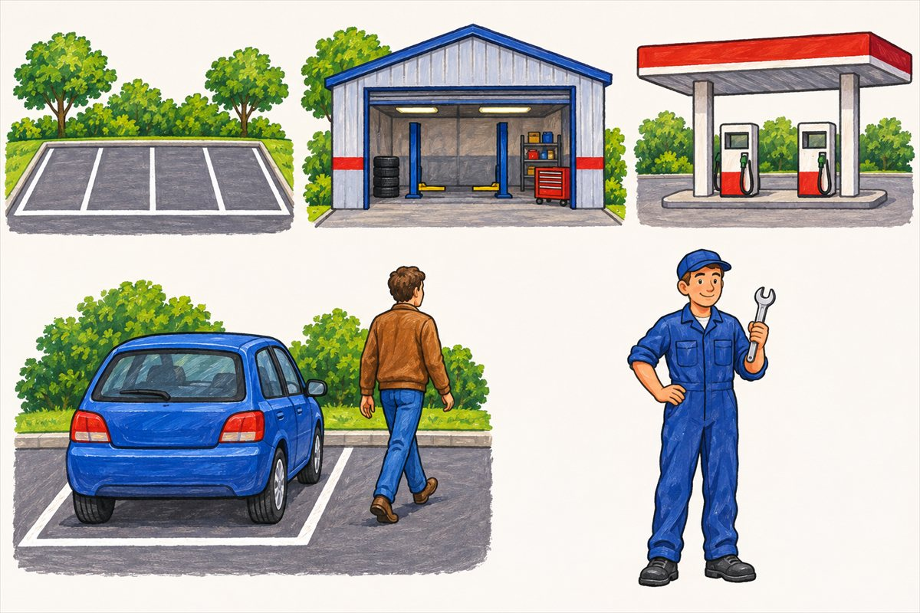
Parking, repair and refuelling
Car park An area where vehicles can be parked.
Repair garage A place where people repair vehicles.
Fuel station A place where vehicles can receive fuel.
Park Bring a vehicle to a stop in a place where it can stay.

Slide 28
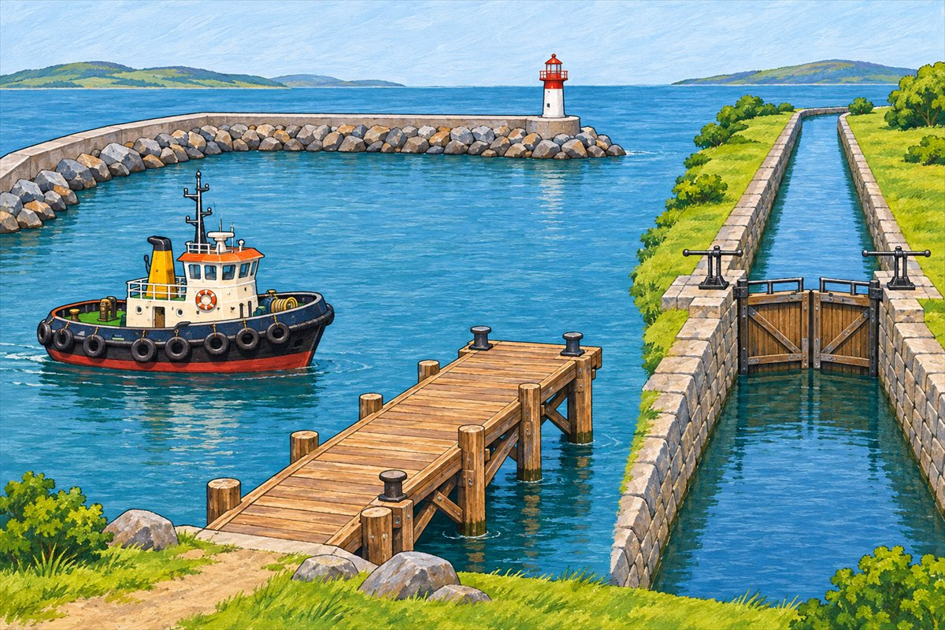
Harbour and canal
Harbour A sheltered area of water where boats and ships can stay.
Ferry dock A place beside the water where a ferry ties up so people can get on or off.
Canal A waterway made or changed by people for boats or water to pass along.
Tugboat A strong boat that helps move other boats or ships.

Slide 29
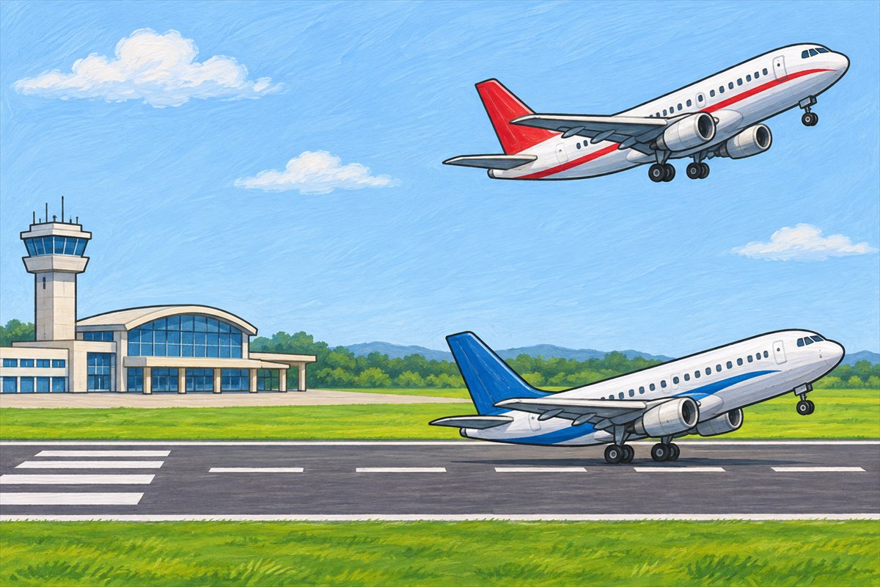
Airport and runway
Airport A place where aircraft take off and land and passengers begin or end flights.
Runway A long prepared strip where aircraft take off or land.
Take off To leave the ground and begin flying.
Land To return to the ground or another landing surface from flight.

Slide 30
Can you name them?

Slide 31
Did you get them?
airport
canal
ferry dock
harbour
pedestrian crossing
road

Slide 32

Well done!
You learned about journey places.

