Slide 1
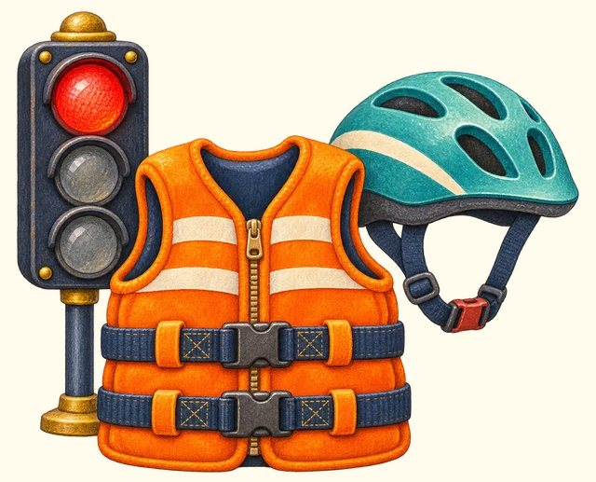
TRANSPORT TOWN
Safe journeys
Transport Town

Slide 2
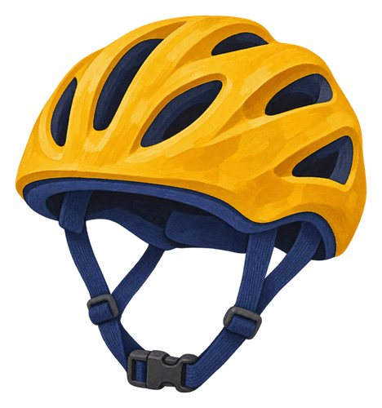
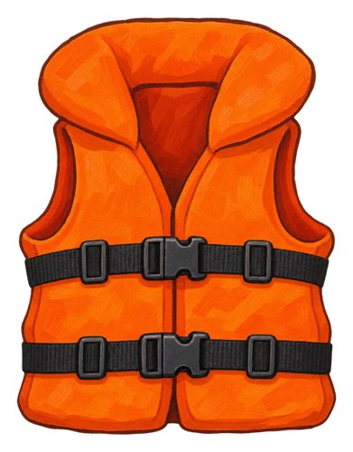
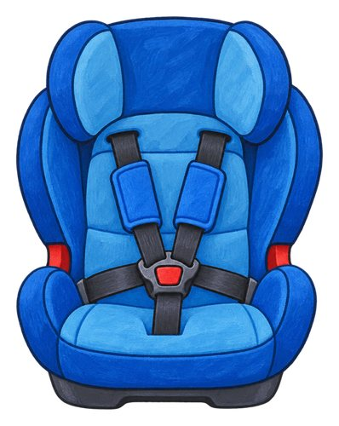
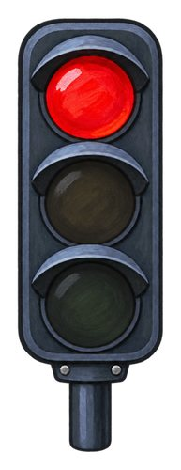
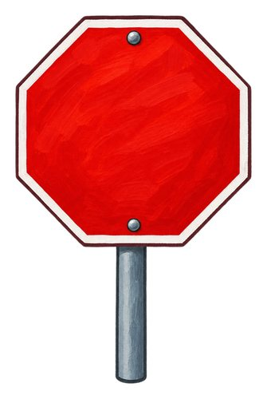
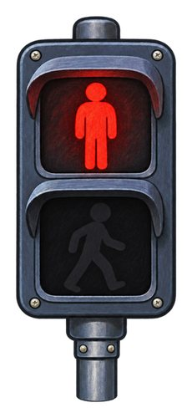
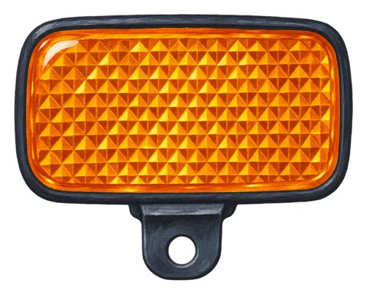
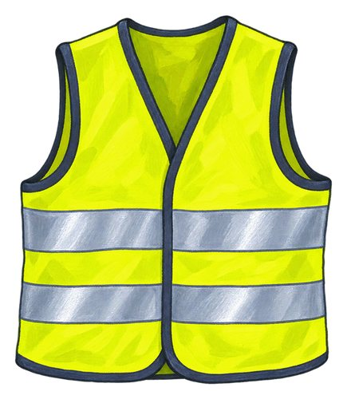
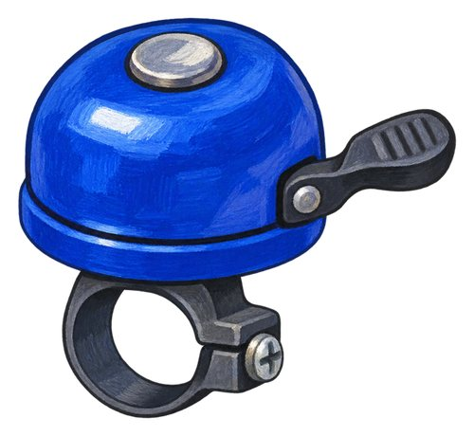
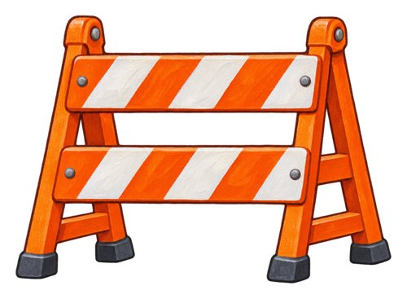
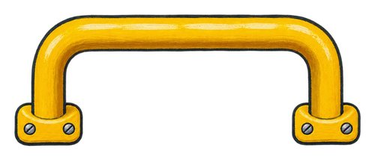
In this lesson
helmet
life jacket
child car seat
traffic light
stop sign
crossing signal
reflector
reflective vest
bicycle bell
barrier
handrail

Slide 3
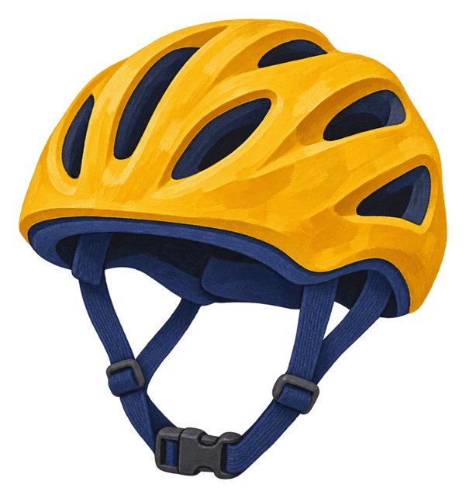
helmet
A strong covering worn to help protect the head.
An adult checks the rider's helmet fits.

Slide 4
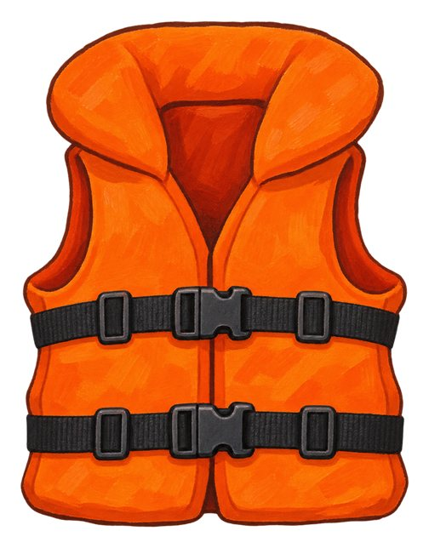
life jacket
A jacket designed to help keep a person afloat in water.
An adult checks the child's life jacket before the boat trip.

Slide 5

child car seat
A seat designed to protect a child travelling in a car. An adult checks the child's restraint.
A trusted adult checks the child's car seat.

Slide 6
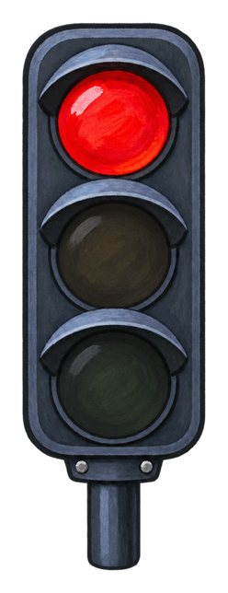
traffic light
A set of coloured lights that gives signals to road users.
The driver stops when the traffic light shows red.

Slide 7

stop sign
A road sign telling drivers to stop.
The driver stops at the stop sign.

Slide 8
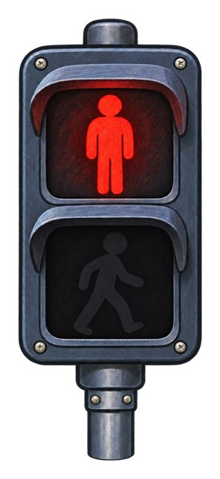
crossing signal
A signal for people crossing the road. This red figure means wait.
We check the crossing signal with an adult.

Slide 9

reflector
A piece that sends light back towards where it came from.
The bicycle reflector shines in the car's lights.

Slide 10
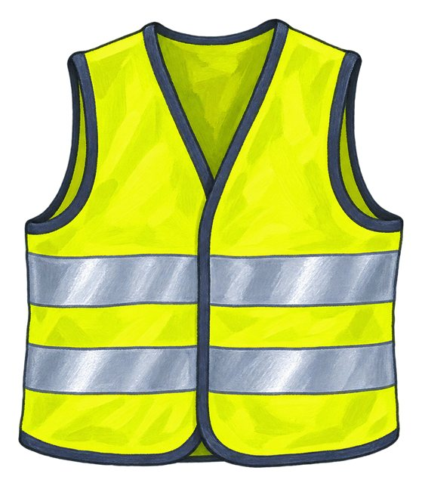
reflective vest
A vest with strips that reflect light and help people see the wearer.
The worker's reflective vest catches the light.

Slide 11
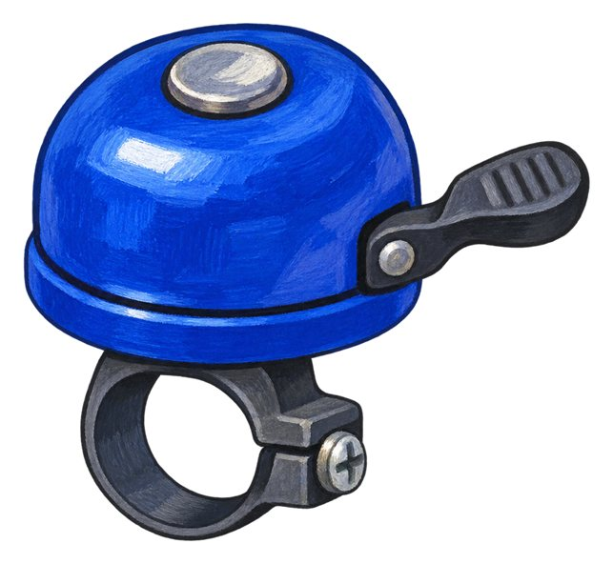
bicycle bell
A small bell used by a cyclist to make a warning sound.
The cyclist rings the bicycle bell.

Slide 12

barrier
An arm or fence that closes a route. This barrier closes the road at a railway crossing.
We wait behind the closed barrier.

Slide 13
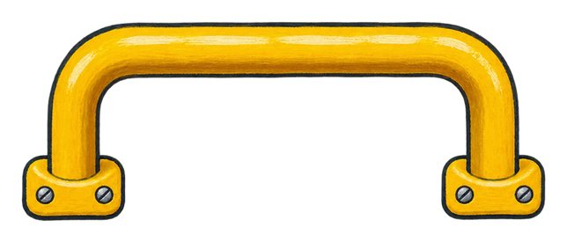
handrail
A rail that people can hold for support.
The passenger holds the handrail on the steps.

Slide 14
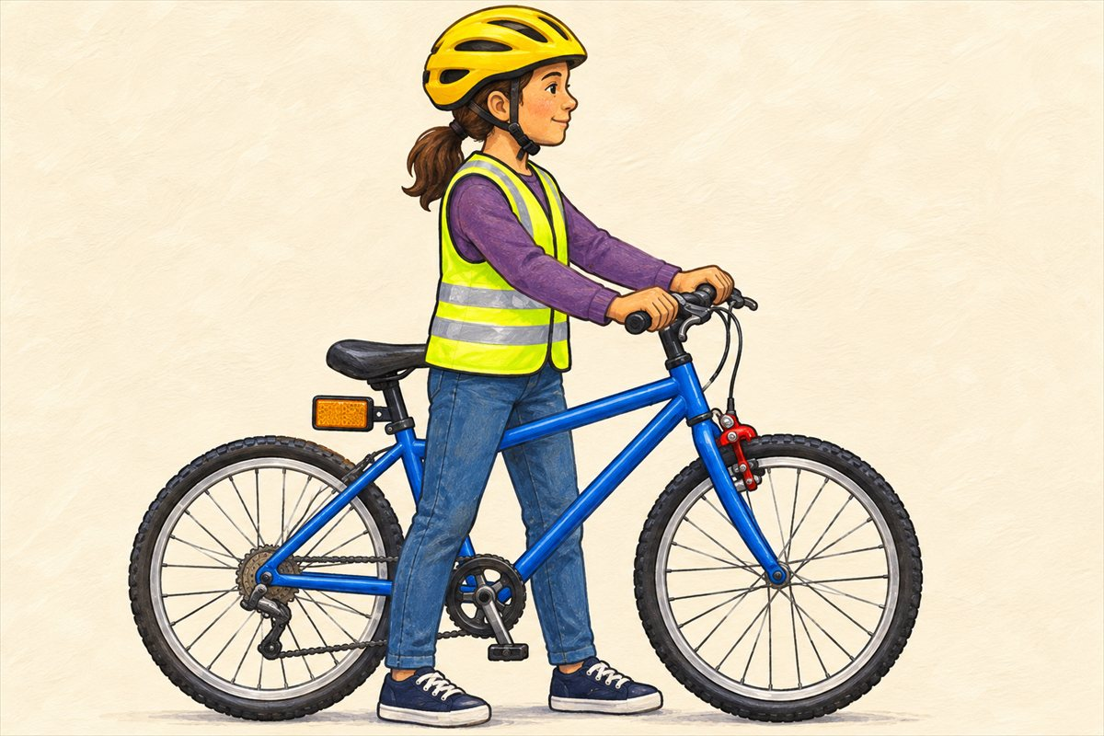
Cycling equipment
Cyclist A person riding a bicycle.
Brake A brake slows or stops a vehicle. On this bicycle the hand lever operates the brake at the wheel.
Helmet A strong covering worn to help protect the head.
Reflector A piece that sends light back towards where it came from.

Slide 15
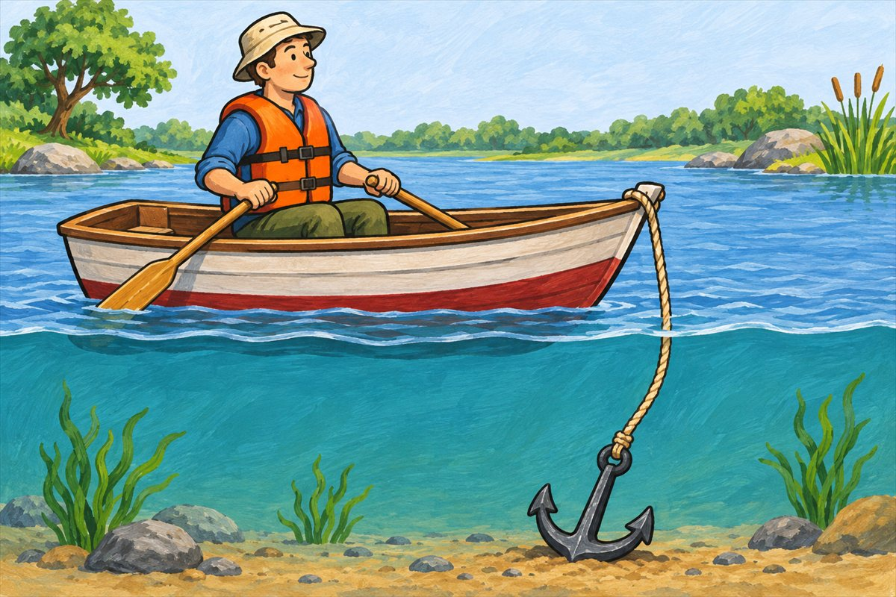
A safe trip on the water
Life jacket A jacket designed to help keep a person afloat in water.
Anchor A heavy object lowered from a boat to help hold it in place.
Float Stay at the surface of water. You can see this boat floating at the waterline.

Slide 16
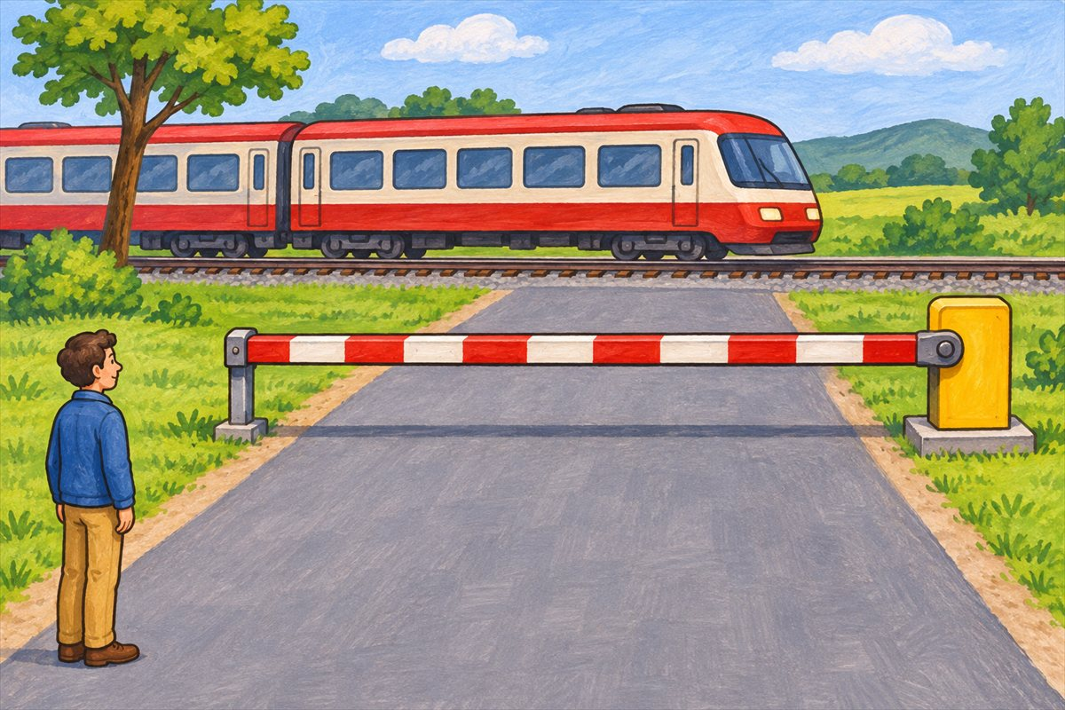
Waiting at the railway crossing
Barrier An arm or fence that closes a route. This barrier closes the road at a railway crossing.

Slide 17
Can you name them?

Slide 18
Did you get them?
barrier
bicycle bell
child car seat
crossing signal
handrail
helmet

Slide 19

Well done!
You learned about safe journeys.

