Slide 1
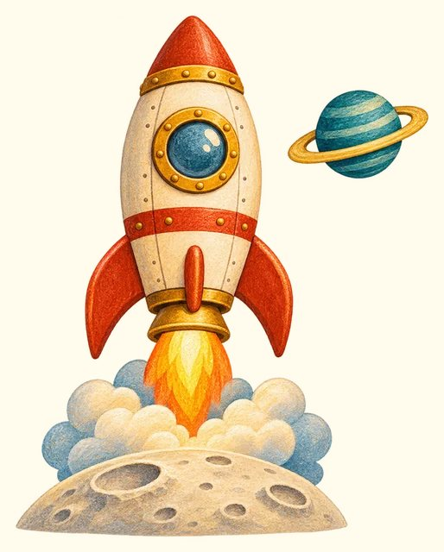
TRANSPORT TOWN
Space travel
Transport Town

Slide 2
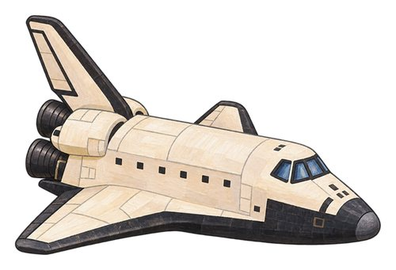
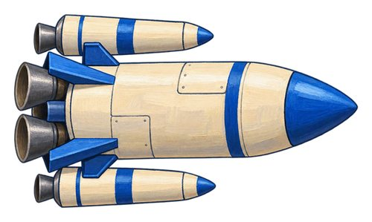
In this lesson
space shuttle
rocket

Slide 3

space shuttle
A reusable spacecraft whose winged orbiter returned to Earth and landed on a runway.
The space shuttle orbiter returned to a runway.

Slide 4

rocket
A vehicle whose engines push it upwards and can carry things into space.
The rocket lifts away from its launch pad.

Slide 5
Can you name them?

Slide 6
Did you get them?
rocket
space shuttle

Slide 7

Well done!
You learned about space travel.

