Slide 1
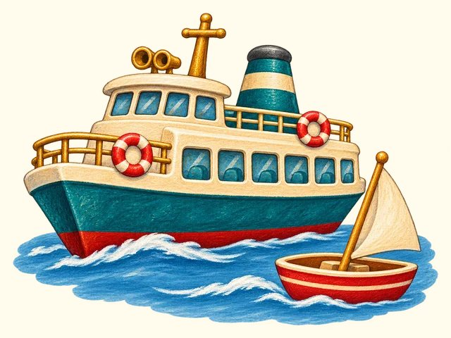
TRANSPORT TOWN
Water travel
Transport Town

Slide 2
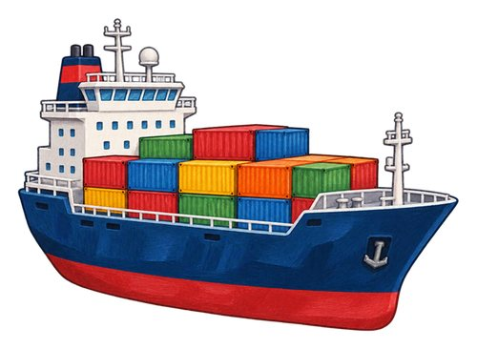
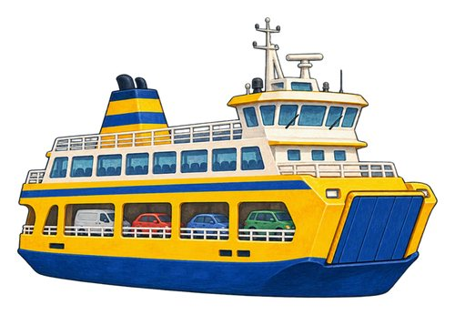
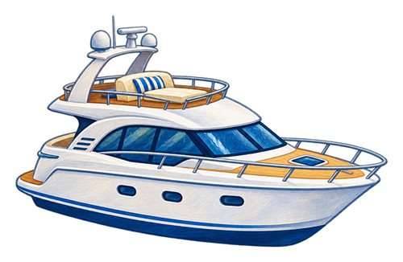
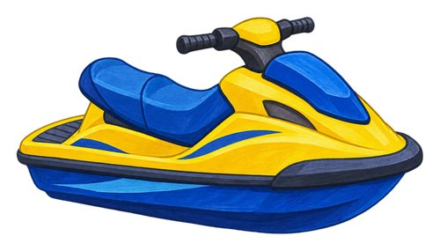
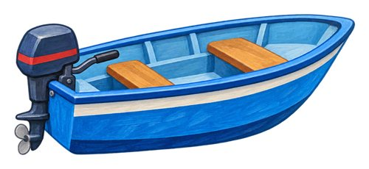
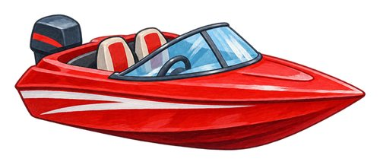
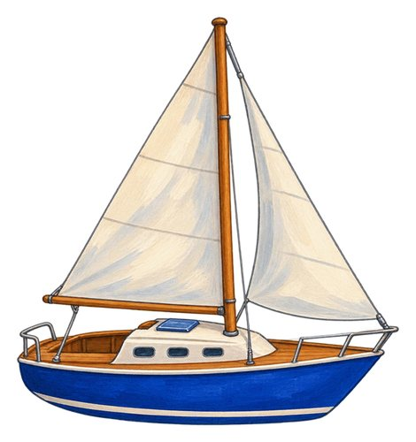
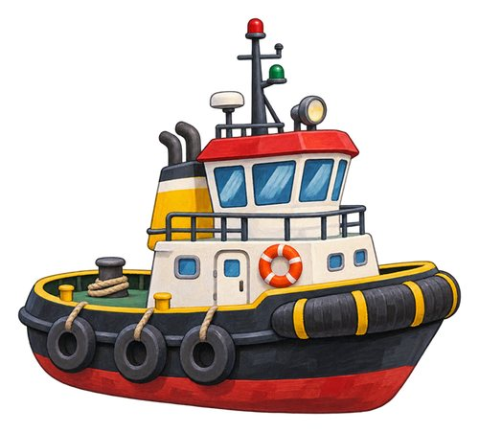
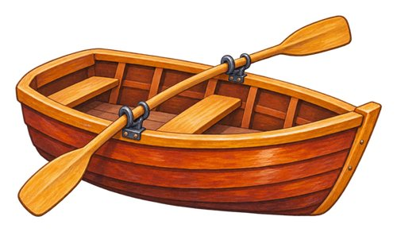
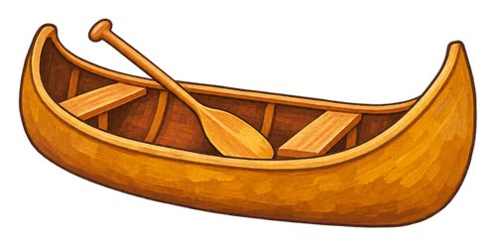
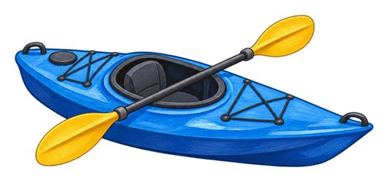
In this lesson
boat
ship
ferry
speedboat
yacht
jet ski
rowboat
sailboat
canoe
kayak
tugboat

Slide 3

boat
A water vehicle used to carry people or things.
We travel across the water in a boat.

Slide 4

ship
A large water vehicle that carries people or goods.
The ship carries a large load across the sea.

Slide 5

ferry
A boat or ship that carries passengers, and sometimes vehicles, between stopping places.
The ferry carries passengers between stopping places.

Slide 6
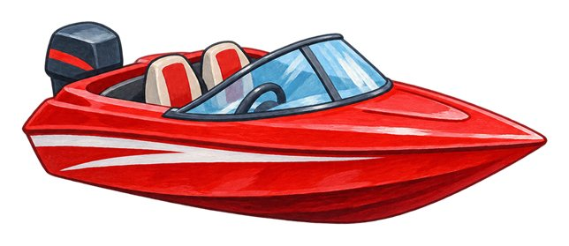
speedboat
A motorboat designed to travel quickly on water.
The speedboat moves quickly across the water.

Slide 7

yacht
A boat used for leisure, powered by sails or an engine.
The family takes a leisure trip on a yacht.

Slide 8

jet ski
A small powered watercraft that a rider sits or stands on.
A rider steers the jet ski with its handlebars.

Slide 9

rowboat
A small boat moved using oars.
A person uses oars to move the rowboat.

Slide 10

sailboat
A boat that can use wind in its sails to move.
Wind fills the sailboat's sail.

Slide 11
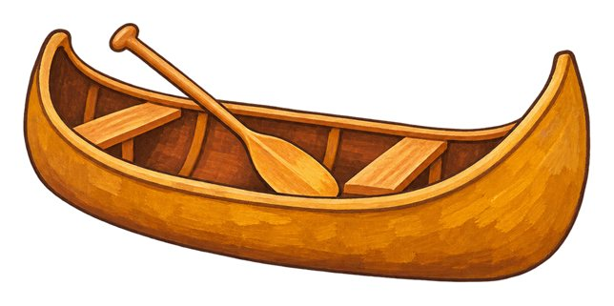
canoe
An open boat. This canoe is shown with a paddle that has one blade.
The paddler moves the canoe across calm water.

Slide 12

kayak
A narrow boat with a low seat. This kayak is shown with a paddle that has a blade at each end.
The kayaker uses a double-bladed paddle.

Slide 13

tugboat
A strong boat that helps move other boats or ships.
The tugboat helps a ship near the harbour.

Slide 14
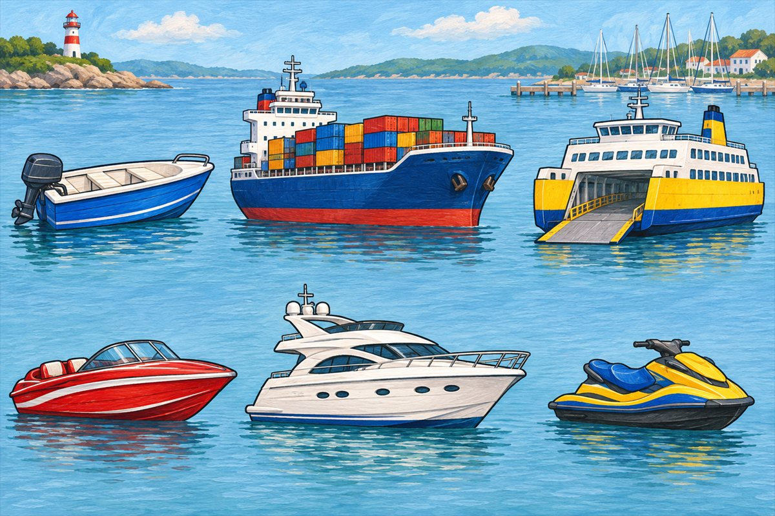
Watercraft comparison
Boat A water vehicle used to carry people or things.
Ship A large water vehicle that carries people or goods.
Ferry A boat or ship that carries passengers, and sometimes vehicles, between stopping places.
Speedboat A motorboat designed to travel quickly on water.

Slide 15
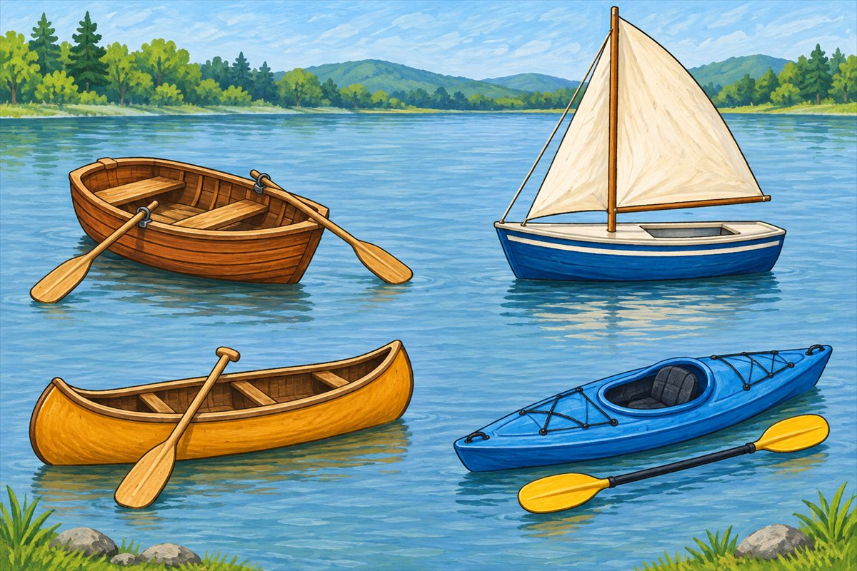
Boats and paddles
Rowboat A small boat moved using oars.
Sailboat A boat that can use wind in its sails to move.
Canoe An open boat. This canoe is shown with a paddle that has one blade.
Kayak A narrow boat with a low seat. This kayak is shown with a paddle that has a blade at each end.

Slide 16
Can you name them?

Slide 17
Did you get them?
boat
canoe
ferry
jet ski
kayak
rowboat

Slide 18

Well done!
You learned about water travel.

