Slide 1
DATA SCIENCE ASSIGNMENT

Slide 2
DATA PREPERATION
Clean the data
Adding the Dimension columns
Converting target price to GBP
Adjusting missing values
Converting data columns to appropriate format

Slide 3
DATA CLEANING
Converting the ID’s into numbers
Some numbers were in the format ‘1e3’ which python does not support natively, converting it to ‘1E3’ was necessary.

Slide 4
ADDING DIMENSIONS
Each ID followed the following format
 | DIM1 | DIM2 | DIM3
ID 1 | Value | Value | NaN
ID 2 | Value | NaN | Value
Each ID has a max of 3 values associated with it, spanning across 3 dimensions.
Some dimension values may also be missing.

Slide 5
ADDING DIMENSIONS
The ID column was removed from the train set and the dimensions were appended to the original data.
All missing values were replaced with averages of each dimension.
Some ID’s had no dimension values against them, the dimension columns for these ID’s then represented the dimension averages.

Slide 6
CONVERTING CURRENCY
All currency rates from various currencies to GBP were stored, they were as follows;
From | Rate
USD | 0.79723
EUR | 0.85142034
AUD | 0.6061227
CAD | 0.59837455
NZD | 0.558284
KRW | 0.0007161299
KWD | 2.61626
VUV | 0.0073631303
JPY | 0.007160577
GBP | 1
The currency and prices columns were extracted and removed from the original data, and using the currency columns the prices were normalised to GBP and stored as the target set, or label set.

Slide 7
ADDING MISSING VALS
All missing values in the set were replaced with the mean of each column if numeric, and with the largest occurring entry if categorical
Col | Value replaced with
X2 | E_Y
X3 | SI1
X4 | 61.7487168622
X5 | 57.4533462221
X6 | 0.799362700148
These values replaced the NaN values in the dataset

Slide 8
CONVERTING COLUMNS TO FORMAAT
Categorical columns were then converted to one hot encoded columns due to
sk-learn not supporting categorical and numerical features together.

Slide 9
TESTING MODELS
4 Different model were tested
Random Forest Regressor
KNN Regressor
MLP Regressor
Linear Regression
Each model was tested with 5 iterations, on train and validation set with different hyperparameters.

Slide 10
MAKING PREDICTIONS
MLP Regressor turned out to be the best model due to it giving the best score.
Sk-learn returns the coefficient of determination (R^2). A measure of how well observed outcomes are replicated by the model, as the proportion of total variation of outcomes explained by the model.
MLP Regressor had the best score.

Slide 11
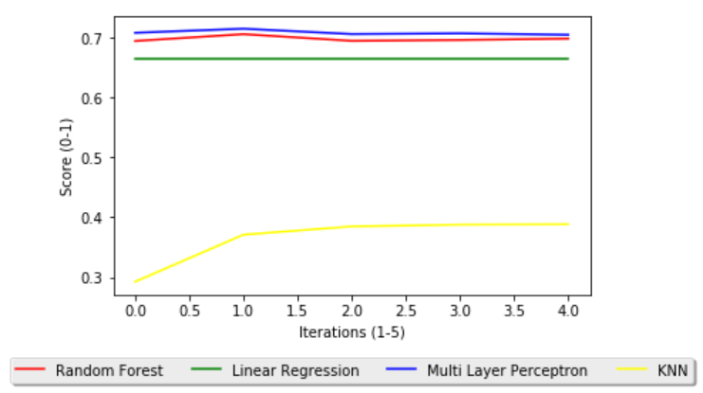
MODEL COMPARISONS

Slide 12
PREPARING TEST DATA
To make predictions the test data had to go through preparation as well
NaN values were replaced with the appropriate means from the train set
Dimensions were added to the test set
Price and currency columns were removed
Categorical columns were replaced with one hot encoded ones

Slide 13
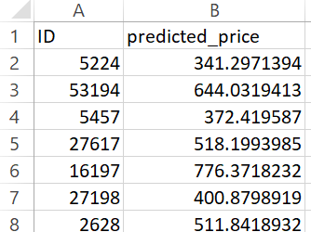
PREDICTION FILE
Results were stored in the appropriate format and were saved to ‘predictions.csv’

Slide 14
END OF PRESENTATION

