Slide 1
The Waterline Model
Based on work by
R. Harrison, J. Scherer and R. Short

Slide 2
Task Functions
TASK
GOALS
Developing the Agenda
Initiating
Information Seeking
Information Giving
Opinion Giving
Elaborating
Coordinating
Evaluating
Energizing
Structuring
Summarizing
Consensus Testing
Reality Testing

Slide 3
Reality of Group Dynamics
TASK
GOALS
~~~~~~~~~~~~~~~~~~~~~~~~~~~~~~~~~~~~~~~~
WATERLINE
~~~~~~~~~~~~~~~~~~~~~~~~~~~~~~~~~~~~~~~~
MAINTENANCE
GOALS

Slide 4
Maintenance Functions
TASK
GOALS
~~~~~~~~~~~~~~~~~~~~~~~~~~~~~~~~~~~~~~~~
WATERLINE
~~~~~~~~~~~~~~~~~~~~~~~~~~~~~~~~~~~~~~~~
MAINTENANCE
Gate keeping
Encouraging
Harmonizing
Consensus Seeking
Giving and Receiving Feedback
Standard Setting
Tension Relief
Expressing Group
Feelings / Perceptions
Processing

Slide 5
Dysfunctional Behavior
Blocking
Power Seeking / Power Struggles
Recognition Seeking
Destructive Competition
Dominating
Excessive Clowning
Silence, Prolonging Tasks, Others…

Slide 6
Maintenance Levels
TASK
GOALS
~~~~~~~~~~~~~~~~~~~~~~~~~~~~~~~~~~~~~~~~
WATERLINE
~~~~~~~~~~~~~~~~~~~~~~~~~~~~~~~~~~~~~~~~
MAINTENANCE
GOALS
STRUCTURE
(Goal & Roles)
GROUP
(Dynamics & Development)
INTERPERSONAL
(Between 2 People)
INTRA-PERSONAL
(within an individual)

Slide 7
Structural Issues
(Roles and Goals)
Confusion about the task or goal
Confusion about one’s role in the task
Disagreement about what’s more important
Unclear reporting structures
Unclear ownership of various parts of the project or responsibility for hand-offs
Some Diagnostic Questions For “Role” issues
Do all members share (and can they articulate) the primary goal?
Can members get answers to questions easily, or is a committee needed to make the decision on numerous routine questions?
Is it clear what decision-making style is being used, and when?

Slide 8
Decision Making Styles
PARTICIPATORY MANAGEMENT
LEADER DECIDES
FOLLOWERS DECIDE
Autocratic
Consultative
Group Decision
Delegation
Decide and Tell
Decide after consultation and/or recommendation
Followers share in decision
Delegation of decision with clear parameters
Style #1 - autocratic
Decide unilaterally and announce decision.
Ask for paraphrase to make sure you have been clear.
Style #2 - consult
Almost decided, check reactions before final decision.
Style #4 - majority
Majority vote with leader having one vote … no veto power.
Style #6 - delegation
Delegate the decision with clear parameters of freedom.
Ask for paraphrase to make sure clear.
Style #3 - recommend
Solicit inputs before deciding.
Style #5 - consensus
All agree after discussion.

Slide 9
Group Issues
(dynamics and development)
How is conflict being handled?
Is the “Integration” stage disproportionately troublesome relative to individual contributions?
Can members (or leaders) identify what the group ‘norms’ are?
  Are these norms consistent?
  Are the norms supportive or challenging to the accomplishment of the goals?
Are there ‘silent’ members who’s contribution is not clear or being maximized?
When a decision is made, is the group clear what it actually was?
Are “group” problems masking unclear “Roles”

Slide 10
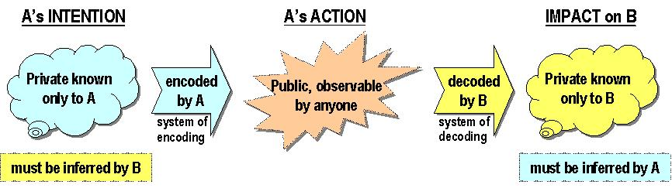
Interpersonal Issues
(between 2 people)
Do people avoid each other rather than face conflicts they have not been able to resolve?
Can feedback be presented effectively?
Is feedback received effectively?
Are members able to learn from each other?
Are there frequent misunderstandings?

Slide 11
Intra-Personal
(Within an individual)
Is there something going on that distracts the individual or team? (family, illness, RIFs)
Do members have the skill required to accomplish their tasks?
Is someone’s personal belief, values, or self-assessment of skill/role a barrier to flexibility within the team?
Is there a language barrier hampering effective communication?

Slide 12
Summary
TASK
GOALS
~~~~~~~~~~~~~~~~~~~~~~~~~~~~~~~~~~~~~~~~
WATERLINE
~~~~~~~~~~~~~~~~~~~~~~~~~~~~~~~~~~~~~~~~
MAINTENANCE
GOALS
STRUCTURE
(Goal & Roles)
Paying attention to the group’s maintenance issues is intended to serve two goals:
1) accomplishment of tasks and
2) enhancement of the work relationships of group members.
Goals-objectives
Functional roles
Decision making
GROUP
(Dynamics & Development)
Inclusion
Influence
Patterns of communication
Inter-dependence
INTERPERSONAL
(Between 2 People)
Communication skills
Feedback
Conflict
INTRA-PERSONAL
(within an individual)
Individual internal experience
Beliefs
Values
Assumptions

