Slide 1

Ecological Footprint
If current material and population growth trends continue and population stabilizes at 10 billion people in 2040, we will need between eight and twelve additional planets.

Slide 2
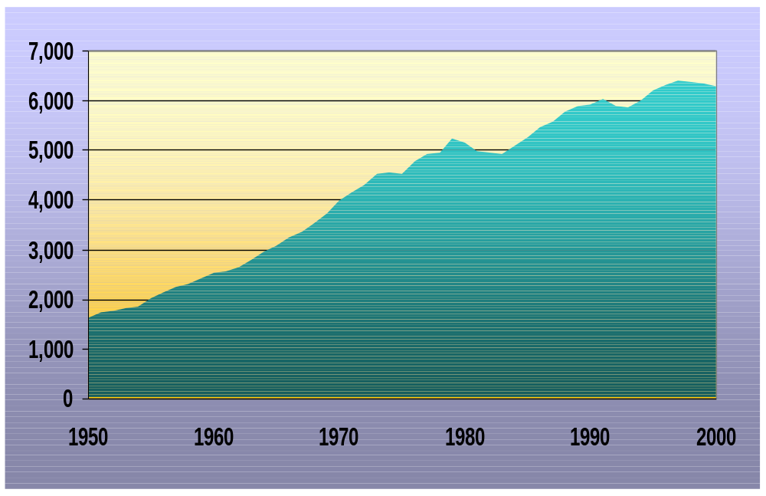
World Carbon Emissions, 1950-2000
From Fossil Fuel Burning
Million
Tons

Slide 3
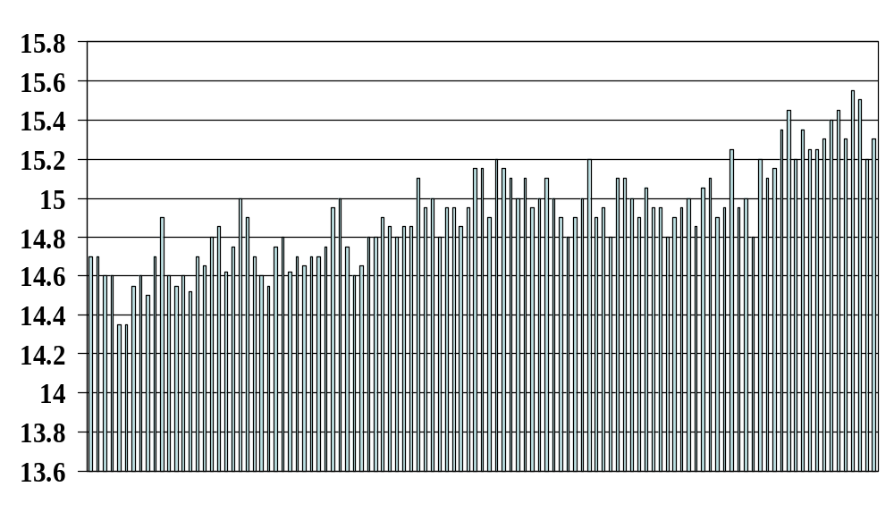
World Mean Temperature
Source: State of the World, World Watch Institute
Notes:
Effects on snow level and water supply rhythms in the Northwest

Slide 4
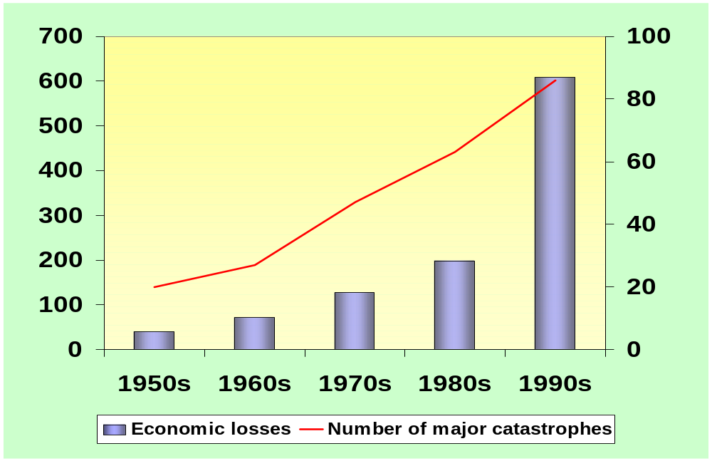
Notes:
Some insurance companies are now leading the way toward ecological consciousness because their actuarial formulas are telling them that they are underwriting the waywardness of the ways in which we are doing business and our lifestyles that are so in conflict with our planet.

Slide 5
Underbelly of our Industrial System
INDUSTRIAL SYSTEM
ENVIRONMENTAL
DEGRADATION
SOCIAL INEQUITY
& POVERTY
INDUSTRIAL SYSTEM
M
Global Warming
*M = Manufactured Capital
Poverty
Habitat Loss
Child Labor
Decimated Biodiversity
Malnutrition
Injustice
Cancer
Erosion
Deforestation
Unclean Water
Widespread Pollution
Human Rights Violations
Waste to Landfill
Toxic Chemical Exposure

Slide 6
The Concept of the Funnel
Decline of Living Systems
Margin for Action
Population x Affluence x Technology

Slide 7
Environmental Concerns
Mass extinctions
Deforestation & soil erosion
Air & water pollution
“Super” bacteria, viruses, and insects
Dwindling natural resources
Cancer rates increasing
Reproductive disorders increasing
Fisheries collapsing
Water tables falling
Climate Change

Slide 8
Extinctions
51% of freshwater animal species are declining in number.
One in four vertebrate species are in sharp decline or facing serious pressure from human activities.
One of every eight known plant species is threatened with extinction or is nearly extinct.
One in ten tree species—some 8,750 of the 80,000 to 100,000 tree species known to science—are threatened with extinction.
The overall rate of extinction is estimated to be 1,000 to 10,000 times higher than it would be naturally.

Slide 9
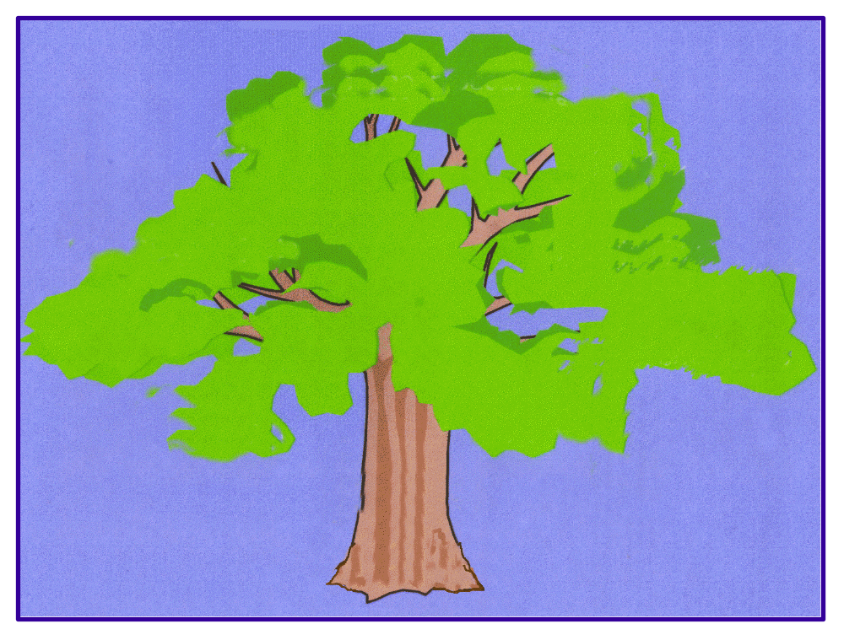
Acid Rain
Rain forest destruction
Fisheries collapse
Toxicity
Global warming
Water Pollution
Air pollution
Nuclear Plants
Forest loss
Jobs vs. environment debates
Hunger
Flooding
Monocultures
Ground water
contamination
Energy Sources
PRINCIPLES OF
SUSTAINABILITY

Slide 10
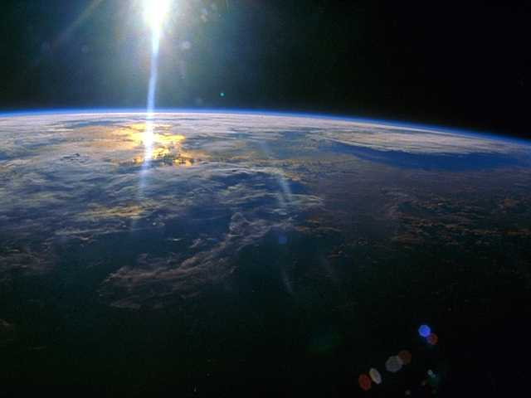
The Purpose of The Natural Step:
To develop and share a common framework comprised of easily understood, scientifically-based principles that can serve as a compass to guide society toward a sustainable future.
© 1996 Paul Hawken, Karl-Henrik Robèrt, and The Natural Step

Slide 11
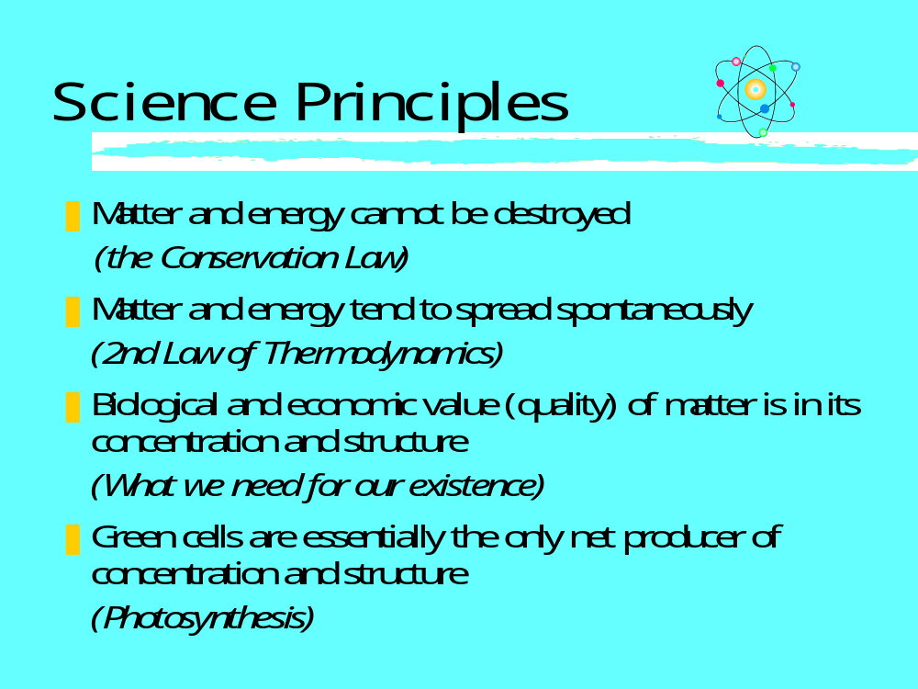

Slide 12
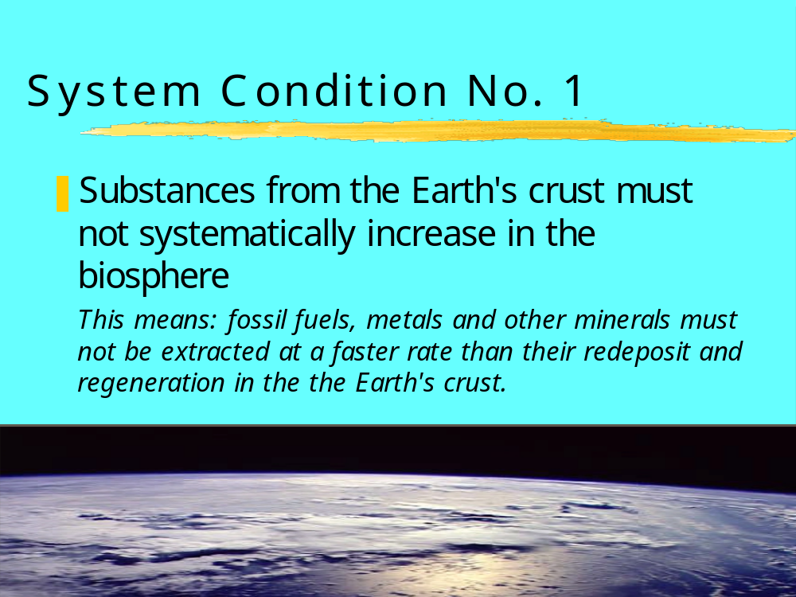

Slide 13
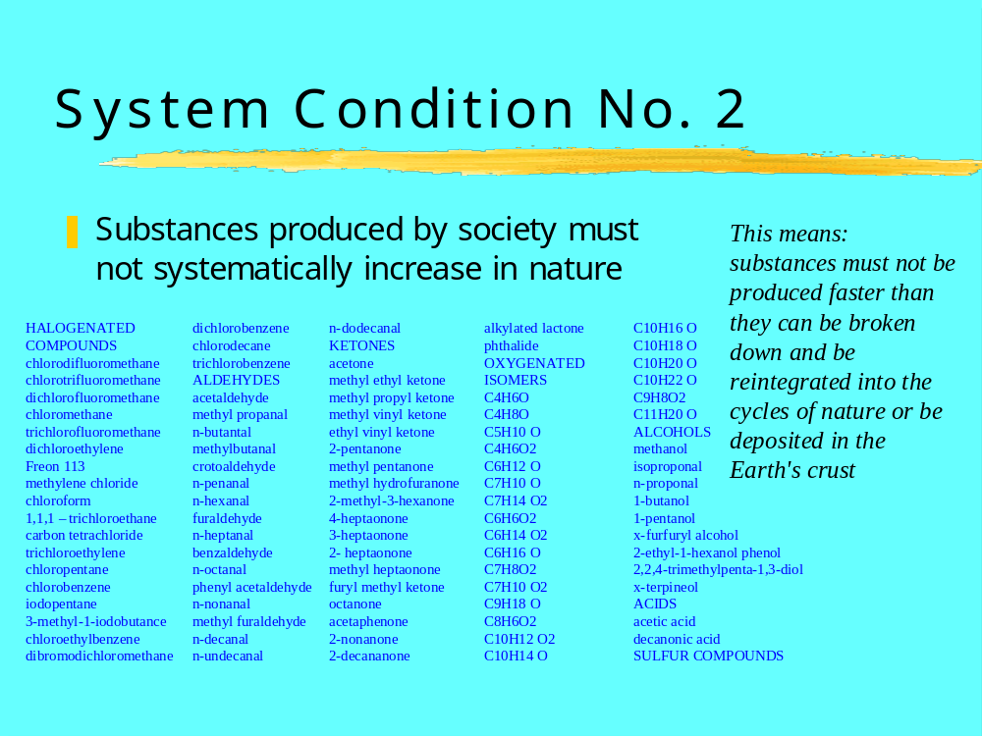

Slide 14
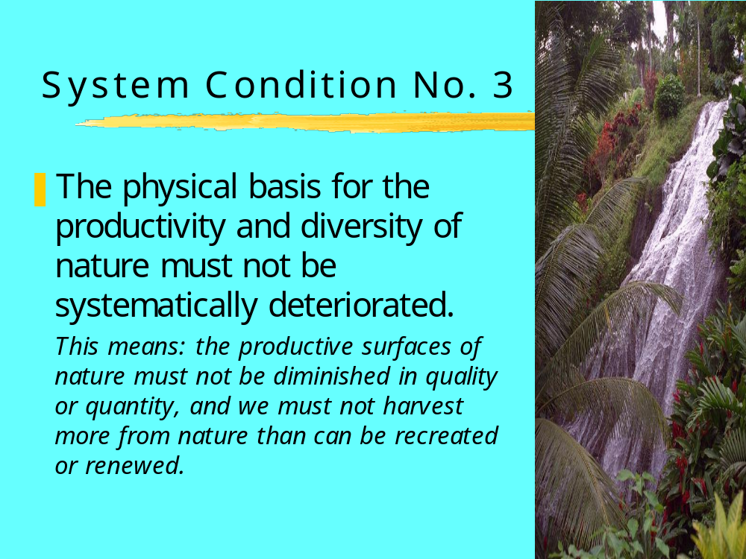

Slide 15
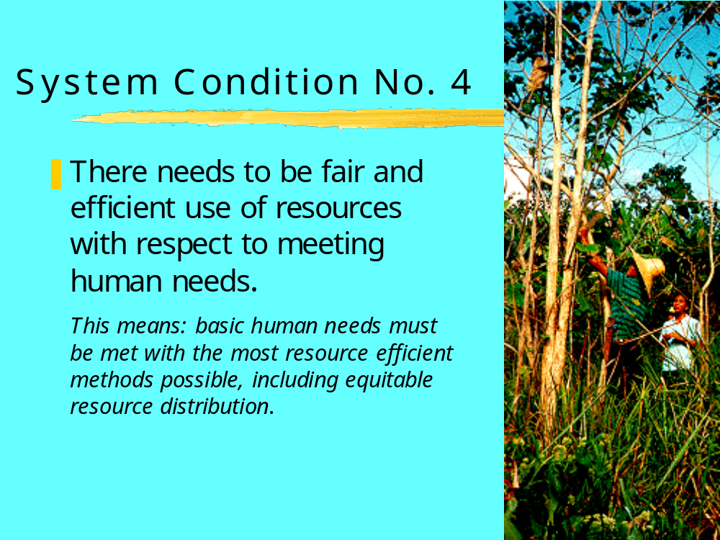

Slide 16
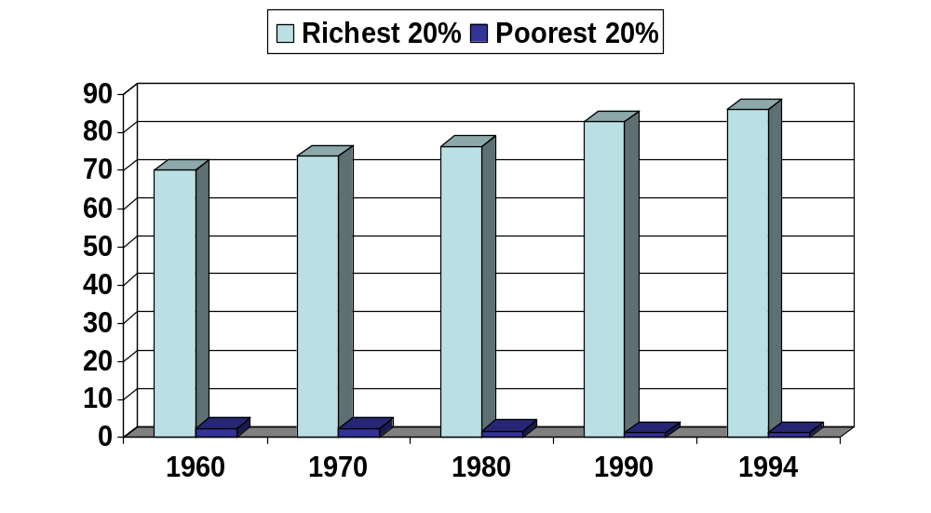
Income Disparities
86.0
70.2
Percentage
2.3
1.1

Slide 17




Four System Conditions
What we take from the Earth’s crust
What we make in the lab
What we take from land and sea
How efficient and equitable we are

Slide 18
Applying the System Conditions
Does this decision:
1. Decrease dependence on oil, gas, and metals?
2. Decrease dependence on compounds produced by society?
3. Increase the productivity and biodiversity in nature?
4. Increase the efficiency and equity with which resources are used?
Yes No
___ ___
___ ___
___ ___
___ ___

Slide 19
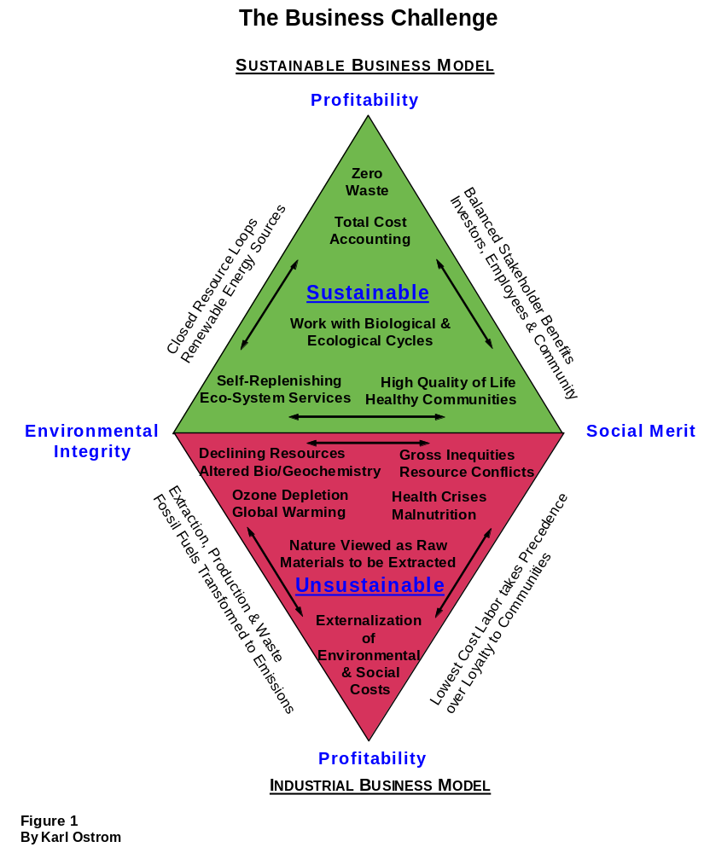

Slide 20
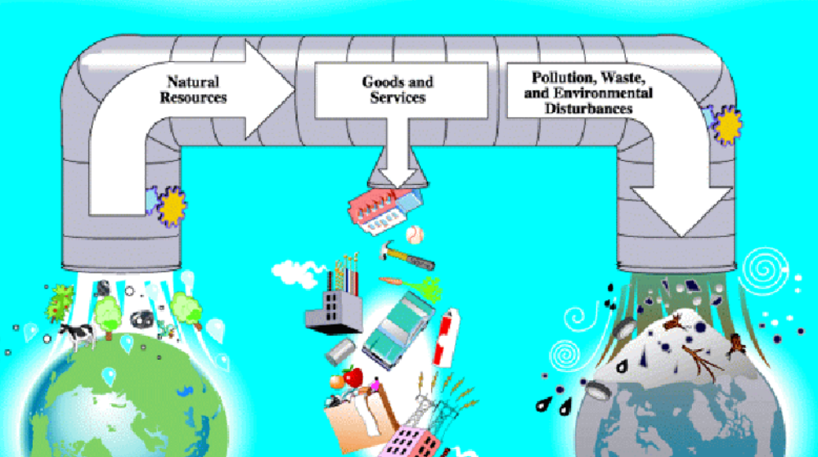
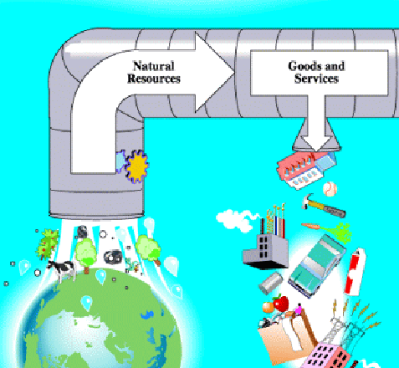
Tomorrow’s Material Cycle
Tomorrow’s profit will come from design, not matter
Natural
Resources
Goods and
Services
Reduce Use of
Natural Resources
Recover Technical Nutrients
Notes:
Main Message: Tomorrow’s profit will come from design, not matter, as companies gain advantage from shrinking and closing the material loop. We can decrease material use by reducing the materials required to build our products and recapturing value from our materials at the end of their first life to become “technical nutrients” in new products.
Background:
“True profit comes from design, not matter” - From "What I Learned in the Rainforest,"
by Tachi Kiuchi, Managing director, Mitsubishi Electric Corp.
Comments:
Source: Kiuchi, Tachi. "What I Learned in the Rainforest”. Speech for New Horizons for Learning. <http://www.newhorizons.org/wwart_kiuchi.html>
Author: Rachel Fineberg
Editor: Don Doering
Created:
Slide 3/7/01
Notes 3/7/01

Slide 21
Closing the Material Loop
Key Concept: Material recovery starts and ends with great product design
Goals:
Need Less material inputs throughout product life
Make use of recovered materials
Make it easy to recover materials
Decreasing Resource Use By Design
Design for Efficient Production
Design for Efficient and Effective Use
Design for Efficient Recovery
Take-back Logistics
Remanufacturing
Reuse
Recycling
Goals:
Find sustainable sources of technical nutrients
Recapture value from materials
Learn from experience to improve future design
Closing the Loop
Notes:
Main Message:
Effectively closing the material loop can be done by reducing material use during product design, including designing for easy disassembly after the product’s first customer use. Manufacturers can complete the material loop by designing an effective system for material collection and sorting, and developing processes for remanufacture, reuse, and recycling.
Background:
For example, elements of resource efficient design include:
Design for Resource Efficient Production
Reducing Toxics
Energy Efficiency in Production process
Minimizing Overall Material Use
Increased Use of Recycled Materials
Design for Resource Efficient Use
Energy Efficient Products
Water and other Input Efficient Products
Design for Resource Efficient Recovery
Products are designed to be easily disassembled
Author: Rachel Fineberg
Created:
Slide 3/7/01
Notes 3/7/01

Slide 22
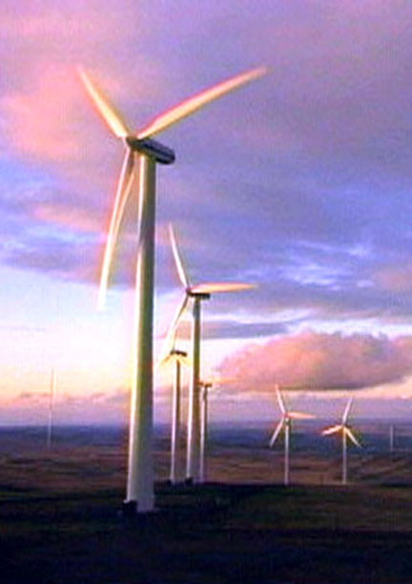

Slide 23
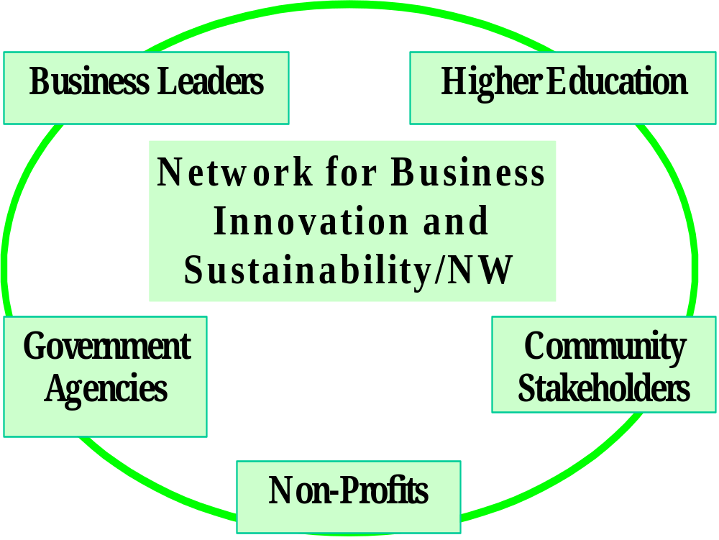

Slide 24
Building Community Collaboration to Support Sustainable Prosperity
  catalyzing and enabling increased business to business collaboration; i.e. best practices, IE
  linking sustainable business projects with the teaching and research capacities being developed in higher education institutions,
  developing informed relationships between businesses and non-profits that profitably reward sustainability in the marketplace,
  Collaboration between business and government that facilitate eco-efficiency, innovation and reward sustainable practices

Slide 25
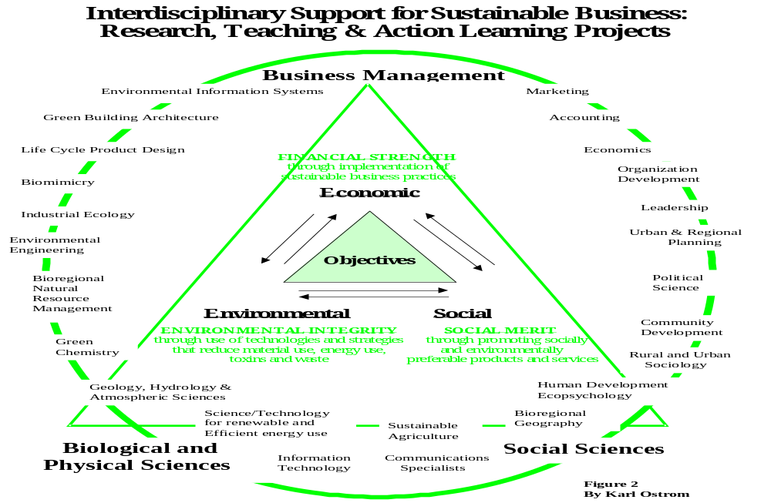

Slide 26
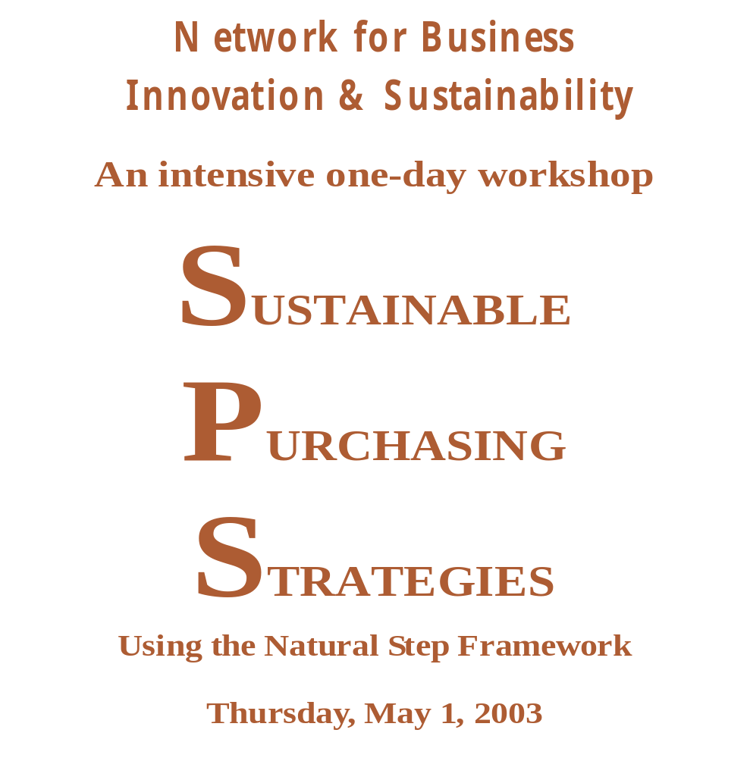

Slide 27
Sustainable Business Strategy
Four strategies to put you on the road to sustainability
Value from
Ecosystems
Material to
Information
Connect to
Value Chain
Connect to
Community
Lower operating costs
New business opportunities
Renewable materials
Renewable energy
Offsets
Biomimicry
Knowledge intensive
Value per volume output
Value per unit capital
Reduce footprint
Material per customer
Green products
Supply chain improvement
Products to Services
Remanufacturing
Stakeholder agenda
Local solutions
Creative partnerships
Trust
Notes:
Main Message:
Examining initiatives in companies that are creating environmental, financial and social value, shows four major arenas of activity for sustainable business strategies.
Editor: Don S. Doering
Source: The Next Bottom Line, WRI
Created: 10/26/01
Slide Mod: 01/05/01
Notes Mod: 05/07/01

