Slide 1

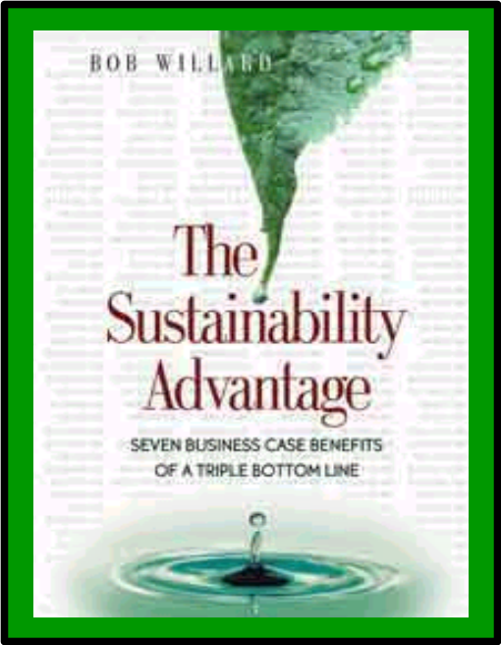
Sustainability-Related
Risks and Opportunities
for Business
Business Education For the Long Run
April 23, 2004
Bob Willard
www.sustainabilityadvantage.com
Notes:
1

Slide 2

Agenda
Terminology / Stages
Emerging Business Risks
Emerging Business Opportunities
The catch
7 benefit areas
What if’s
Notes:
1

Slide 3
Terminology
Sustainability
Sustainable Development (SD)
Corporate Social
Responsibility (CSR)
Corporate Responsibility (CR)
Triple Bottom Line (TBL)
3Es / 3Ps
Economy / Profits
Sustainable business
Profits
Taxes, R&D
Jobs
Expenditures
Training
Fair trade
Core values
Environment / Planet
Eco-Efficiency
Manufacturing efficiencies
Operations efficiencies
Product efficiencies
Smart design
Cradle-to-cradle, take-back
Beyond compliance
Restorative to nature
Equity / People
Ethical business
Internal employees
Human rights
Health & Safety
Empowerment
Respect, Caring
Local community
Rest of the world
Notes:
1

Slide 4
5 Sustainability Stages
5. Purpose / Passion
-------------------------------
4. Integrated Strategy
3. Beyond Compliance
2. Compliance
1. Pre-Compliance
Notes:
1

Slide 5
5 Sustainability Drivers
3 First Wave Drivers
  Founder / CEO’s personal passion … values based
  PR crisis … reputation / brand value / image hit
  Regulatory pressure ... actual or threatened
2 Emerging Drivers
  “Perfect Storm” of threats to license to operate
  Compelling, relevant business case
Notes:
1

Slide 6

“Perfect Storm” of Business Risks
10 Market Forces |  | 5 Business Risks
5 Mega-Issues | 5 Demanding Stakeholders
Climate Change | Green Consumers | Market Risks Balance Sheet Risks Operating Risks Capital Cost Risks Sustainability Risks + Difficult access to capital
Pollution & Health | Activist Shareholders
Globalization Backlash | Civil Society / NGOs
Energy Crunch | Government Regulators
Erosion of Trust | Financial Sectors
Notes:
1
Environics CSR Monitor, 2002; 26,013 citizens in 25 countries on 6 continents, Oct. –Dec. 2001
Social Activists (17%) + Demanding Consumers (12%) = 30%
Social Activists have high expectations of co’s to solve social problems and act ethically
Demanding Consumers have low expectations of co’s to solve social problems but demand it anyway
Another 26% are Latent Activists
All support public-private partnerships to solve social problems
“Rewarded” = buying products or speaking positively about the co
“Punished” = refusing to buy product or speaking critically about the co
5-10% more have punished than rewarded
Up 21-14-15% since 1999 in GB-Can-US since 1999 on punished
Higher punishment from internet users, higher educated, older people (than 15-24 segment)

Slide 7

10 Market Forces
10 Market Forces
5 Mega-Issues | 5 Demanding Stakeholders
Climate Change | Green Consumers
Pollution & Health | Activist Shareholders
Globalization Backlash | Civil Society / NGOs
Energy Crunch | Government Regulators
Erosion of Trust | Financial Sectors
Sea Change
Of
Rising
Expectations
Notes:
1
Environics CSR Monitor, 2002; 26,013 citizens in 25 countries on 6 continents, Oct. –Dec. 2001
Social Activists (17%) + Demanding Consumers (12%) = 30%
Social Activists have high expectations of co’s to solve social problems and act ethically
Demanding Consumers have low expectations of co’s to solve social problems but demand it anyway
Another 26% are Latent Activists
All support public-private partnerships to solve social problems
“Rewarded” = buying products or speaking positively about the co
“Punished” = refusing to buy product or speaking critically about the co
5-10% more have punished than rewarded
Up 21-14-15% since 1999 in GB-Can-US since 1999 on punished
Higher punishment from internet users, higher educated, older people (than 15-24 segment)

Slide 8

A Perfect Storm … of Opportunities
10 Market Forces
5 Mega-Issues | 5 Demanding Stakeholders
Climate Change | Green Consumers
Pollution & Health | Activist Shareholders
Globalization Backlash | Civil Society / NGOs
Energy Crunch | Government Regulators
Erosion of Trust | Financial Sectors
Innovation
Growth
Business
Value
Productivity
Brand
Image
Revenue
$aving$
Competitive
Advantage
Notes:
1
Use the wind, instead of fighting it.
Learn to sail early for competitive advantage
“If you can’t fix it, feature it!”
Read my book, “The Sustainability Advantage,” for details … ☺

Slide 9
Benefits to “SD Inc.”
Potential profit increase: 38%
+ Energized employees
+ Improved corporate image
+ Competitive advantage
+ Positioned for the future
Notes:
1

Slide 10
The Catch
1. Show senior leadership
  Include SD in vision / mission / strategies
  Avoid “green-washing” hype
  Visibly support SD: speeches, questions, actions
2. Educate the whole company
  Visibly sponsor and support the sessions
3. Establish an “SD Profit Center”
  Led by a top person
  Reinforces that it is business strategy vs. a compliance or philanthropy issue
Notes:
1

Slide 11
7 Benefit Areas
Reduced recruiting costs
Reduced attrition costs
Increased employee productivity
Reduced expenses in manufacturing
Reduced expenses at commercial sites
(energy, water, consumables)
Increased revenue / market share
Reduced risk, easier financing
Usual
focus
Notes:
1

Slide 12
7 Benefit Areas … % Improvement
Reduced recruiting costs -1%
Reduced attrition costs -2%
Increased employee productivity +10.5%
Reduced expenses in manufacturing -5% (-2.5%)
Reduced expenses at commercial sites -20%
(energy, water, consumables)
Increased revenue / market share +5%
Reduced risk, easier financing -5%
… yielding a Profit increase of +38%
Notes:
1

Slide 13
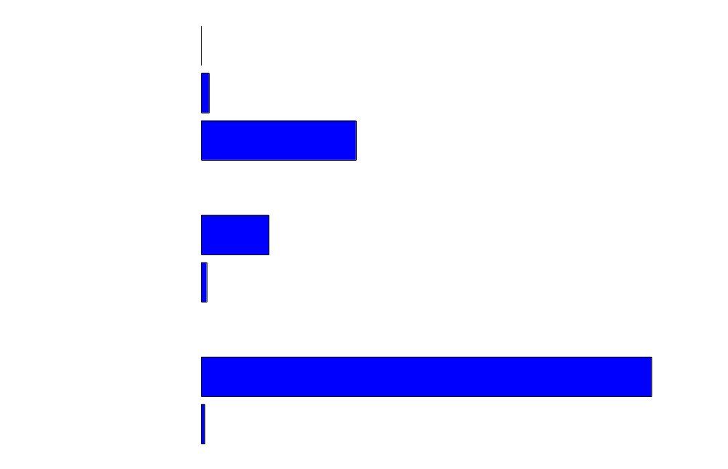
7 Benefit Areas … Relative Sizes
Notes:
1

Slide 14
7 Benefit Areas … % Improvement
Reduced recruiting costs -1%
Reduced attrition costs -2%
Increased employee productivity +10.5%
Reduced expenses in manufacturing -5% (-2.5%)
Reduced expenses at commercial sites -20%
(energy, water, consumables)
Increased revenue / market share +5%
Reduced risk, easier financing -5%
… yielding a Profit increase of +38%
Notes:
1

Slide 15
What if …
Reduced recruiting costs -1%
Reduced attrition costs -2%
Increased employee productivity +10.5%
Reduced expenses in manufacturing -5% (-2.5%)
Reduced expenses at commercial sites -20%
(energy, water, consumables)
Increased revenue / market share +5%
Reduced risk, easier financing -5%
+2%
… yielding a Profit increase of +38%
+35%
Notes:
1

Slide 16
What if …
Reduced recruiting costs -1%
Reduced attrition costs -2%
Increased employee productivity +10.5%
Reduced expenses in manufacturing -5% (-2.5%)
Reduced expenses at commercial sites -20%
(energy, water, consumables)
Increased revenue / market share +5%
Reduced risk, easier financing -5%
+4%
… yielding a Profit increase of +38%
+23%
Notes:
1

Slide 17
What if …
Reduced recruiting costs -1%
Reduced attrition costs -2%
Increased employee productivity +10.5%
Reduced expenses in manufacturing -5% (-2.5%)
Reduced expenses at commercial sites -20%
(energy, water, consumables)
Increased revenue / market share +5%
Reduced risk, easier financing -5%
+4%
+2%
… yielding a Profit increase of +38%
+20%
Notes:
1

Slide 18
Sustainability-Related
Risks and Opportunities
for Business
Business Education For the Long Run
April 23, 2004
Bob Willard
www.sustainabilityadvantage.com
Notes:
1

Slide 19
5 Inhibiters to Next Wave
1. Lack of support from senior leaders
  Too busy … doing enough … too shy … not our problem … too hard to change … credibility issue
2. Fear of backlash
  Green-washing accusations … open the floodgates … guilt-by-association … skeletons in our closet
3. Lack of pressure from important people
  Boards … investors … customers
4. Weak business case
  WIIFM … short-term … perverse subsidies … payback period
5. Mindset
  Negative baggage … insulting … MBA legitimacy
Notes:
1

Slide 20
5 Signs of Hope
Awakening financial markets
Sustainability reporting advances
B-school attention
Beyond Grey Pinstripes … Net Impact
Shareholder activism
More compelling business case
+ sustainability indicators in GDP
Notes:
1

Slide 21
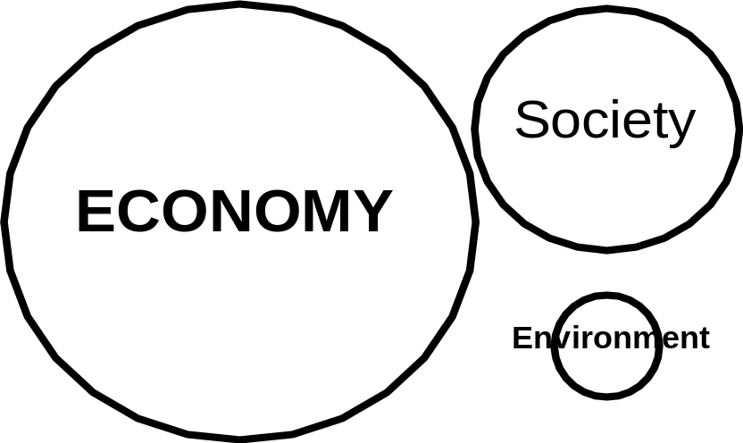
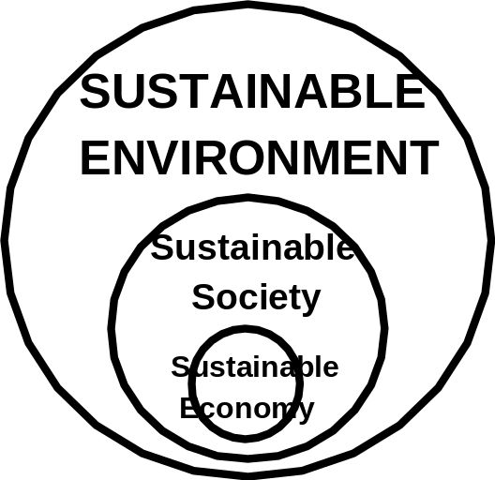
Mental Models
Typical business view
Sustainable view
Notes:
1

