Slide 1
The Technology Value Stream
Name: Ivan Pryymak
Date: 8/18/24

Slide 2
Agenda
Introduction
Defining Lead Time vs. Processing Time
The Importance of Reducing Lead Time
The Common Scenario: Deployment Lead Time Requiring Months
DevOps Ideal: Deployment Lead Times of Minutes
DevOps Strategies
Conclusions

Slide 3
Introduction
Value stream can be defined as “the sequence of activities necessary to deliver a product, service or experience to a customer, internal or external.”
Value streams include every touchpoint on the journey from idea generation to delivery of value to customers. [1]

Slide 4
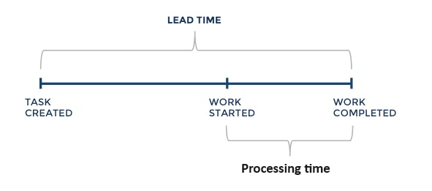
Lead Time vs. Processing Time
Lead Time and Processing Time are two very common performance metrics in value streams.
Lead time is the time it takes for a software development company to fulfill customer’s request. This time spans from the moment request was made, including the queue time, to the moment it is fulfilled.
Processing time is the time the team spent actually working on the request.

Slide 5
Why reduce Lead Time?
Lead time is what the customer experiences. The customers don’t see the internal breakdown of queue time, pre-processing time, and processing time. They only see the time it takes to fulfill the request.
Faster lead times lead to quicker deliver of value, improving customer satisfaction.
Short lead times allow companies to be more responsive to market changes.

Slide 6
Deployment Lead Time of Months
Many organizations have complicated practices that result in deployment lead times requiring months. This is common in large and complex companies that work with tightly coupled systems with scarce integration test environments, high reliance on manual processes, and multiple links of approval chain.
This leads to slow feedback loops, delayed value delivery, and increased costs.

Slide 7
DevOps Ideal: Deployment Lead Times of Minutes
DevOps practices aim to reduce deployment lead times to minutes by automating processes, improving collaboration, and implementing continuous integration and continuous deliver pipelines.
As a result, we get faster times to market, improved quality of the product, and increased ability to quickly respond to market changes.

Slide 8
Key Strategies to Achieve DevOps Ideal
Automation: reduce lead times by automating as many processes as possible.
CI/CD (Continuous Integration/Continuous Delivery): creating pipelines to automate building, testing, and deployment processes.
Collaboration: enhancing cooperation between development, operations, and other stakeholders.
Feedback Loops: shortening feedback cycles to address issues faster.

Slide 9
Conclusions
The technology value stream is a critical aspect of delivering software efficiently. By understanding and optimizing lead time vs. processing time, and adopting DevOps practices, organizations can drastically reduce deployment times and improve overall efficiency.

Slide 10
Reference List
[1] https://www.atlassian.com/agile/value-stream-management#:~:text=Gartner%20defines%20a%20value%20stream,aren't%20labeled%20as%20such.
The DevOps Handbook by Gene Kim, Jez Humble, Patrick Debois, John Willis, Nicole Forsgren; second edition.

Slide 11
Thank you.

