Slide 1
Multi-Modal Deep Learning for
Orthodontic Malocclusion Classification
Comparing Three Experimental Approaches
Phase 1 Experiments

Slide 2
Problem Statement
Objective: Three-class malocclusion classification (Class I, II, III)
Challenge: How to effectively leverage multi-modal medical imaging?
Image Modalities:
• OPG (Panoramic X-rays)
• Intraoral photographs
• Cephalometric X-rays
Dataset: 422 unique patients with patient-aware splitting (70/15/15)

Slide 3
Experimental Approaches
Experiment | Approach | Architecture
E1 | OPG-only Baseline | MedGemma-4B (frozen) + classifier
E2 | Naïve Late Fusion | 3 CNNs (one per modality) + ensemble
E3 | Multi-Image Prompting | MedGemma-4B with multi-image tokens

Slide 4
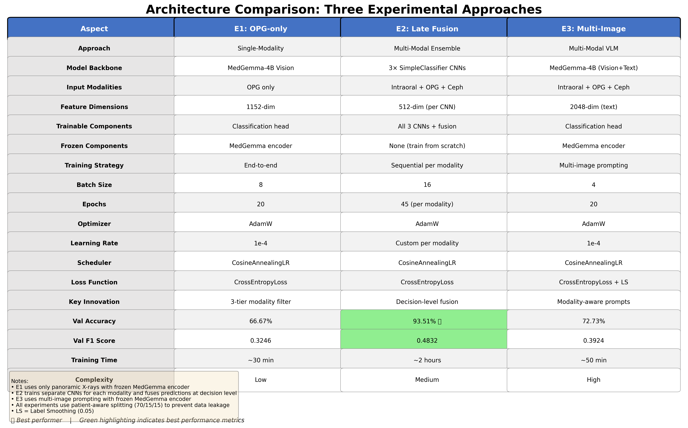
Detailed Architecture Comparison
Comprehensive comparison of all architectural aspects and performance metrics

Slide 5
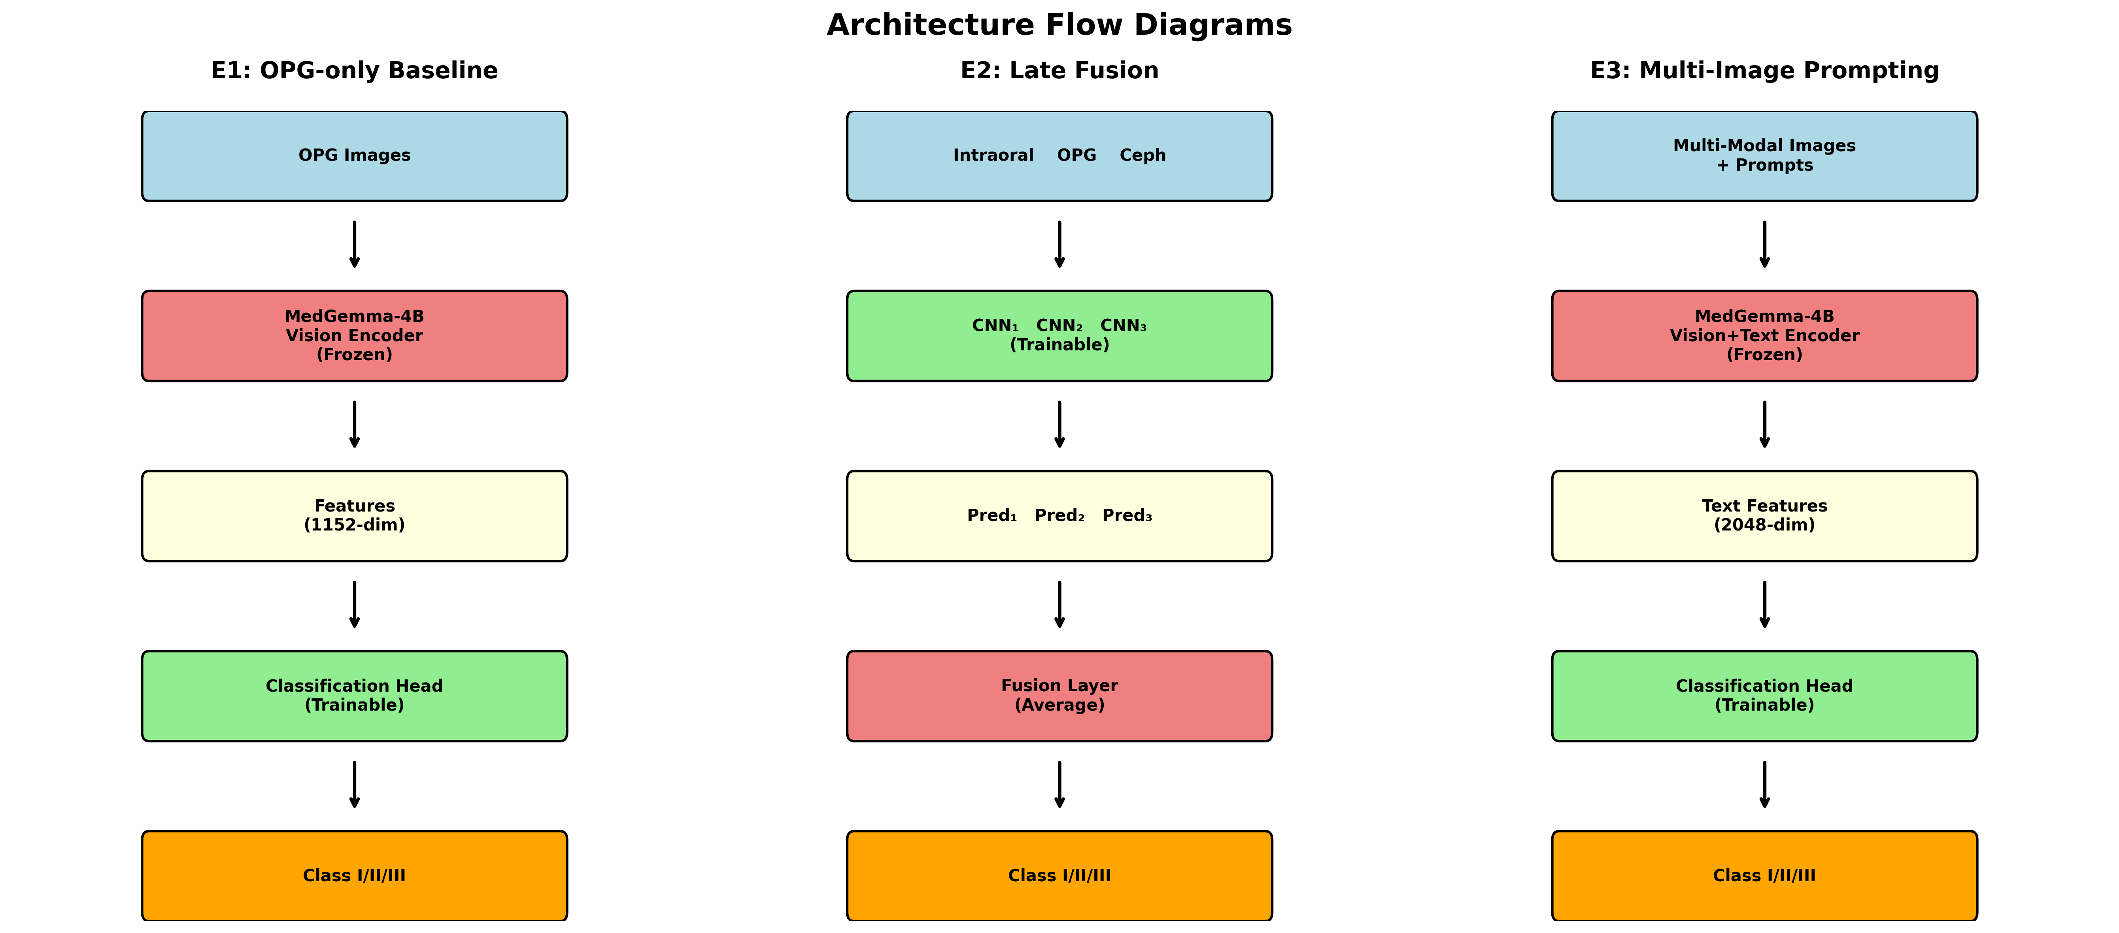
Architecture Flow Diagrams
Visual representation of data flow through each experimental architecture

Slide 6
Experiment 1: OPG-only Baseline
Strategy: Establish single-modality baseline using panoramic X-rays
Architecture:
• Frozen MedGemma-4B vision encoder (1152-dim features)
• Trainable classification head
• Robust 3-tier modality filtering
Training:
• 20 epochs, batch size 8
• AdamW optimizer, Cosine LR scheduler
• Only OPG images used
Best Performance: 66.67% validation accuracy (epoch 1)

Slide 7
Experiment 2: Naïve Late Fusion
Strategy: Train separate classifiers per modality, fuse at decision level
Architecture:
• Intraoral CNN: SimpleClassifier (512-dim) → intraoral images
• OPG CNN: SimpleClassifier (512-dim) → panoramic X-rays
• Ceph CNN: SimpleClassifier (512-dim) → cephalometric X-rays
• Fusion: Average predictions from all three classifiers
Training: Sequential training, 45 epochs each modality
Best Performance: 93.51% validation accuracy ⭐

Slide 8
Experiment 3: Multi-Image Prompting
Strategy: Feed multiple images with specialized prompts to MedGemma
Architecture:
• Frozen MedGemma-4B encoder + classification head
• Multi-image input with <start_of_image> tokens
• Modality-aware prompt engineering
Prompt Example:
"<start_of_image> <start_of_image> <start_of_image>
You are analyzing multiple orthodontic images...
Image 1 is a panoramic X-ray (OPG).
Image 2 is an intraoral photograph..."
Best Performance: 72.73% validation accuracy

Slide 9
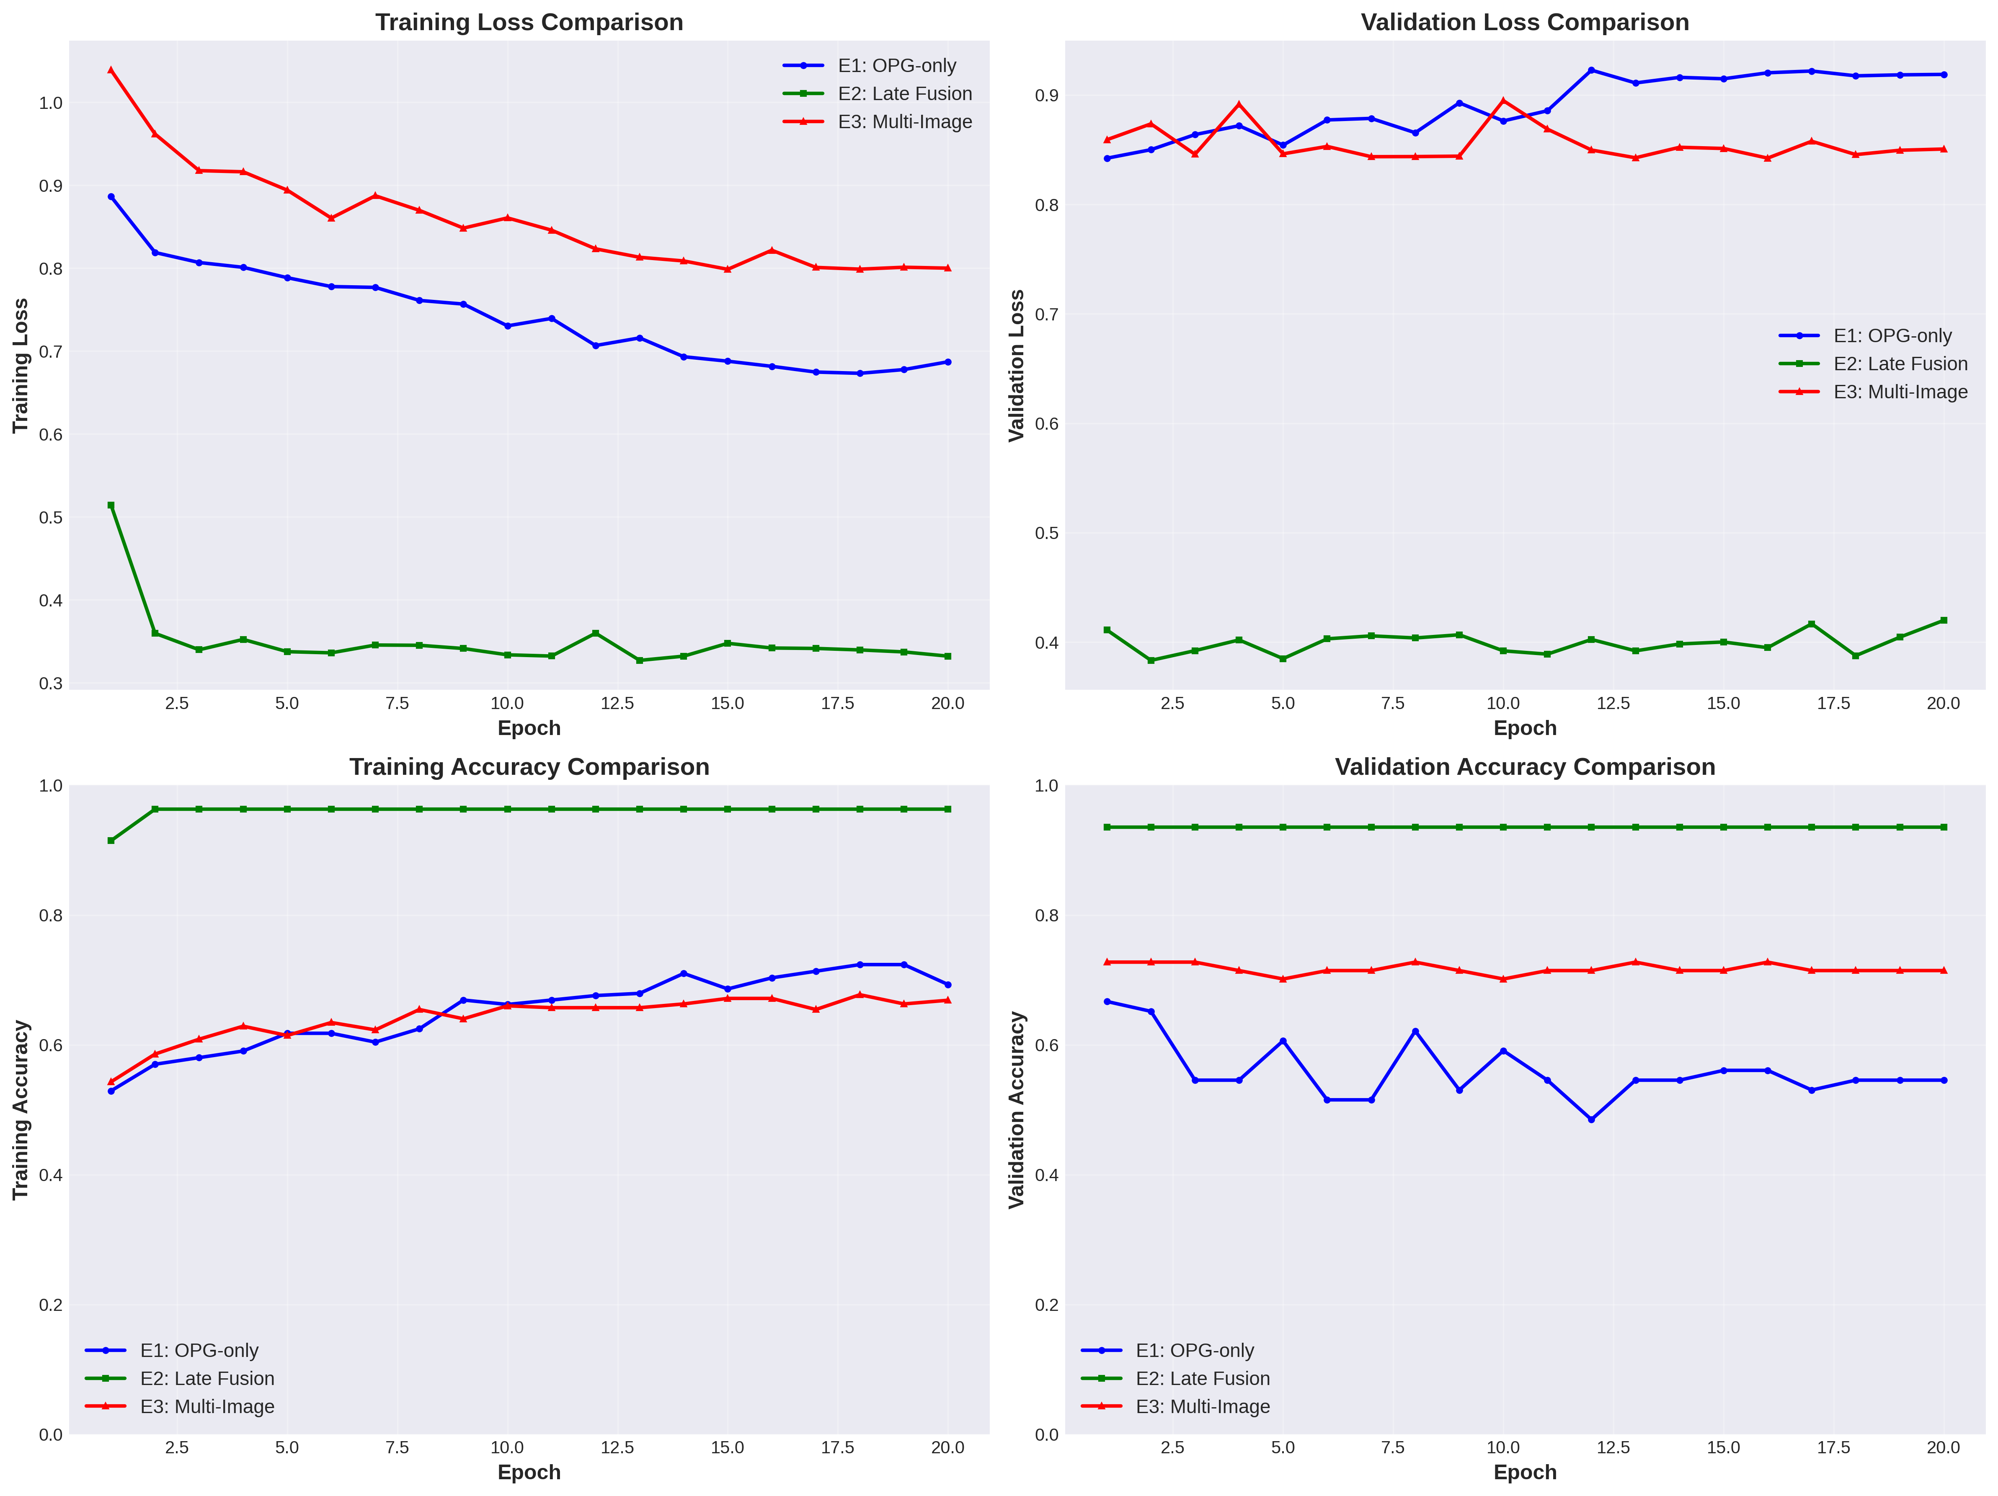
Results Comparison
Comparison of training and validation metrics across all experiments

Slide 10
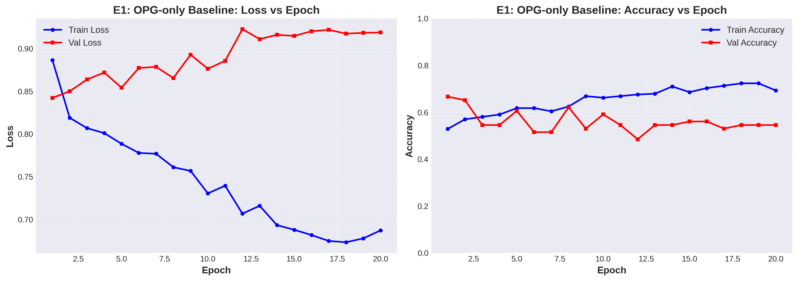
E1: OPG-only Baseline - Training Dynamics
Shows overfitting - validation loss increases while training continues

Slide 11
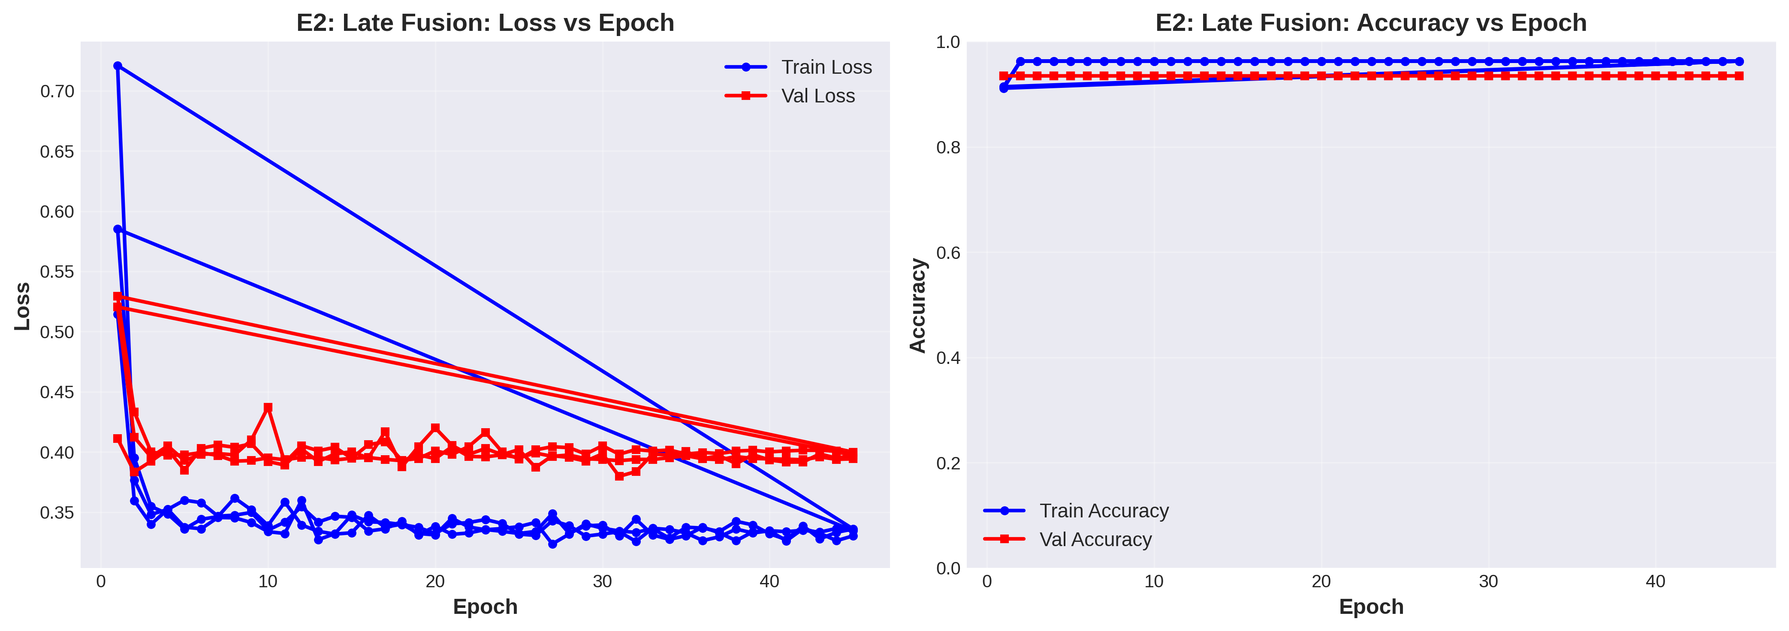
E2: Late Fusion - Training Dynamics (Best Performer)
Extremely stable - maintains ~93.5% validation accuracy throughout

Slide 12
Key Findings & Conclusions
Performance Ranking:
1. E2 (Late Fusion): 93.51% ⭐ - Clear winner
2. E3 (Multi-Image): 72.73% - Moderate improvement over baseline
3. E1 (OPG-only): 66.67% - Baseline
Insights:
✓ Multi-modal fusion significantly outperforms single modality
✓ Simple late fusion beats sophisticated multi-image prompting
⚠ E3 shows promise but may need more training or tuning
⚠ E1 exhibits overfitting with frozen MedGemma encoder
Recommendation: Deploy E2 (Late Fusion) for production use

