Slide 1
DATA SCIENCE PROJECT
FitTech App Analytics
LIVE APP TELEMETRY
100K
600
Assessing fitness app usage, workout behaviour, calorie burn patterns, and engagement to support practical, data-driven personalization.
Workouts
Users
Problem Statement: FitTech has strong workout activity, but needs to understand what drives engagement, notification response, and purchases so the business can personalize user experiences and improve retention.
Name: Prasanna Batch: DA68 Mentor: Priya Shanmugam

Slide 2
PROJECT FOUNDATION
Scope & Dataset Overview
A comprehensive telemetry dataset capturing granular user behavior across three core pillars: daily workout logs, wearable monitoring data, and in-app engagement sessions.
Merged on unique User_ID keys to build one unified view of the customer journey — from signup to workout completion to premium conversion.
600
100K
75%
13.8%
Total Users
Total Workouts
Completion Rate
Purchase Rate
Verified unique profiles
Logged activity entries
Healthy baseline utility
Primary growth target
Data Integrity Note: the source User_Profile file included an Engagement_Level column that was identical ("Medium") for all 600 users — zero real signal. A behavior-based Engagement KPI (session frequency, completion, notifications, purchases) was derived instead and used to rebuild that column, rather than trusting a placeholder label at face value.
FitTech App Analytics | 2 / 17

Slide 3
ROADMAP
Project Objectives
1
2
3
4
To Understand the User
To Evaluate Engagement
To Predict Behavior
To Drive Strategy
Analyze demographics, subscriptions, and goals to map the core audience.
Evaluate feature adoption, session depth, and notification effectiveness.
Build classification and regression models to forecast high-value users.
Translate EDA, SQL, and ML outputs into actionable personalization rules.
WHY: Dictates marketing spend.
WHY: Identifies UI bottlenecks.
WHY: Enables proactive retention.
WHY: Drives ultimate ROI.
FitTech App Analytics | 3 / 17

Slide 4
OBJECTIVE 2
Engagement Funnel Drop-off
The Funnel Reality
Baseline app utility is strong, proven by the 75% workout completion rate — users log in and successfully finish their routines.
The UX falters at proactive engagement instead: only 36.5% of users respond to push notifications, throttling the flow toward premium purchases (13.8%).
Strategic Mandate: the 13.8% purchase rate is the key business opportunity. This is treated as an "improve engagement/marketing" problem, not a "fix the app" problem — machine learning is used later to predict high-engagement users and guide personalized interventions.
FitTech App Analytics | 4 / 17

Slide 5
OBJECTIVE 1
User Profile Analysis
Users by Region
Behavior Consistency Across Age Groups
26-35 is the largest single segment
18-25
22.3%
26-35
40.7%
36-45
24.5%
46+
12.5%
Insight: Mumbai leads on volume (108 users, 18%), but Chennai converts the highest share to Premium (51.3%) — Bangalore close behind (46.5%). Volume and conversion quality are two different things.
Insight: completion (~75%) and avg. session duration (~17.8 min) stay near-identical across every age group — age doesn't meaningfully change behavior here, a finding in itself.
FitTech App Analytics | 5 / 17

Slide 6
OBJECTIVE 1
Workout & Activity Patterns
Avg. Calories Burned by Workout Type
Workout Time of Day
Insight: Cardio yields the highest burn at 9.0 cal/min — more than double Yoga's 4.0 cal/min — thanks to sustained elevated heart rate.
Insight: Morning is the undisputed peak window (45.1%) across all workout types — the best timing for reminders and infrastructure reliability.
FitTech App Analytics | 6 / 17

Slide 7
OBJECTIVE 2
App Engagement Analytics
Share of Sessions by Feature Used
Device Split
Insight: Workout Tracker (39.8%) is the core app utility, with Progress next (25.1%). Together they're 65% of all engagement — any friction here risks the 75% completion rate.
Insight: Mobile, Web, and Smartwatch usage are nearly equal (~33% each) — the experience must stay consistent across all three.
FitTech App Analytics | 7 / 17

Slide 8
STATISTICAL VALIDATION
Statistical Hypothesis Testing
ANOVA
CHI-SQUARE
WELCH T-TEST
Workout type changes calorie burn.
More clicks do not prove more completions.
Clicks do not mean longer sessions.
H₀: average calories burned is equal across workout types.
H₀: notification clicks and workout completion are independent.
H₀: avg. session duration is equal for clicked vs. not-clicked users.
F = 15,699.11
χ² = 0.91
T = 1.22 (17.84 vs 17.82 min), n = 73,024 vs 126,976
p < 0.05
p = 0.34
p = 0.22
Reject H₀ — calorie burn varies significantly by workout type.
Fail to reject H₀ — no significant relationship found.
Fail to reject H₀ — no significant duration lift found.
FitTech App Analytics | 8 / 17

Slide 9
DATA ENGINEERING
SQL Database Automations
Robust SQL structures move the backend from static files into an automated, self-refreshing analytics pipeline for the business team.
01 / VIEW
02 / TRIGGER
Subscription Performance
Real-Time Activity Sync
Pre-calculates KPIs across Free, Trial, and Premium tiers using a virtual table (vw_subscription_performance).
AFTER INSERT trigger on activity continuously updates the activity_summary table using NEW row values.
Benefit: Analysts query insights instantly without writing complex JOINs.
Benefit: Workout metrics on dashboards stay accurate without manual batch scripts.
03 / STORED PROCEDURE
04 / EVENT SCHEDULER
Insight Reporting Generator
Daily Engagement Refresh
sp_subscription_performance_report() encapsulates the full conversion-metrics query.
Truncates and rebuilds engagement_summary every 24 hours via a scheduled EVENT.
Benefit: Non-technical managers retrieve formatted insights with one CALL command.
Benefit: Reporting tables stay synchronized with the latest engagement data automatically.
Architecture Note: a relational SQL setup was chosen for stateful, accurate aggregations for business reporting, over a document-store alternative for unstructured wearable data.
FitTech App Analytics | 9 / 17

Slide 10
OBJECTIVE 3
Predictive Modeling (ML) Approach
Using Data to Predict the Future
Data Pipeline & Preparation
Baseline machine learning is applied to achieve two very specific, measurable business goals:
Target: “High Engagement” = Total Session Time ≥ median (5,943 min) • Dataset: 600 users, balanced classes
1
Classification (Targeting)
1. Split 80% Train / 20% Test
Identify users highly likely to stay engaged, so retention and reward budgets can be focused accurately.
2
Regression (Valuation)
2. Scale StandardScaler applied to normalize numerical variance.
Estimate a user's total session time quantitatively to forecast lifetime value (LTV).
3. Encode OneHotEncoder for Gender, Region, Subscription, Goal, Workout Type.
FitTech App Analytics | 10 / 17

Slide 11
OBJECTIVE 3
ML Classification Models Evaluated
Prediction target: User_Engagement_Level — the real business-assigned Low/Medium/High tier (200 users each), validated against behavior.
BUSINESS RECOMMENDED
WEAKEST
HIGHEST ACCURACY
Logistic Regression
KNN Classifier
Decision Tree
Accuracy: 67.5% | vs. 33% random-guess baseline
Accuracy: 43.3% | weakest of the three
Accuracy: 68.3% | highest raw accuracy
Correctly identifies 27/40 Low, 24/40 Medium, and 30/40 High users — and never confuses Low with High directly.
Finds 23/40 Low and 22/40 High, but only 7/40 Medium — and sometimes confuses Low directly with High.
Finds 30/40 Low, 21/40 Medium, and 31/40 High — highest raw accuracy, never confuses Low with High.
Virtually tied with Decision Tree on accuracy, but coefficients are directly explainable — the business can defend exactly which behaviors drive each tier.
No coefficients to explain — classifies by comparing users to similar users, with no “why” behind a prediction.
Leads by less than 1 point; branching rules are harder for stakeholders to generalize from than Logistic Regression's coefficients.
FitTech App Analytics | 11 / 17

Slide 12
OBJECTIVE 3
ML Drivers: What Impacts Engagement?
The Real Driver: Workout Frequency
Logistic Regression: Drivers of the 'High' Tier
Logistic Regression was chosen not just for its 67.5% accuracy (virtually tied with Decision Tree's 68.3%), but for its perfect business explainability.
Workout frequency dominates the 'High' engagement tier — more than 2x the next driver, Completion Rate. Notification Click Rate also pushes users toward High engagement. Purchase Rate, however, carries almost no weight: buying behavior and being a highly-engaged user are largely independent in this data.
Strategic Mandate: drive workout frequency, completion, and notification response to grow the real High-engagement segment — purchase-focused campaigns are a separate, weakly-related lever.
Smaller, secondary effects: Total Steps and Premium Subscription contribute smaller positive effects; Purchase Rate is the only negative driver once workout frequency is accounted for.
FitTech App Analytics | 12 / 17

Slide 13
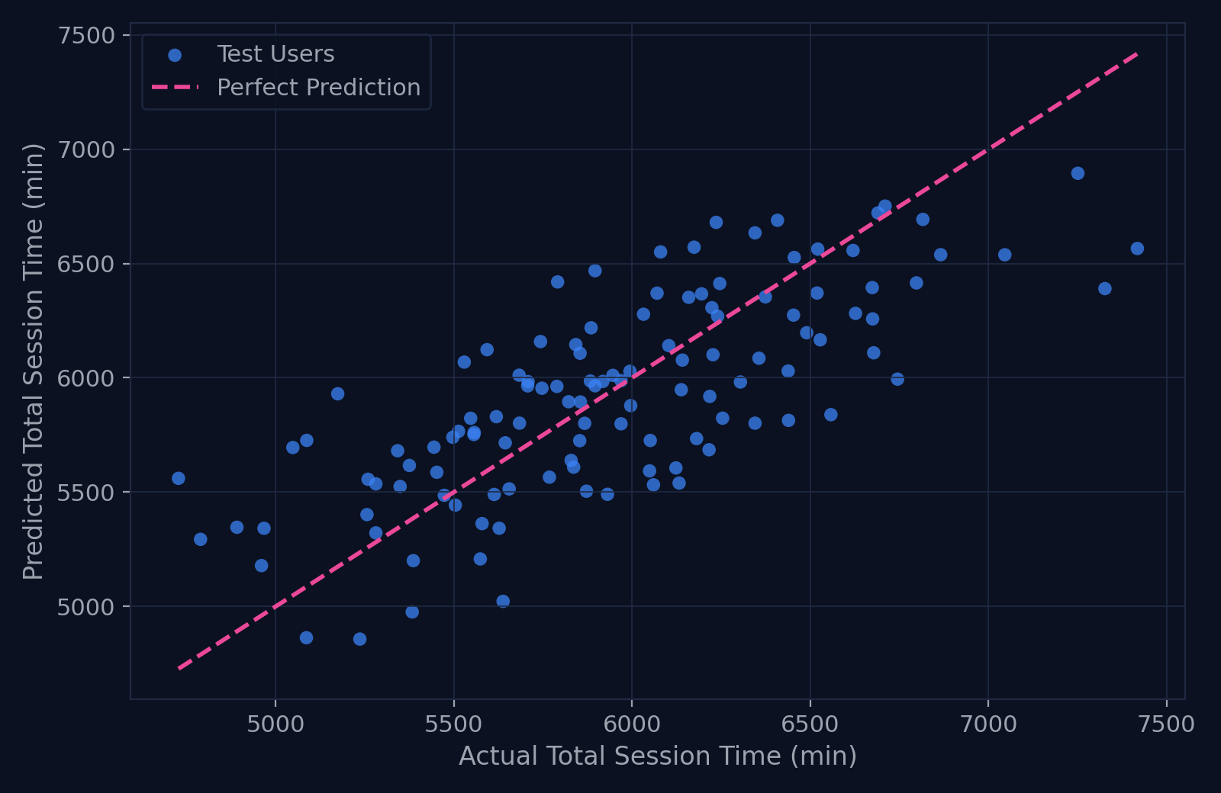
OBJECTIVE 3
Linear Regression: Predicting Session Time
From Categories to a Number
Actual vs Predicted Session Time
Classification predicts a tier; regression predicts an actual quantity. Linear Regression estimates a user's Total Session Time directly, using the same demographic and behavioral inputs as the classification models.
On unseen test users, predictions are typically off by about 298 minutes (MAE), and the model explains 55% of the variation (R²) in session time — a solid baseline, not a production-grade forecast.
Business use: Estimate expected engagement depth per user to support lifetime-value planning and capacity forecasting, alongside the Low/Medium/High classification.
Insight: MAE ≈ 298 min | RMSE ≈ 361 min | R² ≈ 0.55. Points near the diagonal are accurate predictions.
FitTech App Analytics | 13 / 17

Slide 14
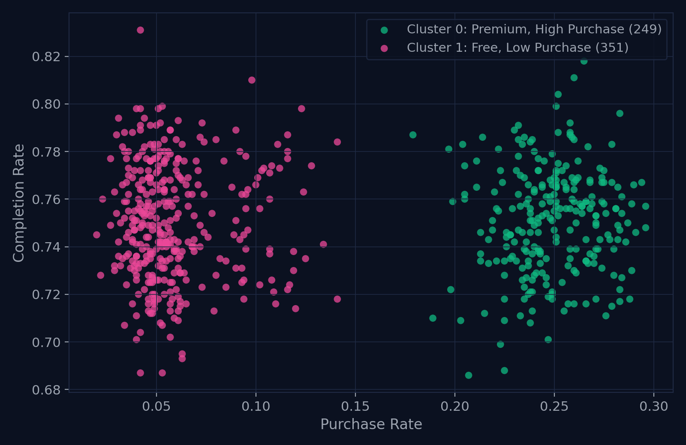
OBJECTIVE 3
K-Means Clustering: Two Real User Segments
Segmenting for Adaptive Reminders
User Segments: Purchase vs Completion Rate
Clustering on Completion Rate, Purchase Rate, and Notification Click Rate — with k = 2 chosen because it wins decisively on silhouette, Davies-Bouldin, and Calinski-Harabasz scores, not picked for simplicity.
Purchase Rate is what actually separates the two groups, mirroring Subscription Type almost exactly: 249 Premium users converting at 25%, versus 351 Free users converting at just 6%. Completion Rate is nearly identical between them (0.75 both).
Suggested actions: Reward and retain the 249 already-converting Premium users; send the 351 Free users goal-based premium trial reminders rather than generic reactivation.
Insight: This split tracks purchase behavior, not overall activity — it does not line up with the real Engagement_Level label, which is driven by workout frequency instead.
FitTech App Analytics | 14 / 17

Slide 15
RECAP
Summary of Findings & Interpretations
Workout Preferences
Funnel Bottleneck
Yoga is the most recorded workout at 25.1%, while Cardio has the highest average calorie burn at 539.7 calories.
Completion is strong at 75.0%, but notification clicks (36.5%) and purchases (13.8%) show real conversion drop-off.
Prime Timing
Statistical Reality
Morning accounts for 45.1% of workouts — the best timing window for reminders and app reliability.
Testing shows notification clicks do not automatically create longer sessions — message quality matters more than click volume.
Feature Utility
Modeling Direction
Workout Tracker contributes 39.8% of engagement sessions — users clearly value progress tracking.
ML converts these insights into action: identifying likely high-engagement users and estimating session time.
FitTech App Analytics | 15 / 17

Slide 16
OBJECTIVE 4
Strategic Recommendations
Prioritize high-value feature journeys
Use completion-safe feature pairings
Personalize by workout efficiency
Focus product investment on Workout Tracker and Progress, which together account for 65% of feature usage.
Diet Log and Community show the highest workout completion rates. Bundle these pathways with workout guidance to improve satisfaction.
Recommend higher-efficiency workouts for calorie-focused users, consistency-focused routines for wellness goals.
INSIGHT: 39.8% Workout Tracker, 25.1% Progress
COMPLETION: Diet Log 75.5%, Community 75.3%
EFFICIENCY: Cardio 9.0 cal/min, Yoga 4.0 cal/min
⚡ Optimize cross-device consistency
🚀 Focus on engagement drivers, not surface metrics
Mobile, Web, and Smartwatch usage are nearly equal (~33% each) — deliver the same high-quality feature experience across all devices.
Target improvements that directly support Objectives 3 and 4 — feature adoption, notification effectiveness, efficiency, and completion — rather than isolated volume numbers.
DEVICE SHARE: Mobile 33.5%, Web 33.4%, Smartwatch 33.2%
FitTech App Analytics | 16 / 17

Slide 17
Q & A
Thank you for your time and attention.
Prasanna • Batch DA68 • Mentor: Priya Shanmugam

