Slide 1

GitHub
A Hosting Service

Slide 2

GitHub vs Git

Slide 3
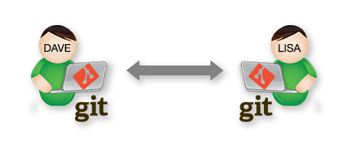
What is Git?

Slide 4
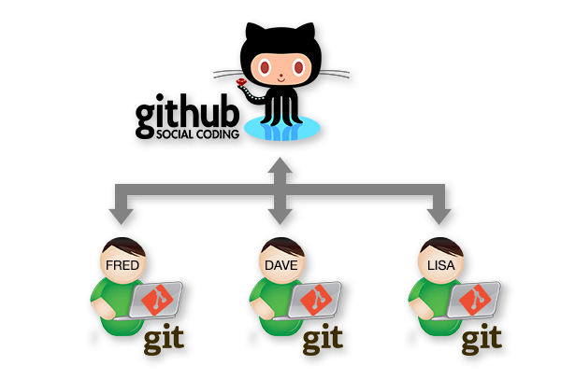
What is Github?

Slide 5

Why use GitHub?
Backup Storage
Sharing
Access
UI

Slide 6

Reference
http://adaptivepatchwork.com/2011/04/15/explaining-github/
https://jahya.net/blog/git-vs-github/
https://octodex.github.com/

