Slide 1
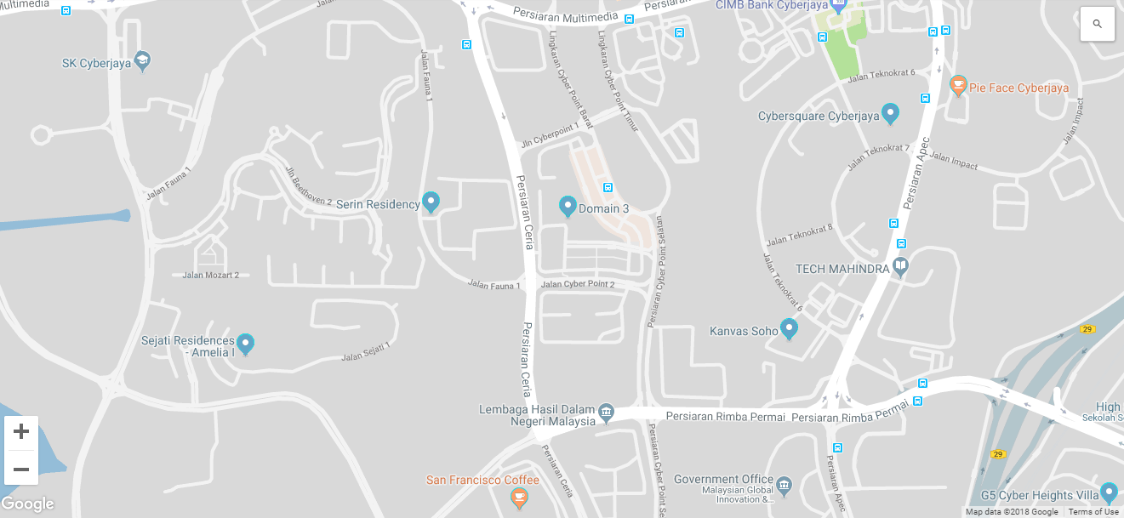
®
CAMS

Slide 2
Car safety in your own hands
®
CAMS
Central asserts monitoring system

Slide 3

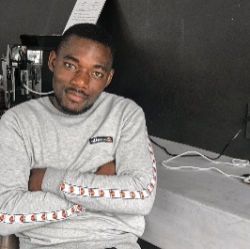
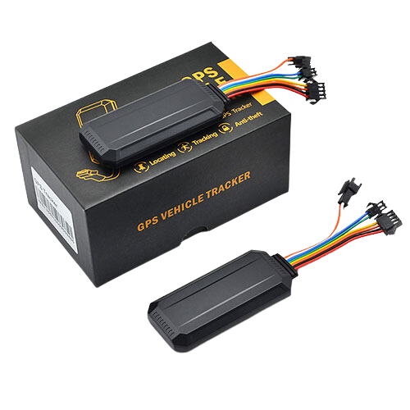






Mpumelelo Maswanganye
ROLES:
Lead Developers/ Backend
Tony Mbedzi
Technical direction of the project making architectural decisions, and ensuring the solution aligns with project requirements.
Implement APIs that facilitate communication between the server and client, and external systems
Ensure the application is scalable and secure.
Integrate third-party services and APIs as needed.
Lead Developers
Katlego Sityi
Lead Developers
Tshepiso Monama
Lead Developers
Oko Mwenzo
Lead Developers

Slide 4
Mpumelelo Maswanganye
ROLES:
Lead Developers
Tony Mbedzi
Create wireframes and prototypes to visualize the user journey, navigation, and layout before development begins.
Design the visual elements that align with the brand and enhance usability
Ensure that new changes don’t break existing functionality by running tests after updates
UX design/ Quality Assurance
Katlego Sityi
Lead Developers
Tshepiso Monama
Lead Developers
Oko Mwenzo
Lead Developers

Slide 5
Mpumelelo Maswanganye
ROLES:
Lead Developers
Tony Mbedzi
Design, implement, and optimize database schemas, queries, and connections for efficient data retrieval and storage.
Monitor application performance and optimize code or database queries to improve responsiveness.
Ensure the application is scalable and secure.
Integrate third-party services and APIs as needed.
Lead Developers
Katlego Sityi
Lead Developers/ Backend
Tshepiso Monama
Lead Developers
Oko Mwenzo
Lead Developers

Slide 6
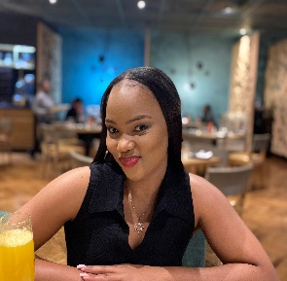

Mpumelelo Maswanganye
ROLES:
Lead Developers
Tony Mbedzi
Define the project scope, objectives, and deliverables based on stakeholder requirements.
Organize and lead the project team, ensuring each member understands their roles and responsibilities.
Act as the primary point of contact between the team and stakeholders.
Lead Developers
Katlego Sityi
Lead Developers
Tshepiso Monama
Project Manager/ UX design
Oko Mwenzo
Lead Developers

Slide 7




Mpumelelo Maswanganye
ROLES:
®
Lead Developers
CAMS
Car safety in your own hands
Tony Mbedzi
Ensure that the application is user-friendly and accessible to a diverse audience
Verify each feature works as intended.
Ensure that new changes don’t break existing functionality
Lead Developers
Tracking Feature
24/7 Support
On mobile application
Assert oversight
On mobile application/website
Katlego Sityi
Lead Developers
CAMS is a vehicle tracking management platform that provides users with real-time data tracking abilities.
Tshepiso Monama
Lead Developers
Oko Mwenzo
Quality Assurance

Slide 8
®
CAMS
SKILLS:
Our Client
Makes key technical decisions and guide the development process
Develop and maintain the server-side logic.
Design and manage the database.
Ensure the application is scalable and secure.
Integrate third-party services and APIs as needed.
Assert oversight
Asset Oversight
The company was founded by Archie Mdaka, driven by a passion for technology and a desire to create a business in a field he loves. Established in early 2020, the company initially focused on instrumentation services before expanding into vehicle tracking. Known for its customer-focused approach, the company values integrity, innovation, adaptability, accountability, and teamwork.
Our client
Mpumelelo Maswanganye
Lead Developers
Tony Mbedzi
Lead Developers
Katlego Sityi
Lead Developers
Tshepiso Monama
Lead Developers
Oko Mwenzo
Lead Developers

Slide 9
®
CAMS
Project Scope
Tracking Feature
Assert oversight
On mobile application
Our Project aims to develop a mobile and web-based vehicle tracking system for Assert Oversight, integrating existing tracking hardware to provide real-time GPS tracking and alerts for improved vehicle security and monitoring.
24/7 Support
On mobile application/website

Slide 10
®
CAMS
Project Statement
Assert oversight
Aim
Solution Application
The Primary Problem identified in the project plan for the CAMS app is vehicle security, specifically addressing the safety and tracking needs of vehicle owners. The solution aims to help users locate their vehicles in various scenarios, such as when parked in large areas or in the event of theft.
This app intends to increase users' sense of security by providing features like real-time tracking
CAMS
Tracking Feature
On mobile application

Slide 11


®
CAMS
Requirements
Assert oversight
Functional Requirements:
Non-Functional Requirements:
Project Phase | Budget (R) | Description
Requirements Gathering | 1,000 | Research, stakeholder meetings, requirements documentation.
UI/UX Design | 2,000 | Wireframes, mockups, and usability testing for user interface design.
Backend Development | 3,000 | Database setup, server logic, API development, and integration with tracking hardware.
Frontend Development | 2,500 | Building the user interface and integrating with backend systems.
Testing & Quality Assurance | 1,500 | Functional testing, usability testing, bug tracking, and quality assurance.
Deployment & Launch | 1,000 | Finalizing deployment to app stores, web hosting, and server setup.
Total | 11,000
Real-Time Vehicle Tracking: The app should display a vehicle’s live location on a map, with updates at regular intervals to ensure accuracy.
Vehicle Management: Users can add, edit, or remove vehicles in their account, with each vehicle's details easily accessible for quick reference.
Real-time vehicle tracking feature displays live GPS locations on an interactive map.
Security is prioritized with encryption for data in transit and at rest and role-based access control to prevent unauthorized access.
For usability, the app has a user-friendly interface that is intuitive and responsive
24/7 Support
On mobile application/website

Slide 12
®
CAMS
Requirements
Budget
Assert oversight
Project Phase | Budget (R) | Description
Requirements Gathering | 1,000 | Research, stakeholder meetings, requirements documentation.
UI/UX Design | 2,000 | Wireframes, mock-ups, and usability testing for user interface design.
Backend Development | 3,000 | Database setup, server logic, API development, and integration with tracking hardware.
Frontend Development | 2,500 | Building the user interface and integrating with backend systems.
Testing & Quality Assurance | 1,500 | Functional testing, usability testing, bug tracking, and quality assurance.
Deployment & Launch | 1,000 | Finalizing deployment to app stores, web hosting, and server setup.
Total | 11,000
Functional Requirements:
Non-Functional Requirements:
The Pro Tracker app offers robust functionality for vehicle security and management, beginning with secure user authentication, including two-factor authentication, to safeguard user accounts.
Real-time vehicle tracking feature displays live GPS locations on an interactive map.
24/7 Support
Security is prioritized with encryption for data in transit and at rest and role-based access control to prevent unauthorized access.
For usability, the app has a user-friendly interface that is intuitive and responsive
On mobile application/website

Slide 13
®
CAMS

