Slide 1

Pirate Processor FP3
By: Nik, Ben, Zach, Brycen and Garrett

Slide 2
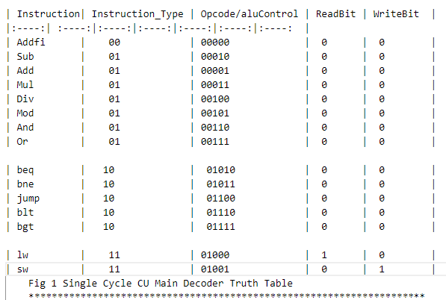
Decoder Tables

Slide 3
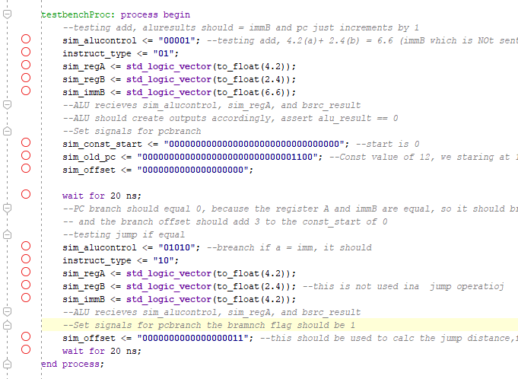
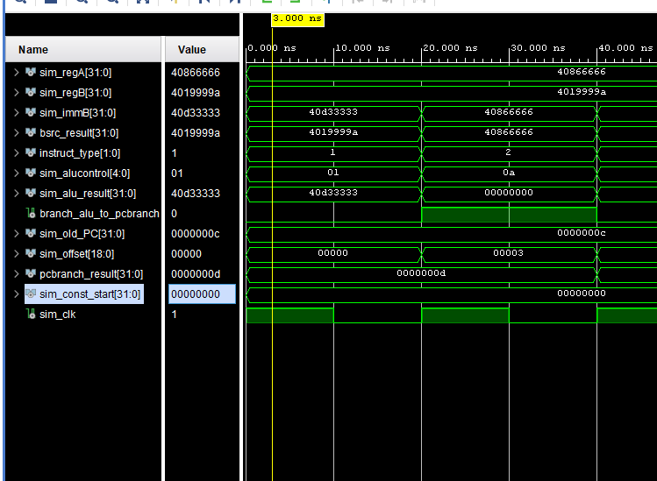
Code/Simulation

Slide 4
Bugs Found and Squashed

Slide 5
Overview

