Slide 1

Pirate Processor FP3
By: Nik, Ben, Zach, Brycen and Garrett

Slide 2
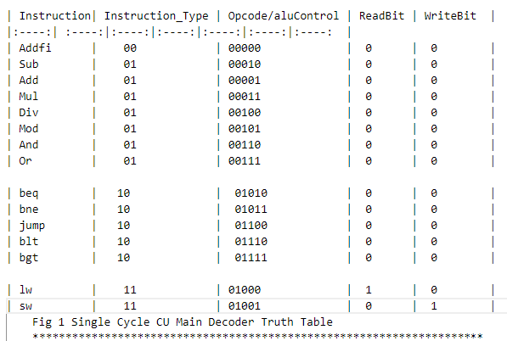
Decoder Tables

Slide 3
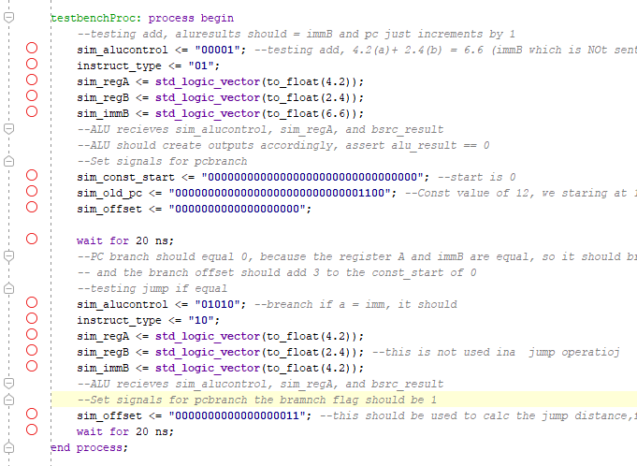
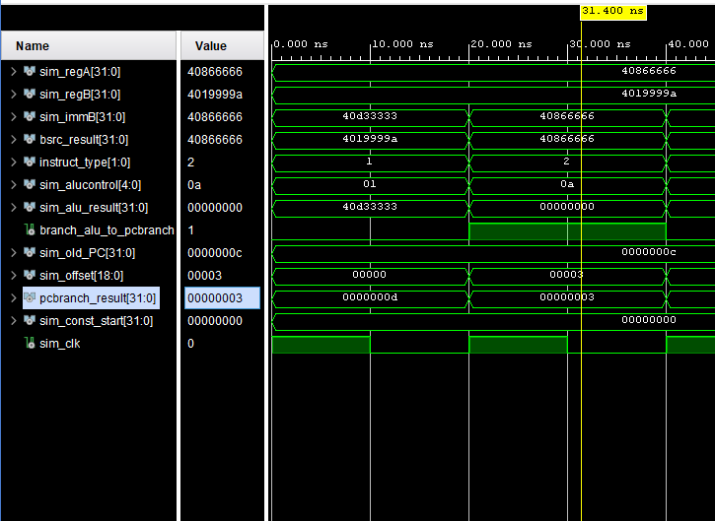
Code/Simulation

Slide 4
Bugs Found and Squashed
Rising edge of clock caused many problems as things were cycling late due to it being incorrect.
Instructions in mem file were not as expected so testing was difficult
Top 2 bits weren’t changing so signal didn’t change
We were reading memory address as being off by 1 bit which made calculations wrong.
In the control unit some of our out signals were writing back to our instructions unintentionally.

Slide 5
Overview
Its surprisingly hard to work on the control unit and get the rest of the project to use it as intended and not shoot back errors all the time
In general, we are happy with the float packages but there are many kinks that our project has that need more work
A week for this project seemed like a hard goal to finish this in compared to the normal time we are used to getting per final project part as a lot more thinking was required to piece the project together.

