Slide 1

FP_2 Presentation
Niklas Roberts, Zach Bowyer, Ben Greenwood, Brycen Martin, Garrett O’Shaughnessy

Slide 2
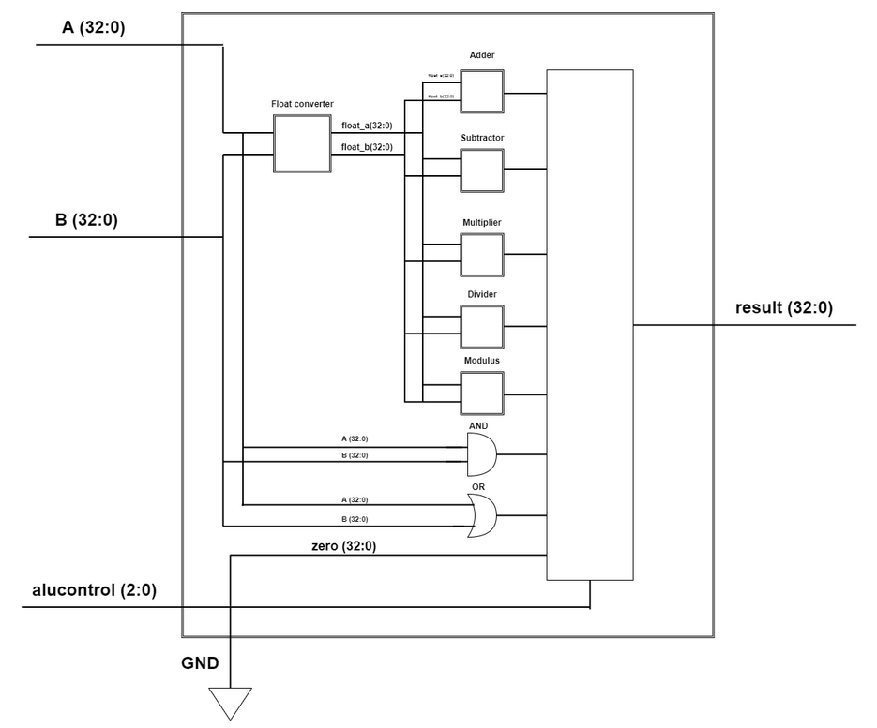
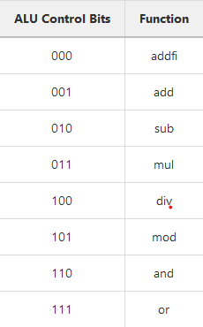
ALU Design
MIPS uses separate control bits and opcodes
MIPS reuses some hardware
We only use opcodes
We have a fatty mux

Slide 3
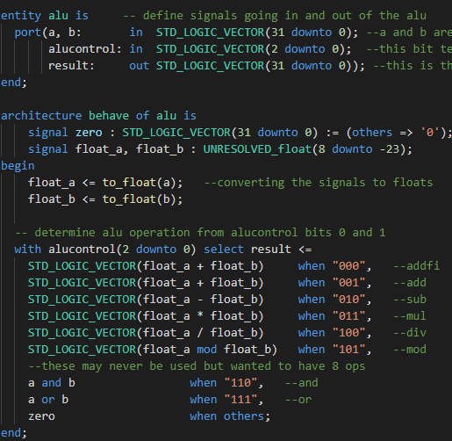
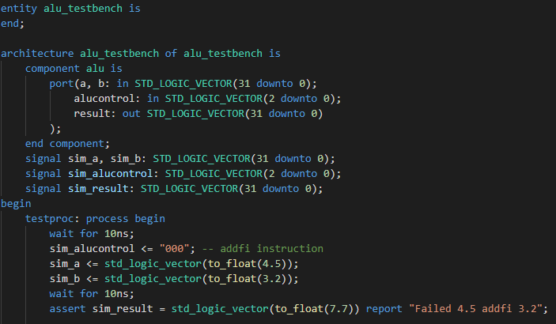
ALU Implementation

Slide 4
DPU Components
ALU: Performs computations
Regfile: Registers and Custom variables
Data Memory: The actual computer memory
Instruction Memory: Holds the instructions
PC Adder: Increments PC by 4 every clock cycle
Bsrc: Mux controlling what goes into the B-input for the ALU
PCBranch: Used for branching, adds a compiler-computed offset to the start of main

Slide 5
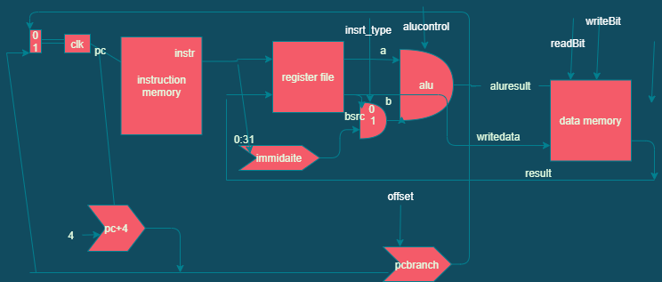
DPU Diagram

Slide 6
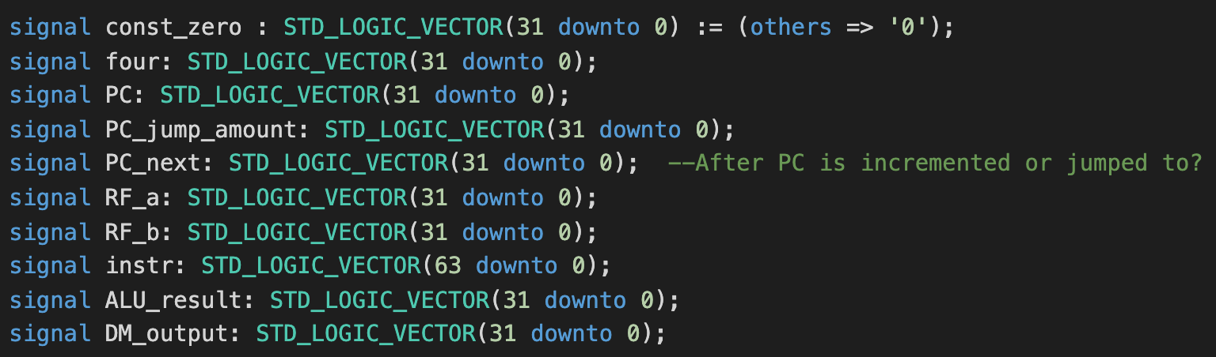
Control Signals and Control Unit Prep
We will use a single cycle FSM based control unit
Not using a multi-cycle control unit

Slide 7
Summary
What went well?
ALU and ALUsim was pretty straightforward
Integration from FP1 was smooth
What didn’t go well?
Floating point at first
What are we happy with in our design?
The floating point works
DPU as a whole
ALU does what we want
Wiring the DPU/communication

