Slide 1

CS 473 Final Project Genetic Algorithm
Team Fleet: Brycen Martin, Jonathan Laughlin, Shane Snediker

Slide 2

Genetic algorithms as optimization tools
Loosely based on evolution​
Our determined problem space: delivery route system​
Initial considerations​
Shane

Slide 3

GOALS
Define a genetic algorithm bot with encoding, selection, crossover, mutation and a fitness score
Use real geographical data to define the problem space
Create a graphical representation of the robots traversing the problem space
Our GA bots will optimize one delivery route
Given a set of inputs that change in real time, our bots will alter their optimization calculations and find a new optimized path
Jonathan

Slide 4
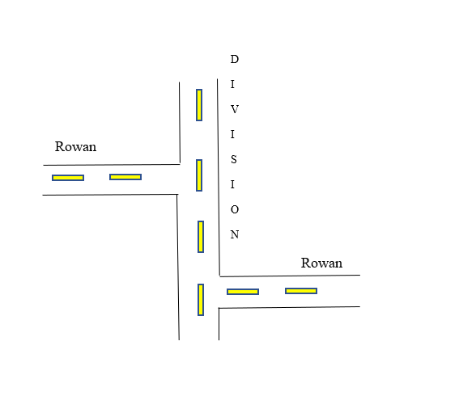
Assumptions
U-turns are allowed
Distance between a starting point and delivery point does not factor in traffic, road construction, or dealing with one-ways
If a road is disconnected by a small distance, we treat it as connected:
Jonathan

Slide 5
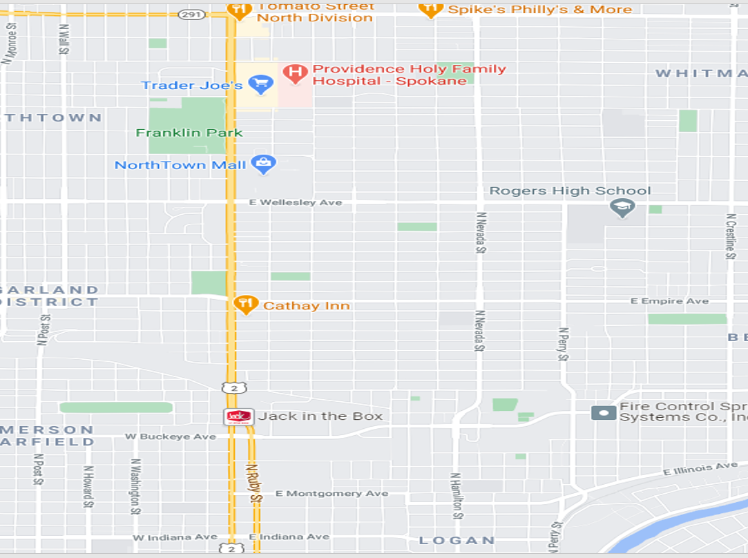

Slide 6
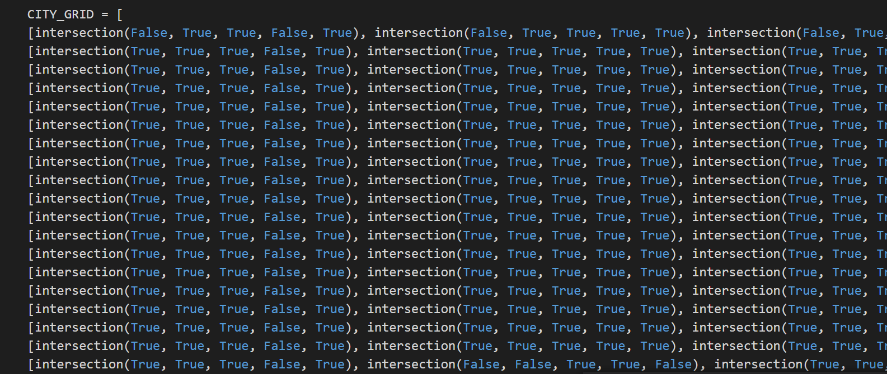

Slide 7

Genetic Algorithm Elements
Fitness Score – define individual success
Encoding – bring the bots to life
Selection – choose who mates
Reproduction – make baby bots
Mutation – introduce gene mash ups
Shane

Slide 8
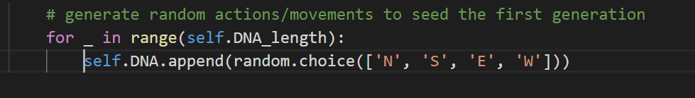
Encoding

Slide 9
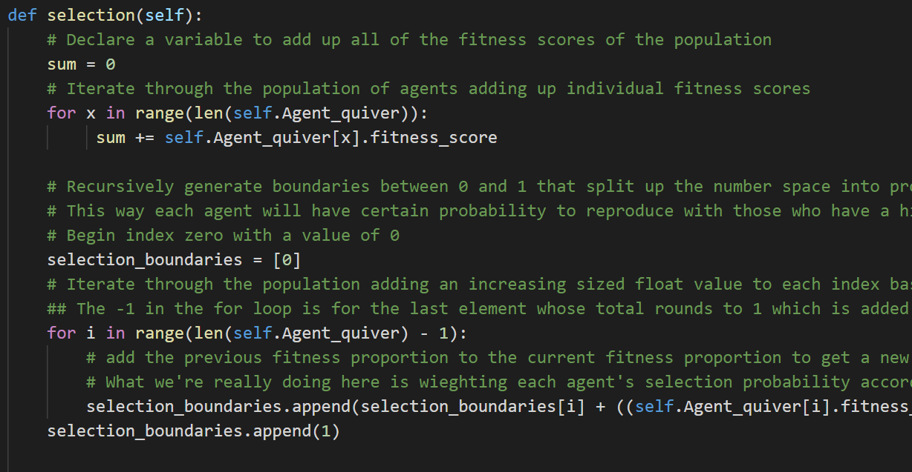
Selection

Slide 10
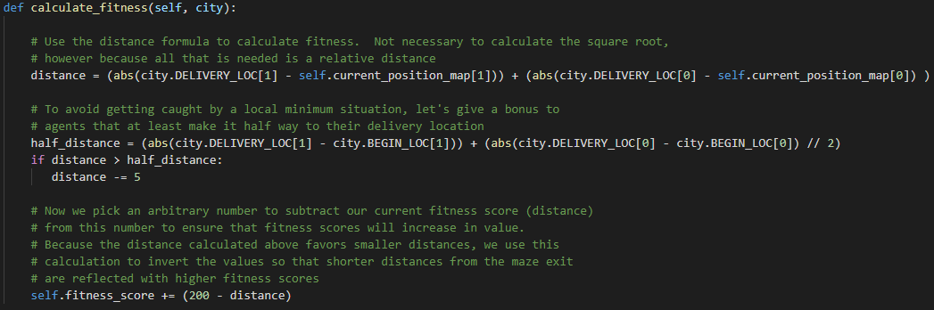
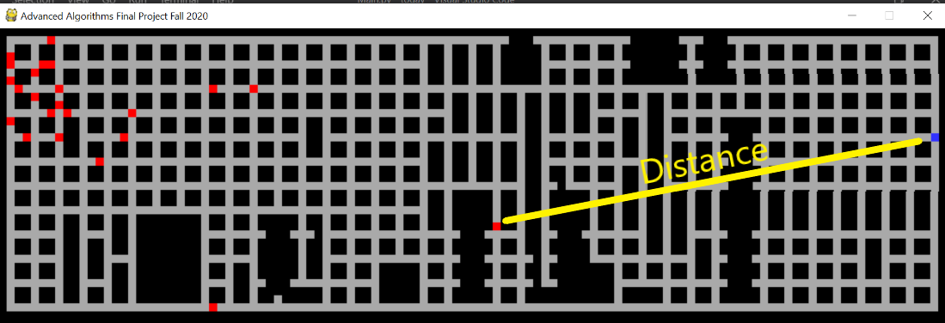

Slide 11
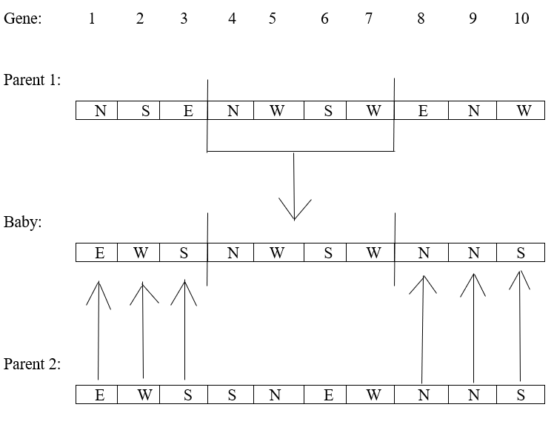
Crossover Reproduction

Slide 12
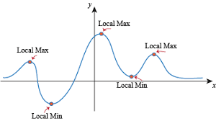
Mutation is critical to a GA!
Shane

Slide 13
Algorithm Analysis
Genetic algorithms are almost impossible to analyze due to the amount of variables
Things such as the number of bots or the genetic sequence of bots and even the movement of the bots can greatly increase or decrease the time the code takes to run.
For example, a simulation was ran that was only around 10 blocks and it took around 10 minutes to complete
The same code but with a goal at the other end of the data set ran for about 15 hours and 125000 generations and was not even close to completion of the problem
Brycen

Slide 14

DEMO TIME

Slide 15
Updates/Improvements
Change roads that were made straight back to diagonal or curved, we made them straight to ease the burden on our algorithm
Add single block streets back into the data set as we removed them to decrease complexity for the bots and for testing purposes
Improve fitness evaluation so our bots converge faster and will be able to handle large distances better than they currently can
Brycen

Slide 16
Conclusion
Importance of a good fitness function
Path finding through a city is not the optimal use for this class of algorithms
Genetic algorithms can be effectively used to approximate solutions to highly complex problems
Parameter tweaking is a complex process and integral to the success of the solution
Future work
Brycen

