Slide 1

Micro-pirate-processor
Garrett O’Shaughnessy, Zachary Bowyer, Brycen Martin, Niklas Roberts, Benjamin Greenwood

Slide 2
Overview
We wanted to make a processor that would handle mathematical calculations
Floating point numbers/arithmetic
64-bit instructions, 32-bit memory

Slide 3
Processor design
Registers:
Eight 32-bit general-purpose registers, saved between calls
Eight 32-bit general-purpose registers, not saved between calls
Constant zero register, non floating point
Constant zero register, floating point
Stack pointer register
Return address
Thirty-two 32-bit memory registers
Instruction types:
I-F-Type
R-Type
J-Type
M-Type

Slide 4
Instructions and formats
I/F-Type
[ 2-bit instruction type] [ 5-bit opcode] [13 extra bits] [6 RS] [6 RD ] [ 32 IMM ]
ADDFI
R-Type
[ 2-bit instruction type] [ 5-bit opcode][39 extra bits][6 RT][6 RD][6 RS]
ADD
SUB
MUL
DIV
MOD
AND
OR
J-Type
[2-bit instruction type][5-bit opcode][6 RD] [32 IMM][19 bit offset]
BEQ
BNE
JUMP
M-Type
[2-bit instruction type][5-bit opcode][45 extra bits][6 RD][6-bit address]
LW
SW

Slide 5
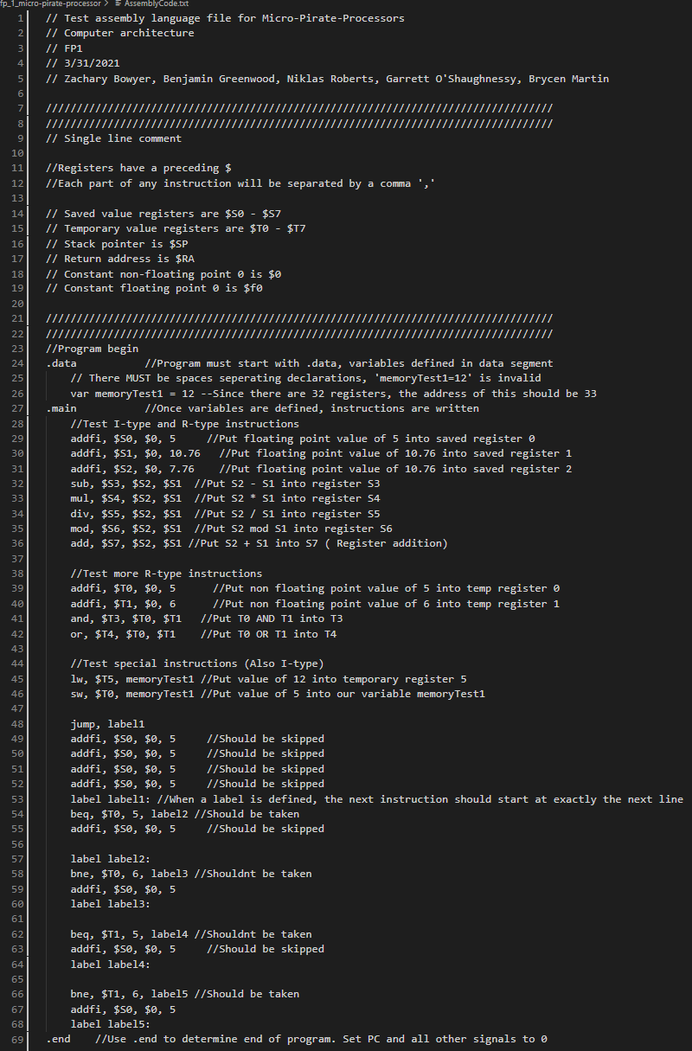
Assembly code
Tests every instruction at least once
Has variables and labels
.Data section
.Main section
C++ style comments

Slide 6
Challenges
What type of processor we wanted
Graphics?
Audio?
128-bit processor?
Scientific processor
Scheduling times to work together
Choosing instruction formats
Deciding on number of registers
Writing the compiler

