Slide 1

Why R?
Reasons and applications for learning R
Matthias Raess
PhD candidate, applied linguistics
Department of English
Ball State University
mraess@bsu.edu / @primesty22
www.matthiasraess.com

Slide 2
What is R anyways??
R is an implementation of the S programming language
Developed by Ross Ihaka and Robert Gentleman at the University of Auckland, NZ
Currently overseen by the R Development Core Team
Project conceived in 1992, initial version 1995, stable beta in 2000.
Notes:
S – developed by John Chambers while at Bell Labs

Slide 3
Why R?
Advantages: Platform independent (Windows/Mac/Linux)
Open source > Changeability, big community > lots of materials
Awesome plotting functions (base plotting, ggplot2, lattice)
New stats method > chances are they come out in R first
Workflow!! Unlike SPSS (GUI), step-by-step documentation (cf. Rmarkdown)
Connection to open science movement + reproducible research
Integrated version control via Git and GitHub
FREE!!

Slide 4
Why R cont’
Social sciences entered the age of data science!!
R is becoming the lingua-franca of data science
According to Redmonk, R ranks 13th of ALL programming languages, the highest of any statistical programming language
Make yourself more marketable: big companies like Facebook and Google have their data scientists use R (also Bank of America, Ford, TechCrunch, Uber, and Trulia among others)

Slide 5
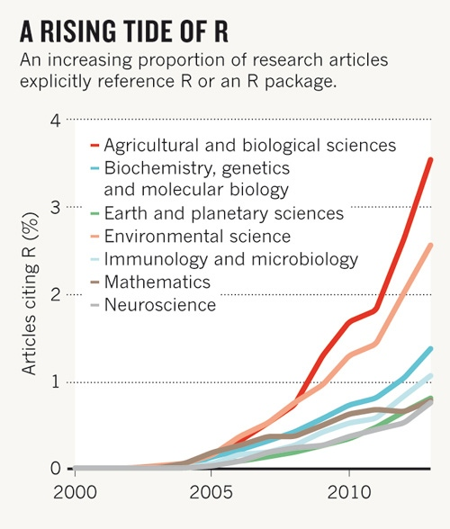
Why R cont’ II
R is very popular in academia
Recent article in Nature (Tippmann, 2015) devoted to use of R in academia >
The best and brightest people are trained in R at university > increases importance of R in industry

Slide 6
Why R cont’ III
Learning the skills of data science is easiest in R
Data wrangling (80% of data science is data manipulation) e.g. R packages, dplyr, tidyr, plyr
Create publication quality graphs (ggplot2 is one of the best tools around)

Slide 7

Why I learned R
Notes:
A friend of mine was talking about it (Summer 2014)
I considered it a challenge to prove to myself I could do it too! - Started teaching myself with Discovering Statistics using R and Lynda
July 2015 – Linguistic Summer Institute, Chicago
EVERBODY there knew R (any other grad student/faculty I talked to) – Ii realized I was living in a bubble at BSU
Realization: We have some catching up to do
Stuck with it ever since (stats classes, workshops, etc.)
Every working line of code – small success!!
Figuring out complex stuff -> you triumph over computer…

Slide 8
Learning R
Lynda – Up and running with R
Lynda – R statistics essential training
Code School – a very soft introduction to R
DataCamp – Learn R for data science
edX – Intro to R for data science – powered by Microsoft
Coursera – Data science specialization (Johns Hopkins University) – the most time consuming option)

Slide 9
Resources
QuickR
Rbloggers – R news and tutorials (580 contributors!!)
STHDA – Just a ton of cool stuff about stats and R
StackOverflow – This is where you ask a question if you have a problem!☺
Rstudio - webinars by Rstudio
Books: The R Cookbook, Elegant Graphics for Data Analysis (Wickham)
Notes:
StackOverflow – show your own example…

Slide 10
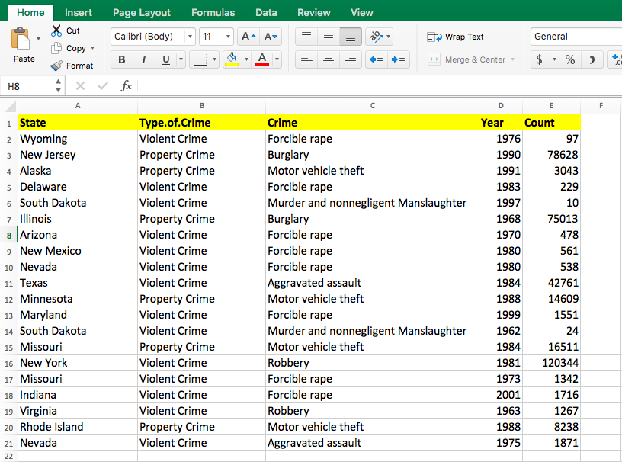
“Traditional” excel spread-sheet

Slide 11
How R structures data
The data frame (observations and variables)
Tidy data paradigm (Wickham, 2014)
> One row per observation, one column per variable (long format)
Also
Vectors (a sequence of data elements of the same basic type)
and matrices (rows and columns)

Slide 12
Tidy data paradigm
Variable
Observation

Slide 13
Types of variables
Categorical variables
Also known as discrete or qualitative variables (nominal, dichotomous, ordinal)
E.g. gender, occupation, 0/1
Continuous variables
Also known as quantitative variables (interval, ratio)
E.g. weight, height, age, income
Some variables could be considered in either way.
E.g. Likert-scale items: attractiveness rating on 5-point scale continuous or categorical (5 levels)

Slide 14
Types of variables cont’
Categorical variable
Continuous variable

Slide 15
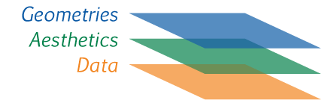
ggplot2
http://docs.ggplot2.org/current/index.html
Written by Hadley Wickham – current version 2.2.0 (2016)
Based on the grammar of graphics (Wilkinson, 2005) – plot made up of layers

Slide 16
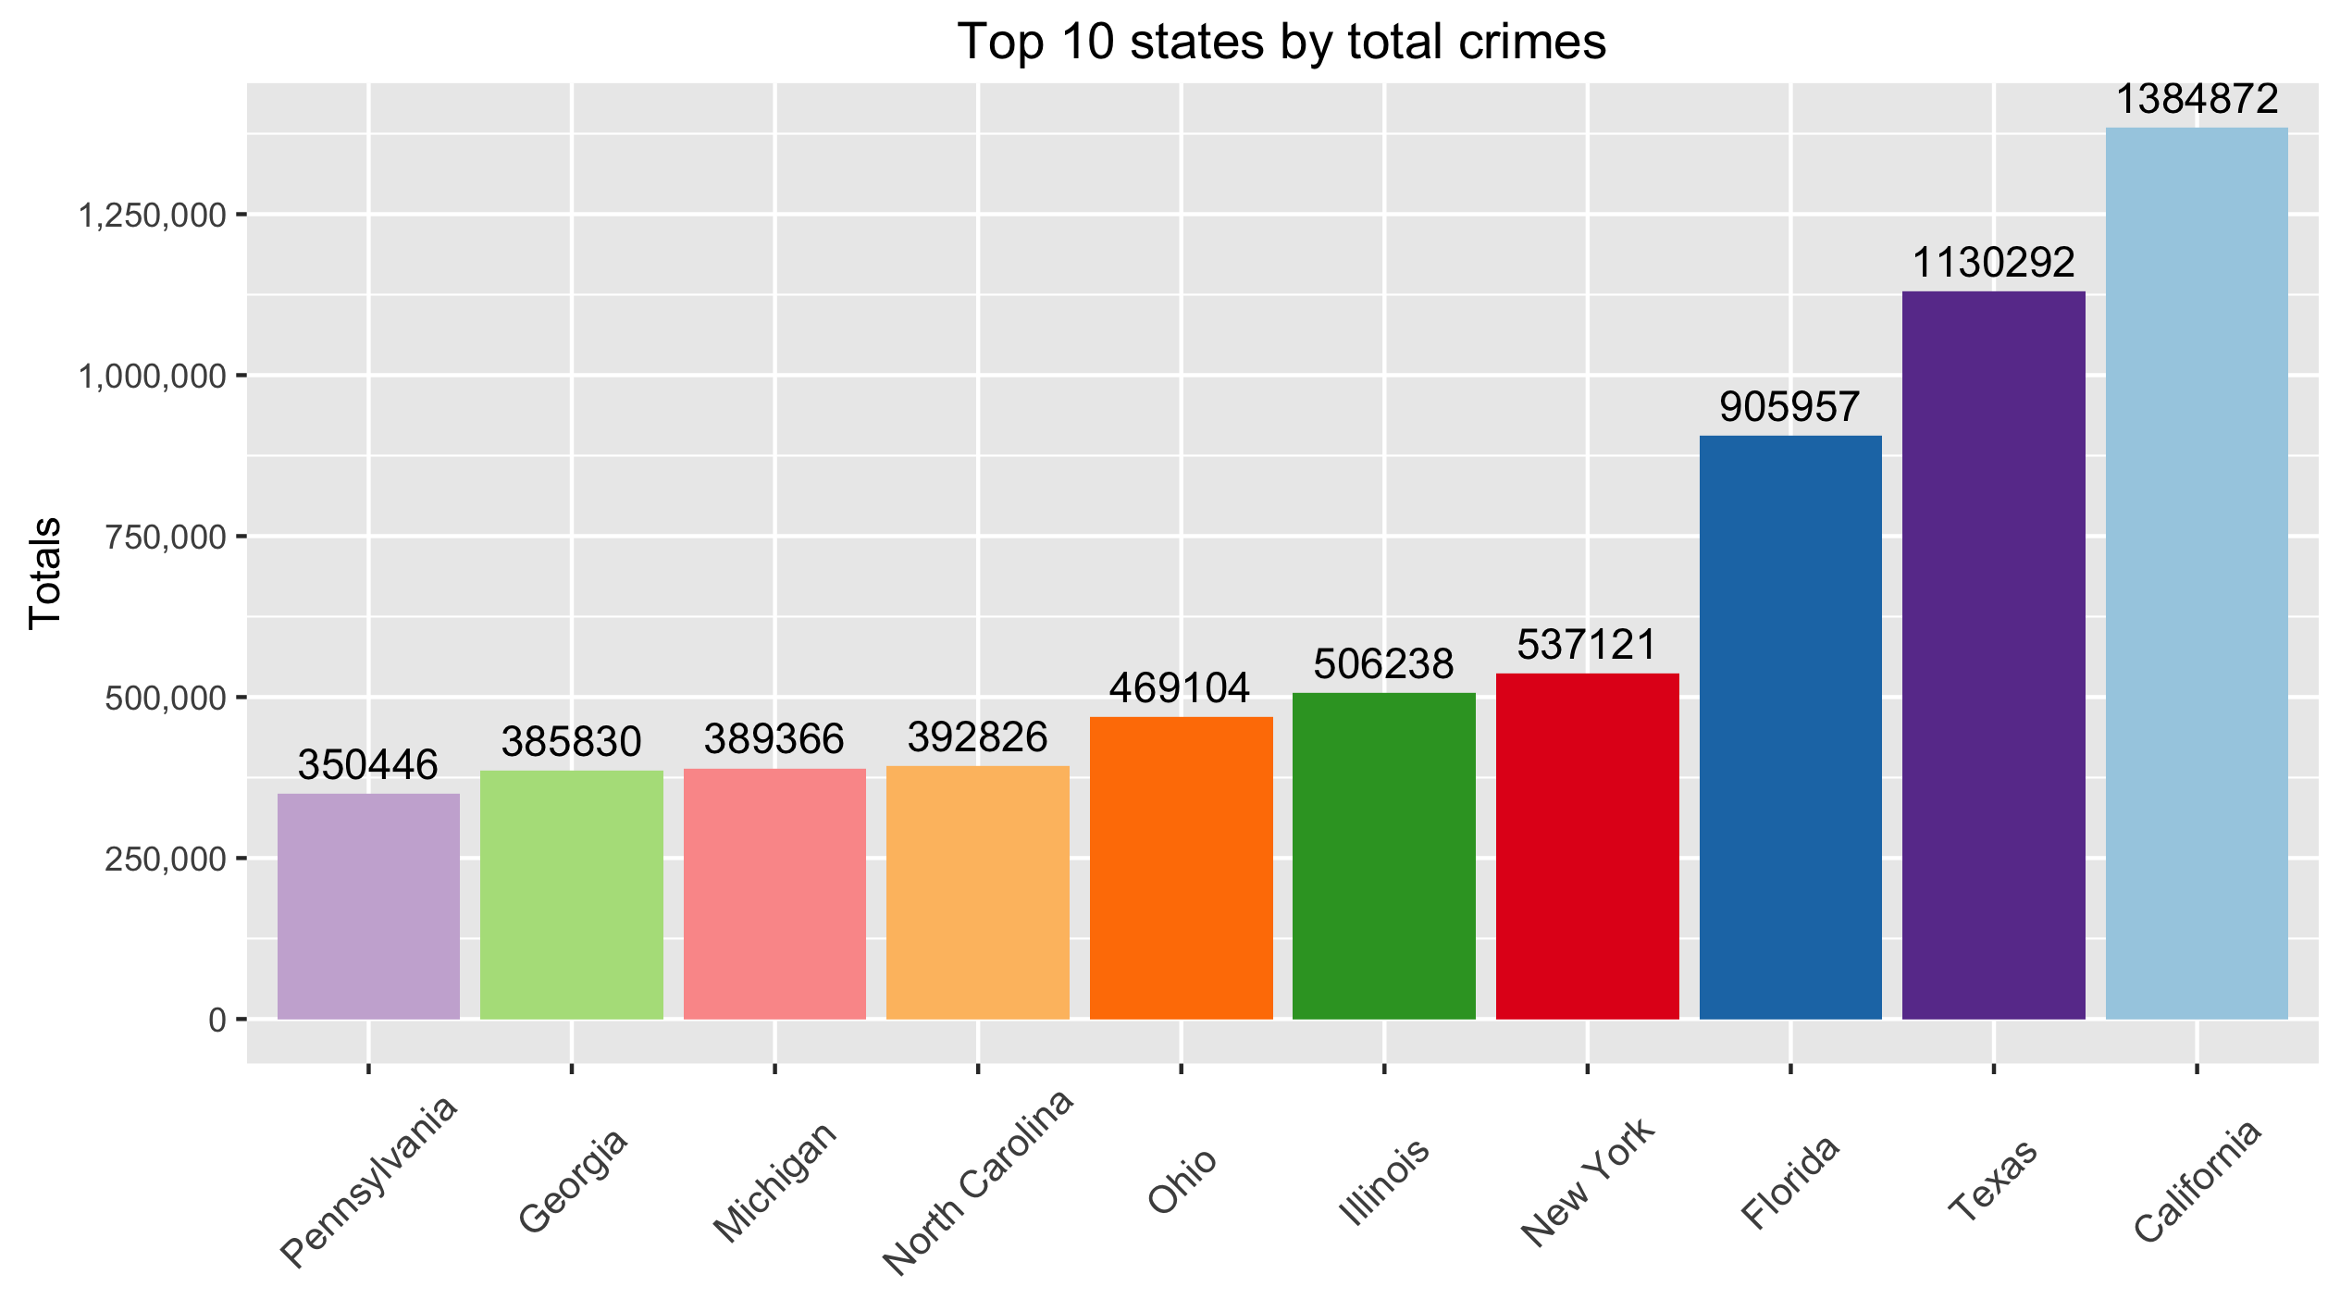

Slide 17
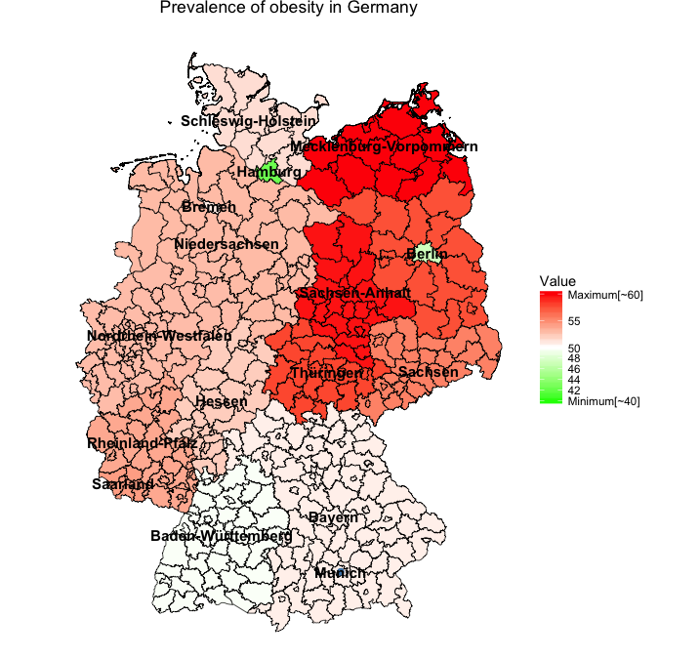
ggplot() +
geom_polygon(data = merge.data, aes(x = long, y = lat, group = group, fill = year2013), color = "black", size = 0.25) + coord_map() +
scale_fill_gradient2(name="Value", limits=c(40,60), low="green", mid = "white", high="red", midpoint = 50, breaks=c(40,42,44,46,48,50, 55, 60), labels=c("Minimum[~40]",42,44,46,48, 50, 55, "Maximum[~60]"), space = "Lab") + theme_nothing(legend = TRUE) +
labs(title = "Prevalence of obesity in Germany") + geom_text(data = statenames, aes(long, lat, label = states), size = 4, fontface = "bold", col = "black", check_overlap = TRUE) + geom_point(data = dot, aes(long, lat), color = "steelblue", size = 2) +
geom_text(data = dot, aes(long, lat, label = city), size = 4, fontface = "bold", color = "black")

Slide 18
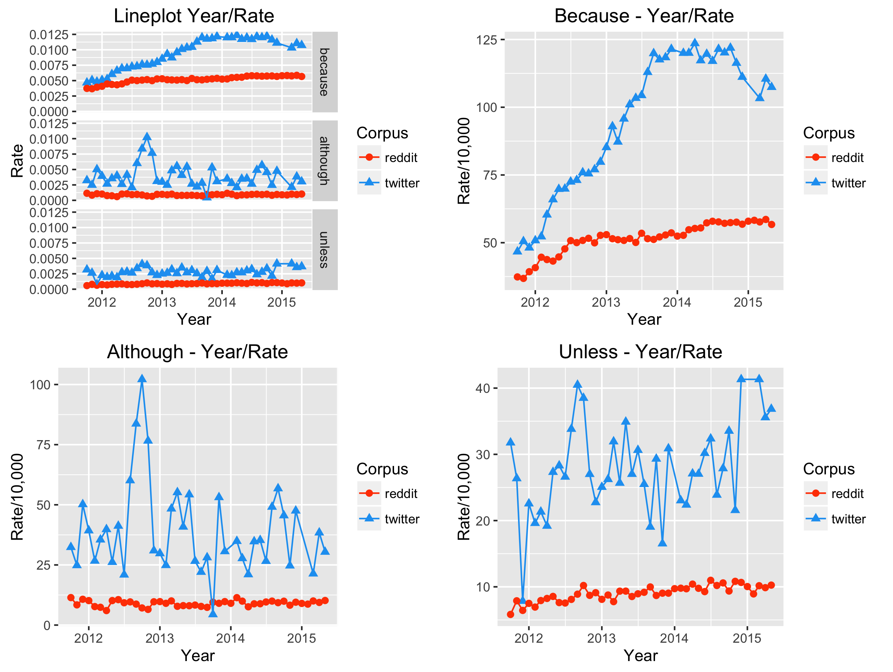

Slide 19
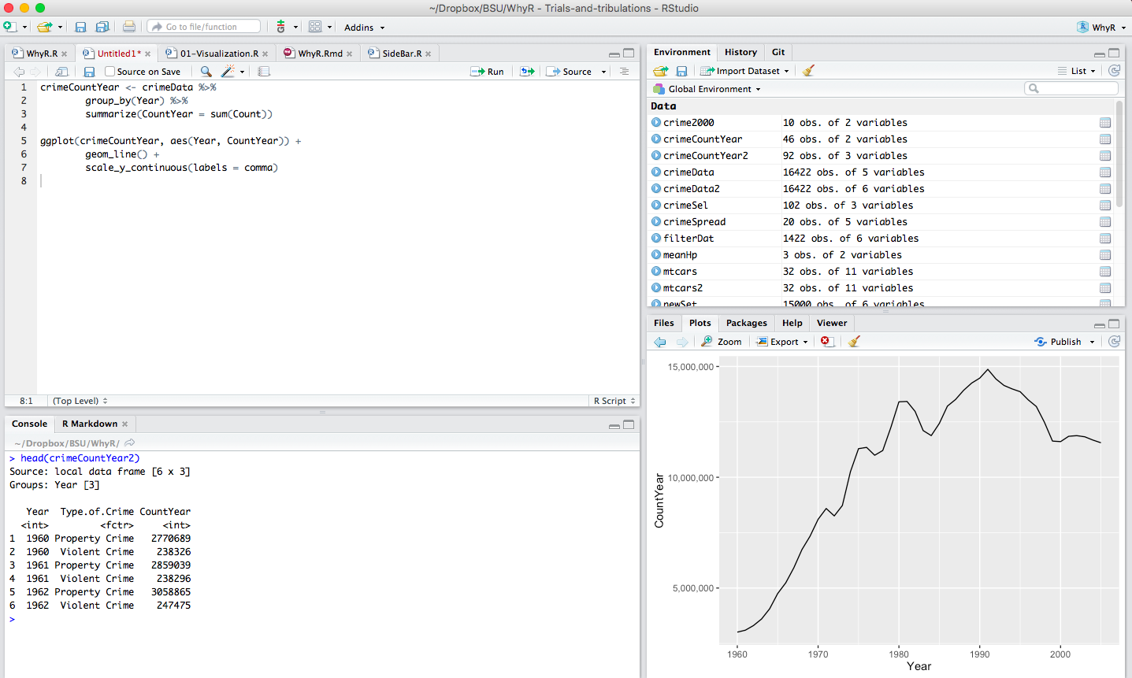

Slide 20
