Slide 1
Quality
Software Architecture

Slide 2
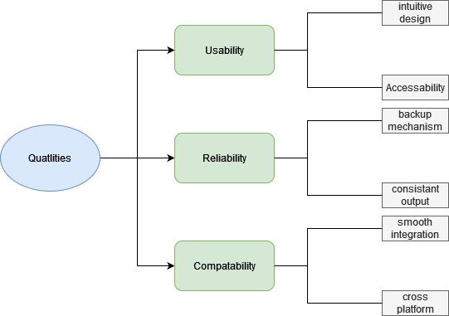
Quality Tree

Slide 3
Quality Goals and Scenarios
Usability
It is designed to be accessible to users with disabilities. Features like screen reader, keyboard short cuts are implemented.
A user who does not know the system can operate it after 20 minutes of instruction.
Reliability
User’s uploads are stored securely because of the apps backup mechanism.
Even under maximum and minimum capacity, the app always outputs at the same speed.
Compatibility
If the third party integrations is used the uptime should be at least 99,95%, with a response time of maximum 1s.
The interface and functionality remains consistent no matter the operating system.

