Slide 1
Deployment view
Software Architecture

Slide 2
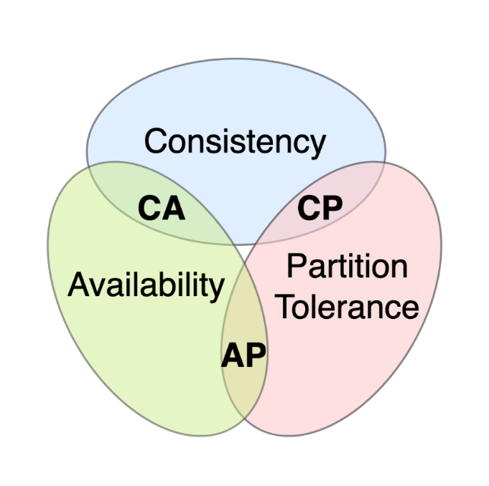
CAP theorem
AP prioritization
App remains accessible even during network partitions
User can interact with the app without significant disruptions

Slide 3
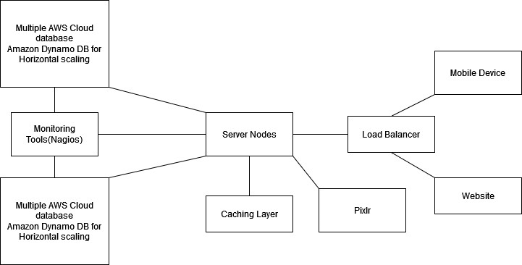
Deployment diagram

