Slide 1
Deployment view
Software Architecture

Slide 2
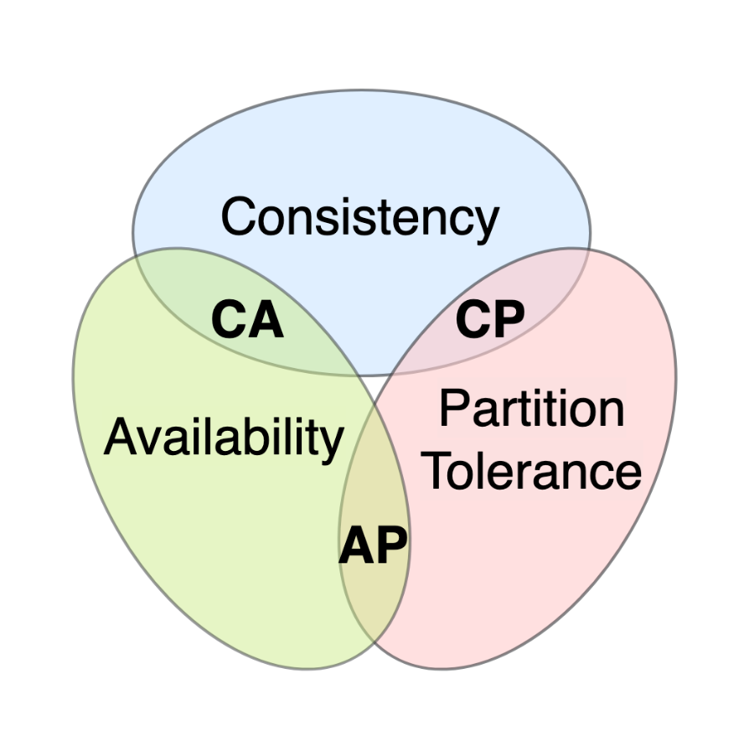
CAP theorem
The CAP theorem tells us that a distributed system can only provide two of the three desired properties: Consistency, Availability and Partition Tolerance.
Present your thoughts about your system and the CAP theorem.
Help: https://en.wikipedia.org/wiki/CAP_theorem

Slide 3
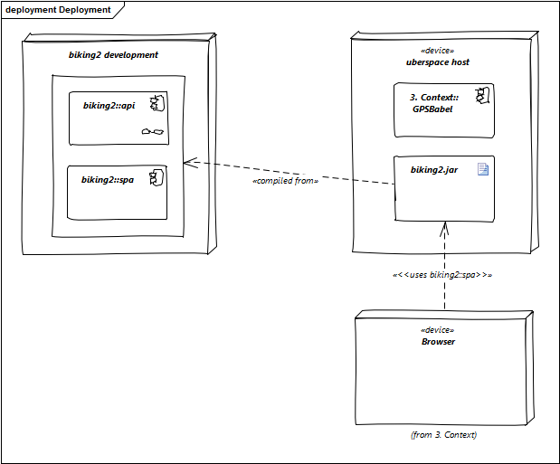
Deployment diagram
Software does not run without hardware. This underlying infrastructure can and will influence your system and/or some cross-cutting concepts. Therefore, you need to know the infrastructure.
Define the deployment of your software.
Help: https://docs.arc42.org/section-7/ & https://biking.michael-simons.eu/docs/index.html#section-deployment-view

