Slide 1
Runtime View
Software Architecture

Slide 2
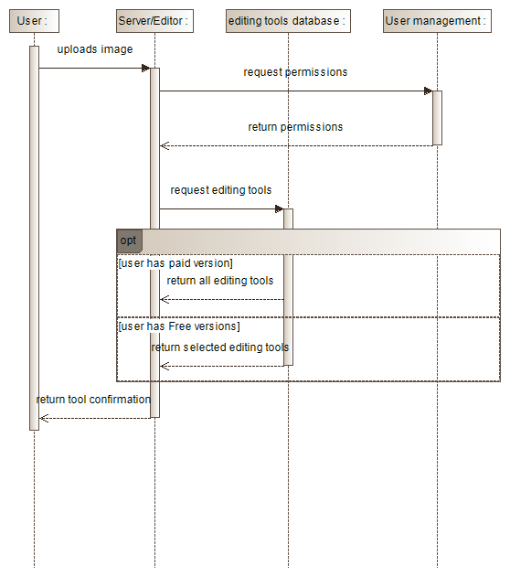

Slide 3
