Slide 1
Building Block View
Software Architecture

Slide 2
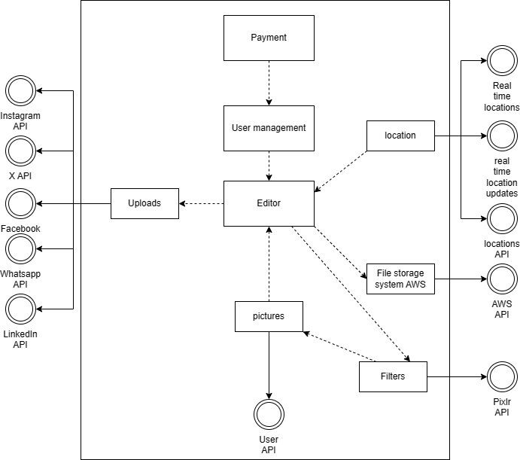
Level 1

Slide 3
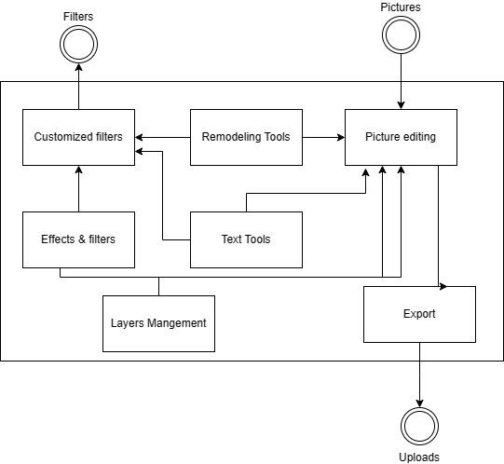
Level 2

Slide 4
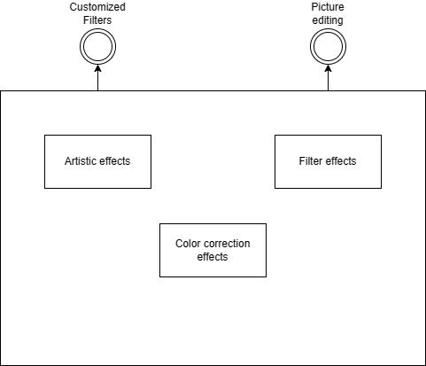
Level 3

