Slide 1
GROUP 8 SOFTWARE DEVELOPMENT PLAN

Slide 2
INTRODUCTION
David Fearn
Computer Science, Political Science
Team Lead
Working on QTI manipulation
Reece Milligan
Computer Science w/ Data Science Concentration
Technical Writer
Working on the database
Gary Nino
Computer Science
Test Lead
Working on server hosting
Alex Wood
Computer Science, Philosophy, Mathematics, GPPE Certificate (Japanese)
Technical Lead
Working on the website front and back end

Slide 3
PROJECT SUMMARY
PROBLEM
Challenge educators face creating, organizing and printing in-class tests, specifically in hybrid classes w/ Canvas
SOLUTION
Development of a “test creation manager”
A system to import, manage, and generate hardcopy exams/quizzes, designed to integrate with Canvas’ QTI question banks
Eliminates time-consuming exam creation process, providing reusable test banks
Allows teachers to transfer over the content they worked on virtually without having to start from scratch

Slide 4

REQUIREMENTS OVERVIEW
Question Bank Management
Create, edit, import/export questions
Track question fields with a database
Test Generation
Combine questions into tests with cover pages, templates, etc.
Support randomization of answers and answer key
Output in HTML, editable in Word
Role-Based Access
Publisher: Manage textbook-based question banks, receive feedback
Teacher: Create, edit, share tests, and give feedback
Webmaster: Manage user roles and website settings

Slide 5
SCHEDULE
Sprint One (Jan. 15 - Jan. 26)
Initial requirements written
Software Development Plan complete
Sprint Two (Jan. 27 - Feb. 9)
Stories created for all developers
Basic website front end structure developed
Sprint Three (Feb. 10 - Feb. 23)
Back end skeleton completed
Architectural design and workflow design complete
Sprint Four (Feb. 24 - Mar. 9)
Server hosting set up
Database integration complete
Sprint Five (Mar. 10 - Mar. 23)
Backlog refinement
Detailed Program Review
Sprint Six (Mar. 24 - Apr. 6)
Website stood up
Import/export fully functional
Sprint Seven (Apr. 7 - Apr. 20)
Initial beta released
First deliverable version finished
Final presentation
HI(P) Sprint (Apr. 21 - Apr. 27)
Final team evaluation
Final deliverable turned in

Slide 6
RISK ANALYSIS
Risk | Severity | Mitigation
Loss of a Member | Major | Division of tasks allows stories to be reassigned in the event of a member dropping
Key Decision Failures | Major | We have back-up plans for all of our most important decisions
Transferring to AWS | Minor | We are leaving a lot of time to stand up the website
Tool Conflicts | Minor | We try to keep tool usage in a simple pipeline, transforming data only as much as is necessary
Tool Unfamiliarity | Negligible | Regular study and mutual accountability
Schedule Conflicts | Negligible | Weekend meetings and mutual accountability

Slide 7

SOFTWARE DEVELOPMENT TOOLS
Languages
PHP, HTML5, CSS3, JavaScript
XML, SQL, Python
Server Hosting
AWS or Github Pages
IDEs
Notepad++, Visual Studio
Frameworks
Django
Database
MySQL
Version Control
GitHub
Testing
Terminal for server testing
Canvas’ API and tokens
Any web browser for front end testing
Possibly Hugo

Slide 8

SOFTWARE DEVELOPMENT ENVIRONMENT
Git is our primary choice for our development environment. We will share our files and code using a repository hosted on Github.

Slide 9
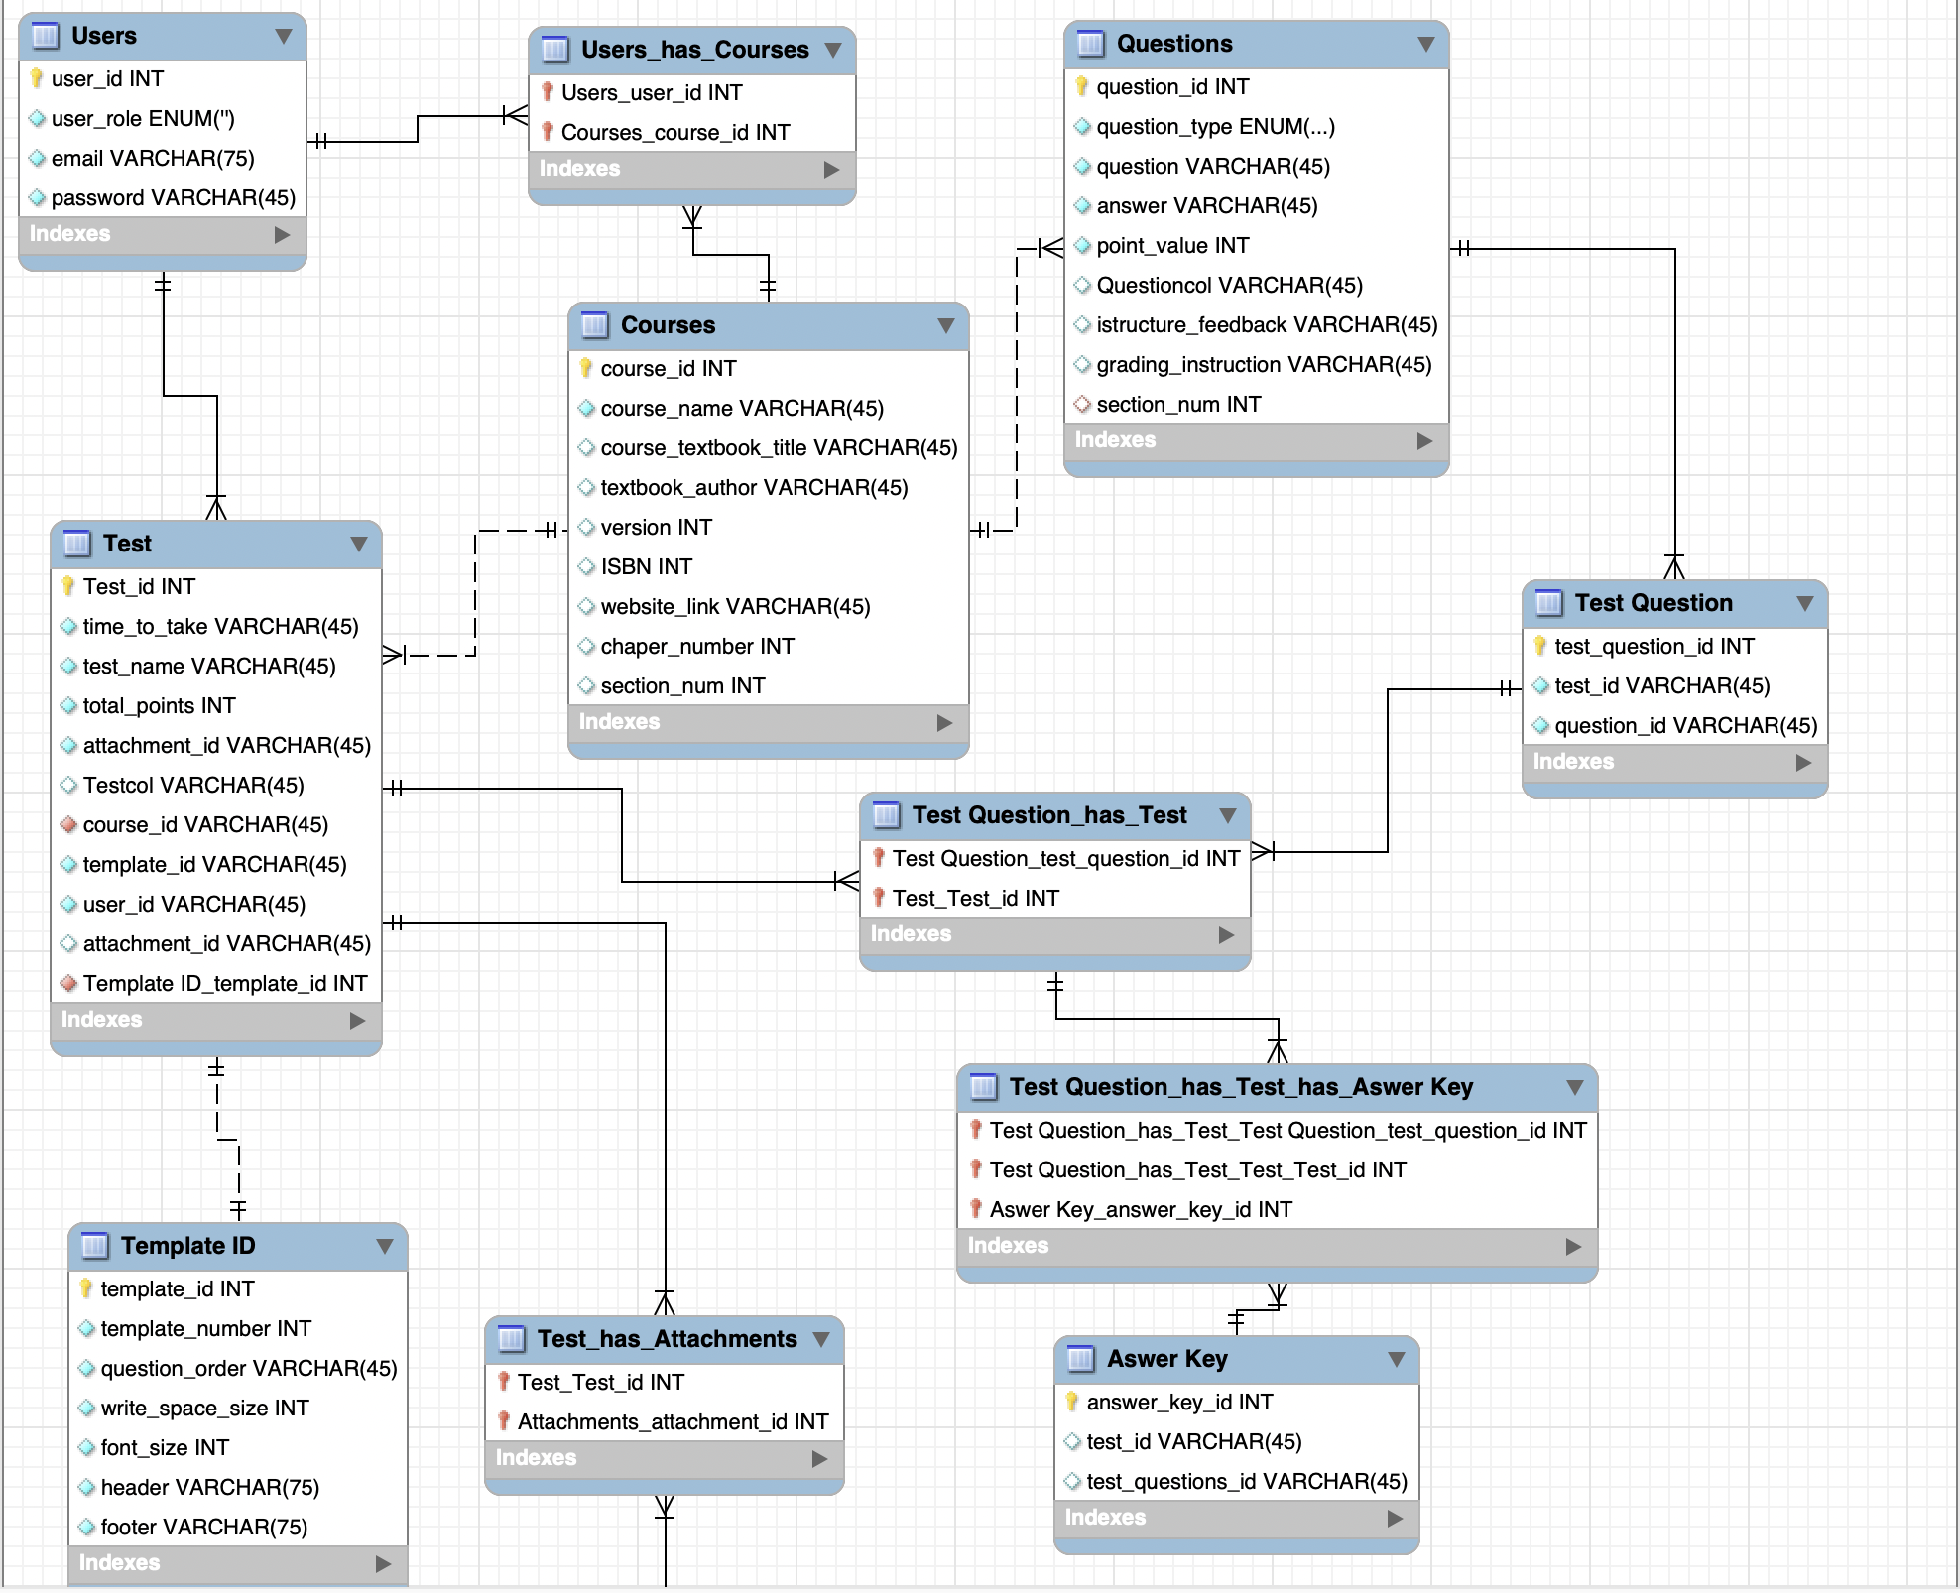
Database Details
Objective:
Facilitates management of courses, users, tests, and questions in an educational platform.
Key Entities:
Users, Courses, Tests, Questions, and Answer Keys
Flexibility:
Supports attachments, customizable templates, and question grading instructions.

Slide 10
Any Questions?

Slide 11
THANKS

