Slide 1
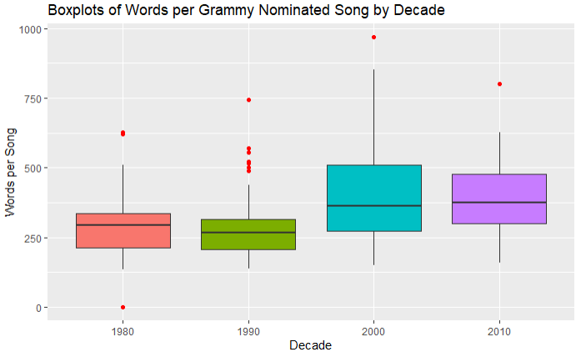

Slide 2
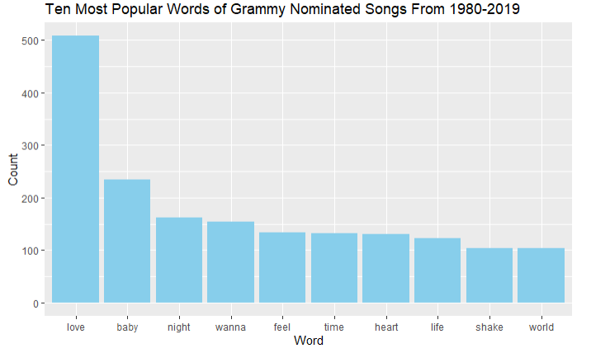

Slide 3
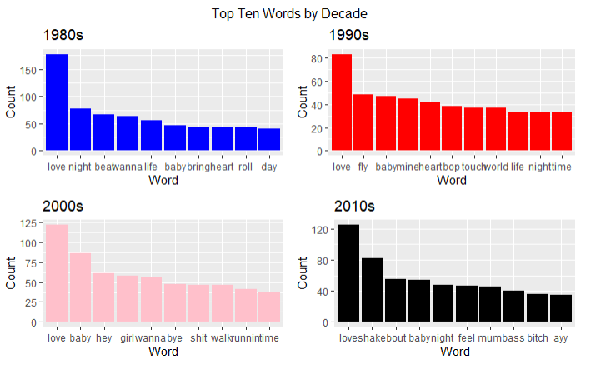

Slide 4
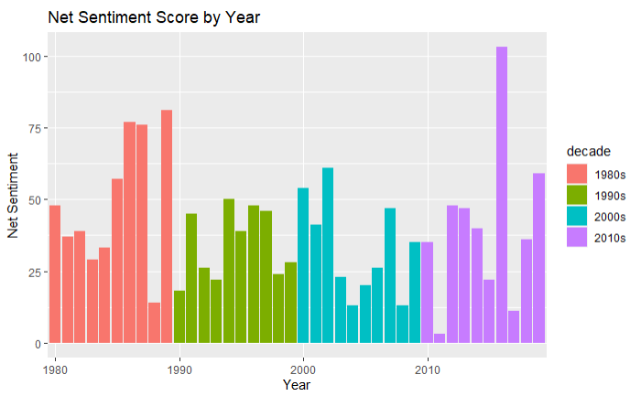

Slide 5
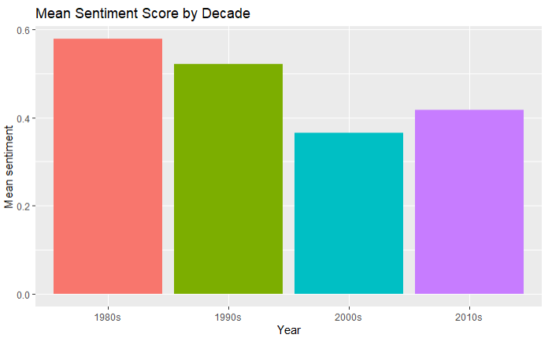

Slide 6
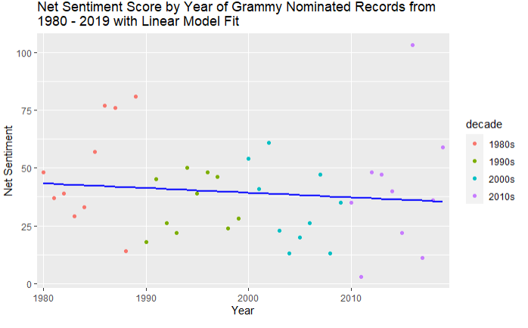

Slide 7
Thoughts
Most challenging:
Organize Data by myself without any hints or instructions
Things learned:
1. How to create a website by using Github
2. Mastered skills on data wrangling and graphing

