Slide 1
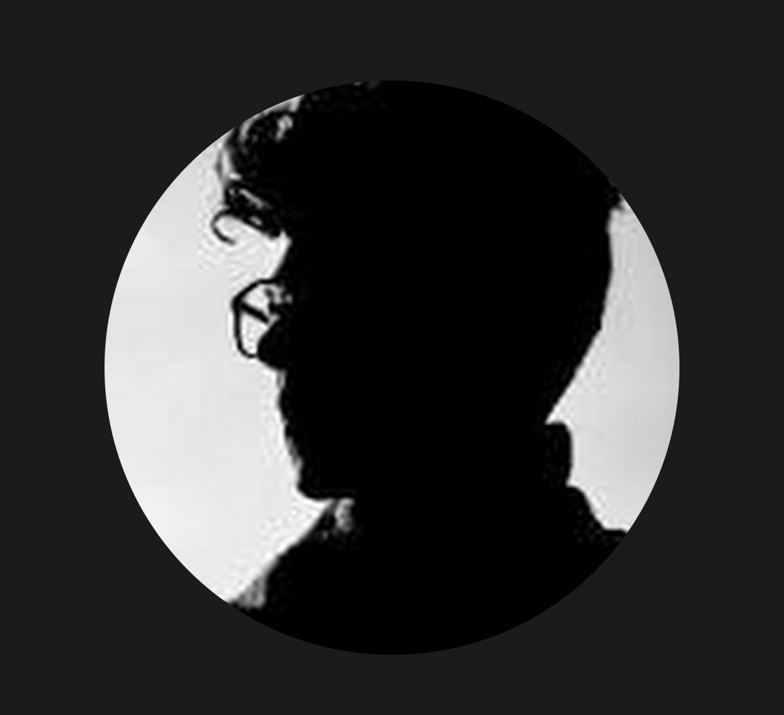
Digital Portfolio for IT Professional
Student Name: Prince.B
Register No: bru5b2426J1610
NMID: E792421DE295FA1A3964E581CC9AB510
Department: B.Sc (IT)
College: Dr.R.V Arts and Science College

Slide 2
AGENDA
1. Problem Statement
2. Project Overview
3.End Users
4. Tools and Technologies
5.Portfolio design and Layout
6. Features and Functionality
7.Results and Screenshots
8.Conclusion
9.Github Link

Slide 3
Problem Statement
• With the rapid growth in technology, there is an increasing demand for IT professionals to showcase their skills and projects.
• A digital portfolio allows professionals to present their work effectively, making it easier for potential employers to assess their abilities.
• The problem is that many IT professionals lack an organized platform to display their projects, achievements, and skills.
• This project aims to provide a customizable digital portfolio for IT professionals that is easy to maintain and share.

Slide 4
Project Overview
• This project focuses on creating a digital portfolio for IT professionals to display their skills, experience, projects, and accomplishments.
• The portfolio will include sections for personal information, educational background, work experience, skills, and projects.
• The digital portfolio will be responsive, visually appealing, and easy to navigate.
• Technologies such as HTML, CSS, and JavaScript will be used to create a modern, interactive design.

Slide 5
Who Are the End Users?
• IT professionals who wish to showcase their skills and work.
• Students in IT-related fields looking to build a portfolio for internships or job applications.
• Employers who want to view the portfolios of potential candidates.
• Freelancers looking to create an online presence and display their previous projects.

Slide 6
Tools and Technologies
• Frontend: HTML, CSS, JavaScript for creating the structure and styling of the portfolio.
• Backend (optional): Node.js for any server-side functionality, if required.
• Version Control: GitHub for storing and managing the code.
• Libraries: Bootstrap (for responsive design), jQuery (for enhanced interactivity), and other libraries as necessary.

Slide 7
Portfolio Design and Layout
• Clean, modern design with a focus on simplicity and readability.
• Navigation bar for easy access to sections like About, Projects, Skills, and Contact.
• Use of large, high-quality images to showcase projects.
• A grid or card layout to display projects, with detailed descriptions and links to project pages or GitHub repositories.

Slide 8
Features and Functionality
• Interactive UI: Smooth scrolling, hover effects, and pop-ups for project details.
• Responsive Design: The portfolio will be mobile-friendly and adjust to different screen sizes.
• Contact Form: A section for visitors to contact the professional directly.
• Project Showcase: A dedicated section where users can display their work with detailed descriptions and technologies used.
• GitHub Integration: Direct links to GitHub repositories for each project.

Slide 9
Results and Screenshots
• Display screenshots or mockups of the portfolio design.
• Include before and after images, if applicable, to showcase improvements made.
• Example: Screenshot of the homepage, project section, and contact form.

Slide 10
Conclusion
• The digital portfolio for IT professionals is an essential tool for career development in today’s tech-driven world.
• It provides an easy-to-share platform for showcasing projects, skills, and experience.
• The project successfully demonstrates the potential of using web technologies to build an interactive, user-friendly portfolio.

Slide 11
GitHub Link
Find my code on [GitHub]
https://github.com/Prince-09062006/Digital-portfolio-By-Prince.B

