Slide 1
Unit-3 Types, Operations and Functional Objects

Slide 2
Contents
Types and operations: Basic types,
Literals, Operators and methods,
Arithmetic operations
Relational and logical operations, Bitwise operations
Object equality, Operator precedence and associativity.
Functional Objects: Constructing a Rational
Reimplementing the to String method
Checking preconditions-Adding fields
Self references
Auxiliary constructors- Private fields and methods
Defining operators Identifiers in Scala
Method overloading Implicit conversions.

Slide 3
Arithmetic operations
In Scala, like in many other programming languages, you can use various arithmetic operators to perform mathematical operations on numerical values. Here are the common arithmetic operators in Scala:
Operator | Description
+ | Adds two operands
- | Subtracts second operand from the first
* | Multiplies both operands
/ | Divides numerator by de-numerator
% | Modulus operator finds the remainder after division of one number by another
+= | Increment operator, equivalent to myVar = myVar + step_size
-= | Decrement operator, equivalent to myVar = myVar - step_size

Slide 4
object operators {
def main(args: Array[String]): Unit = {
val a = 10
val b = 3
val sum = a + b
val difference = a - b
val product = a * b
val quotient = a / b
val remainder = a % b
println(s"Sum: $sum")
println(s"Difference: $difference")
println(s"Product: $product")
println(s"Quotient: $quotient")
println(s"Remainder: $remainder")
}
}

Slide 5
Relational Operators
Relational operators are used to compare values and express relationships between them. The common relational operators in Scala are similar to those in many other programming languages.
Operator | Description
== | Checks if the values of two operands are equal or not, if yes then condition becomes true.
!= | Checks if the value of left operand is greater than the value of right operand, if yes then condition becomes true.
> | Checks if the value of left operand is less than the value of right operand, if yes then condition becomes true.
< | Checks if the value of left operand is greater than or equal to the value of right operand, if yes then condition becomes true.
>= | Checks if the value of left operand is greater than or equal to the value of right operand, if yes then condition becomes true.
<= | Checks if the value of left operand is less than or equal to the value of right operand, if yes then condition becomes true.

Slide 6
object MyApp {
def main(args: Array[String]): Unit = {
val x = 10
val y = 20
// Equality (==) and Inequality (!=)
println(s"$x == $y: ${x == y}") // Output: 10 == 20: false
println(s"$x != $y: ${x != y}") // Output: 10 != 20: true
// Greater Than (>) and Less Than (<)
println(s"$x > $y: ${x > y}") // Output: 10 > 20: false
println(s"$x < $y: ${x < y}") // Output: 10 < 20: true
// Greater Than or Equal To (>=) and Less Than or Equal To (<=)
println(s"$x >= $y: ${x >= y}") // Output: 10 >= 20: false
println(s"$x <= $y: ${x <= y}") // Output: 10 <= 20: true
}
}

Slide 7
Logical Operators
Logical operators are used to perform logical operations on boolean values. The common logical operators are && (AND), || (OR), and ! (NOT)
Operator | Description
&& | && (AND) returns true if both operands are true, otherwise, it returns false
|| | || (OR) returns true if at least one of the operands is true, otherwise, it returns false.
! | ! (NOT) negates the boolean value, so !true is false, and !false is true.

Slide 8
object MyApp {
def main(args: Array[String]): Unit = {
val a = 10
val b = 20
val c = 5
// Logical AND in an if statement
if (a > b && b > c) {
println("Both conditions are true.")
} else {
println("At least one condition is false.")
}
// Logical OR in an if statement
if (a > b || b > c) {
println("At least one condition is true.")
} else {
println("Both conditions are false.")
}
}
}

Slide 9
Bitwise Operators
Operator | Description
& | Performs a bitwise AND operation between each pair of corresponding bits.
|| | Performs a bitwise OR operation between each pair of corresponding bits.
^ | Performs a bitwise XOR (exclusive OR) operation between each pair of corresponding bits.
~ | Inverts each bit of the operand, changing 1s to 0s and vice versa.
<< | left shift operator, <<, shifts the bits of a binary number to the left by a specified number of positions.
>> | right shift operator, >>, shifts the bits of a binary number to the right by a specified number of positions.

Slide 10
object Demo {
def main(args: Array[String]):Unit = {
var a = 60; //60 = 0011 1100
var b = 13; //13 = 0000 1101
var c = 0;
c = a & b; //12 = 0000 1100
println(s"$a & $b = $c")
c = a | b; //61 = 0011 1101
println("a | b = " + c )
c = a ^ b; // 49 = 0011 0001
println("a ^ b = " + c )
c = ~a; //-61 = 1100 0011
println("~a = " + c )
c = a << 2; //240 = 1111 0000
println("a << 2 = " + c )
c = a >> 2; //215 = 1111
println("a >> 2 = " + c )
c = a >>> 2; //215 = 0000 1111
println("a >>> 2 = " + c )
}
}

Slide 11
Assignment Operators
Operator | Description | Example
= | Simple assignment operator, Assigns values from right side operands to left side operand | C = A + B will assign value of A + B into C
+= | Add AND assignment operator, It adds right operand to the left operand and assign the result to left operand | C += A is equivalent to C = C + A
-= | Subtract AND assignment operator, It subtracts right operand from the left operand and assign the result to left operand | C -= A is equivalent to C = C - A
*= | Multiply AND assignment operator, It multiplies right operand with the left operand and assign the result to left operand | C *= A is equivalent to C = C * A
/= | Divide AND assignment operator, It divides left operand with the right operand and assign the result to left operand | C /= A is equivalent to C = C / A

Slide 12
Assignment Operators
Operator | Description | Example
%= | Modulus AND assignment operator, It takes modulus using two operands and assign the result to left operand | C %= A is equivalent to C = C % A
<<= | Left shift AND assignment operator | C <<= 2 is same as C = C << 2
>>= | Right shift AND assignment operator | C >>= 2 is same as C = C >> 2
&= | Bitwise AND assignment operator | C &= 2 is same as C = C & 2
^= | bitwise exclusive OR and assignment operator | C ^= 2 is same as C = C ^ 2
|= | bitwise inclusive OR and assignment operator | C |= 2 is same as C = C | 2

Slide 13
Operators Precedence
Operator | Description | Example
%= | Modulus AND assignment operator, It takes modulus using two operands and assign the result to left operand | C %= A is equivalent to C = C % A
<<= | Left shift AND assignment operator | C <<= 2 is same as C = C << 2
>>= | Right shift AND assignment operator | C >>= 2 is same as C = C >> 2
&= | Bitwise AND assignment operator | C &= 2 is same as C = C & 2
^= | bitwise exclusive OR and assignment operator | C ^= 2 is same as C = C ^ 2
|= | bitwise inclusive OR and assignment operator | C |= 2 is same as C = C | 2

Slide 14
Functional objects
In Scala, functional programming is a key paradigm, and functional objects play a significant role in building functional programs.
Functional objects are objects that adhere to functional programming principles, emphasizing immutability, referential transparency, and the use of first-class functions.
Functional objects are often immutable, meaning their state cannot be changed after creation. This immutability contributes to referential transparency and makes it easier to reason about the behavior of the program.
Functional programming in Scala often involves the use of higher-order functions, such as functions that take other functions as parameters or return functions as results. This allows for the creation of more generic and composable code.

Slide 15
Functional objects
// Functional object representing a simple counter
case class Counter(value: Int = 0) {
// Function to increment the counter
def increment: Counter = copy(value = value + 1)
// Function to decrement the counter
def decrement: Counter = copy(value = value - 1)
// Function to add a specific value to the counter
def add(amount: Int): Counter = copy(value = value + amount)
// Function to check if the counter is zero
def isZero: Boolean = value == 0
}

Slide 16
Functional objects
object funcDemo {
def main(args:Array[String]): Unit= {
// Example usage:
val initialCounter = Counter() // Creating an instance with the default value (0)
println(s"Initial Counter: $initialCounter")
val incrementedCounter = initialCounter.increment
println(s"Incremented Counter: $incrementedCounter")
val addedCounter = incrementedCounter.add(5)
println(s"Added Counter: $addedCounter")
val decrementedCounter = addedCounter.decrement
println(s"Decremented Counter: $decrementedCounter")
println(s"Is the counter zero? ${decrementedCounter.isZero}")
}
}

Slide 17
Case Class
In Scala, a case class is a special kind of class that is primarily used for immutable data modeling. Case classes are concise and come with a variety of built-in functionalities that are especially useful for working with data.

Slide 18
Case Class
case class Person(name: String, age: Int)
object caseClass {
def main(args:Array[String]): Unit= {
// Creating an instance of the case class
val person = Person("Alice", 30)
// Automatic toString, equals
println(person) // Output: Person(Alice,30)
println(person == Person("Alice", 30)) // Output: true
// Copy method
val modifiedPerson = person.copy(age = 31)
println(modifiedPerson) // Output: Person(Alice,31)
}
}

Slide 19
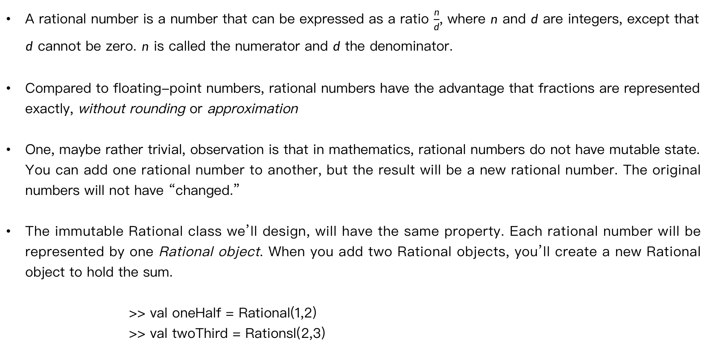
Rational class
A rational number is a number that can be expressed as a ratio $\frac{n}{d}$, where $n$ and $d$ are integers, except that $d$ cannot be zero. $n$ is called the numerator and $d$ the denominator.
Compared to floating-point numbers, rational numbers have the advantage that fractions are represented exactly, without rounding or approximation
One, maybe rather trivial, observation is that in mathematics, rational numbers do not have mutable state. You can add one rational number to another, but the result will be a new rational number. The original numbers will not have “changed.”
The immutable Rational class we’ll design, will have the same property. Each rational number will be represented by one Rational object. When you add two Rational objects, you’ll create a new Rational object to hold the sum.
>> val oneHalf = Rational(1,2)
>> val twoThird = Rationsl(2,3)

Slide 20
Constructing a Rational
Given we’ve decided to make Rational objects immutable, we’ll require that clients provide all data needed by an instance (in this case, a numerator and a denominator) when they construct the instance.
class Rational(n: Int, d: Int)
One of the first things to note about this line of code is that if a class doesn’t have a body, you don’t need to specify empty curly braces and cannot terminate with a colon.
The identifiers n and d in the parentheses after the class name, Rational, are called class parameters. The Scala compiler will gather up these two class parameters and create a primary constructor that takes the same two parameters.
The Scala compiler will compile any code you place in the class body, which isn’t part of a field or a method definition, into the primary constructor
class Rational(n: Int, d: Int):
println("Created " + n + "/" + d)

Slide 21
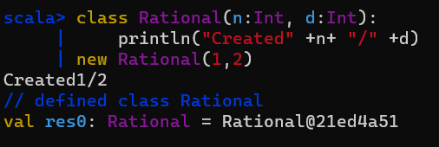
Constructing a Rational
Given this code, the Scala compiler would place the call to println into Rational’s primary constructor. The println call will, therefore, print its debug message whenever you create a new Rational instance:

Slide 22
Reimplementing the to String method
When we created an instance of Rational in the previous example, the REPL (Read, Evaluate, Print and Loop) printed “Rational@21ed4a51”.
The REPL obtained this string by calling toString on the Rational object. By default, class Rational inherits the implementation of toString defined in class java.lang.Object, which just prints the class name, an @ sign, and a hexadecimal number.
The result of toString is primarily intended to help programmers by providing information that can be used in debug print statements, log messages, test failure reports, and REPL and debugger output.
The result currently provided by toString is not especially helpful because it doesn’t give any clue about the rational number’s value. A more useful implementation of toString would print out the values of the Rational’s numerator and denominator.

Slide 23
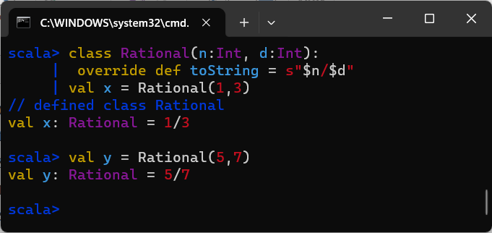
Reimplementing the to String method
You can override the default implementation by adding a method toString to class Rational, like this:

Slide 24
Checking preconditions
Rational numbers may not have a zero in the denominator.
>> Rational(5, 0)
val res1: Rational = 5/0
In the case of an immutable object such as Rational, this means that you should ensure the data is valid when the object is constructed. Given that a zero denominator is an invalid state for a Rational number, you should not let a Rational be constructed if a zero is passed in the d parameter.
The best way to approach this problem is to define as a precondition of the primary constructor that d must be non-zero.

Slide 25
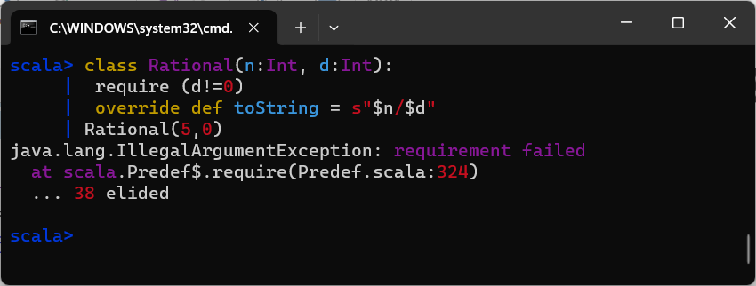
Checking preconditions
A precondition is a constraint on values passed into a method or constructor, a requirement which callers must fulfill. One way to do that is to use require, like this:
The require method takes one boolean parameter. If the passed value is true, require will return normally. Otherwise, require will prevent the object from being constructed by throwing an IllegalArgumentException.

Slide 26
Adding Fields
We can define a public add method on class Rational that takes another Rational as a parameter.
To keep Rational immutable, the add method must not add the passed rational number to itself. Rather, it must create and return a new Rational that holds the sum.

Slide 27
Adding Fields
class Rational(n:Int, d:Int){
require(d != 0)
val numer:Int = n
val denom:Int = d
override def toString = s"$numer/$denom"
def add(newObj:Rational):Rational =
new Rational(numer*newObj.denom+newObj.numer*denom, denom * newObj.denom)
}
object Demo extends App {
val rational1 = new Rational(1, 2)
val rational2 = new Rational(3, 4)
val sum = rational1.add(rational2)
println(sum)
}

Slide 28
Adding Fields
In the add method of our Rational class:
def add(newObj: Rational): Rational =
This means that when we call the add method on an instance of Rational, it will produce a new Rational instance as the result.
The method add that takes a parameter newObj of type Rational and returns a result of type Rational
This design allows for chaining operations and producing new instances of Rational when performing mathematical operations. Each time we call add, we get a new Rational instance representing the result of the addition in previous code.

Slide 29
Self references
In Scala, a self-reference, often referred to as this or self, is a way for a class to refer to itself.
It is useful in various scenarios, such as distinguishing between instance variables and method parameters with the same name, or when you need to pass a reference to the current instance to another method or function.

Slide 30
class MyClass(value: Int) {
// Instance variable
val myValue: Int = value
// Method using this
def printValue(): Unit = {
println(s"Value in this instance: $myValue")
}
// Another method that takes a parameter with the same name as the instance variable
def isSameValue(myValue: Int): Boolean = {
// Using this to refer to the instance variable
this.myValue == myValue
}
}
object Main extends App {
// Creating an instance of MyClass
val myObject = new MyClass(42)
// Calling methods
myObject.printValue() // Output: Value in this instance: 42
// Using isSameValue with a parameter having the same name
val result = myObject.isSameValue(42)
println(s"Is it the same value? $result") // Output: Is it the same value? true
}

Slide 31
Auxiliary constructors
In Scala, constructors other than the primary constructor are called auxiliary constructors.
They complement the primary constructor and provide alternative ways to create instances of the class with different parameter lists.

Slide 32
class Rational(n: Int, d: Int) {
require(d != 0, "Denominator must be nonzero")
// Primary constructor
val numer: Int = n
val denom: Int = d
// Auxiliary constructor for integers (denominator is 1 by default)
def this(n: Int) = this(n, 1)
// override def toString = s"$numer/$denom"
// Method to display the rational number
def display(): Unit = {
println(s"$numer / $denom")
}
}
object Main extends App {
// Using the primary constructor
val rational1 = new Rational(1, 2)
rational1.display() // Output: 1 / 2
// Using the auxiliary constructor for integers
val rational2 = new Rational(5)
rational2.display() // Output: 5 / 1
}

Slide 33
Private fields and methods
To make a field or method private you simply place the private keyword in front of its definition.
The purpose of the private methods is to factor out code needed by some other part of the class, in this case, the primary constructor.

Slide 34
class Rational(n: Int, d: Int) {
require(d != 0)
// Calculate greatest common divisor and simplify the fraction
private val g = gcd(n.abs, d.abs)
val numer = n / g
val denom = d / g
// Auxiliary constructor for integers (denominator is 1 by default)
def this(n: Int) = this(n, 1)
// Method to add two rational numbers
def add(newObj: Rational): Rational =
new Rational(numer * newObj.denom + newObj.numer * denom, denom * newObj.denom)
// Override toString for a meaningful representation
override def toString: String = s"$numer/$denom"
// Helper method to calculate greatest common divisor
private def gcd(a: Int, b: Int): Int = {
if (b == 0) a
else gcd(b, a % b)
}
}
object Demo extends App {
val Rational1 = new Rational(66,42)
val Rational2 = new Rational(25,15)
val sum = Rational1.add(Rational2)
println(sum)
}

Slide 35
Defining operators

Slide 36
Happy Learning

