Slide 1
Unit-2 Introduction to Scala

Slide 2
Contents
A Scalable Language, First Steps in Scala, Next Steps in Scala
Steps in Scala- Parameterize arrays with Use list- Use tuples-
Use sets and maps- Learn to recognize the Read lines from a file,
Classes and objects-Classes, fields, and methods-Semicolon Inference
Singleton objects-Scala application.

Slide 3
A Scalable Language
The name Scala stands for “scalable language.”
The language is so named because it was designed to grow with the demands of its users.
One can apply Scala to a wide range of programming tasks, from writing small scripts to building large systems
It runs on the standard Java and JavaScript platforms and interoperates seamlessly with all platform libraries
Scala is a blend of object-oriented and functional programming concepts in a statically typed language
Scala’s functional programming constructs make it easy to build interesting things quickly from simple parts. Its object-oriented constructs make it easy to structure larger systems and adapt them to new demands.

Slide 4
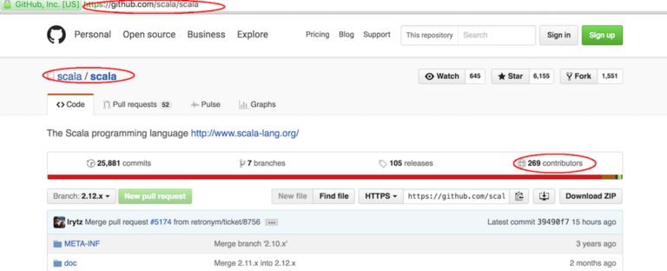
A Scalable Language
It was designed by Martin Odersky and the language runs on the Java Virtual Machine (JVM). The language has been around for just about a decade and is actively being developed. At the time of writing, there were 269 contributors on the GitHub Scala repository.

Slide 5
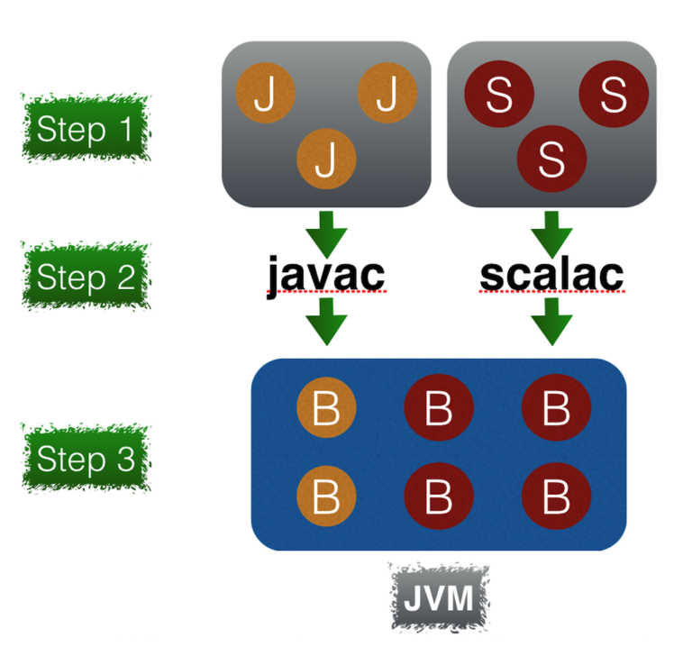
A Scalable Language

Slide 6


Main features of Scala
Functional programming
When defining a function it is important that the function does only what it is meant to do . In brief, the function should not have any hidden internal behaviour.
We could define a function to calculate Energy by taking the input M for the mass and multiplying by a constant C² which represents the speed of ligh
2. Composing functions
Functions that can be freely mixed in with other functions to compose even more functions.

Slide 7


Main features of Scala
3. Higher Order functions
functions in Scala are by design first class citizens. As such, in Scala you can create higher order functions which are functions that take other functions as parameters.
4. Pattern Matching
No functional programming language would be complete without pattern matching
load data in segments or partitions
filter for some entity
do some aggregation or computation
output or save the result to some database.

Slide 8


Main features of Scala
5. Asynchronous and parallel programming
6. Dependency Injection
Being an Object Oriented programming language, you have the usual type hierarchies as you'd expect from an Object Oriented language. However, Scala brings new meaning to dependency injection using features such as traits and implicits.

Slide 9
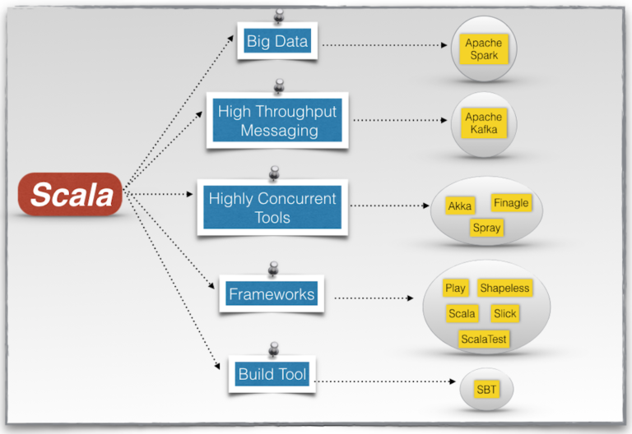
Main features of Scala

Slide 10
Scala Installation
Go to : https://scala-lang.org/

Slide 11
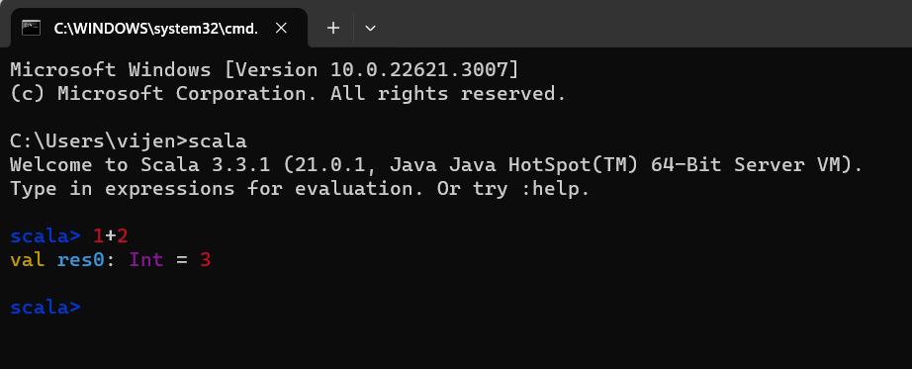
This line includes:
The keyword val, which declares a variable,
An automatically generated or user-defined name to refer to the computed value (res0, which means result 0),
A colon (:), followed by the type of the expression (Int),
An equals sign (=),
The value resulting from evaluating the expression (3)

Slide 12
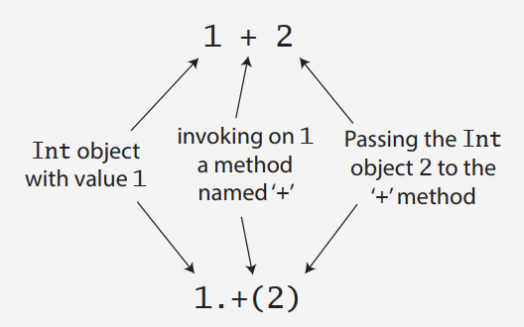
Scala doesn’t technically have operator overloading, because it doesn’t actually have operators in the traditional sense. Instead, characters such as +, -, *, and / can be used in method names.
Thus, when you type 1 + 2 into the Scala interpreter, you are actually invoking a method named + on the Int object 1, passing in 2 as a parameter. You could alternatively have written 1 + 2 using traditional method invocation syntax, 1.+(2).

Slide 13
Welcome to Scala 3.3.1 (21.0.1, Java Java HotSpot(TM) 64-Bit Server VM).
Type in expressions for evaluation. Or try :help.
scala> val msg = "hello world"
val msg: String = hello world
The type of msg is java.lang.String, because on the JVM Scala strings are implemented by Java’s String class
In this case, because you initialized msg with a string literal, Scala inferred the type of msg to be String. This is called type inference.
scala> val msg2:java.lang.String = "Hello again"
val msg2: String = Hello again
Or, Simply
scala> val msg3:String = "Hello"

Slide 14
Scala has two kinds of variables, vals and vars. A val is similar to a final variable in Java. Once initialized, a val can never be reassigned. A var, by contrast, is similar to a non-final variable in Java. A var can be reassigned throughout its lifetime.
scala> val msg:String = "hello world"
scala> msg = "We are using JVM"
-- [E052] Type Error: ------------------------------------------
1 |msg = "We are using JVM"
|^^^^^^^^^^^^^^^^^^^^^^^^
|Reassignment to val msg
|
| longer explanation available when compiling with `-explain`
1 error found
If reassignment is what we want, we’ll need to use a var, as in:
scala> var msg:String = "hello world"
scala> msg = "We are using JVM"

Slide 15
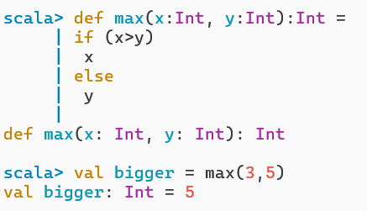
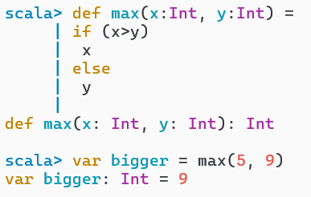
Define some functions
In this example, the function named max takes two parameters, x and y, both of type Int. After the close parenthesis of max’s parameter list you’ll find another “: Int” type annotation. This one defines the result type of the max function itself. Following the function’s result type is an equals sign and an indented block that defines the body of the function.

Slide 16
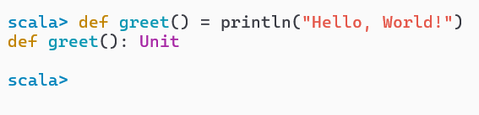
When you define the greet() function in the REPL, it will respond with def greet(): Unit.
“greet” is, of course, the name of the function. The empty parentheses indicate the function takes no parameters. And Unit is greet’s result type.
Scala’s Unit type is similar to Java’s void type; in fact, every void-returning method in Java is mapped to a Unit-returning method in Scala.

Slide 17
Writing Scala Scripts
A script is just a Scala source file that includes a top-level function annotated as @main.
Put this into a file named hello.scala:
@main def m() =
println("Hello, world, from a script!")
then run:
$ scala hello.scala
You can access command line arguments passed to your script by taking them as parameters to your main function.

Slide 18
Parameterize arrays with types
In Scala, you can instantiate objects, or class instances, using new. When you instantiate an object in Scala, you can parameterize it with values and types.
For example, the following Scala code instantiates a new java.math.BigInteger and parameterizes it with the value "12345"
val big = java.math.BigInteger("12345")
Parameterization means “configuring” an instance when you create it. You parameterize an instance with values by passing objects to a constructor in parentheses.

Slide 19
Parameterize arrays with types
You parameterize an instance with types by specifying one or more types in square brackets
In this example, greetStrings is a value of type Array[String] (an “array of string”) that is initialized to length 3 by parameterizing it with the value 3 in the first line of code.
One could have specified the type of greetStrings explicitly like this:
Given Scala’s type inference, this line of code is semantically equivalent to the actual first line

Slide 20
Parameterize arrays with types
val greetStrings:Array[String] = new Array[String](3)
greetStrings(0) = "Hello"
greetStrings(1) = ","
greetStrings(2) = "World!"
for i <- 0 to 2 do
println(greetStrings(i))
When you define a variable with val, the variable can’t be reassigned, but the object to which it refers could potentially still be changed.
greetStrings will always point to the same Array[String] instance with which it was initialized. But you can change the elements of that Array[String] over time, so the array itself is mutable.

Slide 21
Parameterize arrays with types
Arrays are simply instances of classes like any other class in Scala. When you apply parentheses surrounding zero, one, or more values to a variable, Scala will transform the code into an invocation of a method named apply on that variable.
So greetStrings(i) gets transformed into greetStrings.apply(i). Thus accessing an element of an array in Scala is simply a method call like any other.
This principle is not restricted to arrays: any application of an object to some arguments in parentheses will be transformed to an apply method call.

Slide 22
val greetStrings:Array[String] = new Array[String](3)
greetStrings.update(0, "Hello")
greetStrings.update(1, ",")
greetStrings.update(2, " World!")
for i <- 0.to(2) do
print(greetStrings.apply(i))

Slide 23
Parameterize arrays with types
for i <- 0 to 2 do
println(greetStrings(i))
general rule of Scala: if a method takes only one parameter, you can call it without a dot or parentheses.
The to in this example is actually a method that takes one Int argument. The code 0 to 2 is transformed into the method call 0.to(2).

Slide 24
First Program
The various parts of the main function are as follows:
def - In Scala the def keyword is used to define a function.
main - This is the function name.
(args: Array[String]) - main function takes in a named parameter args which is an Array of String.
: Unit - In Scala, the Unit keyword is used to define a function which does not return anything. This is similar to the void keyword similar to Java or .NET
object hello{ def main(args:Array[String]): Unit = { println(" Hello Again") } }

Slide 25
Basic syntax
The following are the basic syntaxes and coding conventions in Scala programming.
Case Sensitivity − Scala is case-sensitive, which means identifier Hello and hello would have different meaning in Scala.
Class Names − For all class names, the first letter should be in Upper Case. If several words are used to form a name of the class, each inner word's first letter should be in Upper Case. Example − class MyFirstScalaClass.
Method Names − All method names should start with a Lower Case letter. If multiple words are used to form the name of the method, then each inner word's first letter should be in Upper Case. Example − def myMethodName()

Slide 26
Program File Name − Name of the program file should exactly match the object name. When saving the file you should save it using the object name (Remember Scala is case-sensitive) and append ‘.scala’ to the end of the name. (If the file name and the object name do not match your program will not compile). Example − Assume 'HelloWorld' is the object name. Then the file should be saved as 'HelloWorld.scala’.
def main(args: Array[String]) − Scala program processing starts from the main() method which is a mandatory part of every Scala Program.

Slide 27
Basic syntax
When we consider a Scala program, it can be defined as a collection of objects that communicate via invoking each other’s methods.
Object − Objects have states and behaviors. An object is an instance of a class. Example − A dog has states - color, name, breed as well as behaviors - wagging, barking, and eating.
Class − A class can be defined as a template/blueprint that describes the behaviors/states that are related to the class.
Methods − A method is basically a behavior. A class can contain many methods. It is in methods where the logics are written, data is manipulated and all the actions are executed.

Slide 28
Fields − Each object has its unique set of instance variables, which are called fields. An object's state is created by the values assigned to these fields.
Closure − A closure is a function, whose return value depends on the value of one or more variables declared outside this function.
Traits − A trait encapsulates method and field definitions, which can then be reused by mixing them into classes. Traits are used to define object types by specifying the signature of the supported methods.

Slide 29
Scala Identifiers
All Scala components require names. Names used for objects, classes, variables and methods are called identifiers. A keyword cannot be used as an identifier and identifiers are case-sensitive. Scala supports four types of identifiers.
1. Alphanumeric Identifiers: An alphanumeric identifier starts with a letter or an underscore, which can be followed by further letters, digits, or underscores. The '$' character is a reserved keyword in Scala and should not be used in identifiers.
Following are legal alphanumeric identifiers −
age, salary, _value, __1_value
Following are illegal identifiers −
$salary, 123abc, -salary

Slide 30
2. Operator Identifiers: An operator identifier consists of one or more operator characters. Operator characters are printable ASCII characters such as +, :, ?, ~ or #. Following are legal operator identifiers −
+ ++ ::: <?> :>
3. Mixed Identifiers: A mixed identifier consists of an alphanumeric identifier, which is followed by an underscore and an operator identifier. Following are legal mixed identifiers −
unary_+, myvar_=
4. Literal Identifiers: A literal identifier is an arbitrary string enclosed in back ticks (` . . . `).
Following are legal literal identifiers −
`x` `<clinit>` `yield`

Slide 31
Scala keywords
abstract case catch class
def do else extends
false final finally for
forSome if implicit import
lazy match new Null
object override package private
protected return sealed super
this throw trait Try
true type val Var
while with yield
- : = =>
<- <: <% >:
# @

Slide 32
Comments in Scala
Scala supports single-line and multi-line comments very similar to Java. Multi-line comments may be nested, but are required to be properly nested. All characters available inside any comment are ignored by Scala compiler.
object HelloWorld {
/* This is my first java program.
* This will print 'Hello World' as the output
* This is an example of multi-line comments.
*/
def main(args: Array[String]) {
// Prints Hello World
// This is also an example of single line comment. println("Hello, world!")
}
}

Slide 33
Newline Characters
Scala is a line-oriented language where statements may be terminated by semicolons (;) or newlines. A semicolon at the end of a statement is usually optional.
You can type one if you want but you don't have to if the statement appears by itself on a single line. On the other hand, a semicolon is required if you write multiple statements on a single line. Below syntax is the usage of multiple statements.
val s = "hello"; println(s)

Slide 34
Scala Packages
A package is a named module of code. The package declaration is the first non-comment line in the source file as follows −
package com.liftcode.stuff
Scala packages can be imported so that they can be referenced in the current compilation scope. The following statement imports the contents of the scala.xml package −
import scala.xml._
You can import a single class and object, for example, HashMap from the scala.collection.mutable package −
import scala.collection.mutable.HashMap
You can import more than one class or object from a single package, for example, TreeMap and TreeSet from the scala.collection.immutable package −
import scala.collection.immutable.{TreeMap, TreeSet}

Slide 35
Data Types in Scala
Data types in scala are much similar to java in terms of their storage, length, except that in scala there is no concept of primitive data types every type is an object and starts with capital letter.
Data Type | Default Value | Size
Boolean | False | True or false
Byte | 0 | 8 bit signed value (-2⁷ to 2⁷-1)
Short | 0 | 16 bit signed value(-2¹⁵ to 2¹⁵-1)
Char | '\u0000' | 16 bit unsigned Unicode character(0 to 2¹⁶-1)
Int | 0 | 32 bit signed value(-2³¹ to 2³¹-1)
Long | 0L | 64 bit signed value(-2⁶³ to 2⁶³-1)
Float | 0.0F | 32 bit IEEE 754 single-precision float
Double | 0.0D | 64 bit IEEE 754 double-precision float
String | Null | A sequence of characters

Slide 36
Scala Basic Literals
Integral Literals: Integer literals are usually of type Int, or of type Long when followed by a L or l suffix. Here are some integer literals −
0
035
21
0xFFFFFFFF
0777L
Floating Point Literal: Floating point literals are of type Float when followed by a floating point type suffix F or f, and are of type Double otherwise. Here are some floating point literals −
0.0
1e30f
3.14159f
1.0e100
.1

Slide 37
Boolean Literals: The Boolean literals true and false are members of type Boolean.
Symbol Literals: A symbol literal 'x is a shorthand for the expression scala.Symbol("x"). Symbol is a case class, which is defined as follows.
package scala
final case class Symbol private (name: String) {
override def toString: String = "'" + name
}
Character Literals: A character literal is a single character enclosed in quotes. The character is either a printable Unicode character or is described by an escape sequence. Here are some character literals −
'a'
'\u0041'
'\n'
'\t'

Slide 38
String Literals: A string literal is a sequence of characters in double quotes. The characters are either printable Unicode character or are described by escape sequences. Here are some string literals −
"Hello,\nWorld!"
"This string contains a \" character.“
Multi-Line Strings: A multi-line string literal is a sequence of characters enclosed in triple quotes """ ... """. The sequence of characters is arbitrary, except that it may contain three or more consecutive quote characters only at the very end.
Characters must not necessarily be printable; newlines or other control characters are also permitted. Here is a multi-line string literal −
"""the present string
spans three
lines."""

Slide 39
Variables
Variables are nothing but reserved memory locations to store values. This means that when you create a variable, you reserve some space in memory.
Based on the data type of a variable, the compiler allocates memory and decides what can be stored in the reserved memory. Therefore, by assigning different data types to variables, you can store integers, decimals, or characters in these variables.
Scala has a different syntax for declaring variables. They can be defined as value, i.e., constant or a variable.

Slide 40
Immutable Variables
To define immutable variable, we use the keyword val with the following syntax:
val <Name of our variable>: <Scala type> = <Some literal>
As an example, you can define an immutable variable named donutsToBuy of type Int and assign its value to 5.
val donutsToBuy: Int = 5

Slide 41
Mutable Variables
To define Mutable variable, we use the keyword val with the following syntax:
var <Name of our variable>: <Scala type> = <Some literal>
As an example, you can define an mutable variable named “Salary” of type Float and assign its value to 982500.58.
val Salary: Float = 982500.58

Slide 42
Variable Type Inference
When you assign an initial value to a variable, the Scala compiler can figure out the type of the variable based on the value assigned to it. This is called variable type inference. Therefore, you could write these variable declarations like this
var myVar1 = 9
var myVar2 = “Scala Programming”

Slide 43
Multiple assignments
Scala supports multiple assignments. If a code block or method returns a Tuple, the Tuple can be assigned to a val variable.
val (myVar1:Int, myVar2:String) = (1234, “Ankit”)

Slide 44
object Demo { def main(args: Array[String])= { var a :Int = 10; var str1 :String = “VIT Bhopal"; val b :Float = 12.3f val str2 = “SCSE";
var c = 20;
val (myVar1:Int, myVar2:String) = (2022BCE1234, “Ankit”)
println(a); println(str1); println(b) println(str2) println(c)
} }

Slide 45
Scope of a variable
In Scala, the scope of a variable refers to the region of the code where the variable is accessible. Scala follows the block-scoping rule, meaning that the scope of a variable is limited to the block of code in which it is defined.
1. Local Scope:
Variables defined within a block, such as inside a method or a code block, have local scope.
These variables are only accessible within the block where they are declared.
object temp222 {
def main(args: Array[String]): Unit = {
val x = 10 // Local variable with scope limited to the main method
println(x)
}
}

Slide 46
2. Class/object Scope:
Variables defined within a class or an object have class scope.
They are accessible throughout the entire class or object.
Class temp222 {
val y = 20 // Class scope variable
def main(args: Array[String]): Unit = {
println(y) // Accessing class scope variable
}
}

Slide 47
3. Method Parameters:
Parameters of a method have scope limited to that method.
They are only accessible within the method.
object temp222 {
def add(a: Int, b: Int): Int = {
// a and b have scope limited to the add method
a + b
}
}

Slide 48
4. Block Scope:
Variables defined within a block (enclosed in curly braces) have scope limited to that block.
object temp222 {
def someMethod(): Unit = {
if (true) {
val z = 30 // Block scope variable
println(z)
}
// println(z) // Error: z is not accessible here
}
}

Slide 49
Class
A class is a user-defined blueprint or prototype from which objects are created. Or in other words, a class combines the fields and methods(member function which defines actions) into a single unit.
Basically, in a class constructor is used for initializing new objects, fields are variables that provide the state of the class and its objects, and methods are used to implement the behavior of the class and its objects.
In Scala, a class declaration contains the class keyword, followed by an identifier(name) of the class.
class Class_name{
// methods and fields
}

Slide 50
There are some optional attributes which can be used with class declaration according to the application requirement. In general, class declarations can include these components:
Keyword class: A class keyword is used to declare the type class.
Class name: The name should begin with a initial letter (capitalized by convention).
Superclass(if any):The name of the class’s parent (superclass), if any, preceded by the keyword extends.
Traits(if any): A comma-separated list of traits implemented by the class, if any, preceded by the keyword extends. A class can implement more than one trait.
Body: The class body is surrounded by { } (curly braces).

Slide 51
// A Scala program to illustrate how to create a class
// Name of the class is Smartphone
class Smartphone {
// Class variables
var number: Int = 16
var nameofcompany: String = "Apple"
// Class method
def Display() {
println("Name of the company : " + nameofcompany);
println("Total number of Smartphone generation: " + number);
}
}
object Main {
// Main method
def main(args: Array[String]) {
// Class object
var obj = new Smartphone();
obj.Display();
}
}

Slide 52
Object
It is a basic unit of Object-Oriented Programming and represents the real-life entities. A typical Scala program creates many objects, which as you know, interact by invoking methods. An object consists of :
State: It is represented by attributes of an object. It also reflects the properties of an object.
Behavior: It is represented by methods of an object. It also reflects the response of an object with other objects.
Identity: It gives a unique name to an object and enables one object to interact with other objects
Syntax:
var obj = new Class();

Slide 53
The new operator instantiates a class by allocating memory for a new object and returning a reference to that memory. The new operator also invokes the class constructor.
class Dog(name:String, breed:String, age:Int, color:String )
{
println("Name is:" + name + " Breed is:" + breed);
println("Age is: " + age + " Color is :" + color);
}
object creating_obj {
def main(args: Array[String]) {
var obj = new Dog("tuffy", "Labrador", 5, "Brown");
}
}

Slide 54
Arrays
In Scala, you can create an array using the Array class. You declare the type of the elements inside square brackets, and you can initialize the array with values:
var myVarName: Array[data_type] = Array(val1, val2,…, valuen)
object array_test {
def main(args: Array[String]) {
// Creating an array of integers with size 5
val numbers: Array[Int] = Array(1, 2, 3, 4, 5)
val names: Array[String] = Array("Alice", "Bob", "Charlie")
}
}

Slide 55
Array elements are accessed using zero-based indices
val firstElement: Int = numbers(0)
println(firstElement)
val thirdElement: Int = numbers(2)
println(thirdElement)
You can update the value of an element using its index:
numbers(1) = 10 // Updating the second element to 10
println(numbers(1))
The length property gives you the size of the array:
val length: Int = numbers.length

Slide 56
Iterating Over Arrays: Arrays can be traversed using :
for (num <- numbers) {
println(num)
}
// Using foreach
numbers.foreach(println)
Common Array Methods: sum, max, min: Compute the sum, maximum, and minimum of the array elements.
val sum: Int = numbers.sum
val max: Int = numbers.max
val min: Int = numbers.min

Slide 57
Multidimensional Arrays: Scala supports multidimensional arrays, which are arrays of arrays:
val matrix: Array[Array[Int]] = Array(
Array(1, 2, 3),
Array(4, 5, 6),
Array(7, 8, 9))

Slide 58
Concatenate Arrays:
Using ++ Operator
val array1: Array[Int] = Array(1, 2, 3)
val array2: Array[Int] = Array(4, 5, 6)
val concatenatedArray: Array[Int] = array1 ++ array2
use concat() method to concatenate two arrays. You can pass more than one array as arguments to concat() method.
val array1: Array[Int] = Array(1, 2, 3)
val array2: Array[Int] = Array(4, 5, 6)
val concatenatedArray: Array[Int] = Array.concat(array1, array2)

Slide 59
Collections
Collections are containers of things. Those containers can be sequenced, linear sets of items like List, Tuple, Option, Map, etc.
The collections may have an arbitrary number of elements or be bounded to zero or one element (e.g., Option).
Collections may be strict or lazy. Lazy collections have elements that may not consume memory until they are accessed, like Ranges.
Collections may be mutable (the contents of the reference can change) or immutable

Slide 60
Sr.No | Collections with Description
1 | Scala Lists
2 | Scala Sets
3 | Scala Maps
4 | Scala Tuples
5 | Scala Options
6 | Scala Iterators

Slide 61
List
Scala Lists are quite similar to arrays which means, all the elements of a list have the same type but there are two important differences.
First, lists are immutable, which means elements of a list cannot be changed by assignment.
Second, lists represent a linked list whereas arrays are flat.
object Lists01 { def main(args:Array[String]): Unit = { val fruit: List[String] = List("Apples", "Oranges", "Banana") val nums: List[Int] = List(1,2,3,4) //print fruit.foreach(println) for (vals<-nums) { println(nums) } } }

Slide 62
Lists can also be created used cons (::) operator
object Lists01 { def main(args:Array[String]): Unit = {
val fruit: List[String] = "Apples“::"Oranges“::"Banana“::Nil val nums: List[Int] = 1::2::3::4::Nil //print fruit.foreach(println) for (vals<-nums) { println(vals) } } }

Slide 63
Basic operations on List
SN | Methods & Description
1 | Head: This method returns the first element of a list.
2 | Tail: This method returns a list consisting of all elements except the first.
3 | isEmpty: This method returns true if the list is empty otherwise false.

Slide 64
object Lists01 {
def main(args:Array[String]): Unit = {
val fruit: List[String] = "Apples"::"Oranges"::"Banana"::Nil
val firstElement: String = fruit.head
println("First element is: " +firstElement)
val restOfList: List[String] = fruit.tail
println("Rest of the elements are: " +restOfList)
// restOfList.foreach(println)
val checkEmpty: Boolean = fruit.isEmpty
println("Is the list empty: " +checkEmpty)
}

Slide 65
Concatenating Lists
In Scala, you can concatenate lists using various methods, and the two most common approaches are using the ++ operator or the ::: method.
object ConcatenateLists {
def main(args: Array[String]): Unit = {
// Create two lists
val list1: List[Int] = List(1, 2, 3)
val list2: List[Int] = List(4, 5, 6)
// Concatenate using ++
val concatenatedList1: List[Int] = list1 ++ list2
// Concatenate using :::
val concatenatedList2: List[Int] = list1 ::: list2
// Print the results
println("Concatenated List using ++:")
println(concatenatedList1)
println("\nConcatenated List using :::")
println(concatenatedList2)
}
}

Slide 66
Creating Uniform Lists
Tabulating a Function
Reverse List Order

Slide 67
Tuples
Another useful container object is the tuple. Like lists, tuples are immutable, but unlike lists, tuples can contain different types of elements.
Tuples are immutable, and their elements can be accessed using positional notation.
object tupleExercise {
def main(args:Array[String]):Unit = {
val myTuple: (Int, String, Double) = (42, "Scala", 3.14)
//Accessing Elements
val firstElement: Int = // myTuple(0) // myTuple._1
println(firstElement)
val secondElement: String = myTuple(1) // myTuple._2
println(secondElement)
val thirdElement: Double = myTuple(2) //myTuple._3
println(thirdElement)
}
}
Prior to Scala 3, you can access tuple elements using the _N notation, where N is the 1-based index:

Slide 68
Iterating Over Tuples: One can use myTuple.productIterator() method to iterate over all the elements of a Tuple.
object tupleExercise {
def main(args: Array[String]) {
val numbers = (4,3,2,1)
numbers.productIterator.foreach{ i =>println("Value = " + i )}
}
}
Converting to String: One can convert the elements to Strings using .toString() function.
object tupleExercise22 {
def main(args: Array[String]):Unit= {
val elements = (1, "hello", "Friends")
println("String: " + elements.toString() )
}
}

Slide 69
Sets
In Scala, a Set is a collection of distinct elements without duplicates. Sets are part of the Scala collections library and are available in both mutable and immutable variants.
Immutable Sets:
Immutable sets are preferred in functional programming because they are immutable, meaning their content cannot be changed after they are created. You can create an immutable set using the Set companion object:
object setsDemo{
def main(args: Array[String]):Unit= {
// Creating an immutable set
val immutableSet: Set[Int] = Set(1, 2, 3, 4, 5)
immutableSet.foreach(println)
}
}

Slide 70
Some basic operations :
various operations on immutable sets, such as adding elements, removing elements, checking for membership etc.
object setsDemo{
def main(args: Array[String]):Unit= {
// Creating an immutable set
val immutableSet : Set[Int] = Set(7,22, 93, 53, 52)
// Adding an element to the set
val newSet = immutableSet + 6
println(newSet)
// Removing an element from the set
val removedSet = immutableSet - 3
println(removedSet)
// Checking for membership
val containsElement: Boolean = immutableSet.contains(22)
println(containsElement) }
}

Slide 71
Mutable Sets:
Mutable sets, on the other hand, allow in-place modifications. They are part of the scala.collection.mutable package.
import scala.collection.mutable
object setsDemo{
def main(args: Array[String]):Unit= {
// Creating a mutable set
val mutableSet: mutable.Set[String] = mutable.Set("apple", "orange", "banana")
// Adding an element to the set
mutableSet.add("grape")
// Removing an element from the set
mutableSet.remove("orange")
}
}

Slide 72
Both immutable and mutable sets support common set operations like union, intersection, and difference.
object setsDemo{
def main(args: Array[String]):Unit= {
val set1: Set[Int] = Set(1, 2, 3)
val set2: Set[Int] = Set(2, 3, 4)
// Union
val unionSet: Set[Int] = set1.union(set2)
unionSet.foreach(println)
// Intersection
val intersectionSet: Set[Int] = set1.intersect(set2)
intersectionSet.foreach(println)
// Difference
val differenceSet: Set[Int] = set1.diff(set2)
differenceSet.foreach(println)
}
}

Slide 73
Find Max, Min Elements in a Set:
Use either Set.& method or Set.intersect method to find out the common values between two sets
object setsDemo{
def main(args: Array[String]):Unit= {
// Creating an immutable set
val mySet: Set[Int] = Set(7,22, 93, 53, 56)
println("The minimum value in set is: " +mySet.min)
println("The maximum value in set is: " +mySet.max)
}
}

Slide 74
Maps
Imagine you have a dictionary where you can look up words and find their meanings. In Scala, a map is like a dictionary. It's a collection that associates keys with values, so you can quickly find a value (or "meaning") for a given key (or "word").
object mapsDemo{
def main(args: Array[String]):Unit= {
val fruitPrices: Map[String, Double] = Map("Apple" -> 2.5, "Orange" -> 1.8, "Banana" -> 1.2)
val applePrice: Double = fruitPrices("Apple")
println(applePrice)
}
}

Slide 75
object mapsDemo {
def main(args:Array[String]): Unit= {
// Creating an immutable map
val myMap = Map("key1" -> 42, "key2" -> 23, "key3" -> 15)
// Accessing values
val valueForKey1 = myMap("key1") // Returns 42
println(valueForKey1)
// Adding a new key-value pair (creates a new map)
val newMap = myMap + ("key4" -> 99)
println(newMap)
// Iterating over key-value pairs
for ((key, value) <- myMap) {
println(s"Key: $key, Value: $value")
}
}
}

Slide 76
Mutable Map: Mutable maps can be modified after creation. In Scala, you can use scala.collection.mutable.Map for mutable maps
import scala.collection.mutable.Map
object mapsDemo2 {
def main(args:Array[String]): Unit= {
// Creating a mutable map
val mutableMap = Map("key1" -> 42, "key2" -> 23, "key3" -> 15)
// Modifying values
mutableMap("key1") = 99
// Adding a new key-value pair
mutableMap += ("key4" -> 77)
// Removing a key
mutableMap -= "key2" // using "-=" operator
//mutableMap.remove("key2")
// Iterating over key-value pairs
for ((key, value) <- mutableMap) {
println(s"Key: $key, Value: $value")
}
}
}

Slide 77
Files I/O
In Scala, you can perform I/O (Input/Output) operations using various classes provided by the java.io and java.nio.file packages, as well as Scala-specific utilities.
import java.io._
object Demo {
def main(args: Array[String]):Unit= {
val writer = new PrintWriter(new File("test.txt" ))
writer.println("Hello Scala")
writer.println("VIT Bhopal")
writer.close()
}
}

Slide 78
Reading a Line from Command Line
Sometime you need to read user input from the screen and then proceed for some further processing.
import java.io._
object Demo {
def main(args: Array[String]):Unit= {
print("Please enter the input")
val line = scala.io.StdIn.readLine("Enter a line of text: ")
println(s"You entered: $line")
}
}

Slide 79
Reading File Content
import scala.io.Source
object Demo {
def main(args: Array[String]) {
println("Following is the content read:" )
Source.fromFile("test.txt" ).foreach {
print
}
}
}

Slide 80
Semicolon Inference
In Scala, semicolon inference refers to the ability of the compiler to automatically insert semicolons in specific situations where they are optional.
Scala allows you to write code with or without explicit semicolons, and the compiler can often infer the end of statements based on the structure of the code.
Here are the basic rules for semicolon inference in Scala:
1. Newline Inference:
Semicolons are optional to end statements if the statement is followed by a newline.
The end of a line can be treated as the end of a statement, eliminating the need for a semicolon.
val x = 42
val y = "Hello, Scala"
println(x)
println(y)

Slide 81
2. Explicit Semicolons:
You can use explicit semicolons to separate multiple statements on the same line.
Semicolons are also required if you want to write multiple statements on a single line.
val x = 42; val y = "Hello, Scala"; println(x); println(y)
3. Forcing Statements on the Same Line:
In certain situations, the compiler might interpret newlines differently than you intended. You can use semicolons to explicitly indicate the end of a statement.
val x = 42; println(x)

Slide 82
Singleton Objects
In Scala, a singleton object is an object that is defined using the object keyword rather than the class keyword.
Unlike class instances, which can have multiple instances created, a singleton object can have only one instance, and it is created automatically when the program starts.
object MySingleton {
// This code block represents the body of the singleton object
def sayHello(): Unit = {
println("Hello VIT Bhopal!")
}
}
In this example, MySingleton is a singleton object with a method sayHello. You can call the method like this:
MySingleton.sayHello()

Slide 83
Scala Application
A Scala application typically consists of a main method that serves as the entry point for the program. Here's an example of a simple Scala application:
object MyApp {
def main(args: Array[String]): Unit = {
// Your application logic goes here
println("Hello, Scala Application!")
}
}
In this example:
MyApp is a singleton object that contains a main method.
The main method takes an array of strings (args) as its parameter, which allows you to pass command-line arguments to your application.
Inside the main method, you can put the logic of your application. In this case, it prints "Hello, Scala Application!" to the console.

Slide 84
To run the application, you can save the code in a file (e.g., MyApp.scala) and then use the scala command:
scala MyApp.scala
This will execute the main method in the MyApp object.
If you want to create a standalone executable JAR file for your Scala application, you can use a build tool like sbt (Scala Build Tool) or Maven.

Slide 85
Happy Learning

Slide 86
Extra

Slide 87
Extending trait
In the previous code, we have to define main function manually.
Instead, we can extend the the App trait as follows:
package exercise001 object helloworld extends App{ println("Hello world program") }
The App trait encapsulates the main function.
You can see the source code by:
On Window: press and hold the CTRL key + on the App trait
On Mac: press and hold the CMD key + click on the App left click on the App trait

Slide 88
Singleton Objects
When a singleton object shares the same name with a class, it is called that class’s companion object.
You must define both the class and its companion object in the same source file.
The class is called the companion class of the singleton object. A class and its companion object can access each other’s private members
In this example, MySingleton is a singleton object with a method sayHello. You can call the method like this:
MySingleton.sayHello()
Notes:
Statics don't belong to an object, they can't be inherited, they don't take part in polymorphism. Simply put, statics aren't object-oriented.

