Slide 1

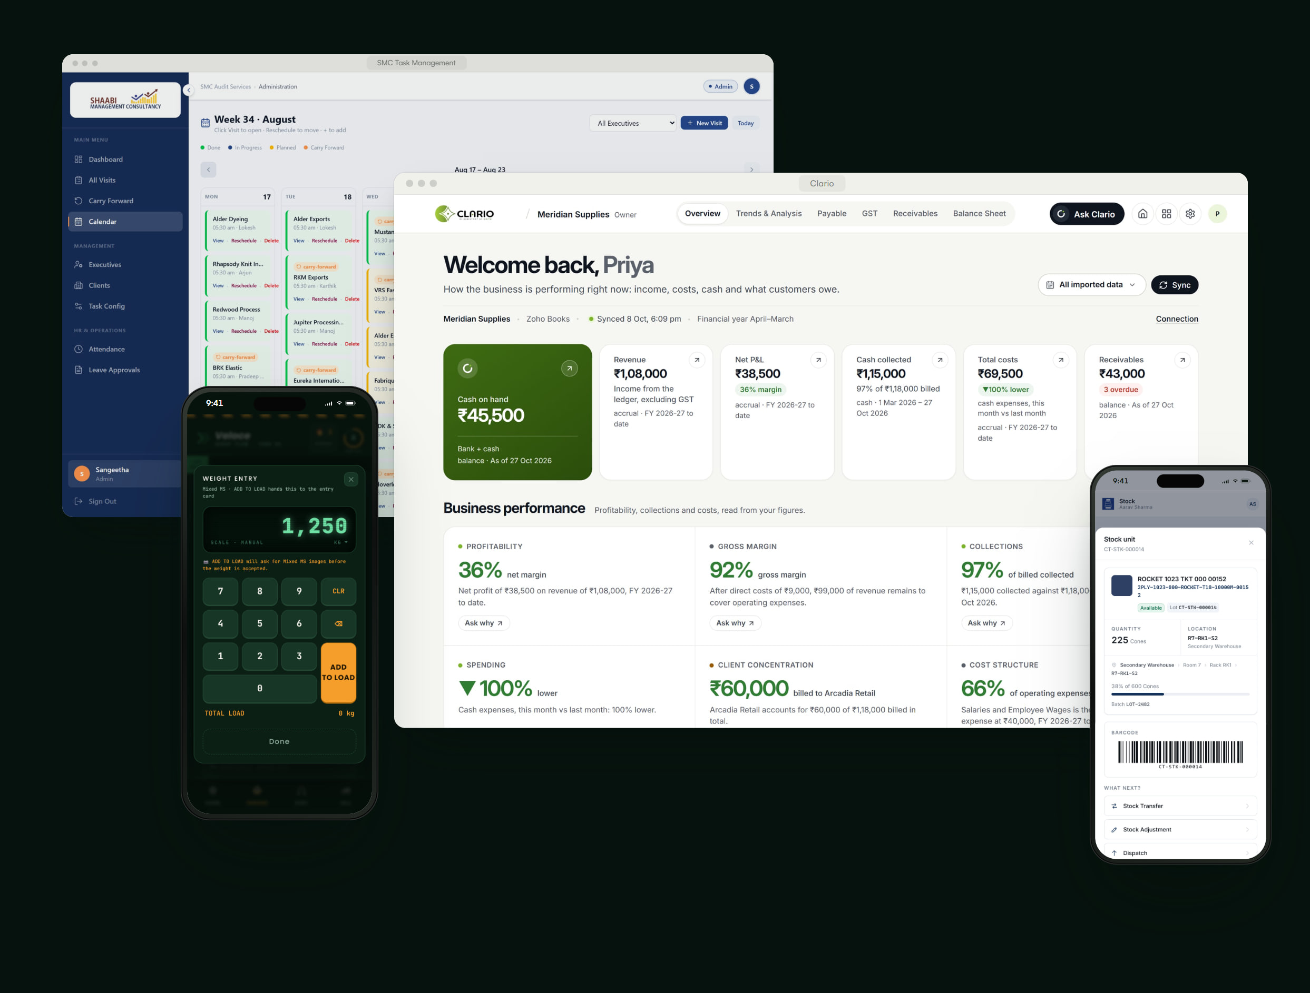

SELECTED WORK 2026
CONSULTING-LED TECHNOLOGY PARTNER
Software that brings clarity to complex operations.
Crita Creative LLP is a consulting-led technology partner. We design and build custom business platforms — for field teams, warehouses, scrap yards and finance — around the way each business actually works.
01
SMC Task Management
Field operations platform
02
Veloce Scrap Flow
Yard operations & inventory platform
03
Clario
Business-intelligence platform
04
City Threads
Warehouse & inventory management
Notes:
OPEN — who we are in one breath.
“Crita is a consulting-led technology partner. We design and build custom business platforms around the way each business actually works.”
What follows: four real platforms we built — a field-audit system, a scrap-yard inventory platform, our own business-intelligence product and a textile warehouse system. Every screen is from the live product.
Tip: click a project name at the bottom to jump straight to it.

Slide 2
Crita Creative LLP
WHO WE ARE
Consulting-led technology partner
18+
We combine strategy, product design and engineering to turn fragmented operations into connected systems people actually use. Every project starts with the business, not the brief.
Projects delivered
07
Crita Creative LLP is a consulting-led technology partner. We design and build custom business platforms — for field teams, warehouses, scrap yards and finance — around the way each business actually works.
Industries served
Figures from crita.in.
HOW WE WORK — CLARITY, THEN CODE.
01
Discover
Map the operation, the constraints and the priorities that really decide how the business scales.
02
Strategize
Design the workflows, roles and architecture against outcomes — not feature lists.
03
Build
Ship a working system quickly, with automation and rules built in from day one.
04
Scale
Tune the system with real usage so it keeps up as the business grows.
Notes:
WHO WE ARE
We combine strategy, product design and engineering to turn fragmented operations into connected systems people actually use. Every project starts with the business, not the brief.
Proof points from crita.in: 18+ projects delivered, 07 industries served.
How we work — “Clarity, then code”: Discover, Strategize, Build, Scale. We earn the right to build by understanding the business first.

Slide 3
What we build for growing businesses.
CAPABILITIES
Every capability is demonstrated in the work that follows.
01
Operations platforms
Role-based systems that plan, run and audit work across field teams and the office.
SMC Task Management · Veloce Scrap Flow
02
Inventory & warehousing
Lots, barcodes, bins and ledgers that make every unit of stock traceable.
Veloce Scrap Flow · City Threads
03
Business intelligence
Dashboards that turn the systems you already use into clear decisions.
Clario · Veloce Scrap Flow
04
Applied AI
Assistants that answer from your own data, with sources — never invented numbers.
Clario
05
Mobile-first apps
Designed for one hand on the shop floor and in the field, packaged for Android.
SMC Task Management · Veloce Scrap Flow · City Threads
06
Multi-tenant foundations
Workspaces, roles, data isolation and audit trails, ready to scale.
Veloce Scrap Flow · Clario
Notes:
WHAT WE BUILD — six capabilities, each proven by a project in this deck:
1. Operations platforms — Role-based systems that plan, run and audit work across field teams and the office. (see SMC Task Management, Veloce Scrap Flow)
2. Inventory & warehousing — Lots, barcodes, bins and ledgers that make every unit of stock traceable. (see Veloce Scrap Flow, City Threads)
3. Business intelligence — Dashboards that turn the systems you already use into clear decisions. (see Clario, Veloce Scrap Flow)
4. Applied AI — Assistants that answer from your own data, with sources — never invented numbers. (see Clario)
5. Mobile-first apps — Designed for one hand on the shop floor and in the field, packaged for Android. (see SMC Task Management, Veloce Scrap Flow, City Threads)
6. Multi-tenant foundations — Workspaces, roles, data isolation and audit trails, ready to scale. (see Veloce Scrap Flow, Clario)
Ask the client which of these matters most, then jump to that project.

Slide 4
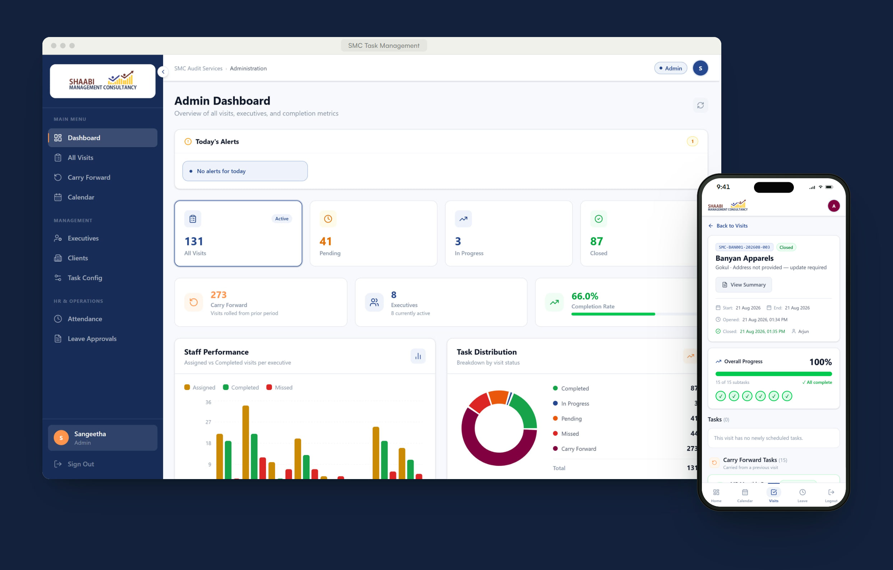
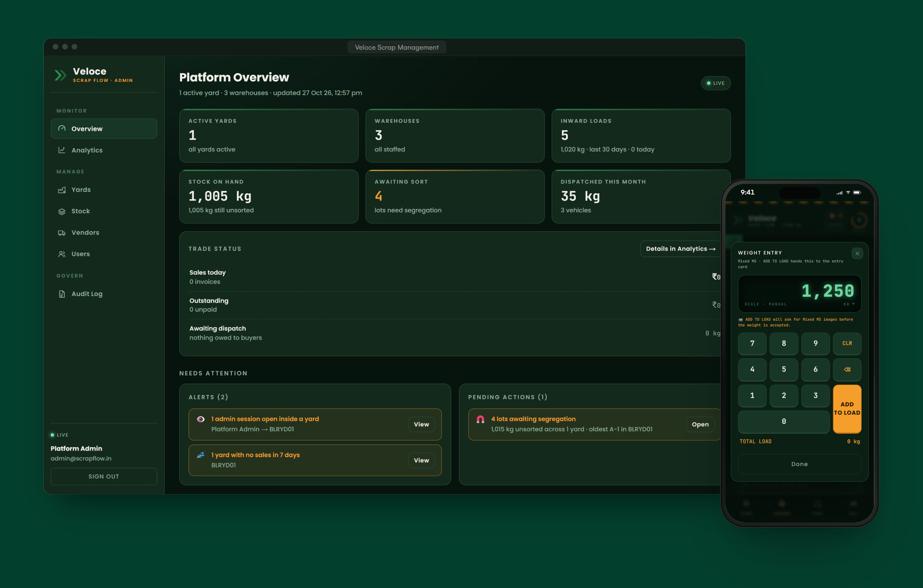
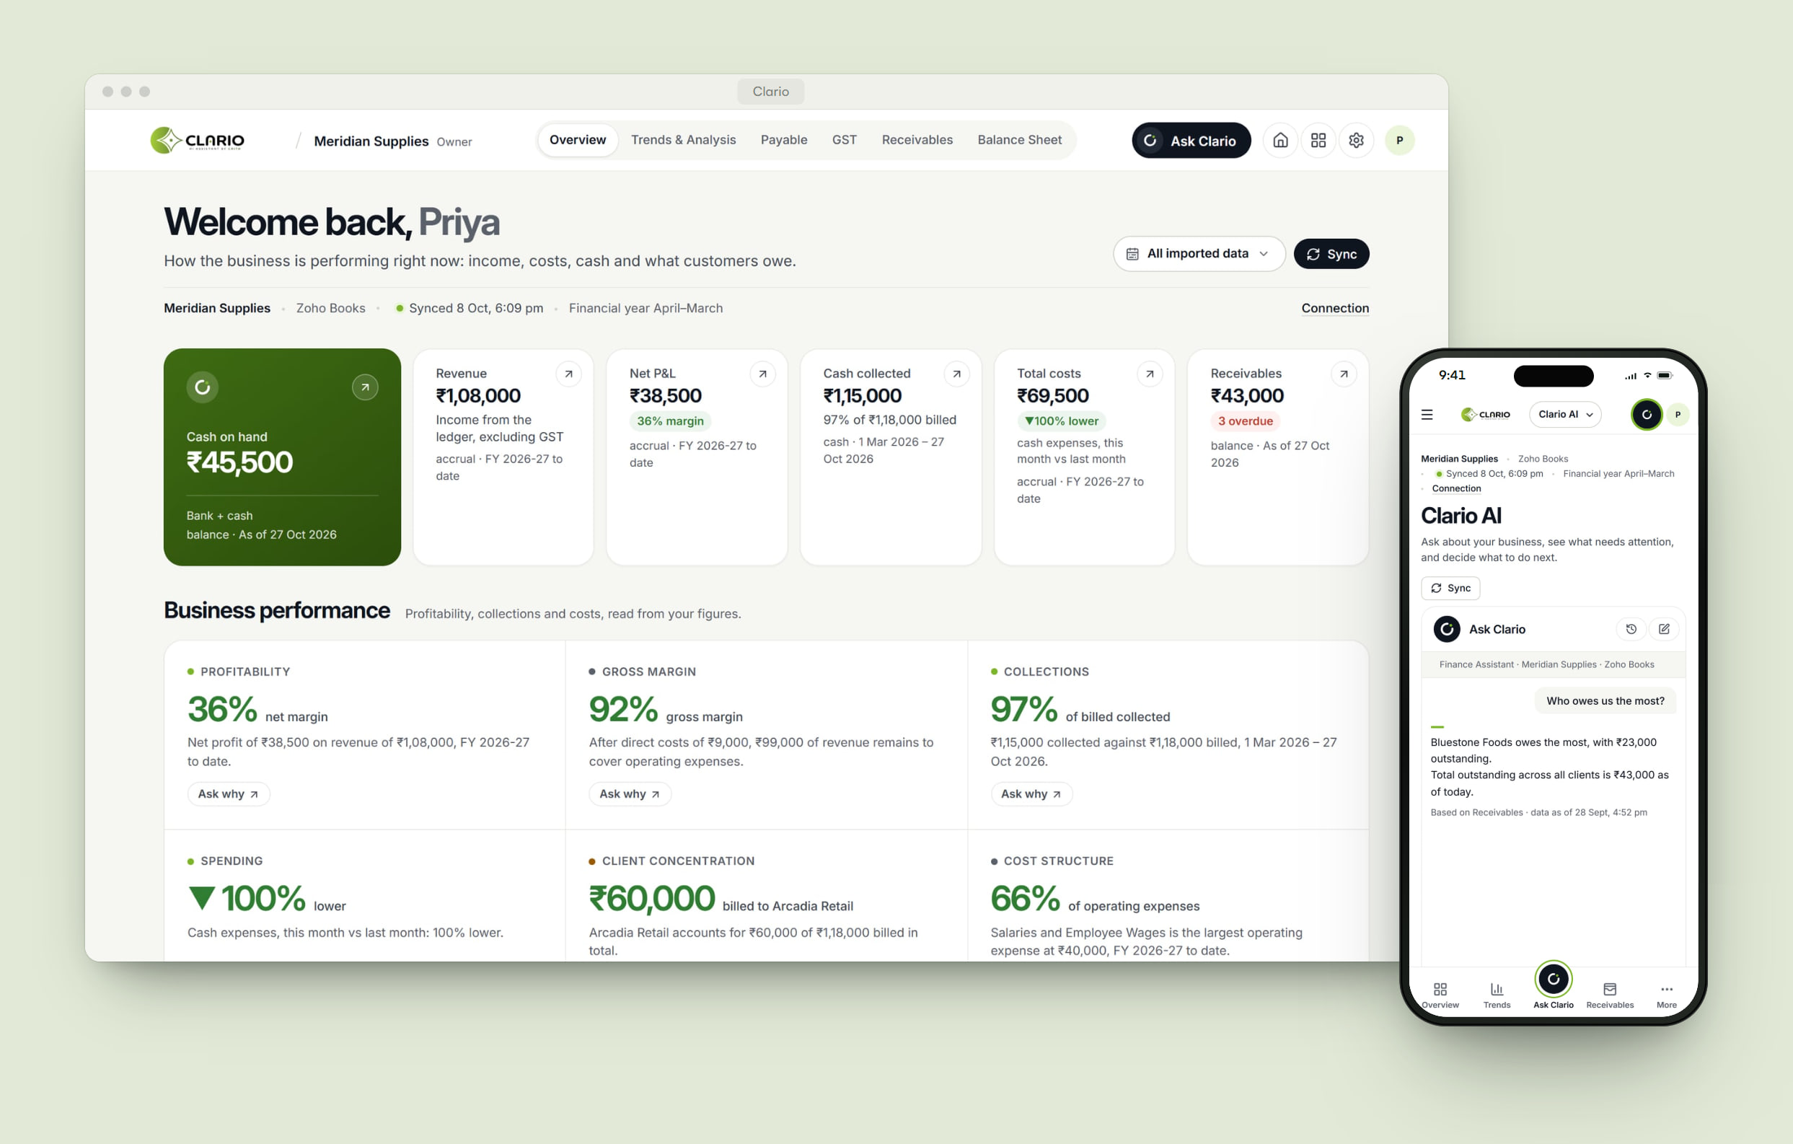
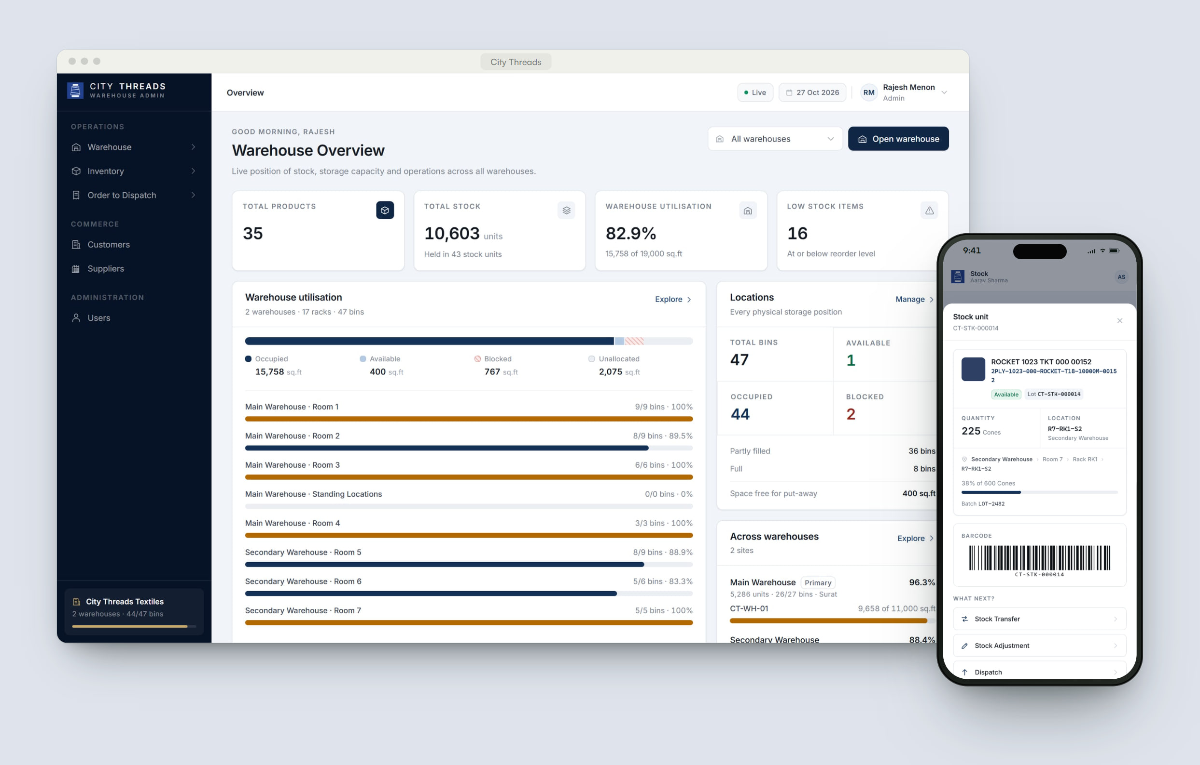
Four platforms, each built around how the business actually works.
SELECTED WORK
01
SMC Task Management
Shaabi Management Consultancy · Audit & consulting
Field audits, planned, run and closed in one system.
Slide 5 →
02
Veloce Scrap Flow
Veloce · Scrap & recycling
Every kilogram, from weighbridge to dispatch.
Slide 13 →
03
Clario
A Crita product · Business intelligence
Understand your business, not just your numbers.
Slide 21 →
04
City Threads
City Threads Textiles · Textile distribution
Every lot, every bin, every dispatch — accounted for.
Slide 29 →
Notes:
SELECTED WORK — four platforms. Click any card or name to jump to that project; use the section list (left panel) to hide projects you won't present.
01 SMC Task Management (slide 5) — Shaabi Management Consultancy, Audit & consulting. Field audits, planned, run and closed in one system.
02 Veloce Scrap Flow (slide 13) — Veloce, Scrap & recycling. Every kilogram, from weighbridge to dispatch.
03 Clario (slide 21) — A Crita product, Business intelligence. Understand your business, not just your numbers.
04 City Threads (slide 29) — City Threads Textiles, Textile distribution. Every lot, every bin, every dispatch — accounted for.

Slide 5
SMC Task Management
01 — FIELD OPERATIONS PLATFORM
Field audits, planned, run and closed in one system.
A field-audit operations platform for an audit consultancy. Admins plan visits and define each client’s checklist; executives run every visit from their phone; nothing incomplete is lost between visits.
CLIENT
Shaabi Management Consultancy
SECTOR
Audit & consulting
PLATFORM
Web · Android
ROLES
Admin · Field Executive
Notes:
SMC TASK MANAGEMENT — Shaabi Management Consultancy (Audit & consulting).
One-liner: “Field audits, planned, run and closed in one system.”
A field-audit operations platform for an audit consultancy. Admins plan visits and define each client’s checklist; executives run every visit from their phone; nothing incomplete is lost between visits.
Live: SMC Task Management
Note: Client, contact and staff names in these screens are anonymised to protect SMC’s confidentiality.

Slide 6
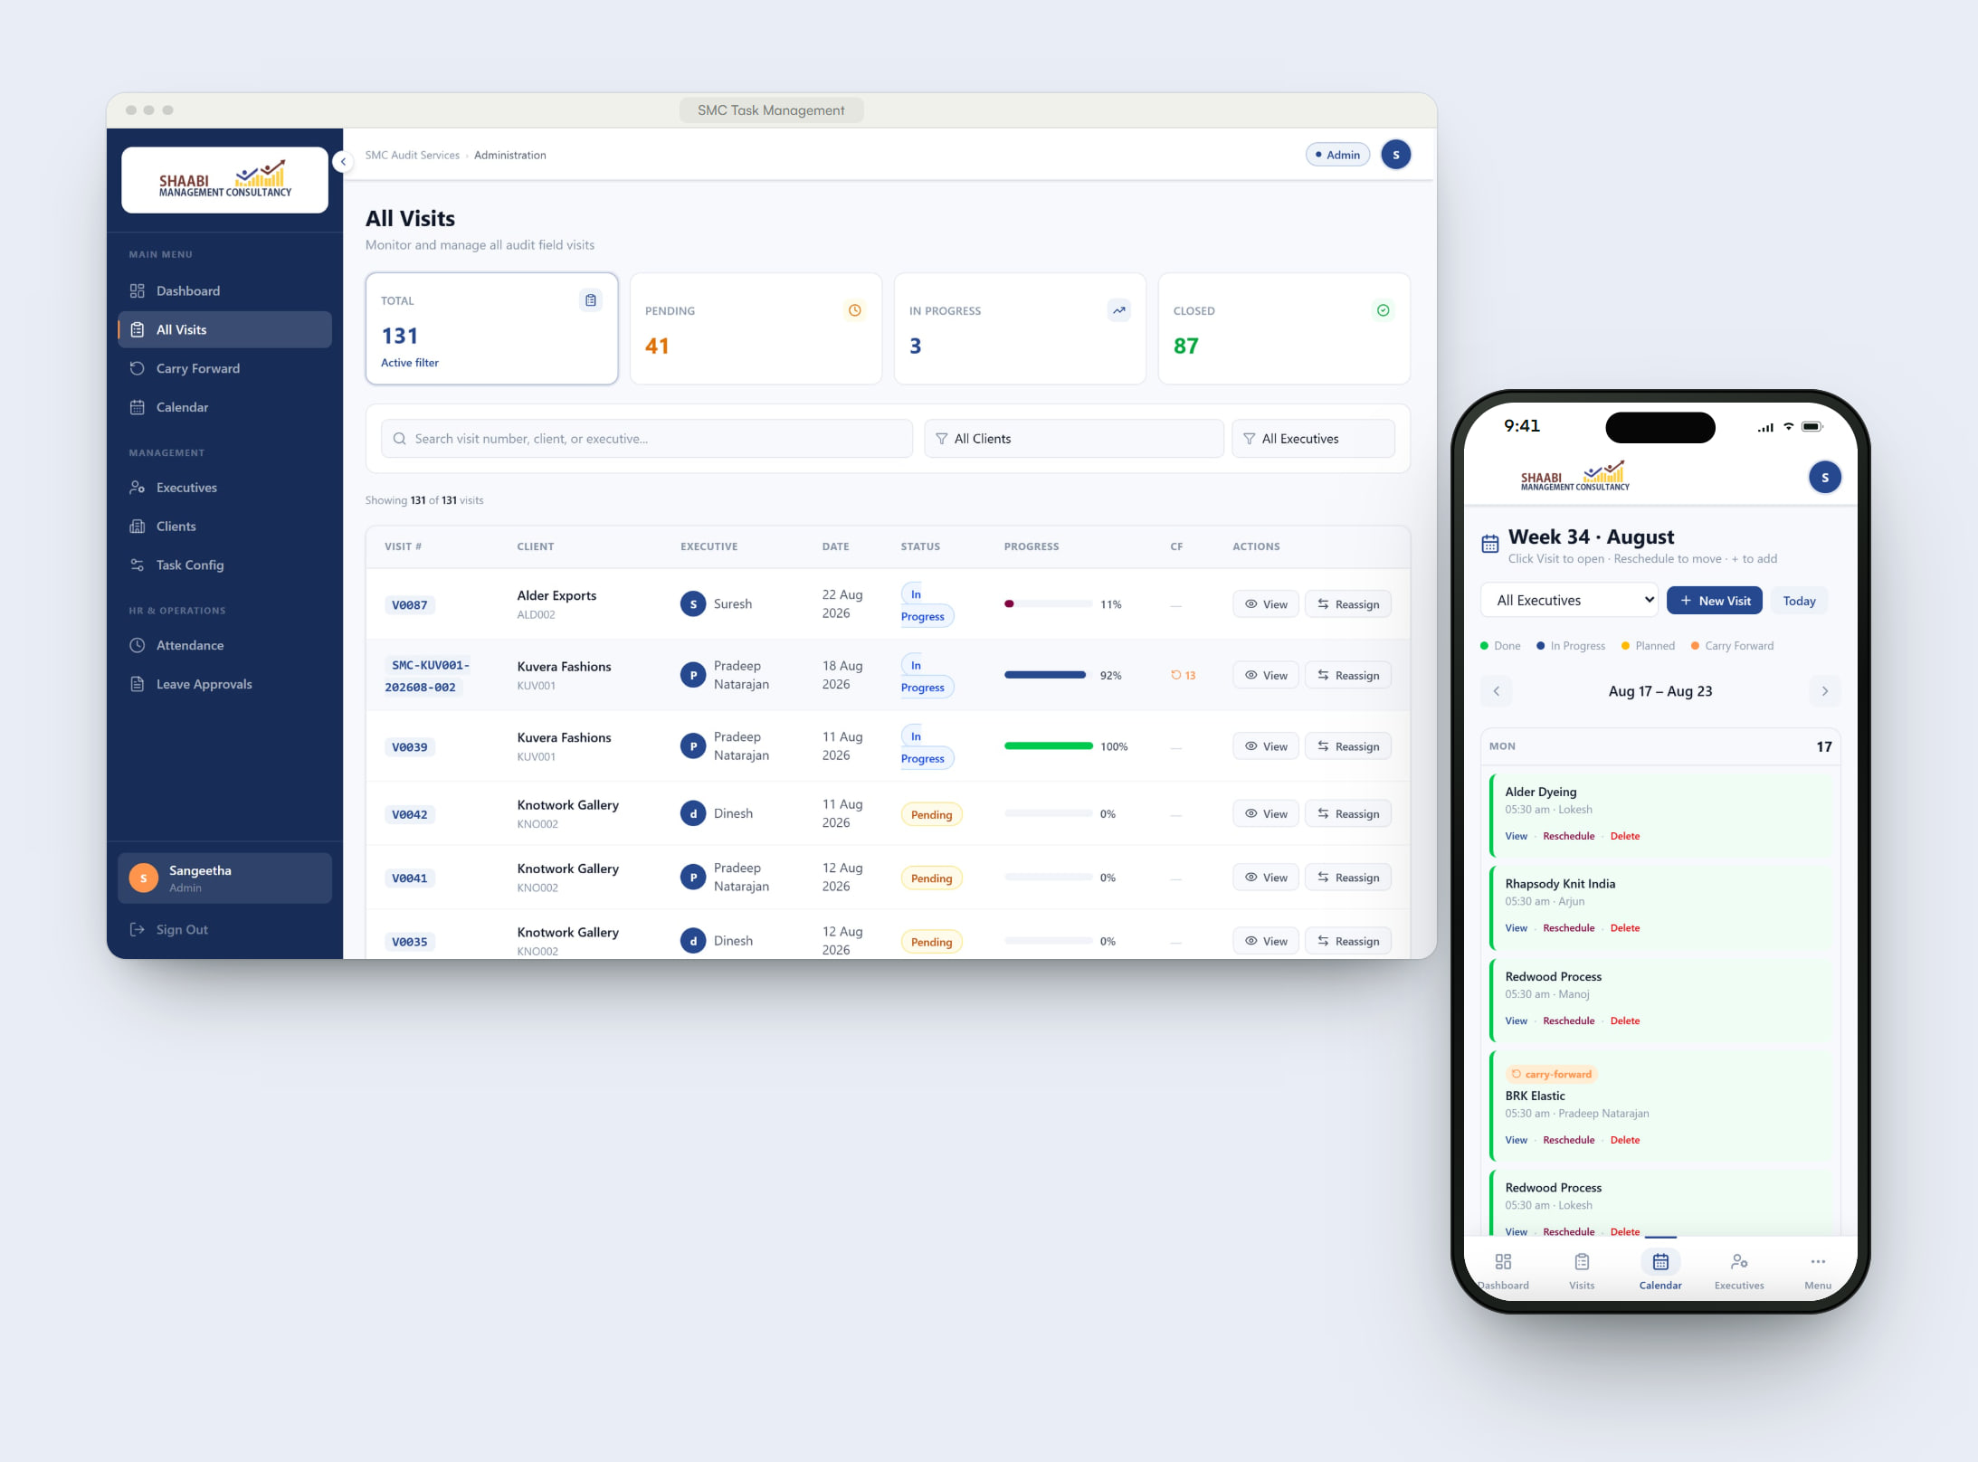
THE CHALLENGE
Weekly audits, dozens of clients, no single view.
SMC’s executives visit client sites every week to verify operations, stock, accounts and reports — and every client needs a different checklist. Tracking was manual: unfinished items relied on memory to reach the next visit, and management had no live view of progress across the team.
WHAT WE BUILT
One system, from the admin’s calendar to the executive’s phone.
Crita built a role-based platform that turns each audit visit into a structured, trackable workflow. Admins schedule visits and configure checklists per client. Executives open the visit on their phone, complete each item or record why it couldn’t be done, and close it only when the rules are met. Unfinished work carries forward — with admin approval — into the next visit.
Notes:
THE CHALLENGE
SMC’s executives visit client sites every week to verify operations, stock, accounts and reports — and every client needs a different checklist. Tracking was manual: unfinished items relied on memory to reach the next visit, and management had no live view of progress across the team.
WHAT WE BUILT
Crita built a role-based platform that turns each audit visit into a structured, trackable workflow. Admins schedule visits and configure checklists per client. Executives open the visit on their phone, complete each item or record why it couldn’t be done, and close it only when the rules are met. Unfinished work carries forward — with admin approval — into the next visit.
Ask: “Does this sound like your operation?” — then show the product.

Slide 7
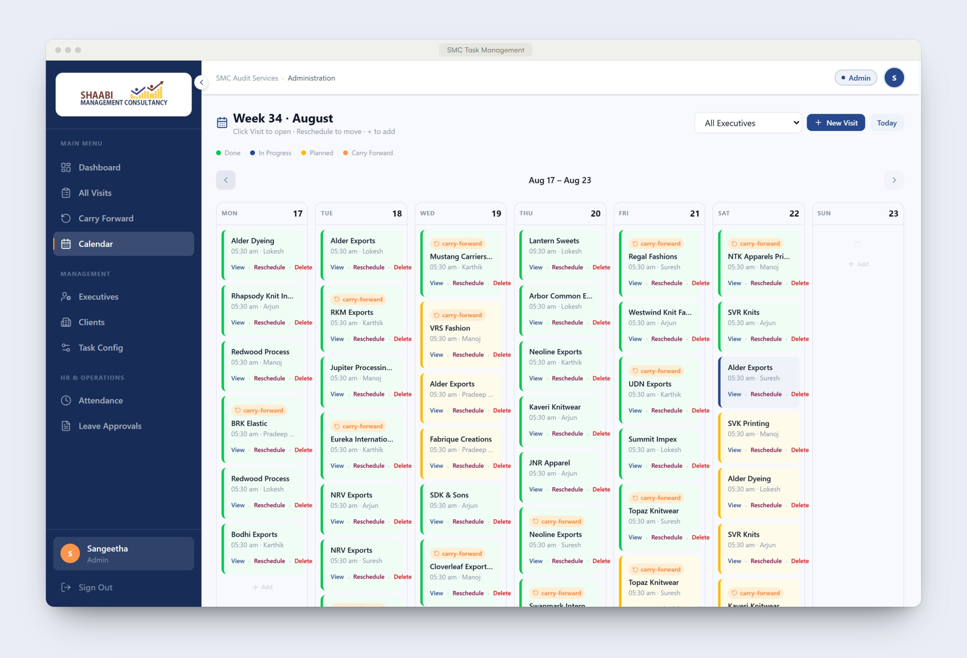
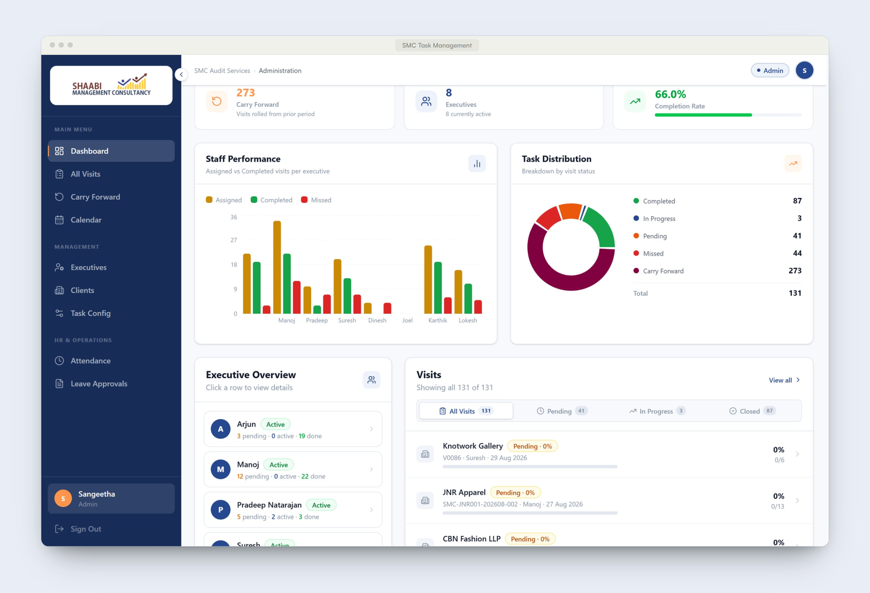
Inside SMC Task Management.
PRODUCT EXPERIENCE · 1 OF 2
01
The week at a glance
Admins plan visits across the team in a weekly calendar — done, in progress, planned and carried forward, colour-coded.
02
Live operational dashboard
Completion rate, staff performance and task distribution, with every executive’s workload one click away.
Notes:
PRODUCT EXPERIENCE
1. The week at a glance — Admins plan visits across the team in a weekly calendar — done, in progress, planned and carried forward, colour-coded.
2. Live operational dashboard — Completion rate, staff performance and task distribution, with every executive’s workload one click away.

Slide 8
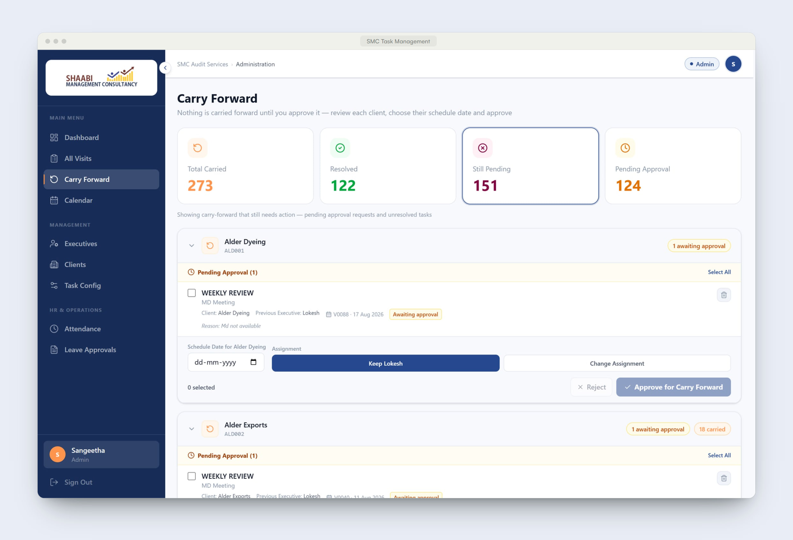
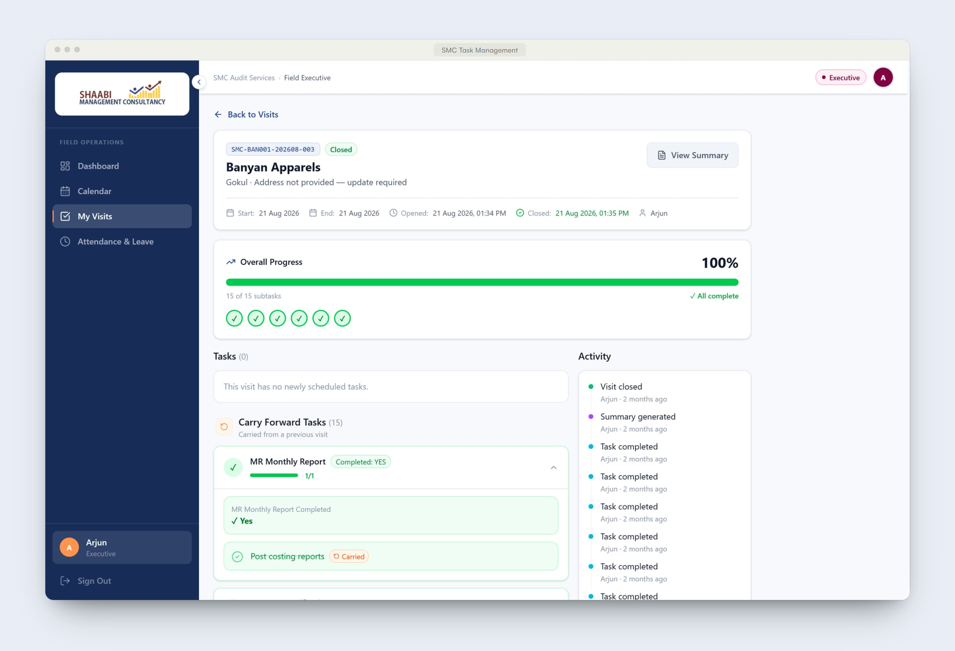
Inside SMC Task Management.
PRODUCT EXPERIENCE · 2 OF 2
03
Carry-forward, under control
Nothing moves to the next visit until an admin reviews it, chooses the schedule date and approves.
04
A visit, start to finish
Tasks, subtasks, carried items and an activity trail on one screen — then an automatic summary at closure.
Notes:
PRODUCT EXPERIENCE
3. Carry-forward, under control — Nothing moves to the next visit until an admin reviews it, chooses the schedule date and approves.
4. A visit, start to finish — Tasks, subtasks, carried items and an activity trail on one screen — then an automatic summary at closure.

Slide 9
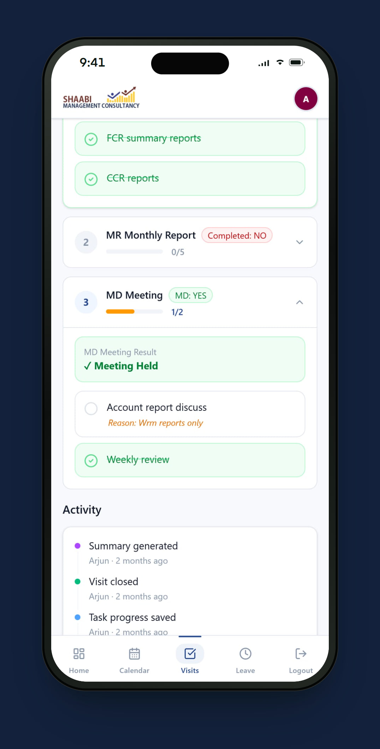
What SMC Task Management does.
KEY CAPABILITIES
01
Visit planning & calendar
Schedule, reschedule and reassign visits across executives in a weekly calendar.
02
Client-specific checklists
Each client gets its own task and subtask template, applied to every new visit automatically.
03
Rules that keep audits complete
A visit closes only when required work is done. The MD meeting must be answered and every open item needs a reason.
04
Carry-forward with approval
Unfinished items move into the next visit with their history — after an admin reviews and approves them.
05
Progress, trail and summary
Live progress per visit, a full activity trail and an automatic summary with a rating when the visit closes.
06
Attendance & leave
Executives punch in and request leave from the app; admins review attendance and approve requests.
Notes:
KEY CAPABILITIES — pick the two or three that matter to this client:
1. Visit planning & calendar — Schedule, reschedule and reassign visits across executives in a weekly calendar.
2. Client-specific checklists — Each client gets its own task and subtask template, applied to every new visit automatically.
3. Rules that keep audits complete — A visit closes only when required work is done. The MD meeting must be answered and every open item needs a reason.
4. Carry-forward with approval — Unfinished items move into the next visit with their history — after an admin reviews and approves them.
5. Progress, trail and summary — Live progress per visit, a full activity trail and an automatic summary with a rating when the visit closes.
6. Attendance & leave — Executives punch in and request leave from the app; admins review attendance and approve requests.

Slide 10
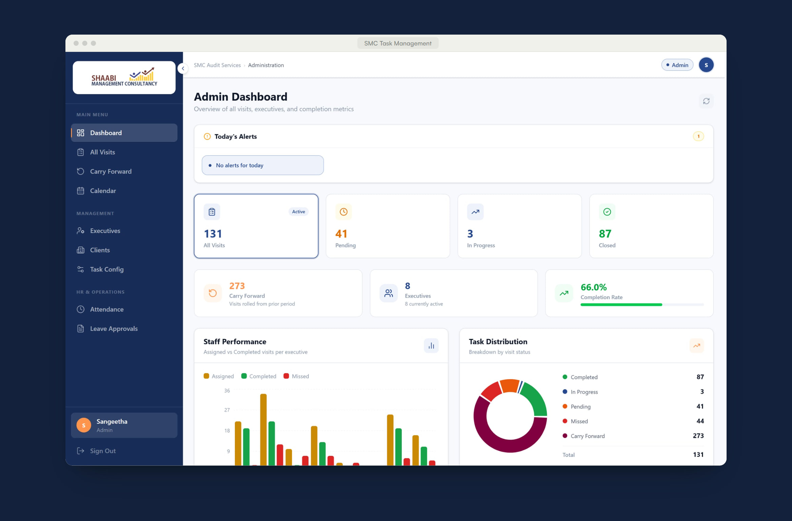
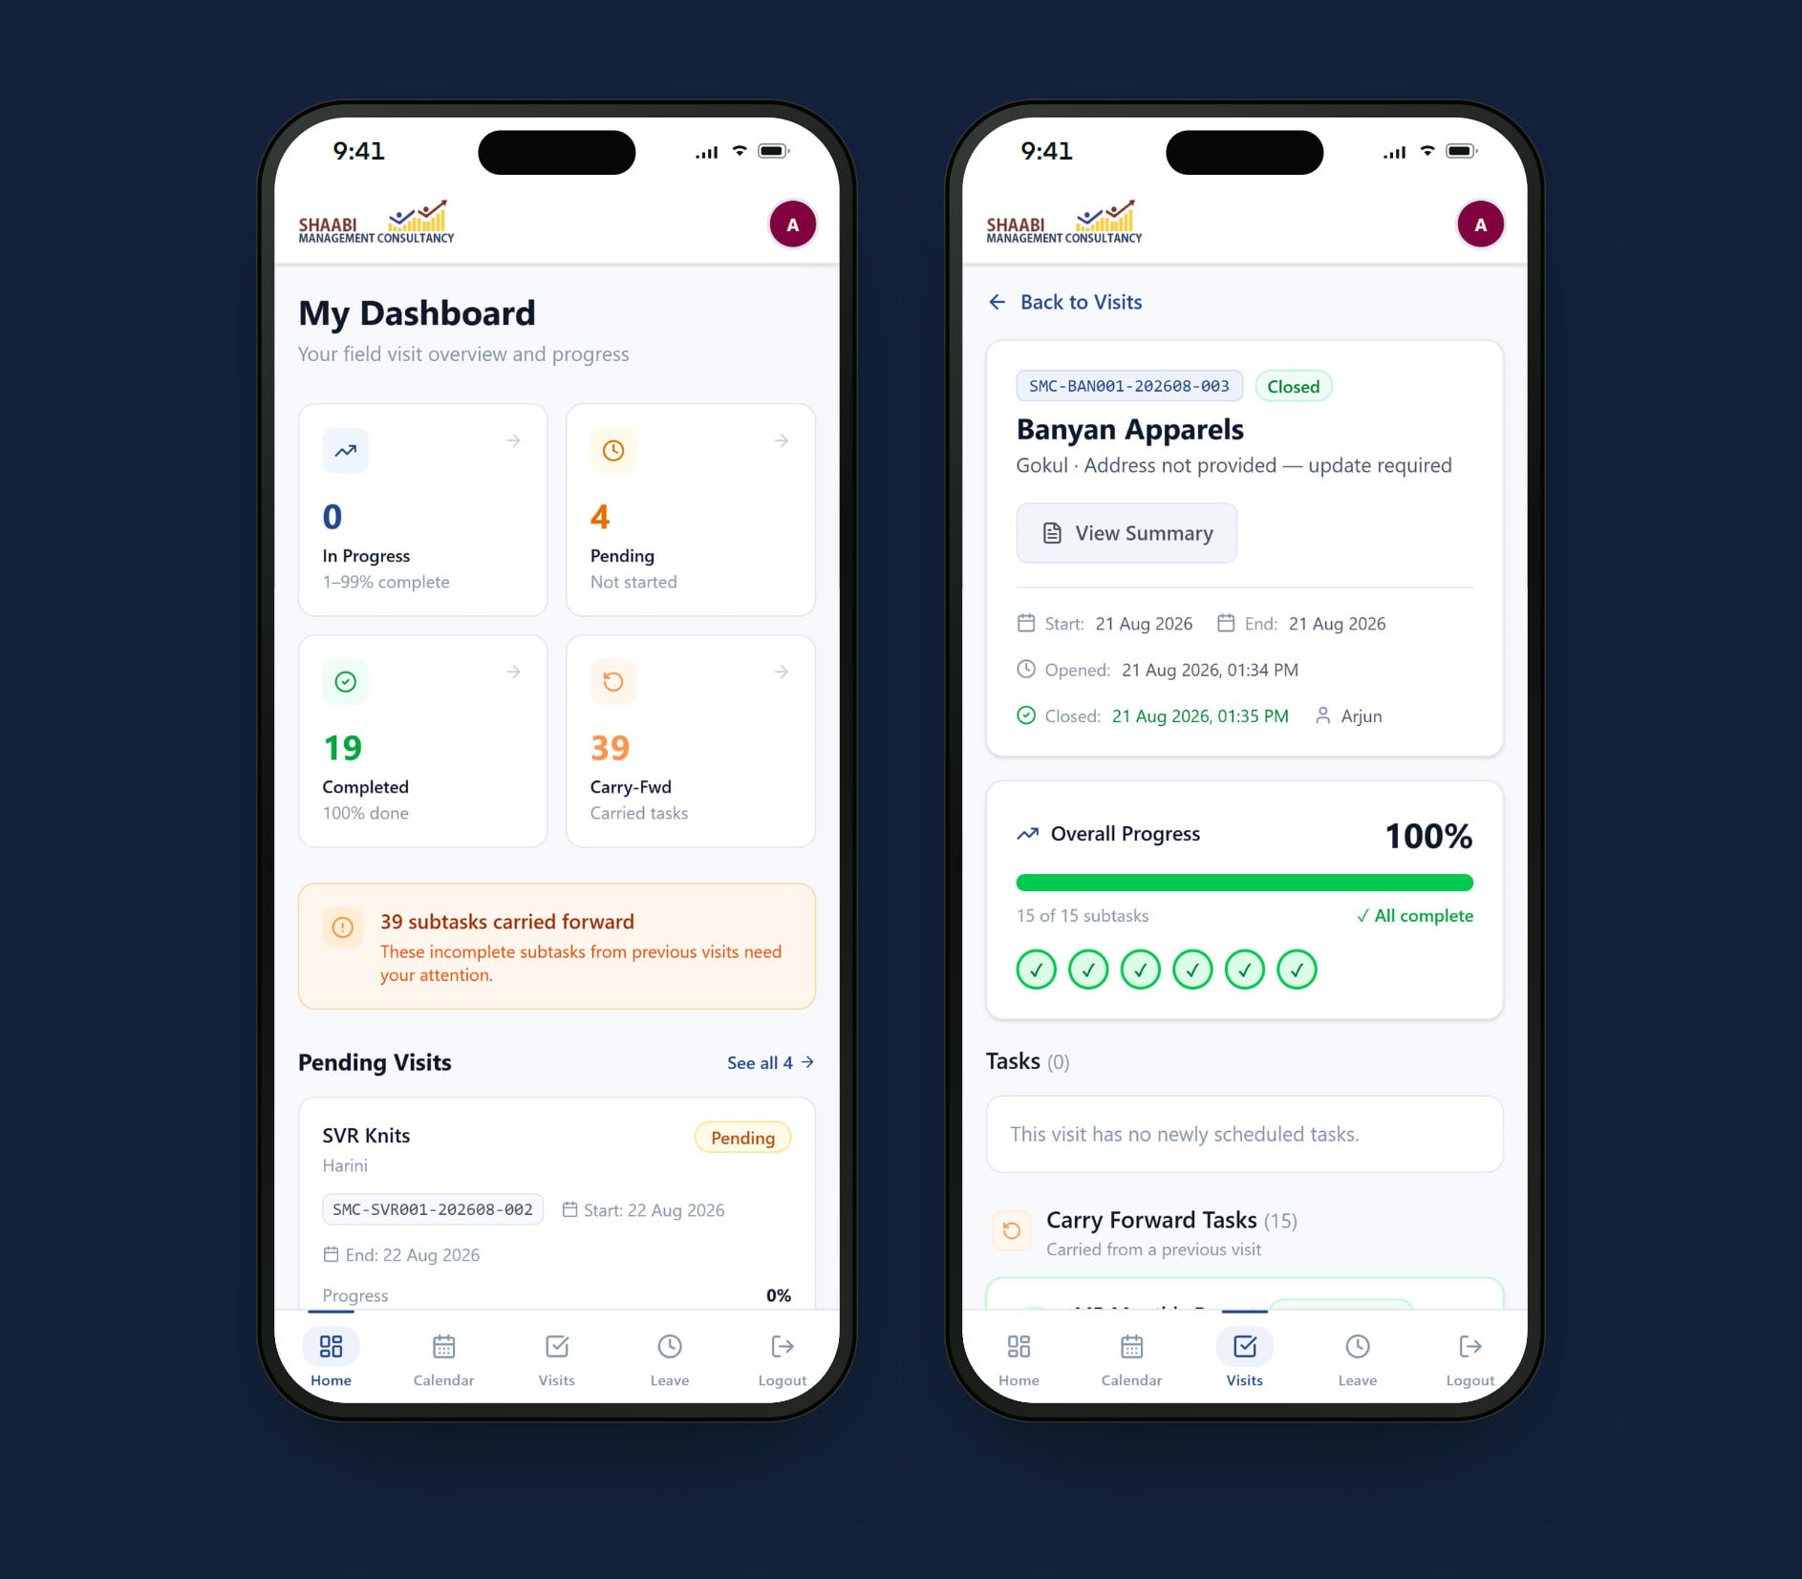
Built for every role.
ROLE-BASED EXPERIENCE
DESKTOP & MOBILE
Admin
Plans the week and keeps every visit on track.
MOBILE-FIRST
Field Executive
Runs each visit on site, from the phone.
Dashboard of visits, completion rate and staff performance
Weekly calendar for scheduling and reassignment
Carry-forward approvals and client checklists
Executive workload, attendance and leave
Pending visits and carried-forward items at a glance
Checklist per task, with reasons for open items
MD meeting confirmation before closing
Punch in, punch out and leave requests
Notes:
ROLES
Admin (Desktop & mobile) — Plans the week and keeps every visit on track. Dashboard of visits, completion rate and staff performance; Weekly calendar for scheduling and reassignment; Carry-forward approvals and client checklists; Executive workload, attendance and leave.
Field Executive (Mobile-first) — Runs each visit on site, from the phone. Pending visits and carried-forward items at a glance; Checklist per task, with reasons for open items; MD meeting confirmation before closing; Punch in, punch out and leave requests.

Slide 11
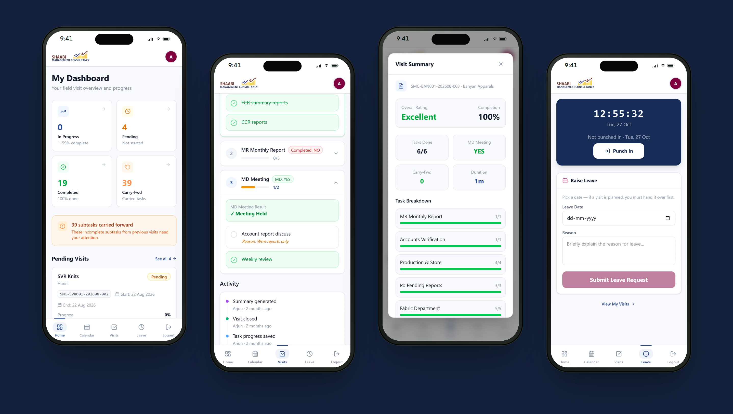
Planned at the desk. Run in the field.
RESPONSIVE EXPERIENCE
Executives run every visit from their phone — checklists, reasons, summaries, attendance. Admins get the same live picture on desktop and mobile.
Notes:
RESPONSIVE
Executives run every visit from their phone — checklists, reasons, summaries, attendance. Admins get the same live picture on desktop and mobile.
Screens: Executive dashboard · MD meeting and reasons · Visit summary · Attendance and leave.

Slide 12
What it changes for the business.
BUSINESS VALUE
TECHNOLOGY & DELIVERY
Next.js
TypeScript
PostgreSQL
Prisma
Role-based access
Android app
Live visibility
Management sees the status of every visit and executive without chasing calls.
Nothing slips between visits
Unfinished items carry forward with their reason, so follow-ups are never lost.
Consistent audits
Client-specific checklists and closing rules make every visit complete and comparable.
Less manual reporting
Progress and visit summaries are produced by the system, not compiled by hand.
LIVE PRODUCT
ENGINEERING HIGHLIGHTS
View live project →
Mobile-first web app with an Android build for field executives
Executives only ever see the visits assigned to them
Lean data and instant checklist feedback on mobile networks
SMC Task Management
Live demo: Admin and Field Executive views.
Client, contact and staff names in these screens are anonymised to protect SMC’s confidentiality.
Notes:
BUSINESS VALUE
• Live visibility — Management sees the status of every visit and executive without chasing calls.
• Nothing slips between visits — Unfinished items carry forward with their reason, so follow-ups are never lost.
• Consistent audits — Client-specific checklists and closing rules make every visit complete and comparable.
• Less manual reporting — Progress and visit summaries are produced by the system, not compiled by hand.
DELIVERY: Next.js, TypeScript, PostgreSQL, Prisma, Role-based access, Android app.
• Mobile-first web app with an Android build for field executives
• Executives only ever see the visits assigned to them
• Lean data and instant checklist feedback on mobile networks
LIVE DEMO — SMC Task Management
Logins for the live demo are in the presenter copy of this deck.
Next: Veloce Scrap Flow.

Slide 13
Veloce Scrap Flow
02 — YARD OPERATIONS & INVENTORY PLATFORM
Every kilogram, from weighbridge to dispatch.
A yard operating system for a scrap business: a calculator-fast mobile app for the weighbridge and the sorting floor, and a desktop console that gives management live control across yards and warehouses.
CLIENT
Veloce
SECTOR
Scrap & recycling
PLATFORM
Web · Android
ROLES
Admin · Owner · Supervisor
Notes:
VELOCE SCRAP FLOW — Veloce (Scrap & recycling).
One-liner: “Every kilogram, from weighbridge to dispatch.”
A yard operating system for a scrap business: a calculator-fast mobile app for the weighbridge and the sorting floor, and a desktop console that gives management live control across yards and warehouses.
Live: Veloce Scrap Management
Note: Screens from the live demonstration yard.

Slide 14
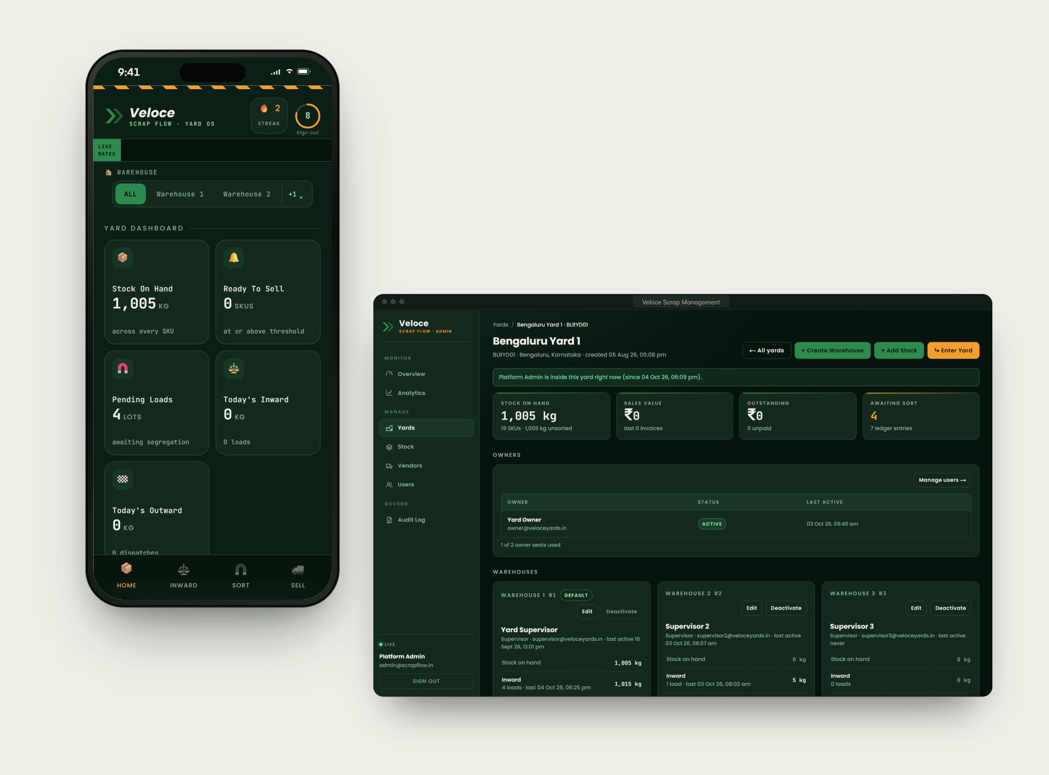
THE CHALLENGE
Mixed loads in. Graded material out. No reliable trail in between.
A scrap yard buys mixed material by weight, sorts it into sellable grades and sells it by the truckload. Every step changes the numbers. Without one system, it is hard to know what is in stock, what is waiting to be sorted and what has actually left the yard — and impossible to see it across several yards.
WHAT WE BUILT
Built for the yard floor. Controlled from one console.
Crita built Scrap Flow as a multi-yard platform. Owners and supervisors work in a mobile app designed like a calculator — big keys, live rates, clear steps — while the platform admin manages yards, warehouses, users and analytics from a desktop console. Every action writes to one inventory ledger, updated in real time.
Notes:
THE CHALLENGE
A scrap yard buys mixed material by weight, sorts it into sellable grades and sells it by the truckload. Every step changes the numbers. Without one system, it is hard to know what is in stock, what is waiting to be sorted and what has actually left the yard — and impossible to see it across several yards.
WHAT WE BUILT
Crita built Scrap Flow as a multi-yard platform. Owners and supervisors work in a mobile app designed like a calculator — big keys, live rates, clear steps — while the platform admin manages yards, warehouses, users and analytics from a desktop console. Every action writes to one inventory ledger, updated in real time.
Ask: “Does this sound like your operation?” — then show the product.

Slide 15
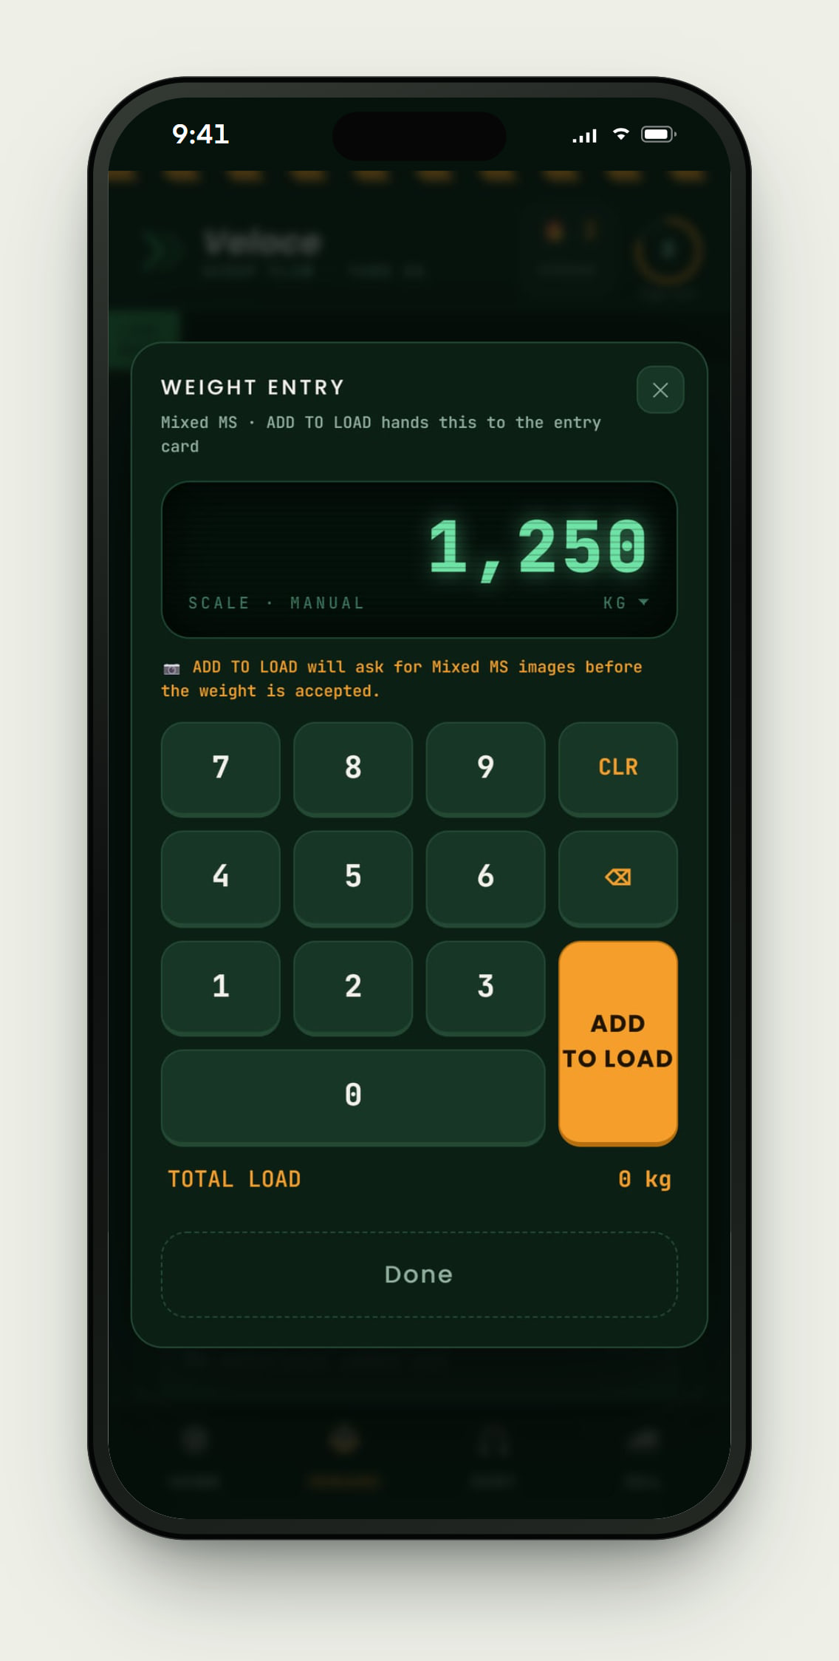
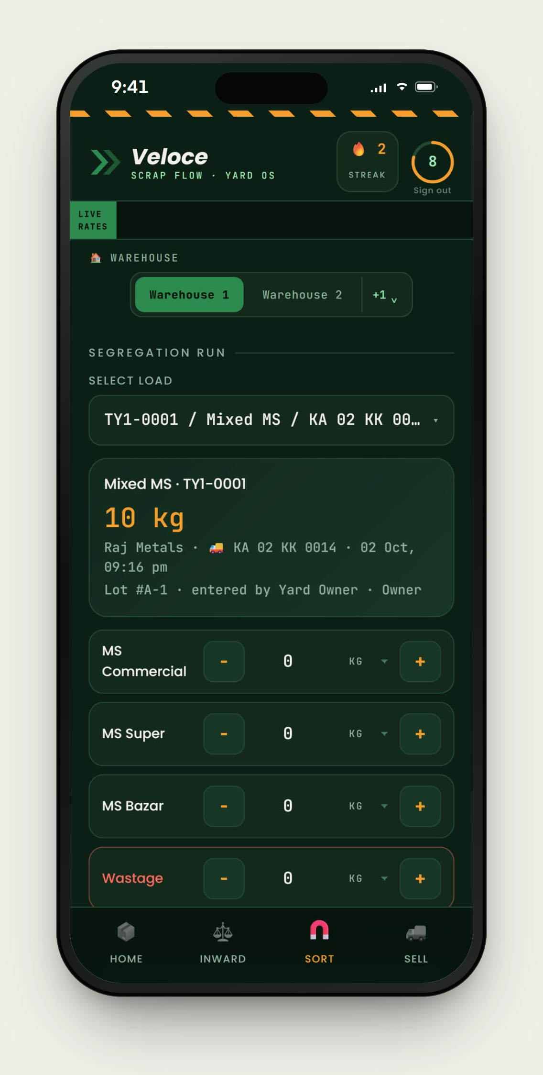
Inside Veloce Scrap Flow.
PRODUCT EXPERIENCE · 1 OF 2
01
Weight entry, calculator-fast
Big keys, a live LED display and kg / ton / tonne switching — built for gloved hands at the weighbridge.
02
Segregation that balances
Pick a mixed lot and split it into grades and wastage. Vendor, vehicle and lot history stay attached.
Notes:
PRODUCT EXPERIENCE
1. Weight entry, calculator-fast — Big keys, a live LED display and kg / ton / tonne switching — built for gloved hands at the weighbridge.
2. Segregation that balances — Pick a mixed lot and split it into grades and wastage. Vendor, vehicle and lot history stay attached.

Slide 16
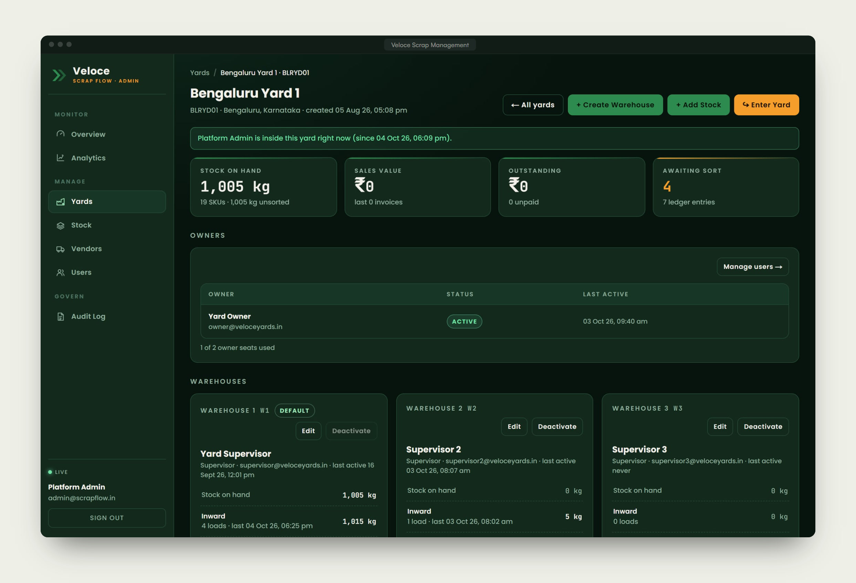
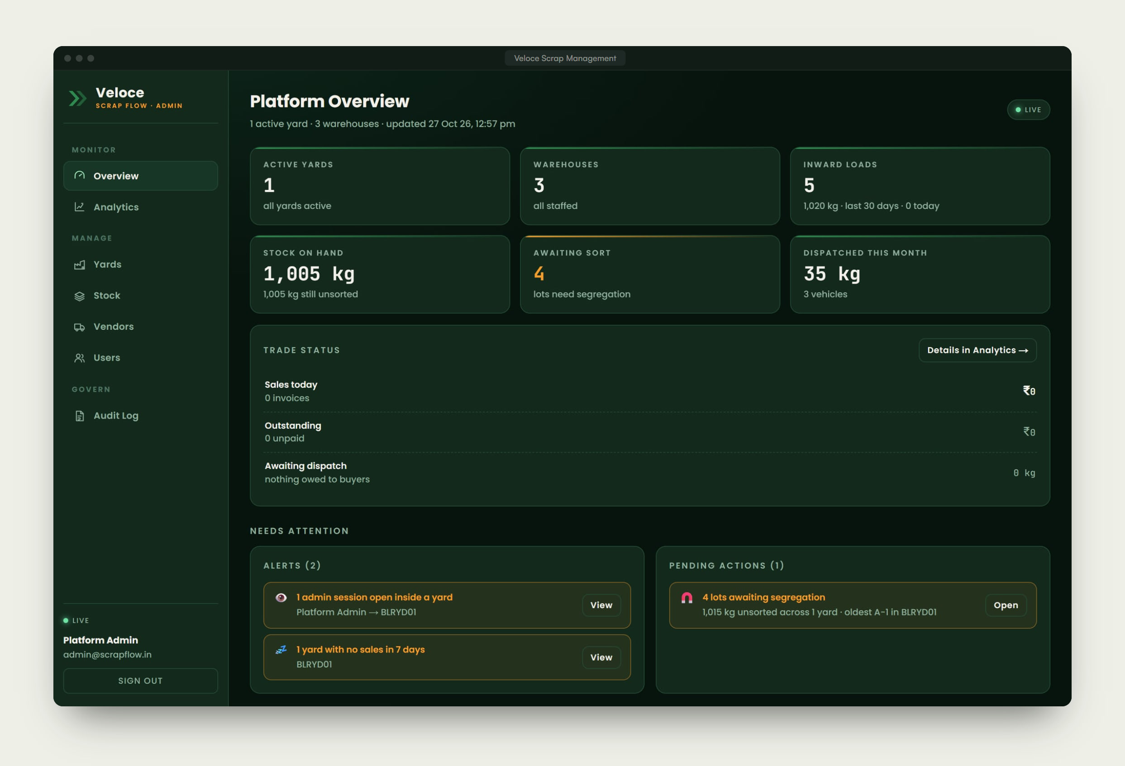
Inside Veloce Scrap Flow.
PRODUCT EXPERIENCE · 2 OF 2
03
One console for every yard
Warehouses, supervisors, stock and records for each yard — with the admin able to step inside any yard.
04
Platform overview
Headline numbers, alerts and pending actions computed by the system, so nothing waits to be noticed.
Notes:
PRODUCT EXPERIENCE
3. One console for every yard — Warehouses, supervisors, stock and records for each yard — with the admin able to step inside any yard.
4. Platform overview — Headline numbers, alerts and pending actions computed by the system, so nothing waits to be noticed.

Slide 17
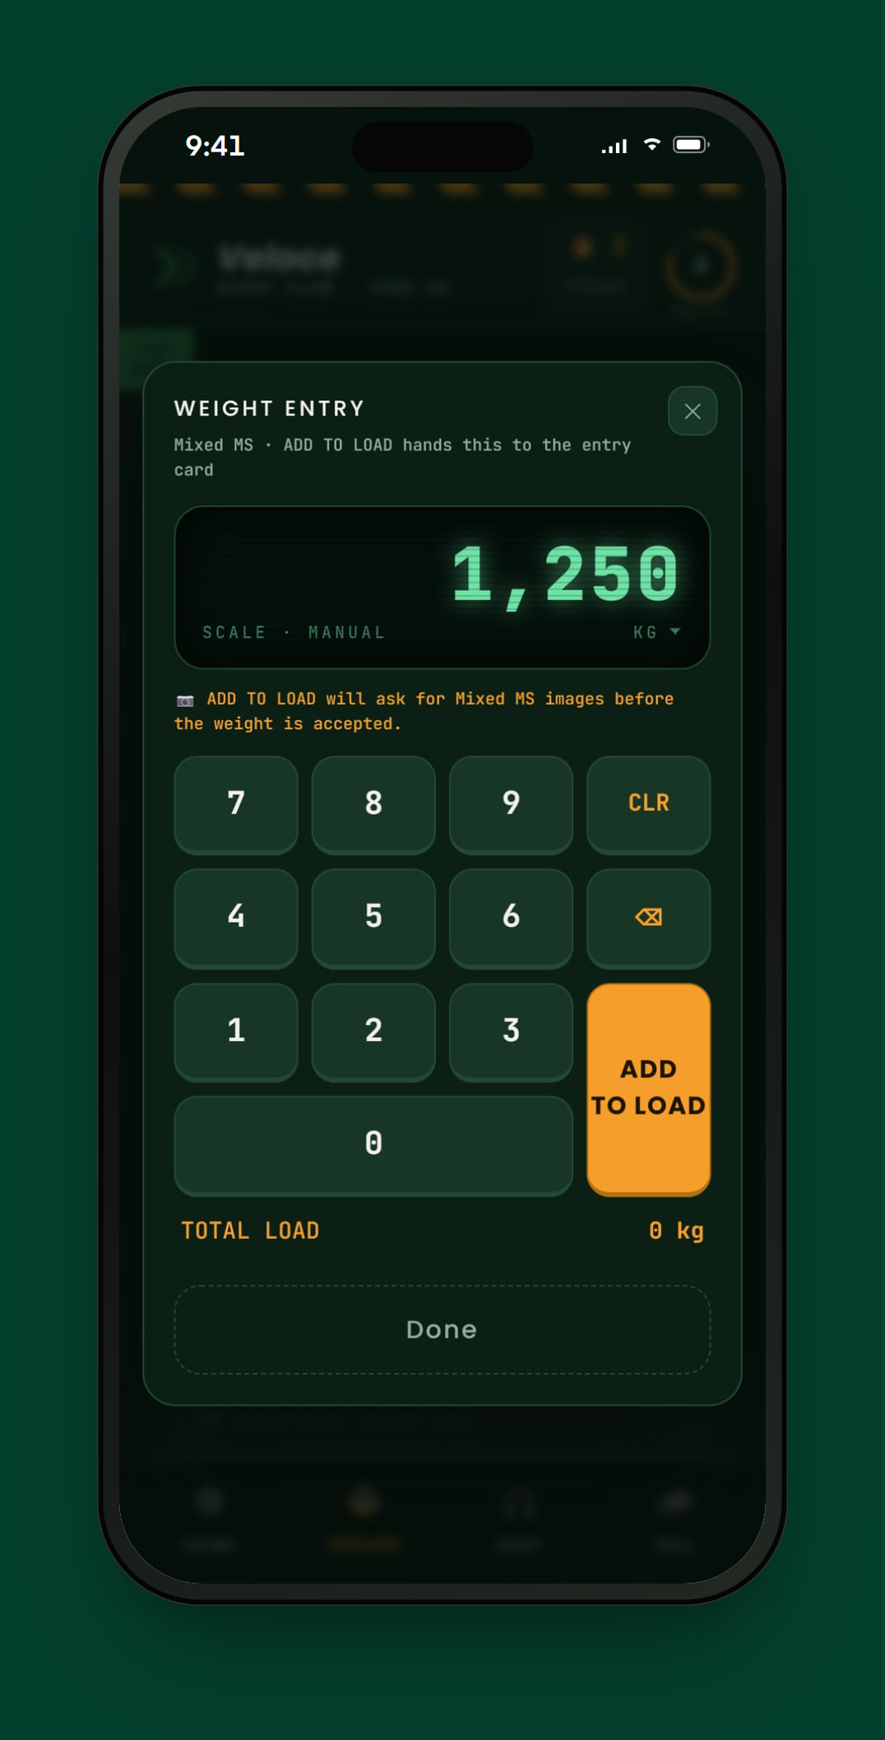
What Veloce Scrap Flow does.
KEY CAPABILITIES
01
Inward at the weighbridge
Vendor, vehicle and multiple weighments on an LED-style keypad, with photo evidence. Each load becomes a traceable lot.
02
Sorting that balances
Mixed lots are split into finished grades and wastage; a run can’t close until every kilogram is accounted for.
03
Sell, allocate, dispatch
A sale reserves stock; supervisors load vehicles against it. The same kilograms can’t be sold twice or over-dispatched.
04
Live stock across warehouses
Stock on hand, sale thresholds and pending work per yard and warehouse, updated as it happens.
05
Admin console & analytics
Yards, warehouses, users and permissions, with analytics for inward, sorting, dispatch and materials.
06
Governance built in
Every privileged action is recorded in an audit log with before-and-after values.
Notes:
KEY CAPABILITIES — pick the two or three that matter to this client:
1. Inward at the weighbridge — Vendor, vehicle and multiple weighments on an LED-style keypad, with photo evidence. Each load becomes a traceable lot.
2. Sorting that balances — Mixed lots are split into finished grades and wastage; a run can’t close until every kilogram is accounted for.
3. Sell, allocate, dispatch — A sale reserves stock; supervisors load vehicles against it. The same kilograms can’t be sold twice or over-dispatched.
4. Live stock across warehouses — Stock on hand, sale thresholds and pending work per yard and warehouse, updated as it happens.
5. Admin console & analytics — Yards, warehouses, users and permissions, with analytics for inward, sorting, dispatch and materials.
6. Governance built in — Every privileged action is recorded in an audit log with before-and-after values.

Slide 18
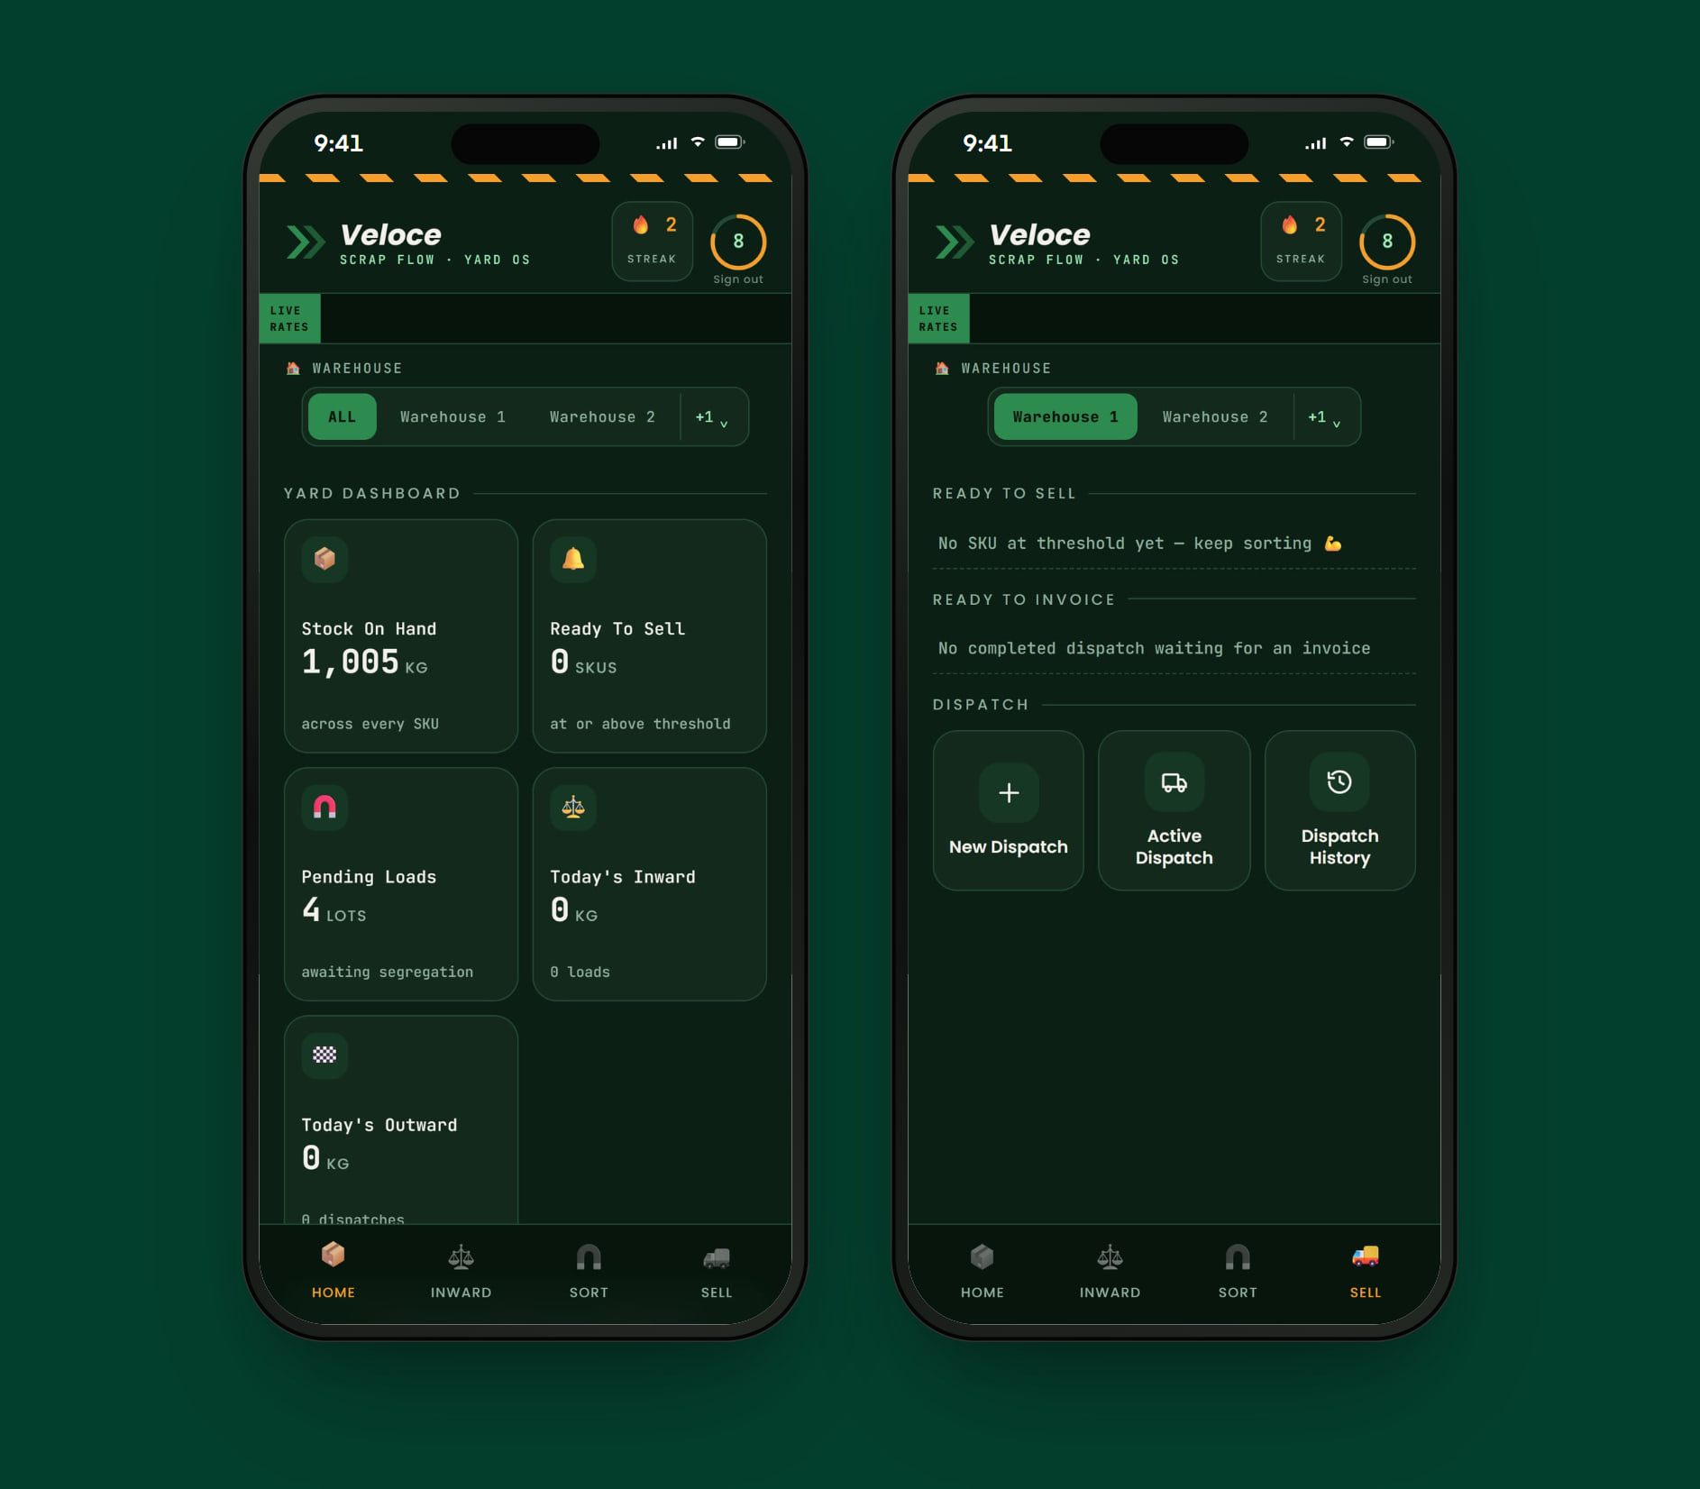
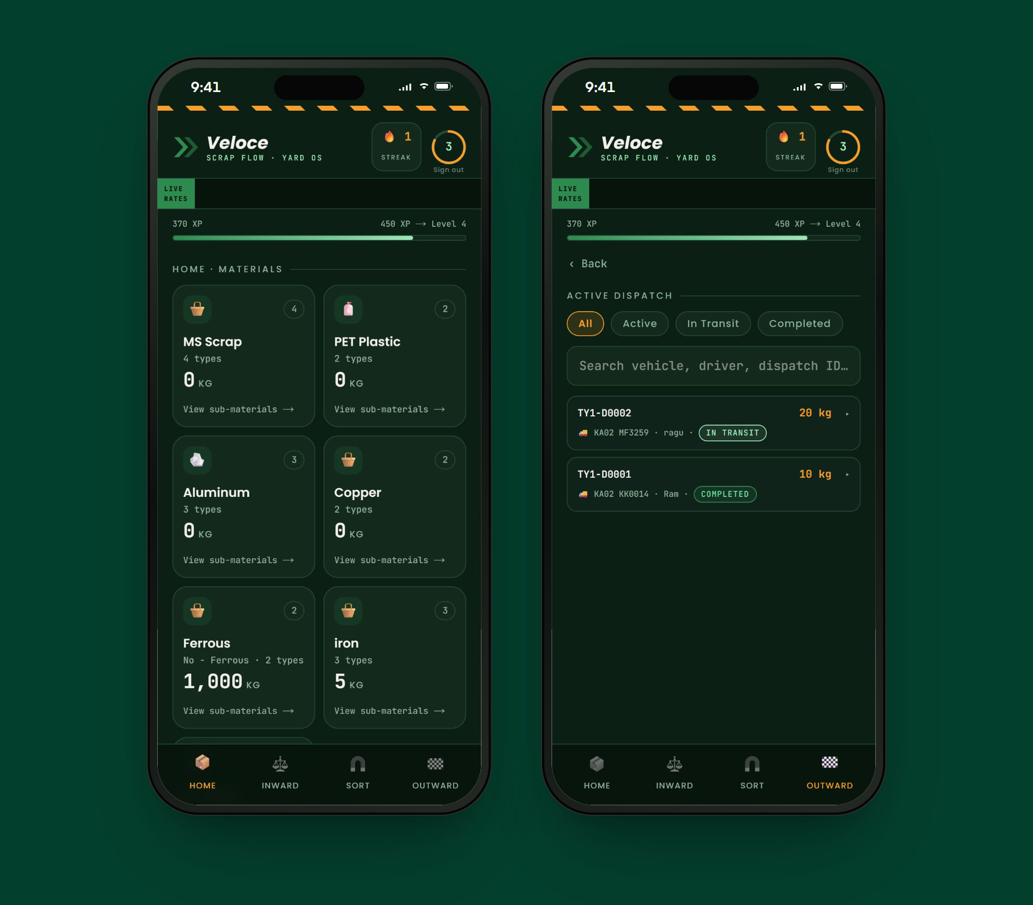
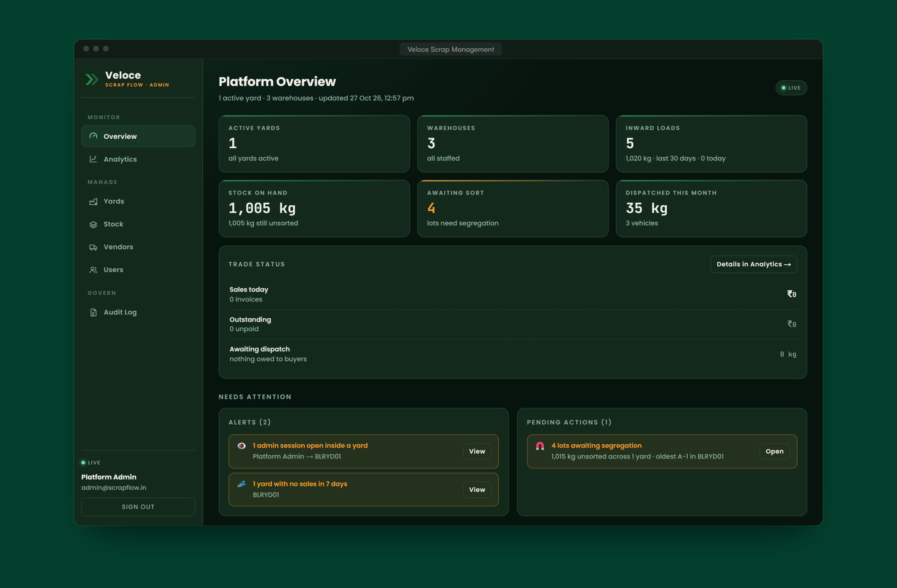
Built for every role.
ROLE-BASED EXPERIENCE
DESKTOP CONSOLE
Admin
Runs the platform across yards.
MOBILE APP
Owner
Runs the yard and the trade.
MOBILE APP
Supervisor
Runs the floor in an assigned warehouse.
Platform overview with alerts and pending actions
Yards, warehouses and supervisor assignments
Users, roles and access
Analytics and a full audit log
Yard dashboard: stock, ready-to-sell and pending lots
Inward, sorting and materials
Sales, invoices and receivables
Dispatch status per invoice
Materials on hand by category
Inward and sorting
Loading vehicles against allocations
Dispatch history
Notes:
ROLES
Admin (Desktop console) — Runs the platform across yards. Platform overview with alerts and pending actions; Yards, warehouses and supervisor assignments; Users, roles and access; Analytics and a full audit log.
Owner (Mobile app) — Runs the yard and the trade. Yard dashboard: stock, ready-to-sell and pending lots; Inward, sorting and materials; Sales, invoices and receivables; Dispatch status per invoice.
Supervisor (Mobile app) — Runs the floor in an assigned warehouse. Materials on hand by category; Inward and sorting; Loading vehicles against allocations; Dispatch history.

Slide 19
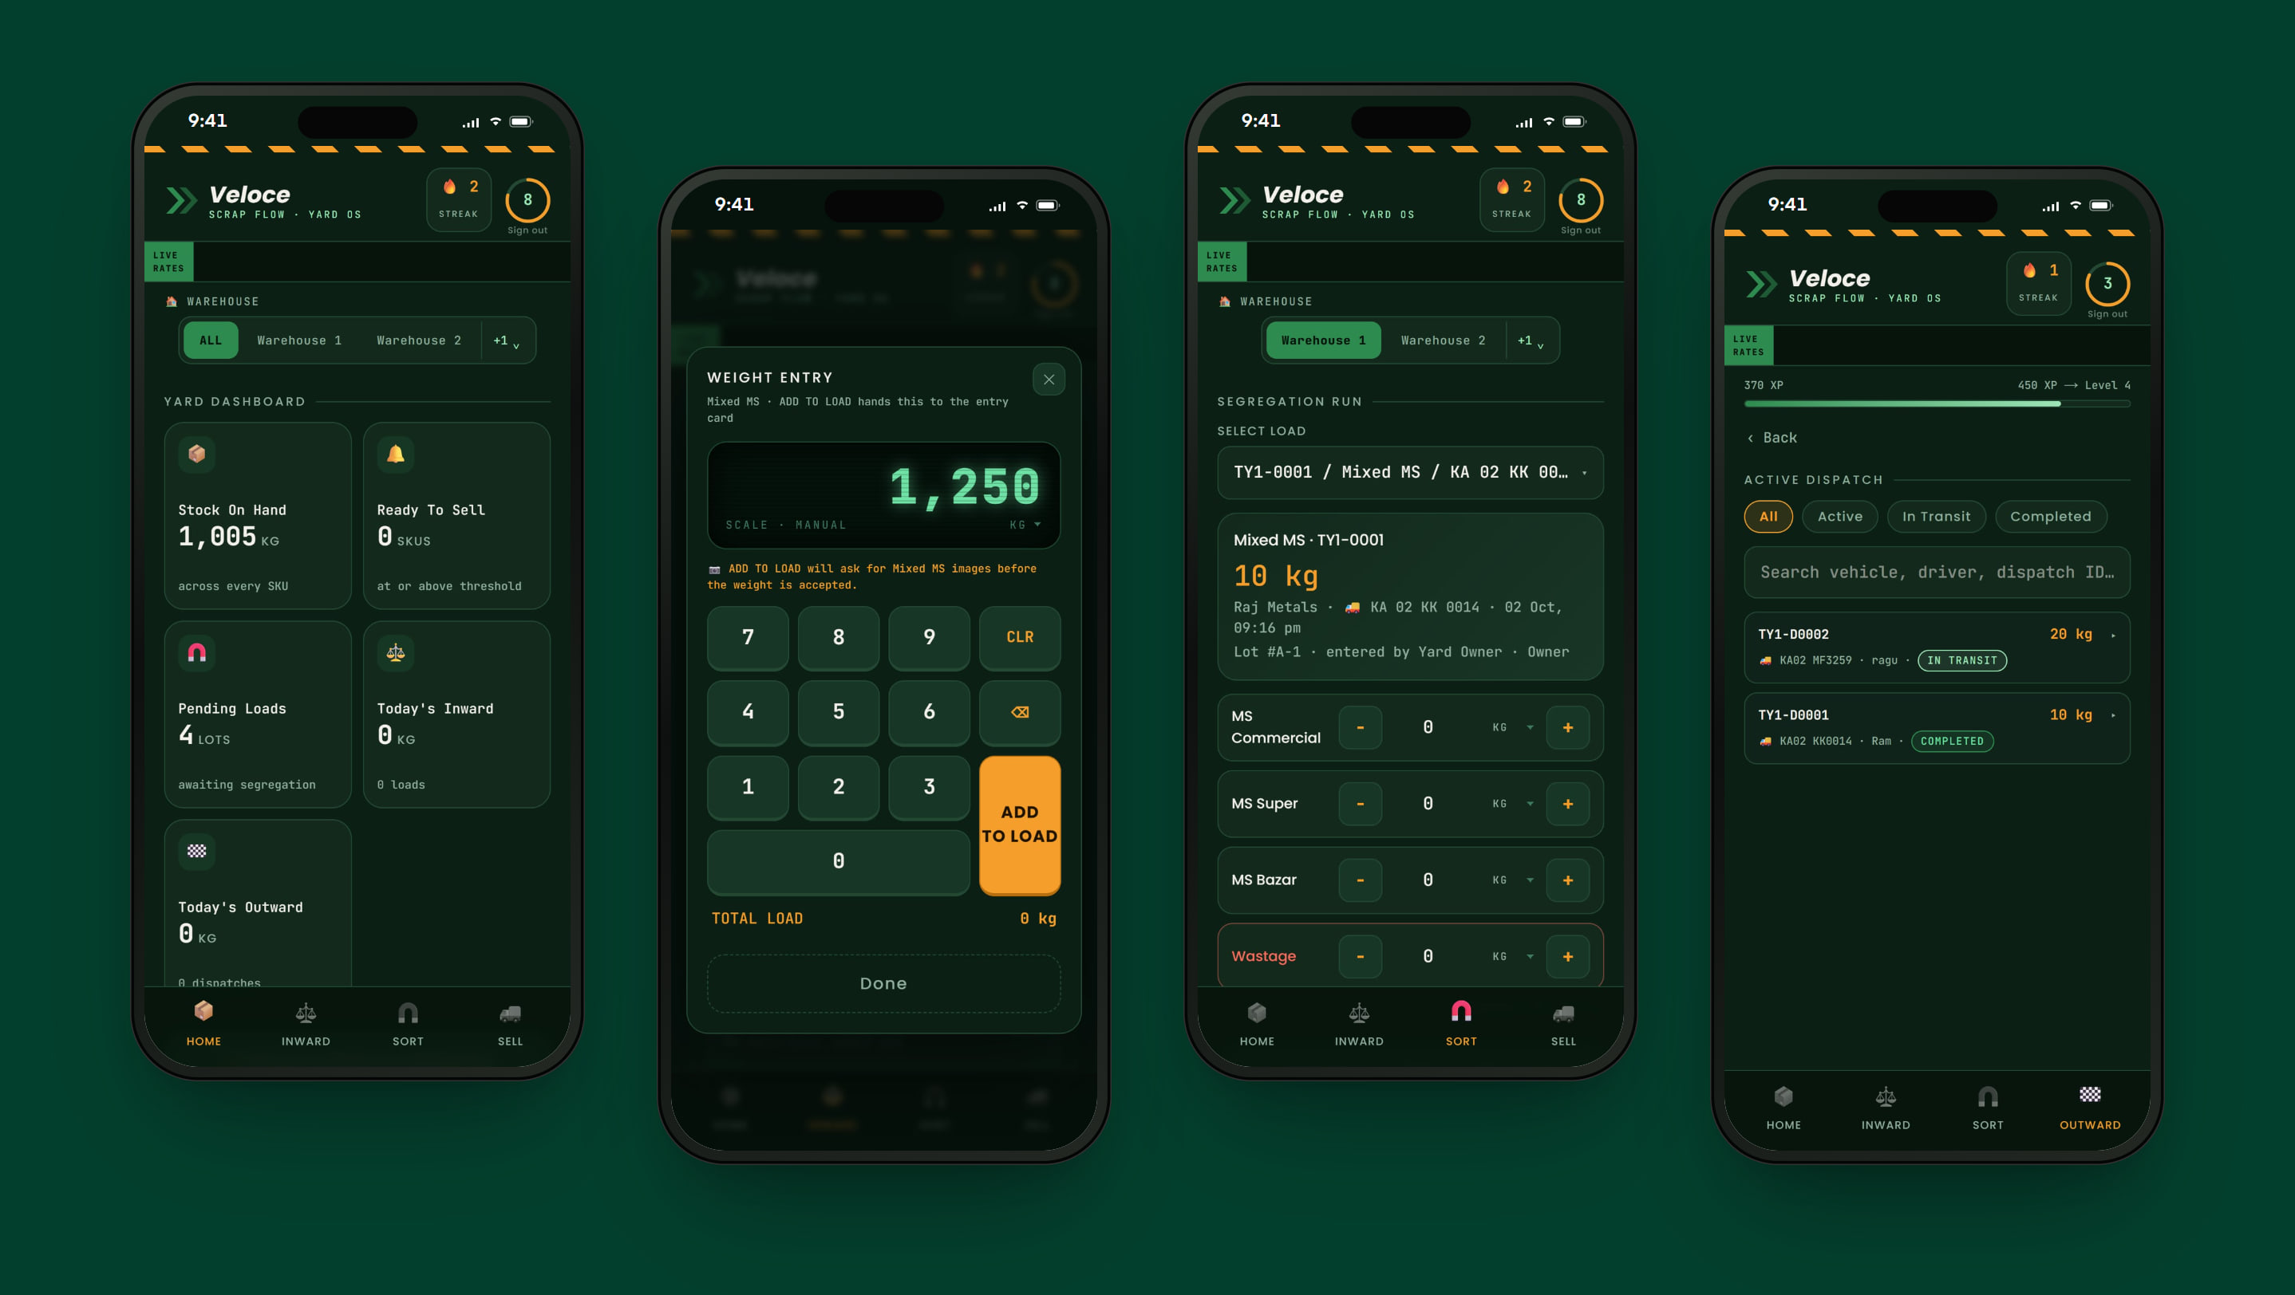
Designed like a calculator, for the yard floor.
RESPONSIVE EXPERIENCE
Big keys, high contrast, live rates and one clear step at a time — so weighments, sorting and dispatch are recorded where they happen.
Notes:
RESPONSIVE
Big keys, high contrast, live rates and one clear step at a time — so weighments, sorting and dispatch are recorded where they happen.
Screens: Yard dashboard · LED weight keypad · Segregation run with a load selected · Active dispatch.

Slide 20
What it changes for the business.
BUSINESS VALUE
TECHNOLOGY & DELIVERY
Next.js
TypeScript
PostgreSQL
Real-time updates
Multi-tenant architecture
Android app
Control without being on site
Owners and admins see stock, pending sorting and dispatch status the moment they change.
Traceable from vendor to buyer
Lots keep their vendor through sorting and dispatch, so every kilogram has a history.
2,500+ automated checks across 36 test suites
Yard data isolated at session, query and database level
Number-plate recognition built as a separate computer-vision service (YOLOv8 + PaddleOCR)
Mistakes prevented, not corrected
Rules block double-selling, over-dispatch and unbalanced sorting before they happen.
Ready for more yards
A multi-yard architecture with strict data isolation between yards.
LIVE PRODUCT
View live project →
“We didn’t need another digital tool; we needed a technology partner who understood how our business worked. CRITA helped us simplify processes, connect different parts of the business, and introduce technology where it could create real value.”
Abhirup · Veloce
Veloce Scrap Management
Live demo: Admin, Owner and Supervisor views.
Screens from the live demonstration yard.
Notes:
BUSINESS VALUE
• Control without being on site — Owners and admins see stock, pending sorting and dispatch status the moment they change.
• Traceable from vendor to buyer — Lots keep their vendor through sorting and dispatch, so every kilogram has a history.
• Mistakes prevented, not corrected — Rules block double-selling, over-dispatch and unbalanced sorting before they happen.
• Ready for more yards — A multi-yard architecture with strict data isolation between yards.
Client quote (Abhirup, Veloce): “We didn’t need another digital tool; we needed a technology partner who understood how our business worked. CRITA helped us simplify processes, connect different parts of the business, and introduce technology where it could create real value.”
DELIVERY: Next.js, TypeScript, PostgreSQL, Real-time updates, Multi-tenant architecture, Android app.
• 2,500+ automated checks across 36 test suites
• Yard data isolated at session, query and database level
• Number-plate recognition built as a separate computer-vision service (YOLOv8 + PaddleOCR)
LIVE DEMO — Veloce Scrap Management
Logins for the live demo are in the presenter copy of this deck.
Next: Clario.

Slide 21
Clario
03 — BUSINESS-INTELLIGENCE PLATFORM
Understand your business, not just your numbers.
Crita’s own business-intelligence platform. Clario connects to the systems a business already uses — starting with Zoho Books — and turns them into a clear finance command centre, with an assistant that answers in plain words, from the books.
CLIENT
A Crita product
SECTOR
Business intelligence
PLATFORM
Web · Responsive
ROLES
Workspace owners & members
Notes:
CLARIO — A Crita product (Business intelligence).
One-liner: “Understand your business, not just your numbers.”
Crita’s own business-intelligence platform. Clario connects to the systems a business already uses — starting with Zoho Books — and turns them into a clear finance command centre, with an assistant that answers in plain words, from the books.
Live: Clario
Note: Shown with a sample company and test data.

Slide 22
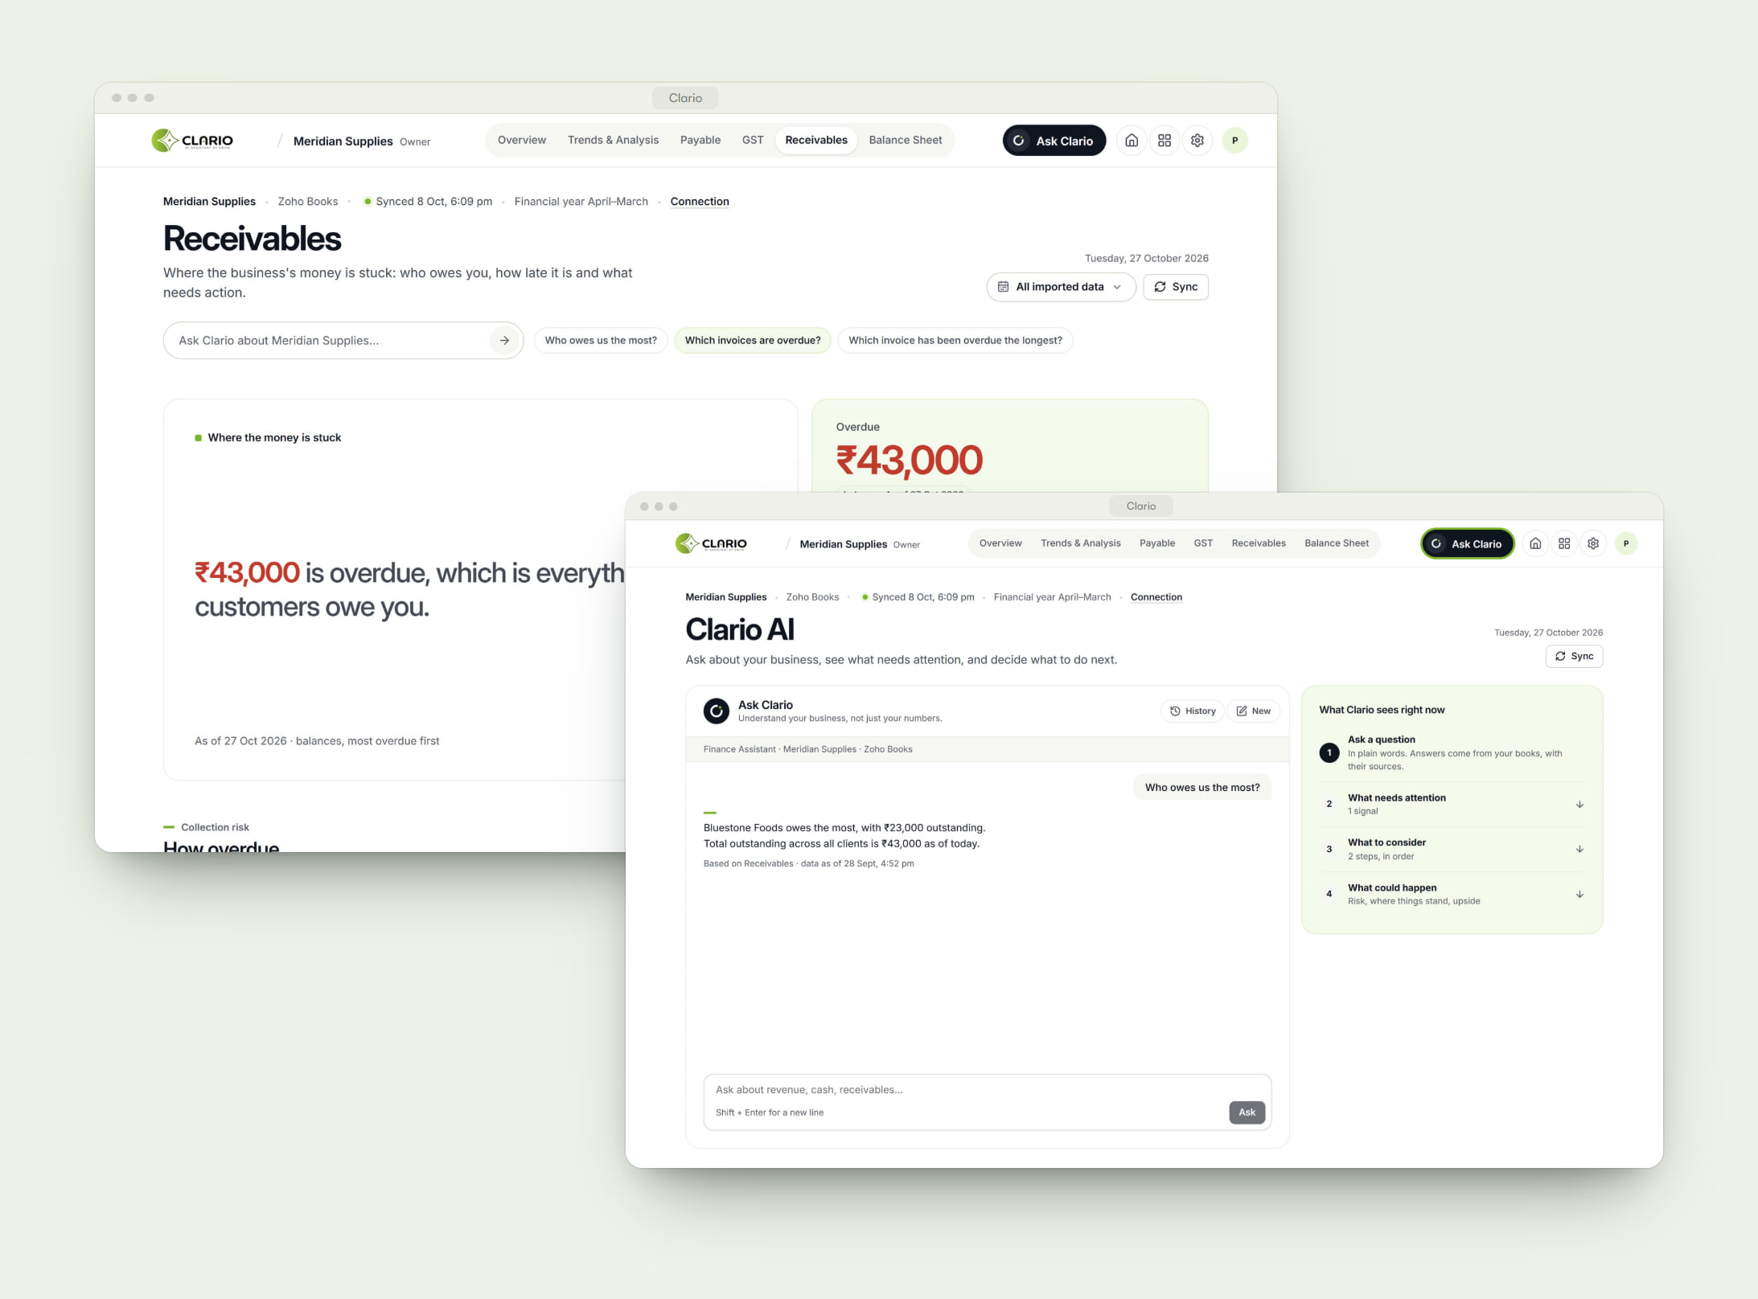
THE CHALLENGE
The numbers exist. The answers don’t.
Growing businesses keep their figures in accounting software, but turning ledgers into decisions takes reports, spreadsheets and an accountant’s time. Generic AI tools can’t be trusted with financial figures — and every new system adds another place to look.
WHAT WE BUILT
Connect once. See clearly. Ask anything.
Clario gives each client a private workspace. They connect Zoho Books securely, and Clario turns the data into a finance command centre — overview, trends, receivables, payables and balance sheet. Ask Clario answers questions in plain words using the same figures as the reports, and shows where each answer comes from.
Notes:
THE CHALLENGE
Growing businesses keep their figures in accounting software, but turning ledgers into decisions takes reports, spreadsheets and an accountant’s time. Generic AI tools can’t be trusted with financial figures — and every new system adds another place to look.
WHAT WE BUILT
Clario gives each client a private workspace. They connect Zoho Books securely, and Clario turns the data into a finance command centre — overview, trends, receivables, payables and balance sheet. Ask Clario answers questions in plain words using the same figures as the reports, and shows where each answer comes from.
Ask: “Does this sound like your operation?” — then show the product.

Slide 23
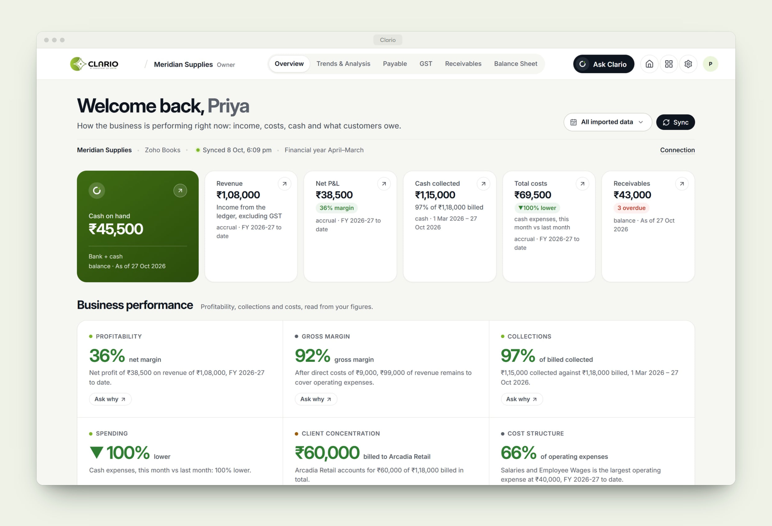
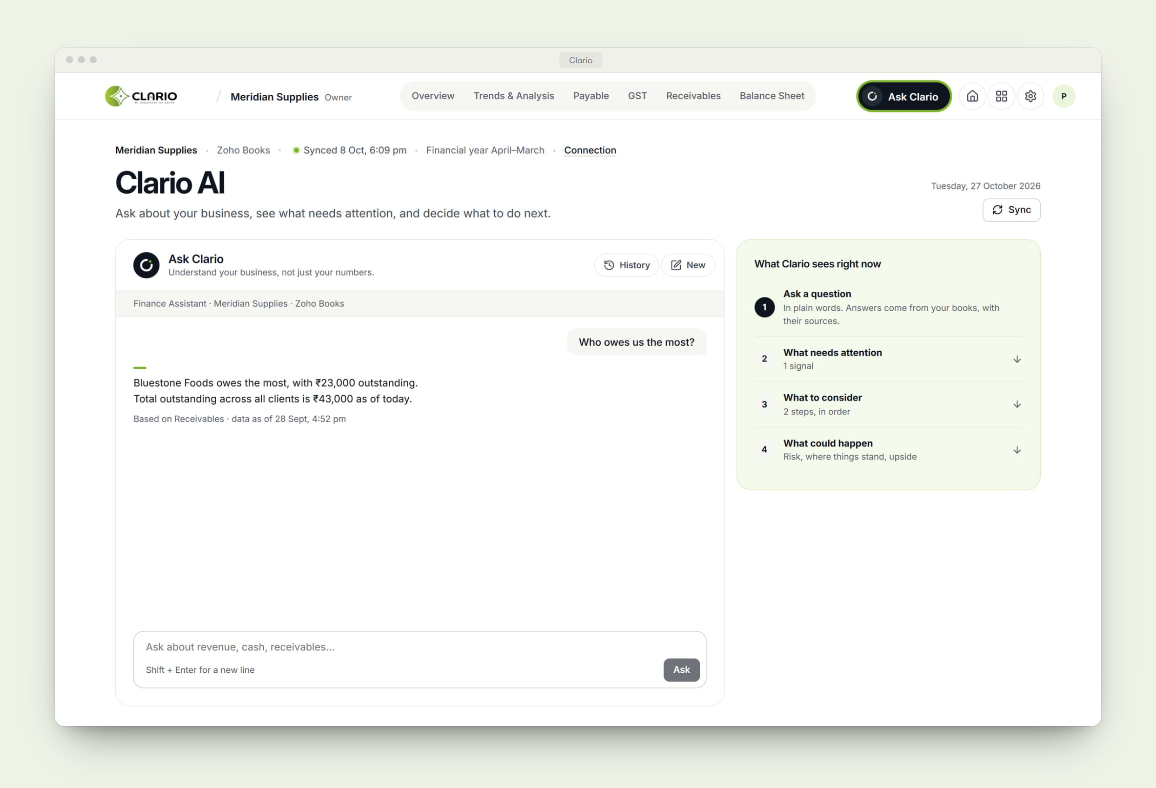
Inside Clario.
PRODUCT EXPERIENCE · 1 OF 2
01
The business on one screen
Cash on hand, revenue, profit, collections and receivables — each with its basis and as-of date.
02
Answers, with sources
Ask in plain words. Every answer uses the same figures as the reports and says where they came from.
Notes:
PRODUCT EXPERIENCE
1. The business on one screen — Cash on hand, revenue, profit, collections and receivables — each with its basis and as-of date.
2. Answers, with sources — Ask in plain words. Every answer uses the same figures as the reports and says where they came from.

Slide 24
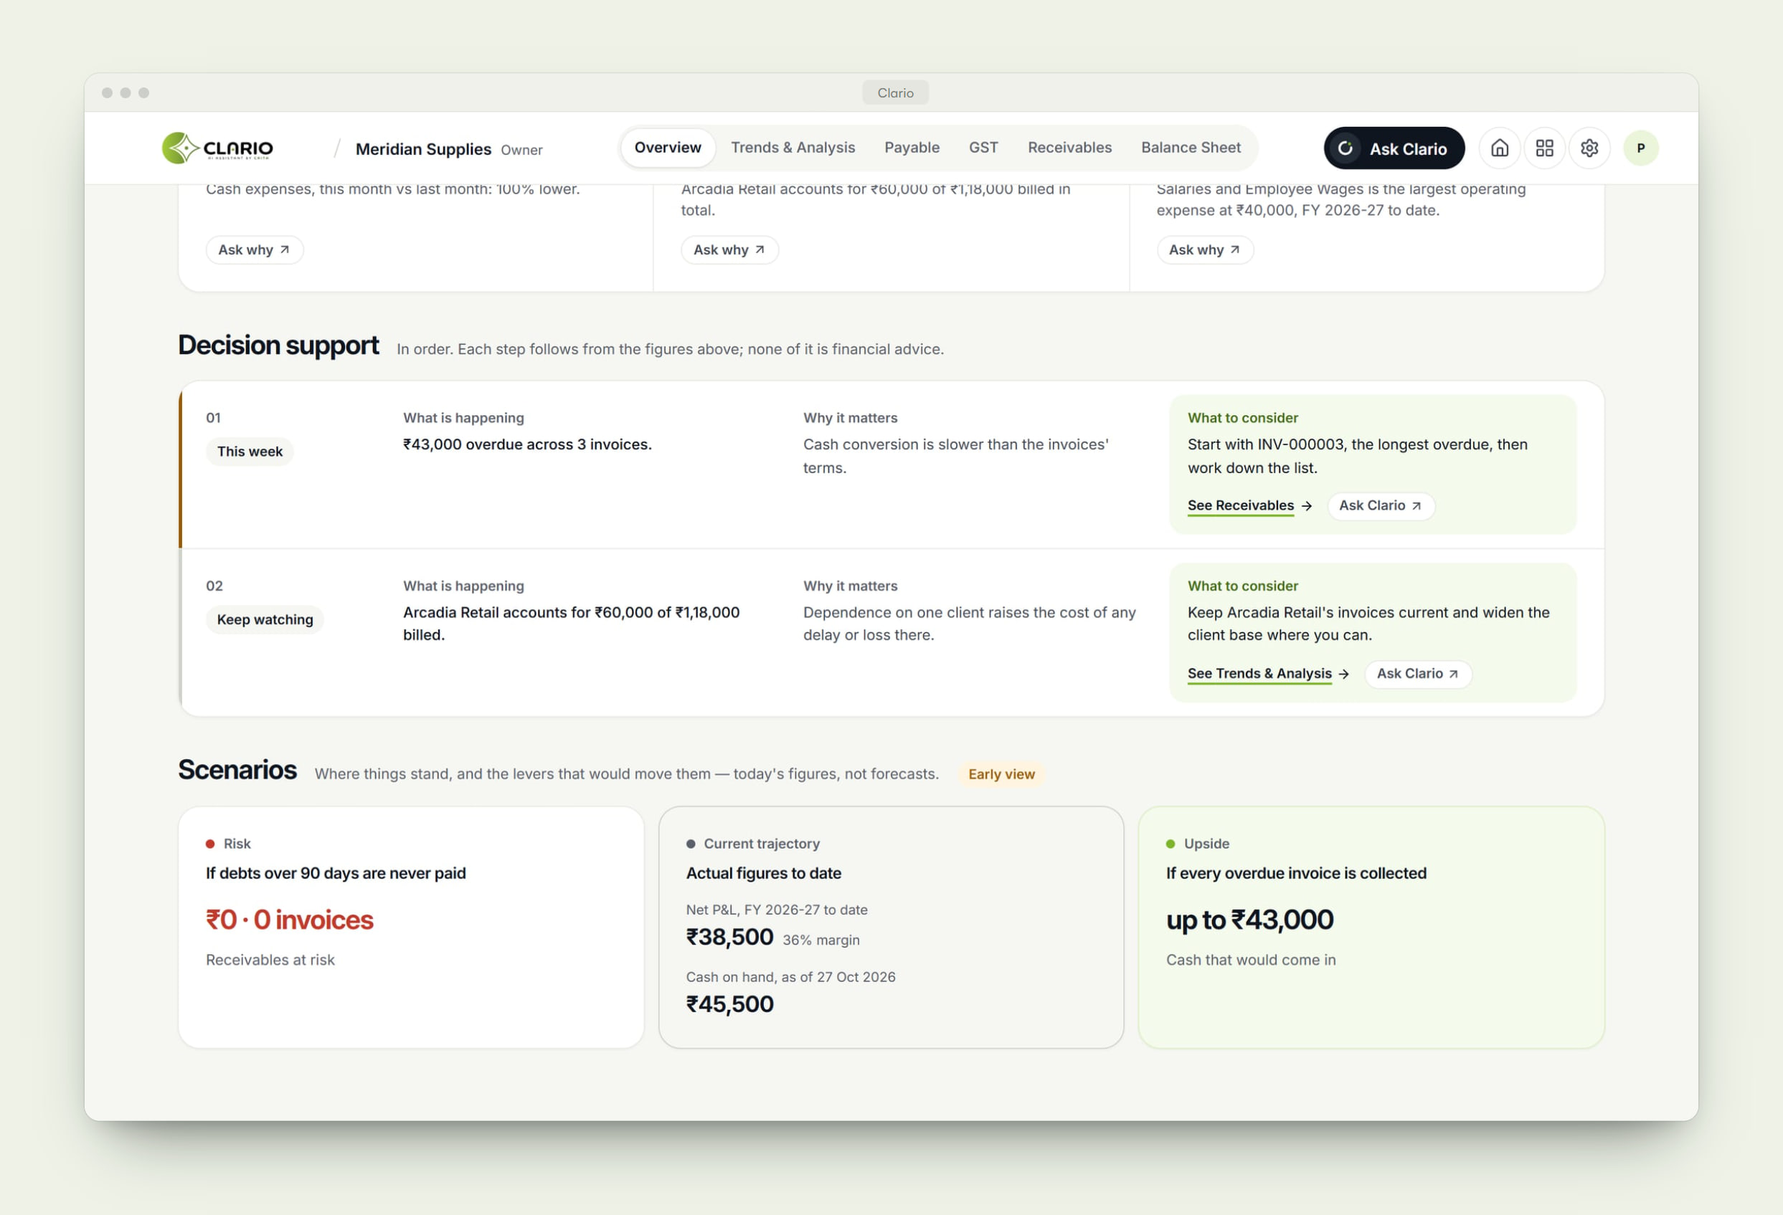
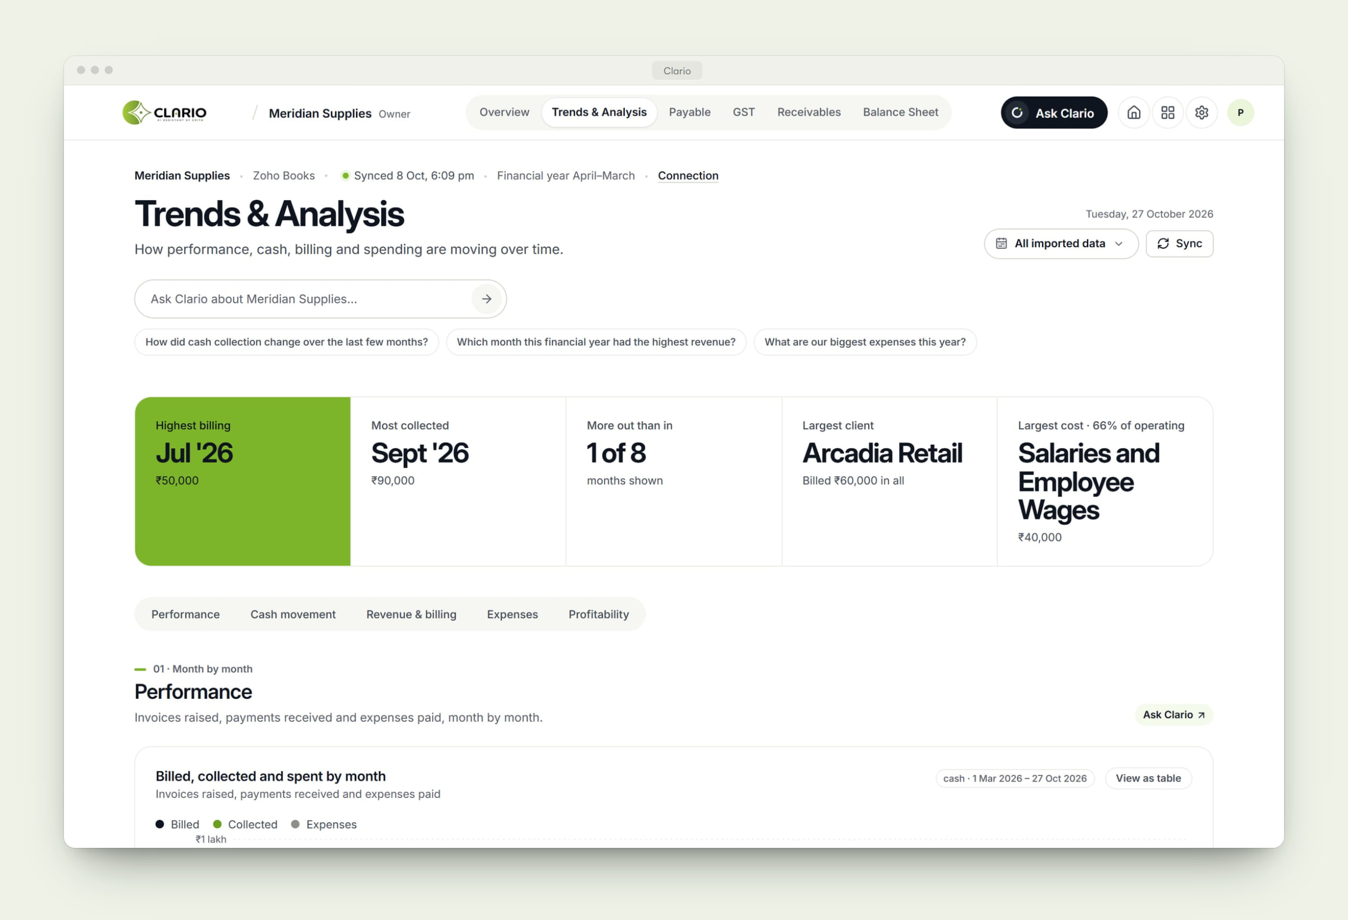
Inside Clario.
PRODUCT EXPERIENCE · 2 OF 2
03
What to do next
Signals and decision support turn the figures into an ordered list of what deserves attention.
04
Trends that explain themselves
Billing, collections and spending month by month — every chart with a table view.
Notes:
PRODUCT EXPERIENCE
3. What to do next — Signals and decision support turn the figures into an ordered list of what deserves attention.
4. Trends that explain themselves — Billing, collections and spending month by month — every chart with a table view.

Slide 25
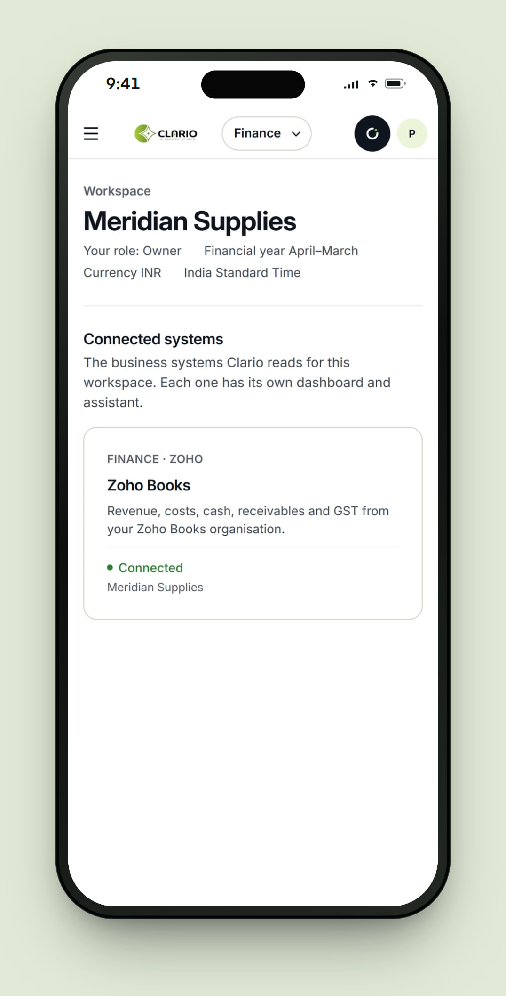
What Clario does.
KEY CAPABILITIES
01
Secure connection
Zoho Books connects through OAuth with read-only access, into the client’s own workspace.
02
Finance overview
Cash, revenue, profit, collections, costs and receivables on one screen, with performance signals.
03
Ask Clario
Plain-language questions answered from the books, with the source and date of every figure.
04
Decision support
What needs attention, what to consider next and simple scenarios — clearly labelled as guidance.
05
Trends & receivables
Month-by-month billing, collections and spending; overdue ageing and a full invoice register.
06
Workspaces & roles
Every client works in an isolated workspace with its own members and connected systems.
Notes:
KEY CAPABILITIES — pick the two or three that matter to this client:
1. Secure connection — Zoho Books connects through OAuth with read-only access, into the client’s own workspace.
2. Finance overview — Cash, revenue, profit, collections, costs and receivables on one screen, with performance signals.
3. Ask Clario — Plain-language questions answered from the books, with the source and date of every figure.
4. Decision support — What needs attention, what to consider next and simple scenarios — clearly labelled as guidance.
5. Trends & receivables — Month-by-month billing, collections and spending; overdue ageing and a full invoice register.
6. Workspaces & roles — Every client works in an isolated workspace with its own members and connected systems.

Slide 26
One platform, many connected systems.
PLATFORM ARCHITECTURE
Figures are calculated in code; the AI explains them. Each assistant only answers from its own domain’s data.
CONNECTORS
Zoho Books LIVE
Tally IN DEVELOPMENT
Inventory systems PLANNED
Lead management PLANNED
DOMAINS
Finance LIVE
Inventory PLANNED
Leads PLANNED
EXPERIENCE
Command centre LIVE
Ask Clario assistant LIVE
PLATFORM
Workspaces, roles & isolation LIVE
“Live” is available in the product today. “In development” and “Planned” describe the platform’s direction.
Notes:
ARCHITECTURE — be precise about what is live.
Live today: Zoho Books connection, the Finance command centre and Ask Clario, on multi-workspace tenancy.
In development: Tally. Planned: inventory connectors (e.g. Veloce, City Threads) and lead management.
Figures are calculated in code; the AI explains them. Each assistant only answers from its own domain’s data.

Slide 27
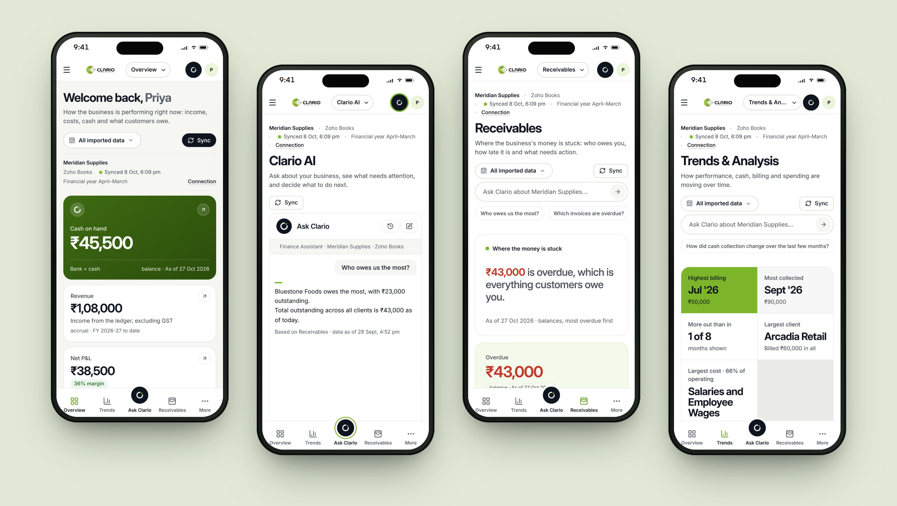
The whole command centre, in your pocket.
RESPONSIVE EXPERIENCE
Every view — including Ask Clario — adapts to a phone, so owners can check cash or chase receivables between meetings.
Notes:
RESPONSIVE
Every view — including Ask Clario — adapts to a phone, so owners can check cash or chase receivables between meetings.
Screens: Finance overview · Answer on mobile · Receivables · Trends.

Slide 28
What it changes for the business.
BUSINESS VALUE
TECHNOLOGY & DELIVERY
React
TypeScript
Python API
PostgreSQL
Zoho Books API
LLM with scoped tools
Clarity without reports
Owners see performance, cash and receivables without building spreadsheets.
Answers you can trust
Every figure traces back to the books, with its date.
Guidance, in order
Signals and next steps turn numbers into a short list of decisions.
Built to grow
Each new system Crita connects becomes another module on the same platform.
LIVE PRODUCT
ENGINEERING HIGHLIGHTS
View live product →
Deterministic finance calculations — the assistant explains figures, never invents them
Server-side OAuth with encrypted tokens
Workspace isolation enforced on the server
Clario
Live demo: Workspace owner views.
Shown with a sample company and test data.
Notes:
BUSINESS VALUE
• Clarity without reports — Owners see performance, cash and receivables without building spreadsheets.
• Answers you can trust — Every figure traces back to the books, with its date.
• Guidance, in order — Signals and next steps turn numbers into a short list of decisions.
• Built to grow — Each new system Crita connects becomes another module on the same platform.
DELIVERY: React, TypeScript, Python API, PostgreSQL, Zoho Books API, LLM with scoped tools.
• Deterministic finance calculations — the assistant explains figures, never invents them
• Server-side OAuth with encrypted tokens
• Workspace isolation enforced on the server
LIVE DEMO — Clario
Logins for the live demo are in the presenter copy of this deck.
Next: City Threads.

Slide 29
City Threads
04 — WAREHOUSE & INVENTORY MANAGEMENT
Every lot, every bin, every dispatch — accounted for.
A warehouse management system for a textile distributor: barcoded stock units, a visual map of every rack and bin, and an order-to-dispatch flow — with a one-handed phone app for the warehouse floor.
CLIENT
City Threads Textiles
SECTOR
Textile distribution
PLATFORM
Web · Android
ROLES
Administrator · Warehouse Executive
Notes:
CITY THREADS — City Threads Textiles (Textile distribution).
One-liner: “Every lot, every bin, every dispatch — accounted for.”
A warehouse management system for a textile distributor: barcoded stock units, a visual map of every rack and bin, and an order-to-dispatch flow — with a one-handed phone app for the warehouse floor.
Live: City Threads
Note: Demonstration environment with sample data.

Slide 30
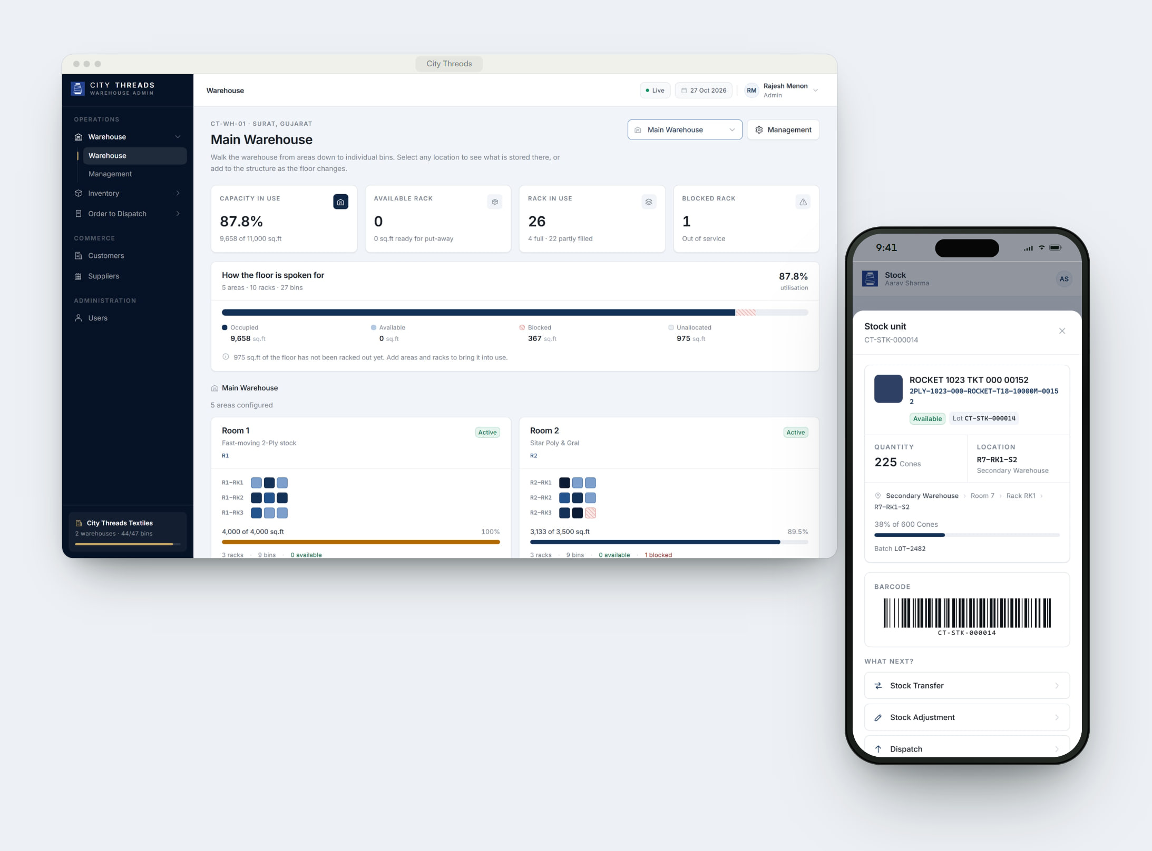
THE CHALLENGE
Two warehouses. A fragmented inventory process.
City Threads stores thread stock across racks and bins in two warehouses. With a fragmented, manual process, finding a lot, knowing which space was free and tracing what moved where took time — and depended on the people who remembered.
WHAT WE BUILT
A barcode on every lot. A map of every bin.
Crita built a warehouse system where every physical lot becomes a stock unit with a permanent ID and barcode. Administrators manage the structure, orders and stock from a desktop workspace; executives receive, move, count, pick and dispatch from their phone — scanning instead of searching.
Notes:
THE CHALLENGE
City Threads stores thread stock across racks and bins in two warehouses. With a fragmented, manual process, finding a lot, knowing which space was free and tracing what moved where took time — and depended on the people who remembered.
WHAT WE BUILT
Crita built a warehouse system where every physical lot becomes a stock unit with a permanent ID and barcode. Administrators manage the structure, orders and stock from a desktop workspace; executives receive, move, count, pick and dispatch from their phone — scanning instead of searching.
Ask: “Does this sound like your operation?” — then show the product.

Slide 31
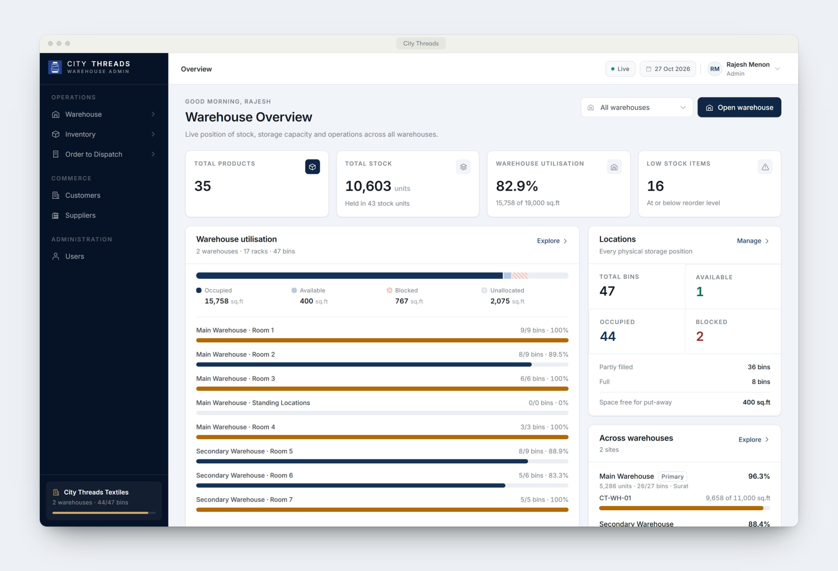
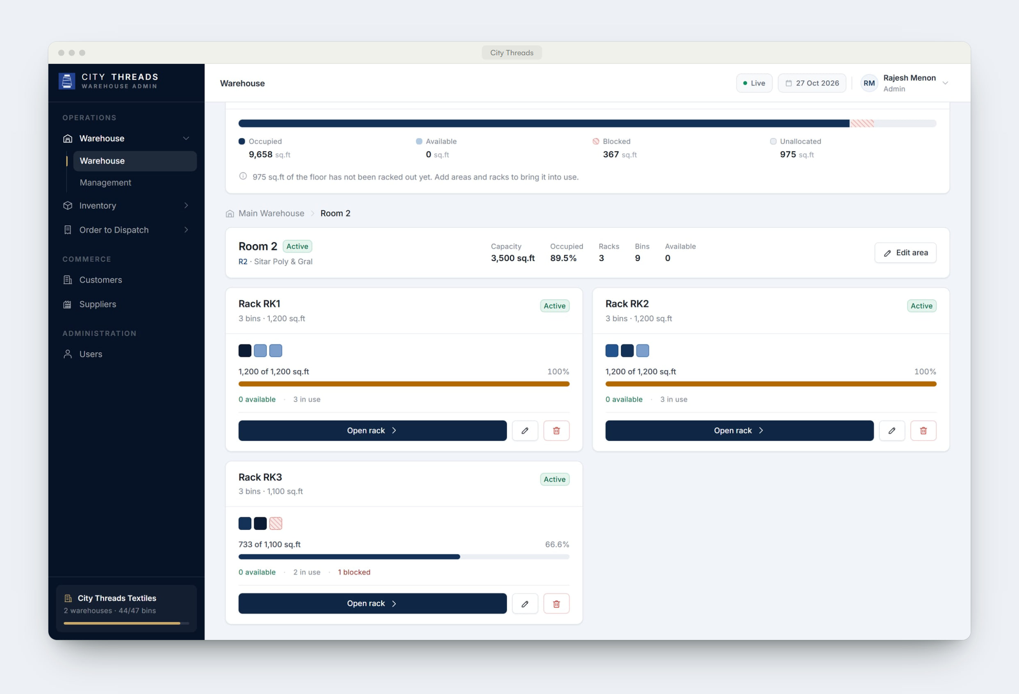
Inside City Threads.
PRODUCT EXPERIENCE · 1 OF 2
01
The whole operation, live
Stock, utilisation, locations, count discrepancies and recent sales across both warehouses.
02
Area, rack, bin
A visual map of the floor: capacity, occupancy and blocked locations at every level.
Notes:
PRODUCT EXPERIENCE
1. The whole operation, live — Stock, utilisation, locations, count discrepancies and recent sales across both warehouses.
2. Area, rack, bin — A visual map of the floor: capacity, occupancy and blocked locations at every level.

Slide 32
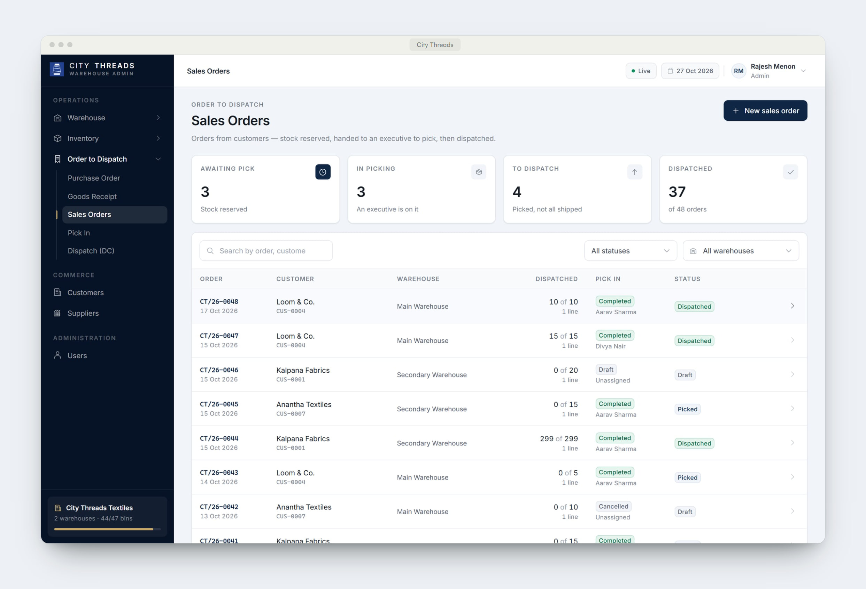
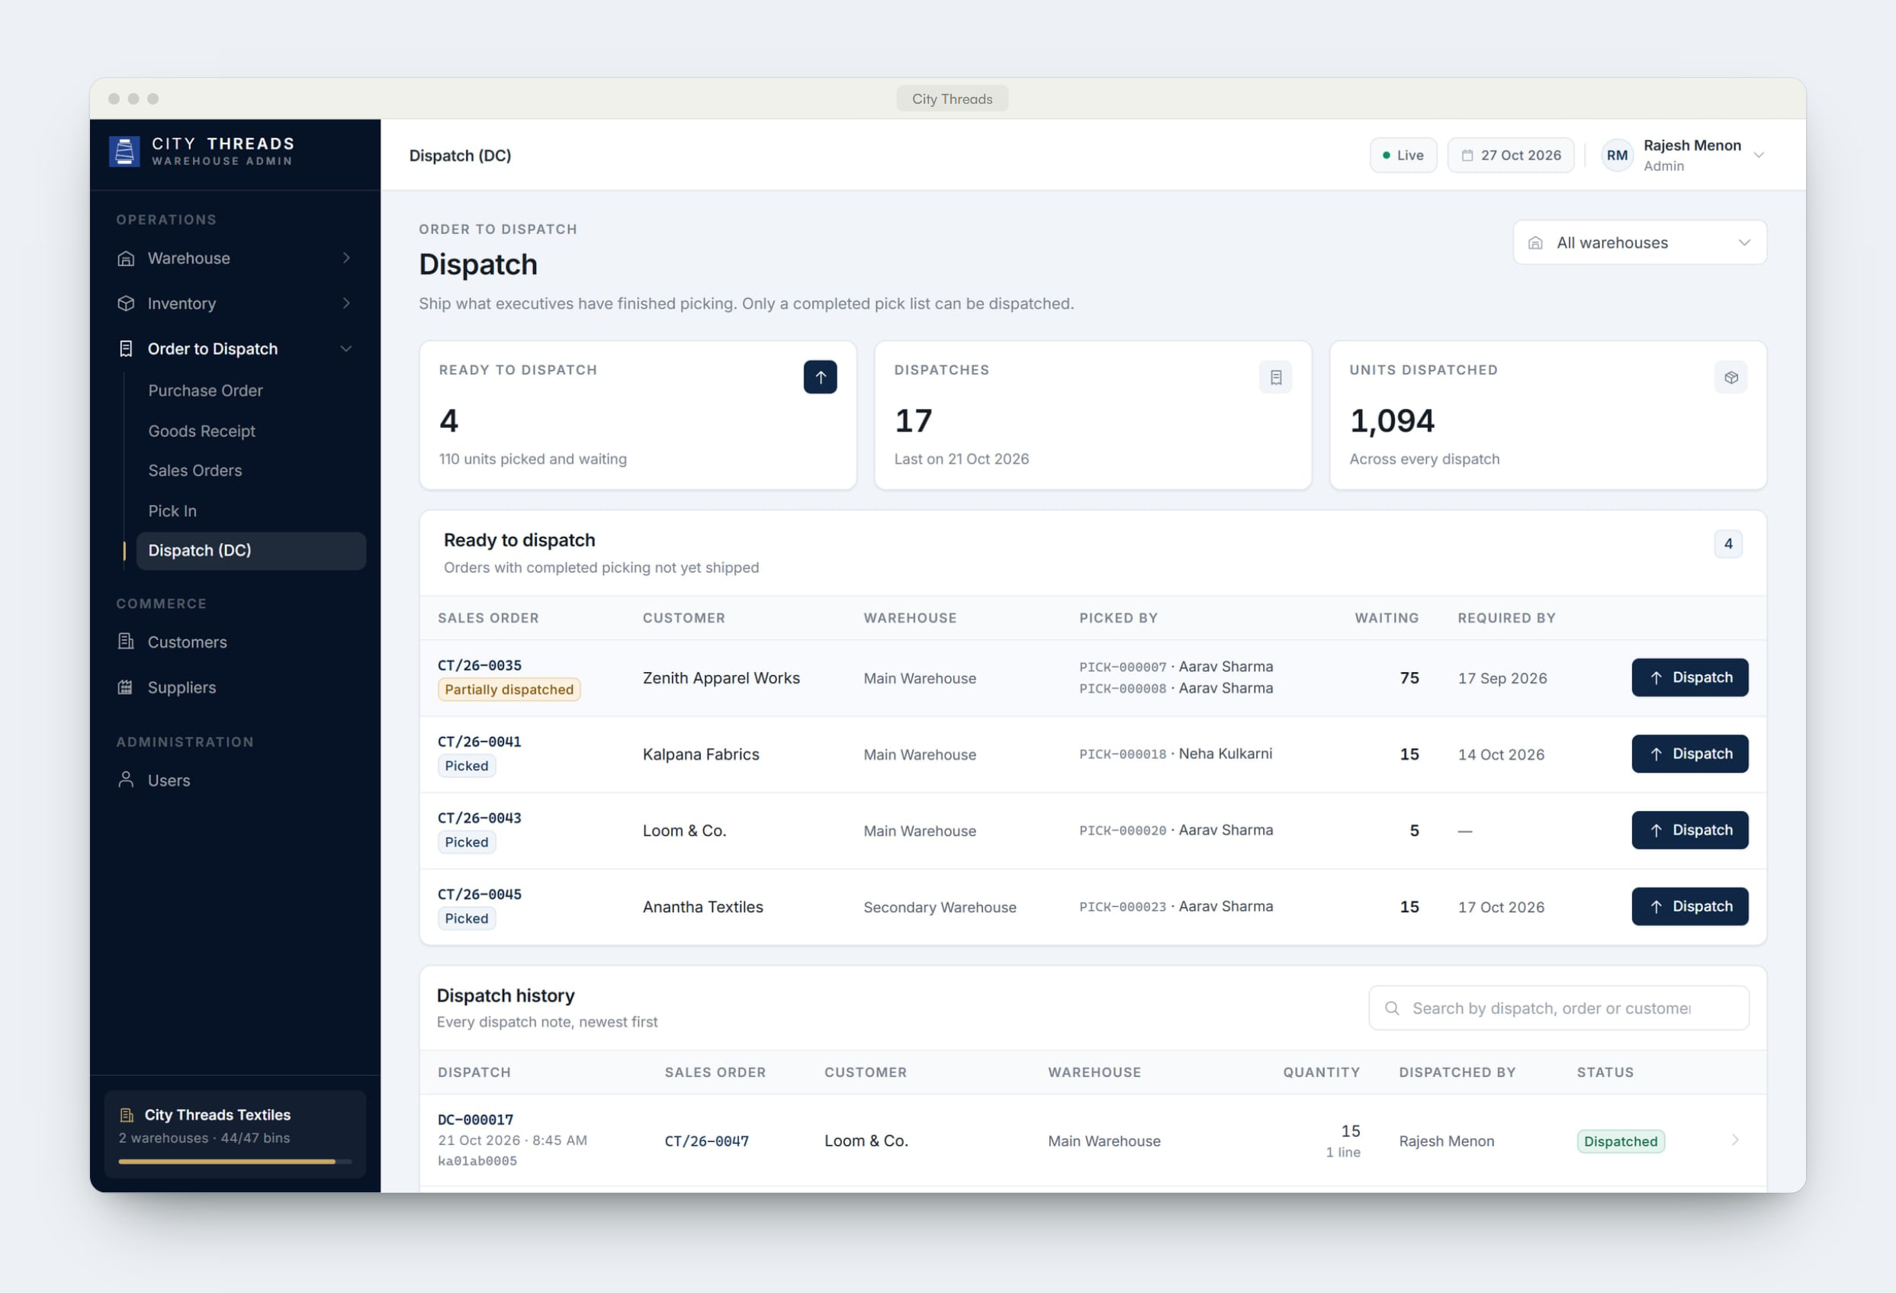
Inside City Threads.
PRODUCT EXPERIENCE · 2 OF 2
03
From order to truck
Sales orders move through picking to dispatch, with every quantity reserved and accounted for.
04
Dispatch with proof
Ready-to-ship orders and a full dispatch history with vehicle numbers and who sent what.
Notes:
PRODUCT EXPERIENCE
3. From order to truck — Sales orders move through picking to dispatch, with every quantity reserved and accounted for.
4. Dispatch with proof — Ready-to-ship orders and a full dispatch history with vehicle numbers and who sent what.

Slide 33
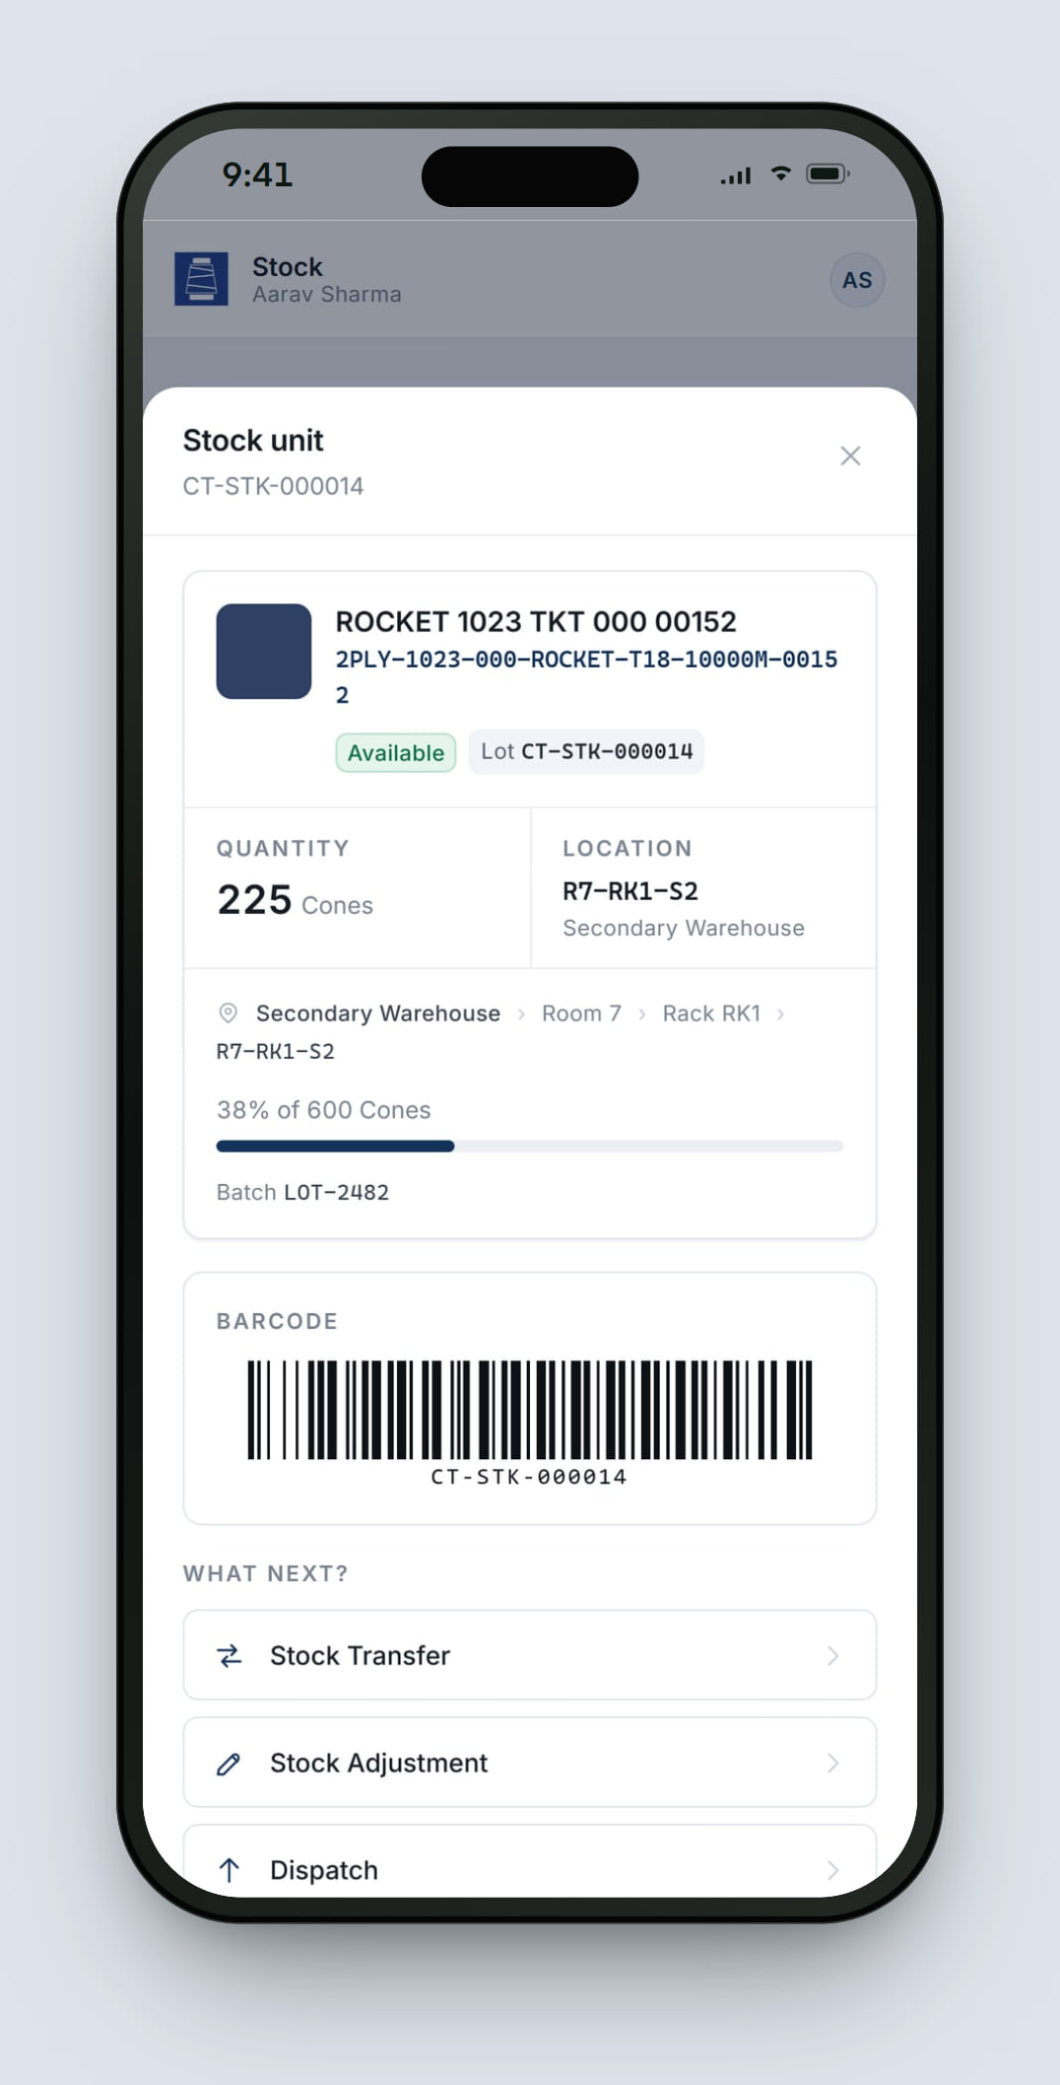
What City Threads does.
KEY CAPABILITIES
01
Barcoded stock units
Every lot gets a permanent Stock ID and Code 128 barcode. Scan it with the phone camera, upload a photo or type the ID.
02
Warehouse explorer
Walk area → rack → bin to see capacity, occupancy and blocked locations, and change the structure in place.
03
Order to dispatch
Purchase orders and goods receipts in; sales orders, pick lists and dispatch out — with stock reserved on the way.
04
Floor operations on the phone
Goods inward, transfer, adjustment, cycle count, picking and dispatch — built for one hand.
05
A ledger that reconciles
Every movement is recorded. Counts verify the shelf without changing stock; differences are corrected with a reason.
06
Commercial visibility
Customers, suppliers, sales and executive performance alongside stock.
Notes:
KEY CAPABILITIES — pick the two or three that matter to this client:
1. Barcoded stock units — Every lot gets a permanent Stock ID and Code 128 barcode. Scan it with the phone camera, upload a photo or type the ID.
2. Warehouse explorer — Walk area → rack → bin to see capacity, occupancy and blocked locations, and change the structure in place.
3. Order to dispatch — Purchase orders and goods receipts in; sales orders, pick lists and dispatch out — with stock reserved on the way.
4. Floor operations on the phone — Goods inward, transfer, adjustment, cycle count, picking and dispatch — built for one hand.
5. A ledger that reconciles — Every movement is recorded. Counts verify the shelf without changing stock; differences are corrected with a reason.
6. Commercial visibility — Customers, suppliers, sales and executive performance alongside stock.

Slide 34
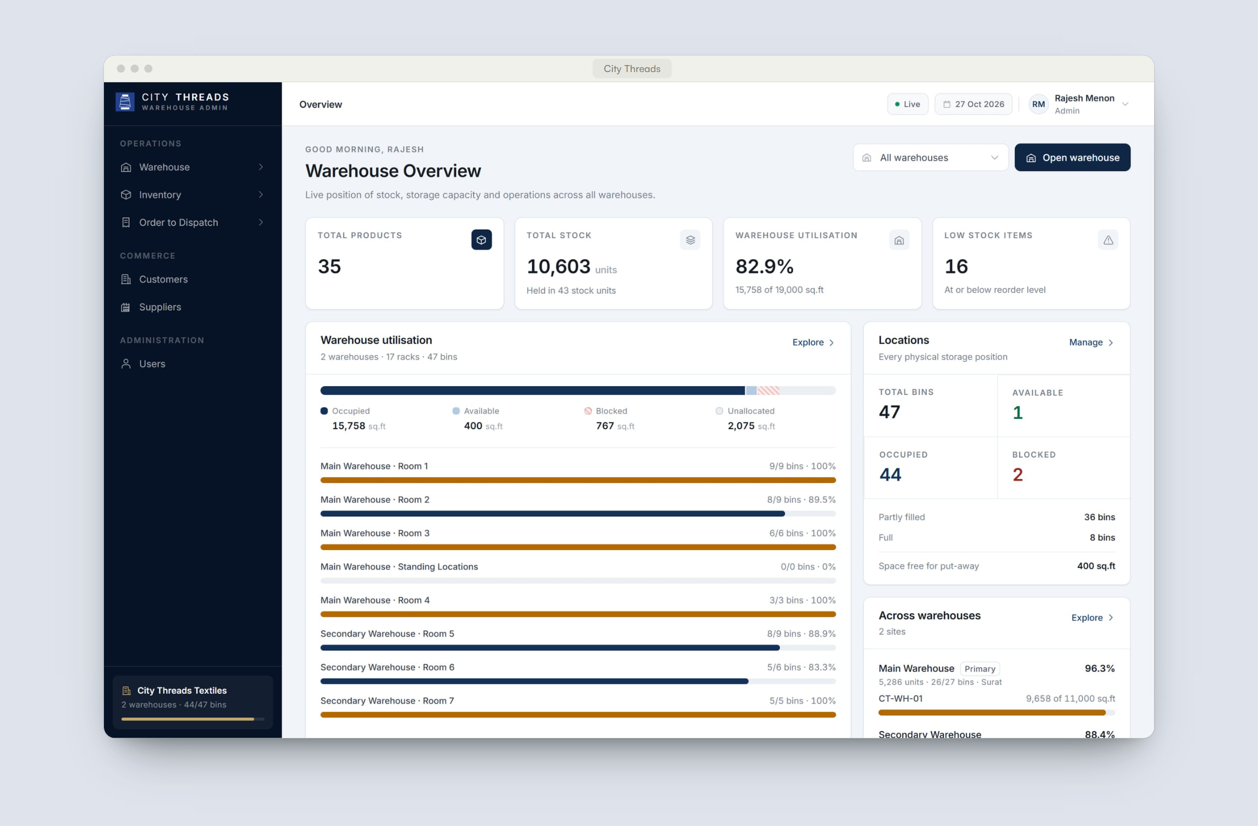
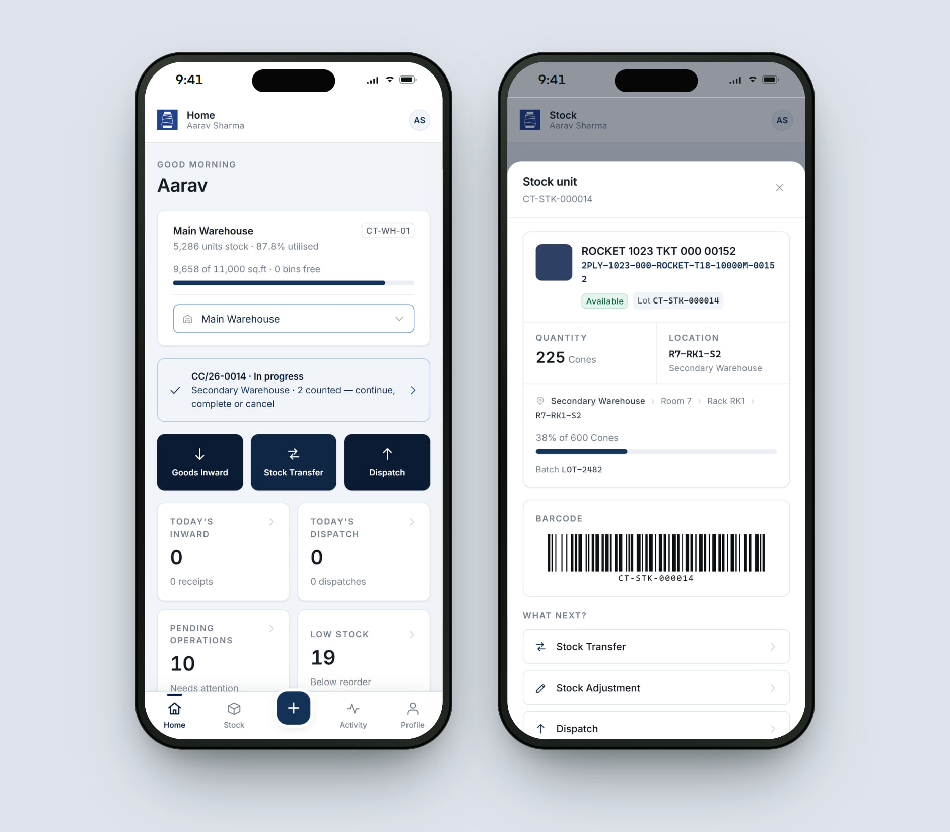
Built for every role.
ROLE-BASED EXPERIENCE
DESKTOP WORKSPACE
Administrator
Sees and shapes the whole operation.
MOBILE APP
Warehouse Executive
Works the floor, one-handed.
Overview of stock, utilisation and recent operations
Warehouse structure: areas, racks and bins
Purchase orders, sales orders and dispatch
Customers, suppliers and users
Home with capacity and today’s operations
Inward, transfer, adjustment, count, pick and dispatch
Scan or search any stock unit
Personal activity history
Notes:
ROLES
Administrator (Desktop workspace) — Sees and shapes the whole operation. Overview of stock, utilisation and recent operations; Warehouse structure: areas, racks and bins; Purchase orders, sales orders and dispatch; Customers, suppliers and users.
Warehouse Executive (Mobile app) — Works the floor, one-handed. Home with capacity and today’s operations; Inward, transfer, adjustment, count, pick and dispatch; Scan or search any stock unit; Personal activity history.

Slide 35
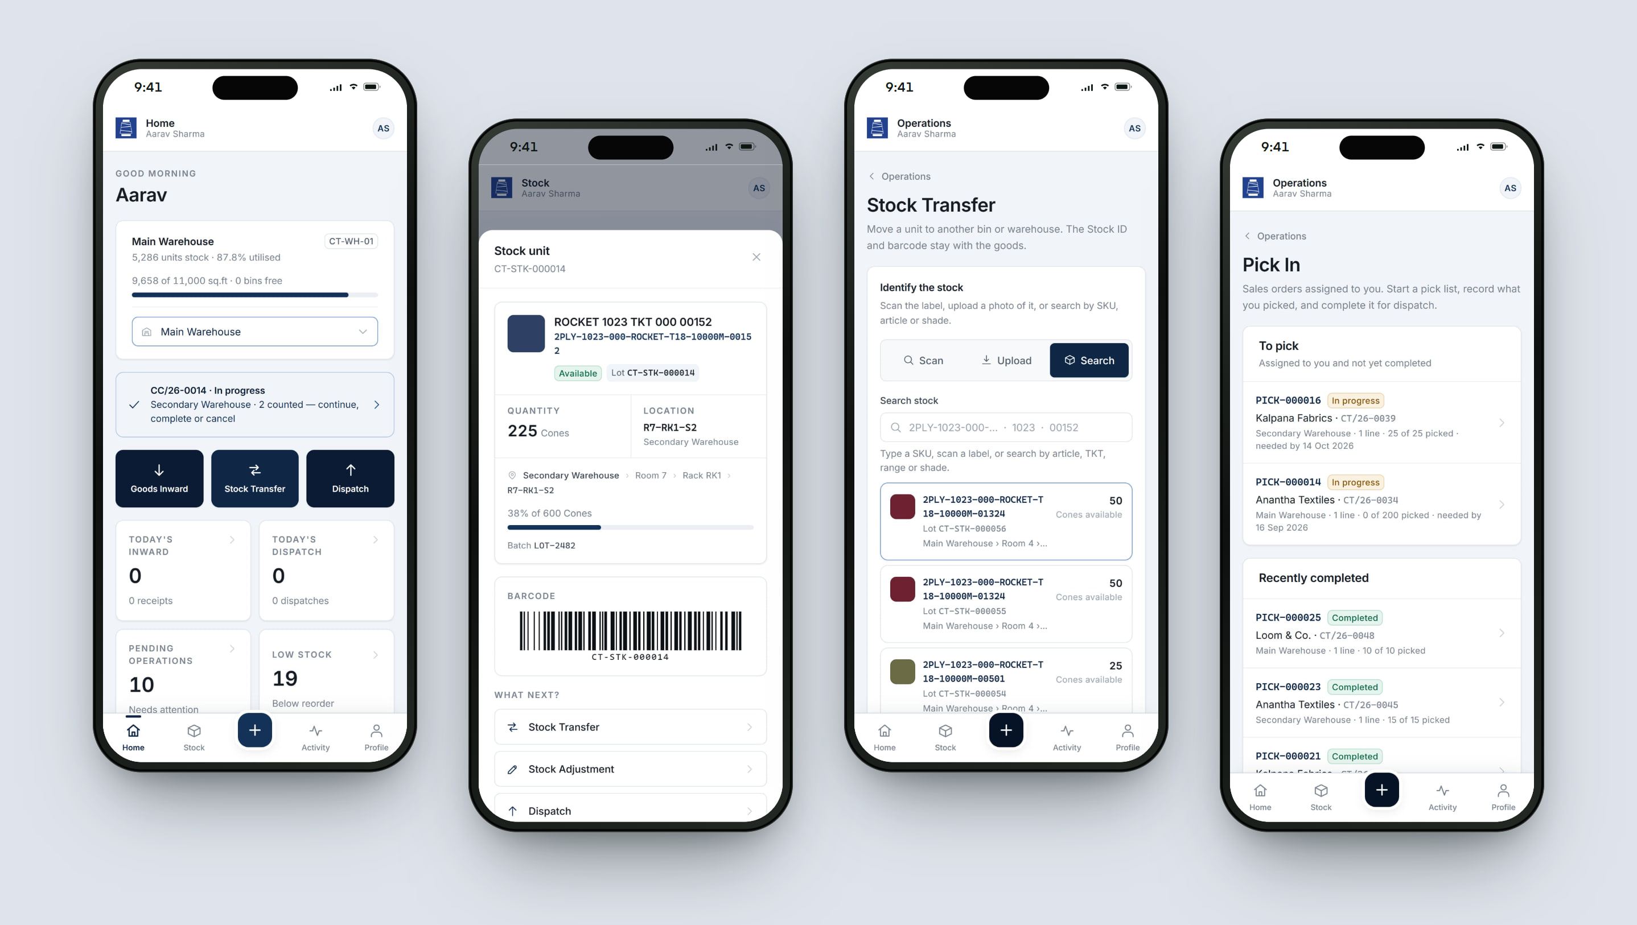
One hand on the phone. One on the stock.
RESPONSIVE EXPERIENCE
Executives scan, confirm and move on — inward, transfer, count, pick and dispatch. Administrators plan and review from the desktop.
Notes:
RESPONSIVE
Executives scan, confirm and move on — inward, transfer, count, pick and dispatch. Administrators plan and review from the desktop.
Screens: Executive home · Stock unit with barcode · Stock transfer · Pick list.

Slide 36
What it changes for the business.
BUSINESS VALUE
TECHNOLOGY & DELIVERY
Next.js
React
PostgreSQL
Cloudflare Workers
Code 128 barcodes
Android app
Find any lot, instantly
Scan a label to see what it is, where it is and what to do next.
Plan space with confidence
Utilisation and free capacity are visible before put-away.
Camera scanning through the browser’s native barcode detector, with manual entry always available
Bins are released only when stock reaches zero — enforced in one place
Served from Cloudflare’s global edge network
Fewer errors on the floor
One identification flow for every operation; counts never change stock silently.
Real-time visibility
Stock and operations across both warehouses, as they happen.
LIVE PRODUCT
View live demo →
“CRITA helped us replace a fragmented inventory process with a much more organised and efficient system. The application gave our team better visibility, reduced manual work, and made it easier to track inventory in real time.”
Sreyash · City Threads
City Threads
Administrator
admin@citythreads.com · Admin@123
Warehouse Executive
aarav@citythreads.com · Exec@123
Demonstration environment with sample data.
Notes:
BUSINESS VALUE
• Find any lot, instantly — Scan a label to see what it is, where it is and what to do next.
• Plan space with confidence — Utilisation and free capacity are visible before put-away.
• Fewer errors on the floor — One identification flow for every operation; counts never change stock silently.
• Real-time visibility — Stock and operations across both warehouses, as they happen.
Client quote (Sreyash, City Threads): “CRITA helped us replace a fragmented inventory process with a much more organised and efficient system. The application gave our team better visibility, reduced manual work, and made it easier to track inventory in real time.”
DELIVERY: Next.js, React, PostgreSQL, Cloudflare Workers, Code 128 barcodes, Android app.
• Camera scanning through the browser’s native barcode detector, with manual entry always available
• Bins are released only when stock reaches zero — enforced in one place
• Served from Cloudflare’s global edge network
LIVE DEMO — City Threads
Demo accounts (Demonstration accounts, also offered on the app’s own login screen.):
Administrator: admin@citythreads.com / Admin@123
Warehouse Executive: aarav@citythreads.com / Exec@123

Slide 37

START THE CONVERSATION
Let’s build something meaningful together.
Tell us where you’re stuck. We’ll reply within one business day with a clear point of view.
abishek@crita.in
www.crita.in
© 2026 Crita Creative LLP
Notes:
CLOSE — ask for the next step.
“Tell us where you’re stuck. We’ll come back within one business day with a clear point of view.”
Suggested next step: a short discovery conversation about their operation.
Contact: abishek@crita.in · www.crita.in

