Slide 1
UmangWellness
Internship at : NextWave Logic., Inc Mentor : Jaykumar Chellappan
Name : Rahul H. Prajapati (2019033800125516)

Slide 2
Objectives
Software/Tools
UmangWelleness Introduction
Modules of UmangWellness
Testing with Jest

Slide 3
Software/Tools
ReactJs
NodeJs
Postman
Jest
VS Code
MongoDB

Slide 4
What is UmangWellness?
In recent years, People who are suffered from Mental health are increased.
Like, Stress, Depression, anxiety, etc.
UmangWelleness is a online counselling platform.
The goal of the UmangWelleness is to make psychological therapy accessible to more people in a private and confidential way in an online setting.
Utilize the power of technology to touch more people’s lives in a positive way.

Slide 5
Modules of UmangWellness
Multi-Role Platform
Counsellor Public Page
Subscription for Counsellor
Platform Services
Reserve Session

Slide 6
Multi-Role Platform
User can now have upto 2 role simultaneously
A user can be -
Client
Counsellor
Or Both

Slide 7
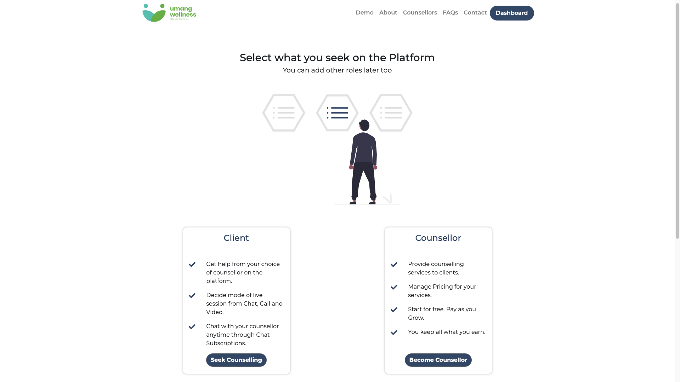

Slide 8
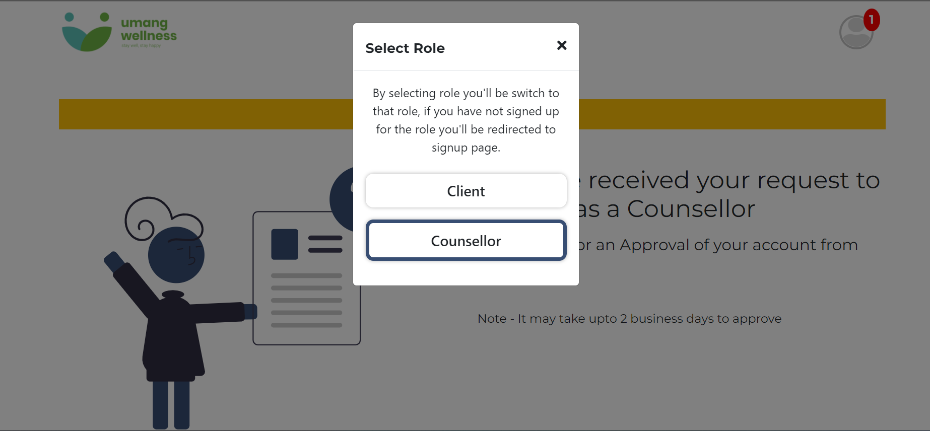

Slide 9
2. Counsellor Public Page
Counsellors now have their own Public Page.
Everyone who visits the web-app can view them.
The page shows all the relevant information about the Counsellor.
The Page shows -
Counsellor Description
Available Timings
Session Pricing
Subscription Plans Pricing
Services
Social Links
Quick Book-session, Start Chat and Service button

Slide 10
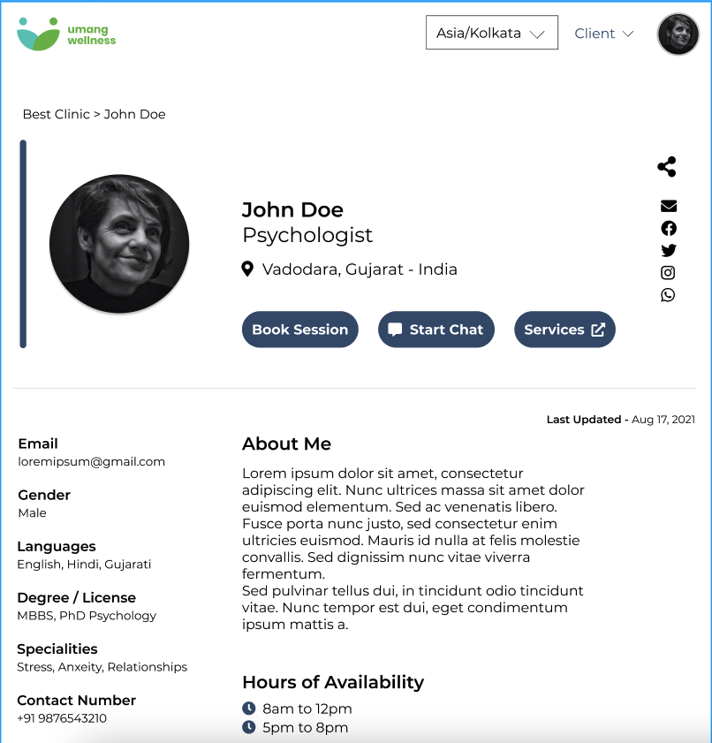

Slide 11
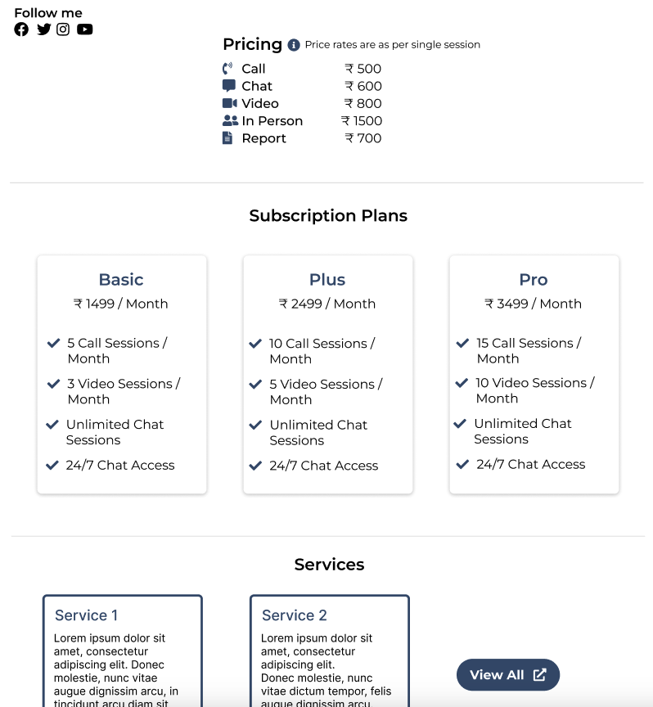

Slide 12
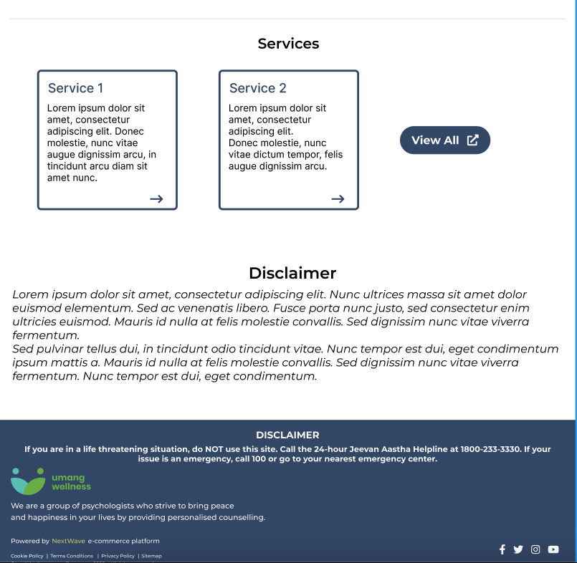

Slide 13
3. Subscriptions
There are 2 types of Subscriptions
Counsellor Subscriptions
Client Subscriptions

Slide 14
3.(a) Counsellor Subscriptions
The Concept of platform charges is removed.
Counsellors now earn the whole amount which they charge for sessions.
In order to keep delivering more sessions, Counsellors need to upgrade to a higher subscription tier.
A Counsellor Subscription controls -
Session limit
Client Limit
Mode of services that can be offered (Call, Chat, Video)

Slide 15
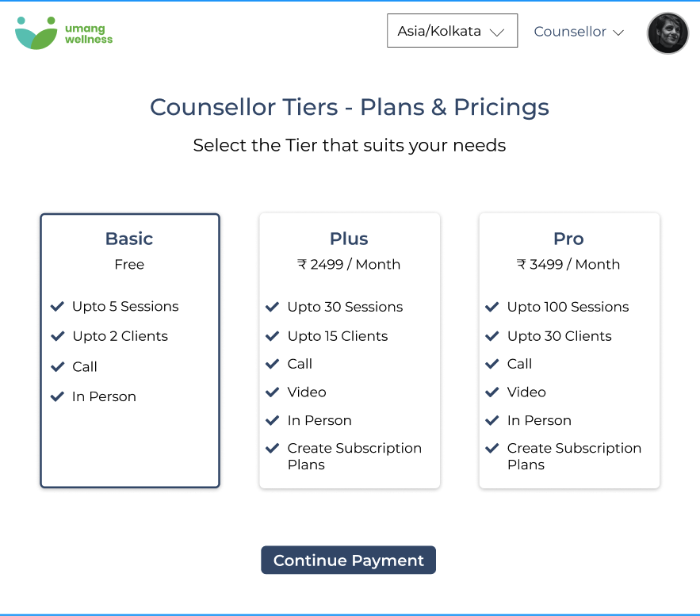

Slide 16
Continued…
By default, when you sign-up as Counsellor, you’ll be subscribed to the free subscription plan.
All Subscription plans are monthly.
You can always upgrade/downgrade the Subscription.
No refund in case of Subscription cancellation.

Slide 17
4. Platform Services
The Admins of the platform can create a set of services which they think the platform can offer outside its Scope.
The Plantform services provides -
A custom layout for creating your services

Slide 18
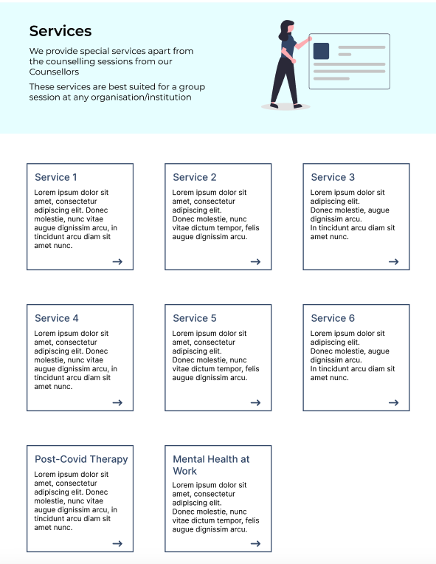

Slide 19
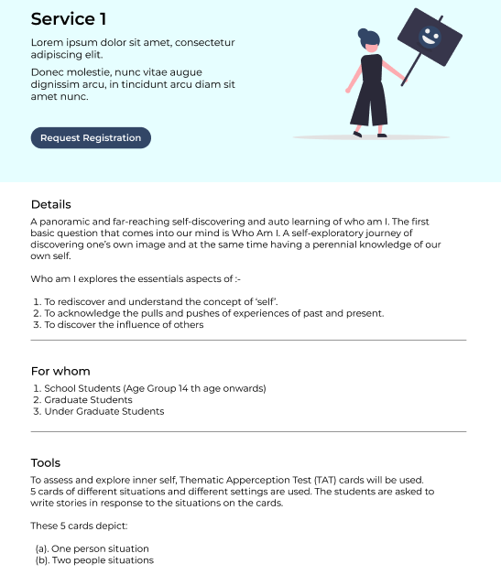
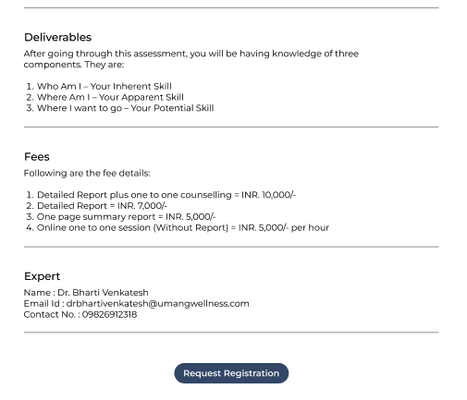

Slide 20
5. Reserve Session
Counsellors now have the ability to reserve a session for their Clients.
They can book a session on behalf of their clients.
The Client will then get a payment link to fulfil the session amount.

Slide 21
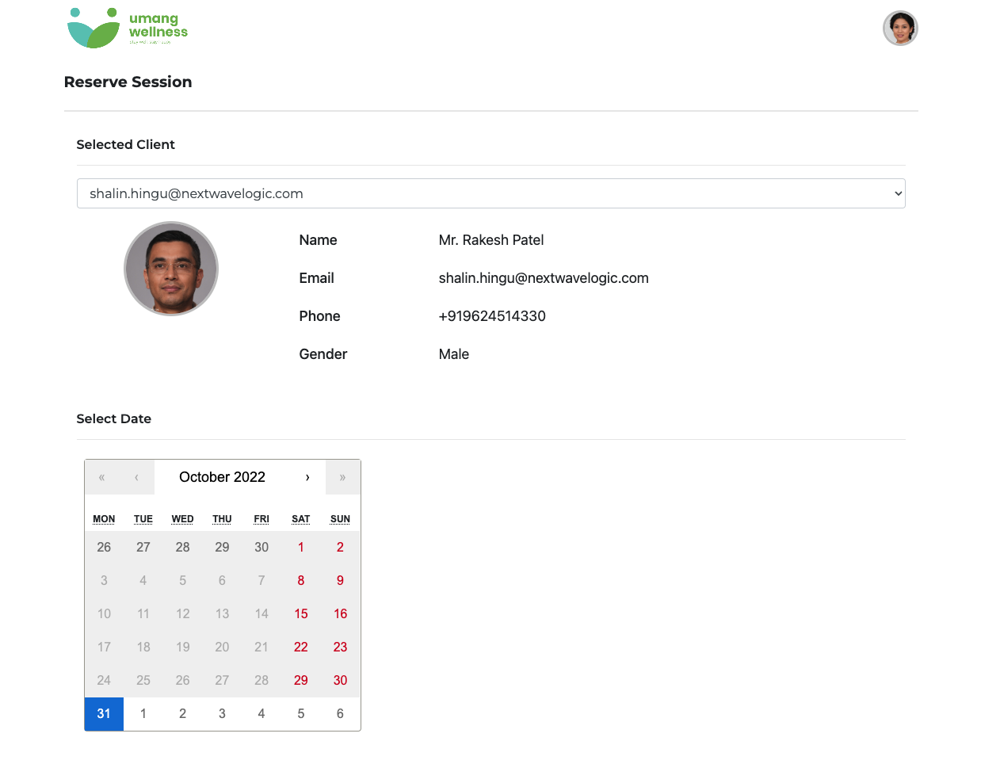

Slide 22
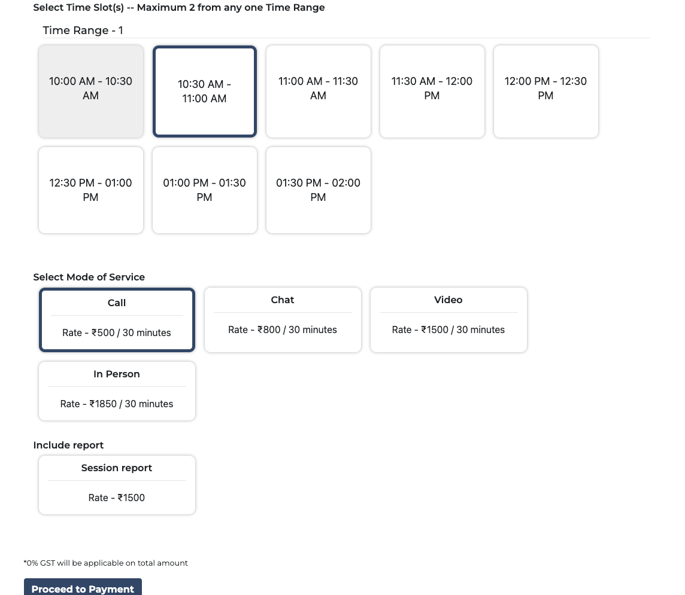

Slide 23
What is Jest ?
Jest is basically a javascript testing framework with which you can perform unit and Integration based tests.
It works with projects that use Node and popular frontend frameworks like React, Angular and Vue.
You can install jetsin your project by type following command
npm install -D jest

Slide 24
Thank You!

