Slide 1

ML
Project
Prince Gupta
B19BB033
Instructor : Yashaswi verma

Slide 2
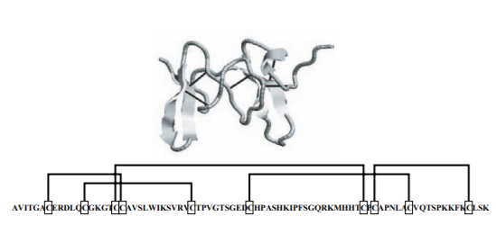
ABOUT THE PROJECT
This paper introduces a new method for the prediction of disulphide bond connectivity
using a 2-Dimensional Recursive Neural Network(RNN).

Slide 3
01
TABLE OF CONTENTS
02
03
04
INTRODUCTION
ALGORITHM
RESULTS
CONCLUSION

Slide 4
Introduction
Cysteine is a semi-
essential proteinogenic
amino acid. The
formation of covalent
links among cysteine
(Cys) residues with
disulphide bridges is an important and unique feature of protein folding and structure.
Disulphide bond
formation involves a
reaction between the
sulfhydryl (SH) side
chains of two cysteine
residues. The disulfide bond links distant portions of a protein and play an important role in protein folding and stability.
Thus prediction /
knowledge of the disulphide connectivity
of a protein is
important and provides essential insights into
its structure and
possibly also into its function and evolution.

Slide 5
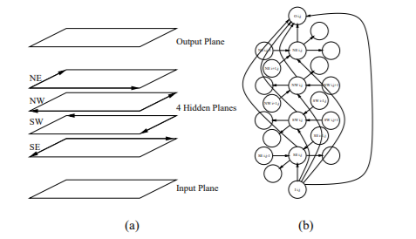
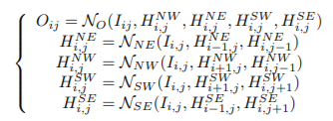
Algorithm
Figure 1
Figure 2

Slide 6
Algorithm
To predict disulphide connectivity patterns, this paper uses 2D-Recursive Neural Network. In figure 1, the graph for disulphide connectivity has 6 2D-layers: input, output and rest 4 are hidden layers. In this map prediction, the (i,j) output represents the probability of whether the i-th and j-th cysteines in the sequence are forming a disulphide bond or not. This prediction can be summarized by 5 neural network as shown in figure 2. Learning can then proceed via gradient descent (backpropagation).
We can train our data here using two methods :-
→ One where we assume the bonded state of individual cysteine is known using a specialized predictor for bonded/non-bonded states.
→ Other where we do not assume anything and predict for all cysteines in the sequence

Slide 7
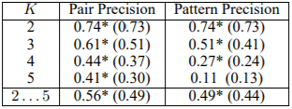
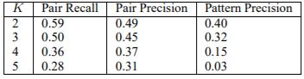
Results
Table 1 : Prediction assuming the bonding state is known.
Table 2 : Prediction on all the cysteines for 2 ≤ K ≤ 5.
Table 3 : Prediction on all the cysteines for K>5.

Slide 8
Results
Disulphide Connectivity Prediction for Bonded Cysteines : Here it is assumed that the bonding state of the cysteines are known. 2D-RNN is trained using the SP39 data set to compare with other published results.
The performance is evaluated using the precision P (P=TP/(TP+FP) with TP = true positives and FP = false positives) and recall R (R=TP/(TP+FN) with FN = false negatives).
In Table 1, the results of this experiment (The value with a *) is compared with the results (The value in brackets) reported in the literature. For example, in the case of 3 bonded cysteines, the precision reaches 0.61 and 0.51 at the pair and pattern levels, whereas the best similar results reported in the literature are 0.51 (pair) and 0.41 (pattern).

Slide 9
Results
Disulphide Connectivity Prediction from scratch : Here it is not assumed that the bonding state of the cysteines are known and the 2D-RNN is applied to all the cysteines(bonded or non-bonded) in the sequence. 2D-RNN is trained using both the the SP39 data set (4-fold cross validation) and SP41(10-fold cross validation).
In Table 2, the precision and recall for SP39 data set is given for 2 ≤ K ≤ 5.
Table 3 shows the kind of results that are obtained when the method is applied to sequences with more than K = 5 bonds in SP41.

Slide 10
Conclusion
Thus this paper presents a complete system for the prediction of disulphide bridges in cysteine rich proteins.
When it is assumed that the bonded state of the cysteines is known, it outperforms existing approaches on the same validation data. The results also show that the 2D-RNN method achieves good recall and accuracy on the prediction of connectivity pattern even when the bonding state of individual cysteines is not known.
Also differently from existing approaches, this method can be applied to chains with k>5 bonds.
Training can take days but once trained predictions can be carried on a proteomic or protein engineering scale

