Slide 1


Slide 2


Slide 3
What is Solidity?
- Object oriented high level language
- Designed specifically for writing smart contracts
- Statically typed, supports inheritance and complex types
- Syntax looks similar to Javascript

Slide 4
What is Solidity?
Ethereum Solidity is a contract-oriented, high-level language with syntax like that of JavaScript.
A solidity is a tool used to generate a machine-level code to execute on EVM.
The solidity compiler takes the high-level code and breaks it down into simpler instructions.
There are, however, other languages, such as serpent, Mutan, and LLL but solidity is the most popular at the time of writing this.

Slide 5
History of Solidity
Solidity was developed by Gavin Wood, Christian Reitwiessner, Alex Beregszaszi, Yoichi Hirai and several former Ethereum core contributors enabled writing smart contracts on blockchain platforms such as Ethereum.
There are many built-in classes and Libraries in Solidity which support hassle free smart contract development.
You can use the IDEs like Remix, Visual Studio (With Solidity extension), Ether atom, IntelliJ IDEA plugin ( both with Solidity extension)

Slide 6
Contracts in Ethereum Solidity
A contract is the fundamental building block of Ethereum’s decentralized Applications.
Using Solidity you will be coding smart contracts which are going to be executed in the Ethereum Virtual Machine.
Ethereum developers mention a set amount of gas which is assigned to their contracts. Each line of the contract requires some amount of gas to execute. The gas limit should be enough for the contract to execute completely.

Slide 7
Storage
Ethereum has three areas where it can store items.
Storage: where all the contract state variables reside. Every contract has its own storage and it is persistent between function calls
Memory: hold temporary values and gets erased between (external) function calls and is cheaper to use
Stack: hold small local variables and is almost free to use, but can only hold a limited amount of values

Slide 8
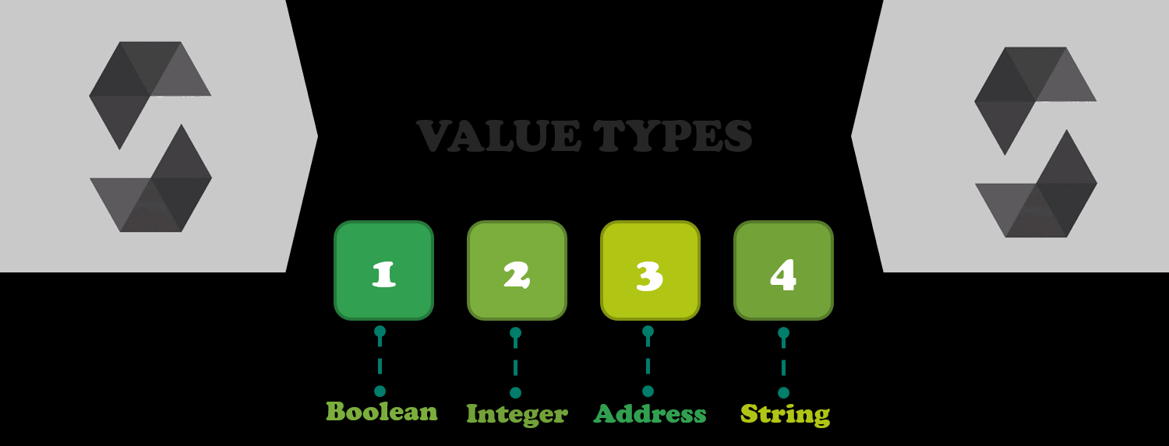
Value Types in Solidity
The following types are also called value types because variables of these types will always be passed by value.

Slide 9
Data Types
In Solidity, you have two types of integers, coming in various sizes:
int - signed integers
uint - unsigned integers
Speaking of size, to specify it, you have keywords such as uint8 up to uint256, that is, of 8 to 256 bits.
the simple uint and int are similar to uint256 and int256, respectively.

Slide 10
Data Types
There are two types of keywords used to declare fixed-point numbers:
fixed - signed fixed point number
ufixed - unsigned fixed point number
The value type called address holds a 20-byte value, which is the size of an Ethereum address.
These types also have members and serve as a base for contracts
Members of Addresses
balance and transfer

Slide 11
Types of function
Internal functions may only be called in the current contract as they cannot be executed outside of the current contract's context.
External functions normally consist of an address and a function signature - they can be returned and passed via from external function calls.

Slide 12
Syntax
Function types are notated as in the example:
function (<parameter types>) {internal|external}
[pure|constant|view|payable] [returns (<return types>)]
Visibility: public, private, internal, external
Behavior: pure, view, payable
In Solidity pure functions are functions, that are promised not to modify or read the state.
Functions are declarable as view, making them promise not to modify the state, thus only being used for viewing the state.

Slide 13
Solidity Function Visibility Specifiers
function functionName() <visibility specifier> returns (bool) { returntrue; }
public: externally and internally visible (will create a getter function in case of storage/state variables)
private: visible inside the current contract exclusively
external: visible externally exclusively (for use on functions only) - i.e. may only be message-called (using this.functionName)
internal: visible exclusivley internally

Slide 14
State Variables
State variables are values which are permanently stored in contract storage.
pragma solidity ^0.4.0;
contract SimpleStorage {
uint storedData; // State variable // ... }

Slide 15
Solidity Modifiers
pure for functions: Does not allow modifying or access of state - not enforced yet.
view for functions: Does not allow modifying of state - not enforced yet.
payable for functions: Allow function to receive Ether via calls.
constant for state variables: Does not allow assignment (except initialization), will not occupy storage slot.
constant for functions: Similar to the view modifier.

Slide 16
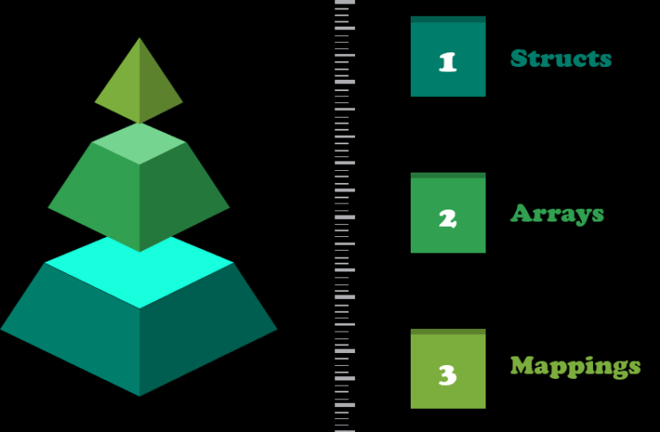
Data Structures in Solidity
Solidity provides three types of data structures:

Slide 17
Enum Types
Enums can be used to create custom types with a finite set of values (see Enums in types section).
pragma solidity ^0.4.0;
contract Purchase {
enum State { Created, Locked, Inactive }
}

Slide 18
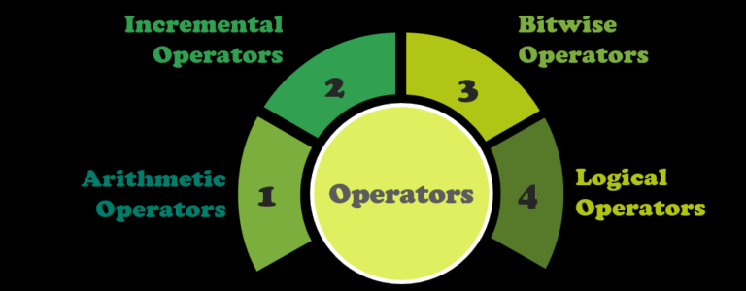
Operators
Operators in solidity are same as in JavaScript. Solidity has four types of operators:

Slide 19
Mappings
Mappings are used for a key to value mapping. This is a way to associate a value with a key.
All values in this map are already initialized with all zeroes, for example, the following:
mapping (address => uint) offers;

Slide 20
Mappings
Mapping is a reference type as arrays and structs. Following is the syntax to declare a mapping type.
mapping(_KeyType => _ValueType)
Where
_KeyType − can be any built-in types plus bytes and string. No reference type or complex objects are allowed.
_ValueType − can be any type.
Considerations
Mapping can only have type of storage and are generally used for state variables.
Mapping can be marked public. Solidity automatically create getter for it.

Slide 21
Arrays, Structs
Arrays represent a contiguous set of elements of the same size and type laid out at a memory location.
Arrays have two members named length and push
uint[] OrderIds;
Structs
These constructs can be used to group a set of dissimilar data types under a logical group. These can be used to define new types, as shown in the following example:
Struct Trade { uint tradeid; uint quantity}

Slide 22
Layout of a solidity source code file
Version pragma
In order to address compatibility issues that may arise from future versions of the solidity compiler version, pragma can be used to specify the version of the compatible compiler as, for example, in the following:
pragma solidity ^0.5.0
This will ensure that the source file does not compile with versions smaller than 0.5.0and versions starting from 0.6.0.

Slide 23
Layout of a solidity source code file
Import
Import in solidity allows the importing of symbols from the existing solidity files into the current global scope.
This is similar to import statements available in JavaScript, as for example, in the following:
Import "module-name“;
Comments
Comments can be added in the solidity source code file in a manner similar to C-language. Multiple line comments are enclosed in /* and */, whereas single line comments start with //.

Slide 24
Layout of a solidity source code file
Events
Events in solidity can be used to log certain events in EVM logs. These are quite useful when external interfaces are required to be notified of any change or event in the contract.
These logs are stored on the blockchain in transaction logs.
Logs cannot be accessed from the contracts but are used as a mechanism to notify change of state or the occurrence of an event (meeting a condition) in the contract.

Slide 25
Layout of a solidity source code file
Events in Solidity are a convenience interface for EVM logging facilities, making them excellent for keeping track of what is happening with a contract.

Slide 26
Control structures & loops
Control structures available in solidity are if – else, do, while, for, break, continue, return.
They work in a manner similar to how they work in C-language or JavaScript.

Slide 27
Solidity Global Variables
block.blockhash(uint numberOfBlock) returns (bytes32): hash which belongs to the given block - will only work for 256 of the most recent blocks, not including current
block.difficulty (uint): difficulty of the current block
block.coinbase (address): miner’s address of the current block
block.number (uint): number of the current block
block.gaslimit (uint): gaslimit of the current block
block.timestamp (uint): timestamp of the current block as seconds passed since the unix epoch
msg.gas (uint): gas that remains
msg.data (bytes): complete calldata
msg.value (uint):
msg.sender (address): message sender (current call)
revert(): execution abort and state change revert
keccak256(...) returns (bytes32): computes the Ethereum-SHA-3 (similar to Keccak-256) hash associated with the (tightly packed) arguments
sha3(...) returns (bytes32): alias for keccak256
sha256(...) returns (bytes32): computes the SHA-256 (tightly packed) argument hash

Slide 28
Demo of remix ide
Remix http://remix.ethereuem.org).
Remix is a suite of tools to interact with the Ethereum blockchain in order to debug transactions. There is an IDE version (Remix IDE) and an online version

Slide 29
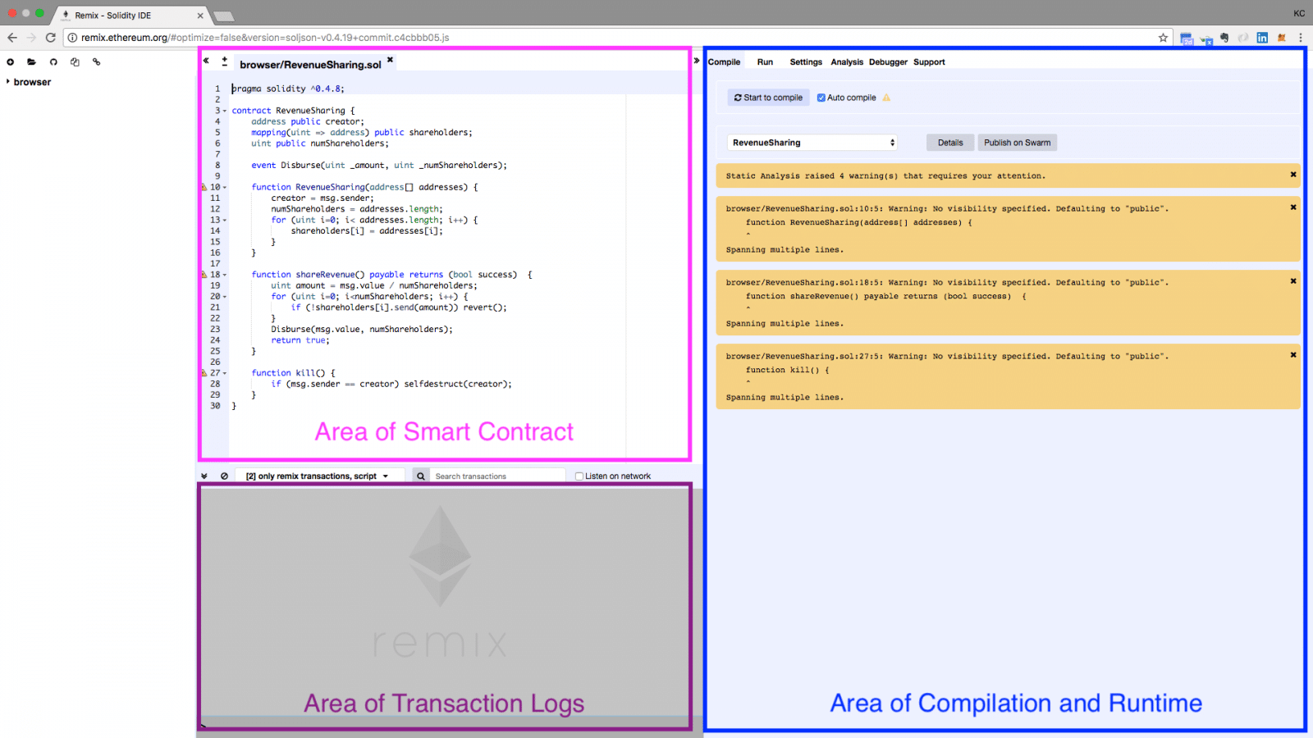
Executing

Slide 30
Demo
1.Working of remix ide
2.Executing simple program only using remix ide
3.Executing solidity programs using remix ide and metamask

Slide 31
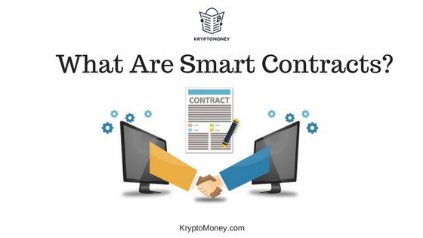

Slide 32
What is a Smart Contract
Nick Szabo coined the term and defined it as “a set of promises, specified in digital form, including protocols within which the parties perform on the other promises.”
In Ethereum, the term "smart contract" refers to immutable computer programs that run deterministically in the context of an Ethereum virtual machine as part of the Ethereum network protocol.

Slide 33
What Are Smart Contracts?
Smart contracts, or crypto-contracts, are nothing but self-executing computer programs that enable digital transactions, business, currency exchanges, asset transfers, and more according to a predefined set of conditions called a smart contract protocol.
Smart contracts not only ensure that both the parties are following the rules and conditions of the contract, but also enforce the contract obligations automatically.

Slide 34
What is a Smart Contract
A contract in the sense of Solidity is a collection of code (its functions) and data (its state) that resides at a specific address on the Ethereum Blockchain.
In each Contract, we can define State Variables, Methods, and Events etc. This contract can manage transactions between blocks in Blockchain network.
Each block has a particular address in the form of a cryptographic key that generated by the result of some functions including hashing of adjacent blocks.
This creates a strong relationship between adjacent blocks. So that manipulation or any other form of hacking in nodes or blocks are not easy or not even possible.

Slide 35
The key components of a smart contract are
Computer program: Normal programs, nothing special except that they execute in the context of the Ethereum virtual machine Immutable: Once deployed, the code of a smart contract cannot change. The only way to deploy a modified contract is by deploying a new instance of it and pointing all users to the new instance. Deterministic: The outcome of the execution of a smart contract is the same for everyone who runs it, given the context of the transaction that initiated its execution and the state of the Ethereum blockchain at the moment of execution. EVM context: Smart contracts operate with a very limited execution context. They can access their own state, the context of the transaction that called them, and some information about the most recent blocks. Decentralized World Computer: The EVM runs as a local instance on every Ethereum node, but because all instances of the EVM operate on the same initial state and produce the same final state, the system as a whole operates as a single "world computer."

Slide 36
Smart Contract Lifecycle
Smart contract code (written in solidity, viper etc) is compiled to bytecode format that runs in the EVM
Compiled code is deployed on the platform using a special contract creation transaction that is sent to 0x0 address
EVM deploys the code and returns a new address at which the contract is now available
Contract code can now be executed by calling its methods
If required, contract can be terminated by running the SELFDESTRUCT function

Slide 37
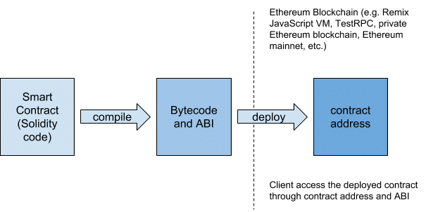
A Simplified Flow of Contract Compilation and Deployment
Notes:
The Contract Application Binary Interface (ABI) is the standard way to interact with contracts in the Ethereum ecosystem, both from outside the blockchain and for contract-to-contract interaction.

Slide 38
Why do we need Smart Contracts?
To implement workflows that eliminate third parties (e.g. escrow services) and allow trading on a peer to peer basis
To implement transparent processes with code visible to everyone (imp in monetary transactions e.g. wills)
To read/write immutable data on the Blockchain to prove authenticity of something (e.g. identity management)
To implement other business logic that must execute in the context of the Blockchain (and is not feasible for external execution due to requirements of trust, transparency or auditability)

Slide 39


Slide 40
Deploying and Testing a Smart Contract
Once you’ve compiled a contract in Remix, you can use the “run” tab to deploy it. The “environment” drop-down gives three options for where to deploy the contract:
JavaScript VM - This lets you run your contract directly in the browser using a JavaScript implementation of the Ethereum virtual machine (EVM). This is great for simple testing but doesn’t allow anyone else to interact with your contract.
Web3 - Web3 is the interface for interacting with an Ethereum node. If you’re using the MetaMask browser extension, it injects an implementation of Web3 into every web page. This option will let you use that injected implementation to deploy to a test network or the main Ethereum network.
Web3 Provider - This option connects directly to an Ethereum node via HTTP. If you’re running your own node (or something like ganache), you can use this option to connect to it.

Slide 41
How smart contracts transform B2B supply chains
In one use case that we are currently exploring for a client, smart contracts automatically and dynamically execute the company’s procure-to-pay process from end-to-end.
In other words, the contract itself takes care of purchase orders; it knows the precise number of units required, at what time, and where; and it secures the best pricing from the best supplier.
What’s more, it can automatically issue the purchase order and pay the supplier when the transaction is complete.

Slide 42
Three blockchain use cases in the B2C space
One area where many blockchain use cases are emerging in the B2C space is claims management—whether medical claims, auto insurance claims, life insurance claims or other types of claims.
One final B2C use case for blockchain: parking solutions. By combining smart contracts with advanced sensors—sensors capable of detecting cars and automatically reading their license plates—it becomes possible to automatically deduct parking charges from citizens using either digital parking wallets or credit cards linked to their identity

Slide 43
Ganache CLI
It’s the command line version of Ganache. It’s used to simulate full client behavior and make developing Ethereum applications faster, easier, and safer.
GANACHE OVERVIEW
Ganache is a personal blockchain for Ethereum development you can use to deploy contracts, develop your applications, and run tests.
It is available as both a desktop application as well as a command-line tool (formerly known as the TestRPC). Ganache is available for Windows, Mac, and Linux.

Slide 44
TRUFFLE OVERVIEW
A world class development environment, testing framework and asset pipeline for blockchains using the Ethereum Virtual Machine (EVM), aiming to make life as a developer easier.
With Truffle, you get:
Built-in smart contract compilation, linking, deployment and binary management.
Automated contract testing for rapid development.
Scriptable, extensible deployment & migrations framework.
Network management for deploying to any number of public & private networks.

Slide 45
DEPLOY SMART CONTRACT
Deploy your own smart contract with Truffle and Ganache CLI
https://medium.com/haloblock/deploy-your-own-smart-contract-with-truffle-and-ganache-cli-beginner-tutorial-c46bce0bd01e
Deploy Smart Contracts on Ropsten Testnet through Ethereum Remix
https://medium.com/swlh/deploy-smart-contracts-on-ropsten-testnet-through-ethereum-remix-233cd1494b4b
Sharing Your Deployed Contract with Others
For someone to interact with your contract, they need to know two things:
The address of the deployed contract.
The contract’s Application Binary Interface (ABI).
Create and deploy contract with ganache and remix ide
https://www.c-sharpcorner.com/article/create-your-first-smart-contract-in-ethereum-with-ganache-remix-ide/

