Slide 1
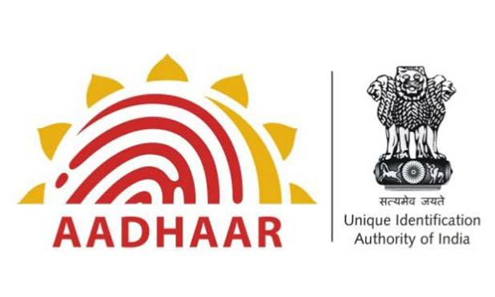
Unique Aadhar Services of India
UIDAI Hackathon 2021

Slide 2
Contents:
1. Team Introduction
2.Introduction
3.Preface
4. Introduction to problem statement
5. Problem statement-1
6. Solution of problem-1
7. Problem statement-2
8. Solution of problem statement-2
9. Architectural Diagram
10. UI Diagrams

Slide 3
Unique Aadhar Services of India
UASI
(APP NAME)
Unique Aadhar Services of India
Proposed by
‘Team Invicto’
Team Reference Id: h1anvPZulO
College Name: Kakatiya Institute of Technology & Sciences, Warangal, Telangana
Team Members:
SL.No&College ID | NAME | EMAIL
1.(B19CN011) | Sana Ur Rahman | b19cn011@kitsw.ac.in
2.(B19CS180) | Mohd. Saif | b19cs180@kitsw.ac.in
3.(B19ME065) | M Essamuddin Ahmed | b19me065@kitsw.ac.in

Slide 4
Unique Aadhar Services of India
Introduction:
In the past 10 years, UIDAI has enabled over 130 crore Indian residents to hold a digital identity. Residents are being given various means of processes to prove their identities. These options being :-
1. Verification through demographic data.
2. Verification through biometric.
3. Verification through One Time Password.
4. Verification through combination of above mentioned options.
Scope of improvement of UIDAI:
UIDAI has installed a large number of enrollment centers across the country. It has also established a self service online platform to undertake update of demo graphical data.
However the availability of a massive number of touch points, UIDAI has a scope for improvement of the experience of the process of updating an address by the means of technology.

Slide 5
Unique Aadhar Services of India
Preface:
As a part of Aazadi ka Amrit Mahotsav, the Unique Identification Authority of India (UIDAI) is hosting an Aadhar Hackathon 2021.
AIM:
The aim of the Hackathon is to solve two major problems. The first one being :-
1. Challenges faced by common man while updating their address.
The second one being:
2.Proving identity without sharing Aadhar number and other demographic information.
From the Hackathon, the best feasible and efficient idea is chosen and implemented by UIDAI to overcome this predicament.
The idea proposed by our team is discussed in this project report.

Slide 6
Unique Aadhar Services of India
The problem statements chosen by our team is:
THEME:ADDRESS UPDATE
Problem statement 1:
Address update challenge in urban areas:-
This challenge is faced in a scenario where a man is shifted to a new address in an urban area and needs to use a copy of his updated Aadhar. However there is no availability of supporting documents to prove the current address. So as per the current policy of the Aadhar, Aadhar address update requires the supporting Proof of Address also known as PoA. Or the other possibility is having an introducer ready to lend his address to update the Aadhar of the user (in this case, the man).
The objective of our app is to provide an interface which establishes a connection between the address donor (landlord) and the user to initiate a request to the donor for the address, thereby eliminating the necessity of PoA of the address of the donor. This is done by supporting the address of the donor to the user via our app.
Problem statement 2:
Address update using supporting document:
Unlike the previous case, in this one, there’s an availability of Po. This scenario involves a mobile operator to undertake update of demo graphical data. These operators reach the doorstep of the user to update their address.
In a nutshell, our app backed up by code establishes a connection between the mobile operator and the user so that they can communicate and update the address of the user as specified by the UIDAI using the concerned supporting documents.

Slide 7
Discussion of problem statement-1
and its solution

Slide 8
Problem statement 1:
Address update challenge in urban areas:-
This challenge is faced in a scenario where a man is shifted to a new address in an urban area and needs to use a copy of his updated Aadhar. However there is no availability of supporting documents to prove the current address. So as per the current policy of the Aadhar, Aadhar address update requires the supporting Proof of Address also known as PoA. Or the other possibility is having an introducer ready to lend his address to update the Aadhar of the user (in this case, the man).
The objective of our app is to provide an interface which establishes a connection between the address donor (landlord) and the user to initiate a request to the donor for the address, thereby eliminating the necessity of PoA of the address of the donor. This is done by supporting the address of the donor to the user via our app.
Problem statement 1:
Address update challenge in urban areas:-
This challenge is faced in a scenario where a man is shifted to a new address in an urban area and needs to use a copy of his updated Aadhar. However there is no availability of supporting documents to prove the current address. So as per the current policy of the Aadhar, Aadhar address update requires the supporting Proof of Address also known as PoA. Or the other possibility is having an introducer ready to lend his address to update the Aadhar of the user (in this case, the man).
The objective of our app is to provide an interface which establishes a connection between the address donor (landlord) and the user to initiate a request to the donor for the address, thereby eliminating the necessity of PoA of the address of the donor. This is done by supporting the address of the donor to the user via our app.

Slide 9
Unique Aadhar Services of India
Solutions for problem statement-1:
Providing the android application with the Connectivity of Internet through out the India Covering the Scalability of all urban and rural areas.
With this app UIDAI will be able to reach the users so efficiently that people having any query and want to avail any services regarding address details and authentication through Aadhar servers.
The user at earlier stage will be asked to authenticate himself with our login/sign up interface provided by the app.
Upon successful completion the above step, the next step is, the donor is intimated by the user to share his address with the concerned user via an OTP sent to the donor to his device.
This notification acts as an alert to notify the user that he requires the address of the donor for the user’s address update in his Aadhar card, for availing nearby services located around him.
How the privacy and security of the donor are maintained by the app:
By the notification system mentioned in the above step, the security and privacy of the donor (landlord) are maintained and the further processes take place only after the consent of the donor.
So in a nutshell, it can be insured that the user is adopting the donor’s address only after his consent.

Slide 10
Unique Aadhar Services of India
The next step is giving the consent of the donor. In this, the donor is alerted via a notification stating an OTP for the user. The notification provides the donor with two options:
1. Accept the request generated by the user
2. Deny the user’s request
If the donor chooses the first option, it is understood that the donor is agreeing to share his address with the user. Consequently, subsequent steps are processed.
If the donor chooses the second option, it is understood that the donor is unwilling to share his address with the user, and the request is considered invalid and the process is terminated.
Consequent steps after the agreement of donor:
First the donor verifies the details of the user to prevent fraudulence, then if he wills to share his address with the user, the next step is put into play.
The next action taken by the donor is to obtain the OTP from the received SMS along with the link, in that link, the OTP is entered by him, appending the last 4 digits of his Aadhar VID (Virtual Id).
Insert picture here

Slide 11
Unique Aadhar Services of India
Why appendation of the VID?
There might be circumstances where the actual donor is not using his personal device, it is being accessed by someone but not the donor. So here the appendation plays a crucial role in adding the required additional security to prevent such unauthorized access.
Appendation: It is defined as the addition of extra 4 digits imported from the donor’s VID to the OTP recieved on the donor’s device.
Appendation provides an additional layer of security and privacy.
Step-2:
The user receives the donor’s address temporally, with the added consent of the donor, thereby satisfying the constraints provided in the guidelines.
Step-3:
After the successful obtain of the address by the donor, the user is allowed to perform minor edits such as flat no., block details etc.
It is also ensured that the edits are limited to restricted fields only and major changes such as state, pin code, area etc are not permitted.

Slide 12
In case of attempt to change the major fields, the process is terminated automatically.
In case of attempt to change the major fields, the process is terminated automatically.
Final address of the user can be viewed by the donor for future reference after all the edits.
The app keeps on producing logs for activity monitoring to take security measures in case of fraudulent usage of the app.
These are the ideas proposed by Team Invicto to overcome the predicament 1.

Slide 13
Discussion of problem statement-2
and its solution

Slide 14
Unique Aadhar Services of India
Problem statement 2:
Address update using supporting document:
Unlike the previous case, in this one, there’s an availability of Po. This scenario involves a mobile operator to undertake update of demo graphical data. These operators reach the doorstep of the user to update their address.
In a nutshell, our app backed up by code establishes a connection between the mobile operator and the user so that they can communicate and update the address of the user as specified by the UIDAI using the concerned supporting documents.

Slide 15
Unique Aadhar Services of India
Solution for problem statement-2:
Address update of the user via the help of supporting documents:
In this case the consent of the donor is unnecessary, the communication only takes place between the user and the local mobile operator recruited by UIDAI of the area of the user.
The role of the app in this case is to establish a communication ground between the user and the mobile operator so that minor edits in the address of the user can be made by the mobile operator using the supporting documents (PoA).
Using this app, the user finds the nearest mobile operator in his area and gets the details of the mobile operator (basic information of the mobile operator).
Consequently, the user generates a service request to the mobile operator via the app.
The application sends a request to the concerned mobile operator chosen by the user from among the list of available mobile operators for that area.
Then that mobile operator receives a request in the same app in his device and is able to view the details of the user and accept his request.
We will assume that mobile operator will be going to the user’s doorstep to provide his services.
Now, the user hands over the PoA documents of the donor to the mobile operator physically.
The mobile operator later scans the document through our app.

Slide 16
Unique Aadhar Services of India
Intuition Behind this Scenario:
The motive is to edit the address in the major fields (ex state, pin code etc) in the PoA document in our app.
Nextly, this PoA document’s address of the donor is edited only by the mobile operator. Hence the app comes into play to solve this crisis by establishing a connection between the user and the mobile operator by providing the necessary interface.
Then the mobile operator makes the final edits in the address fields of the donor which will be the major changes and can be only done by the mobile operator(MO).
The above mentioned step will make the complete and usable donor address and with this address the general PoA document will be generated through our app.
Consequent steps to be followed by the app:
After scanning the PoA document the OCR (Optical Character Recognition) feature will enable us to extract the information from the document and automatically enter the corresponding data into their respectively fields.
Now MO will be able to edit the major changes through the edit fields.
Finally, MO generates the final PoA document of the permanent modified address of landlord and hands it over to concerned user who is able to use it as supporting document to avail the required services.

Slide 17
Architectural
Diagrams
Elaboration

Slide 18
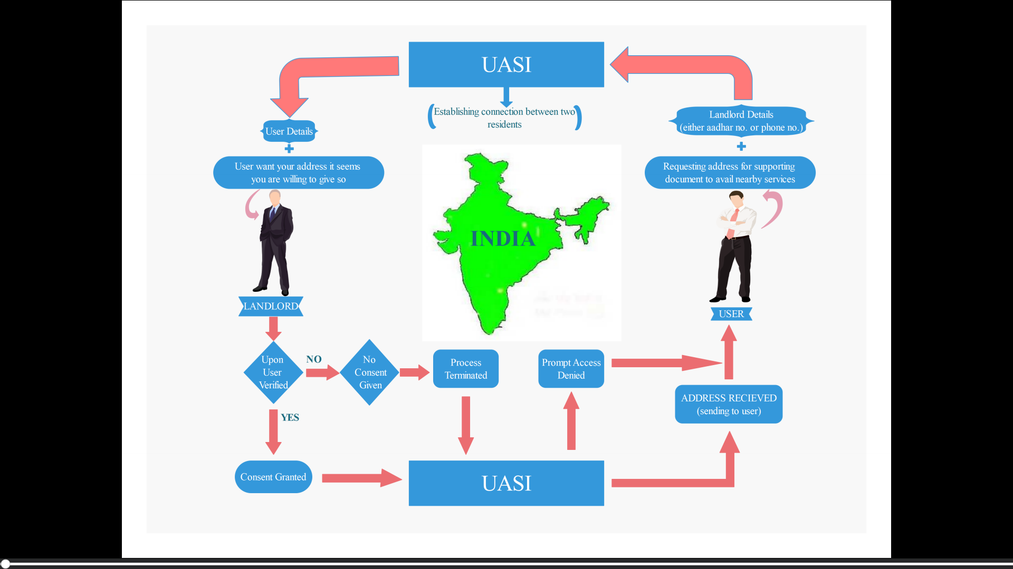

Slide 19
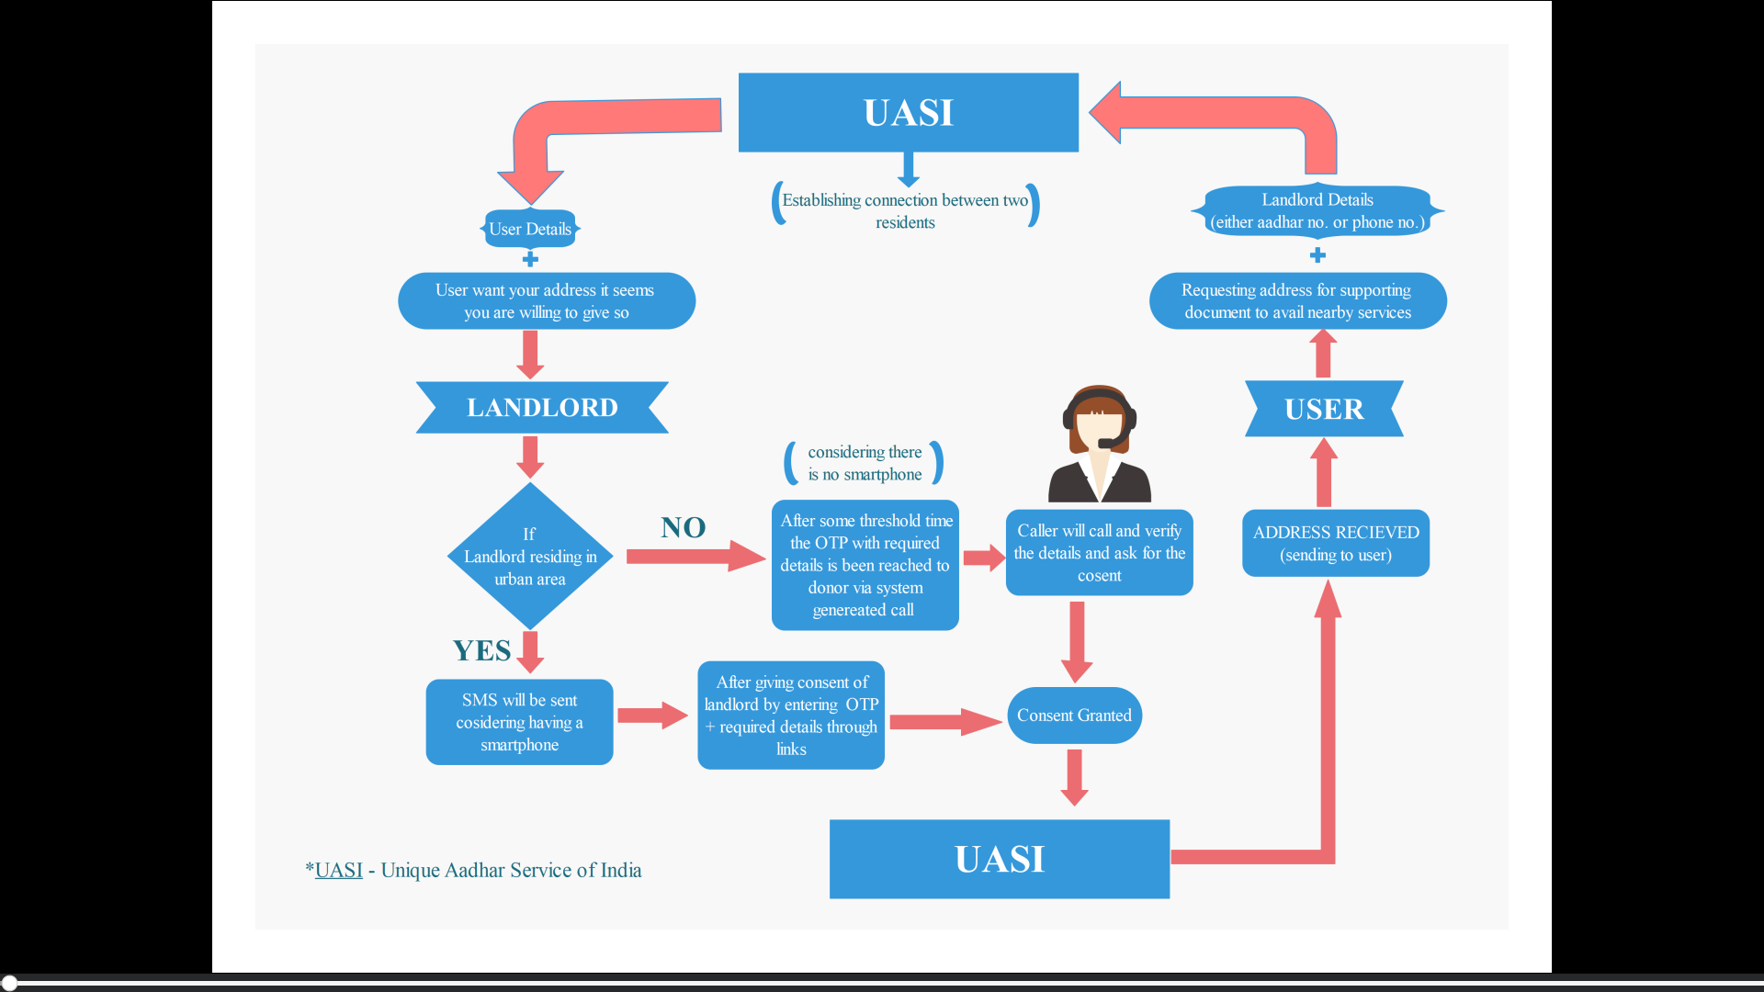

Slide 20
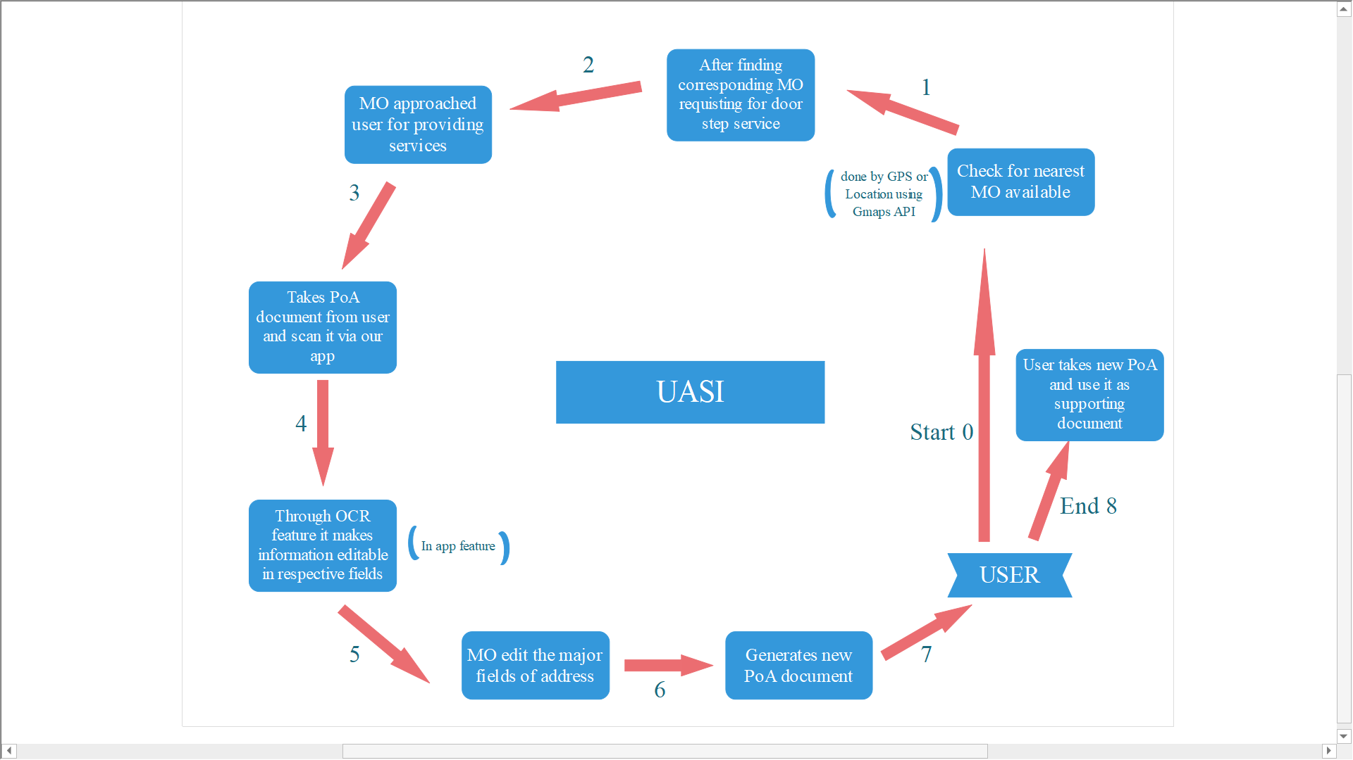

Slide 21
UI EXPLANATIONS

Slide 22
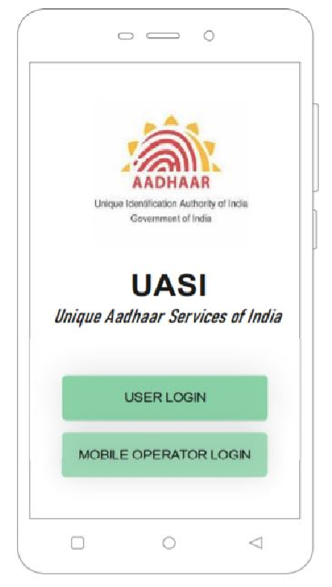
Unique Aadhar Services of India
UI Explained:
This is the entry interface of the app. It provides two options which can be used by both the user and the mobile operator.

Slide 23
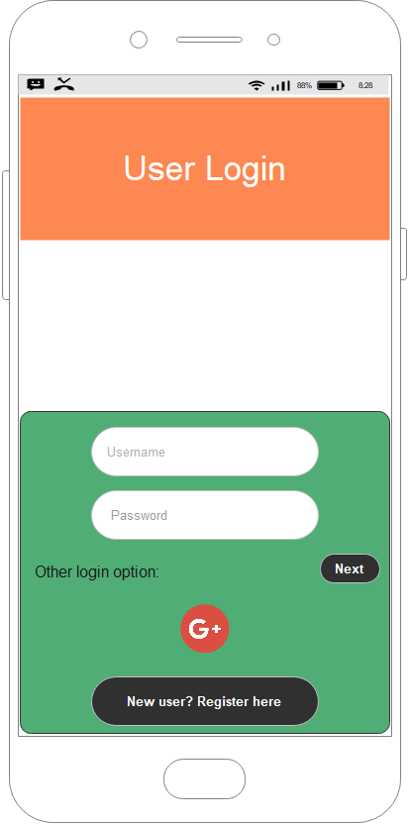
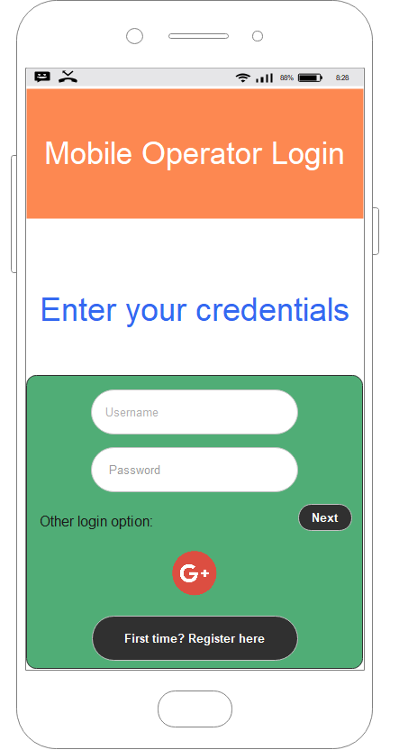
Mobile Operator Login
Interface
User Login Interface
User Login Interface

Slide 24
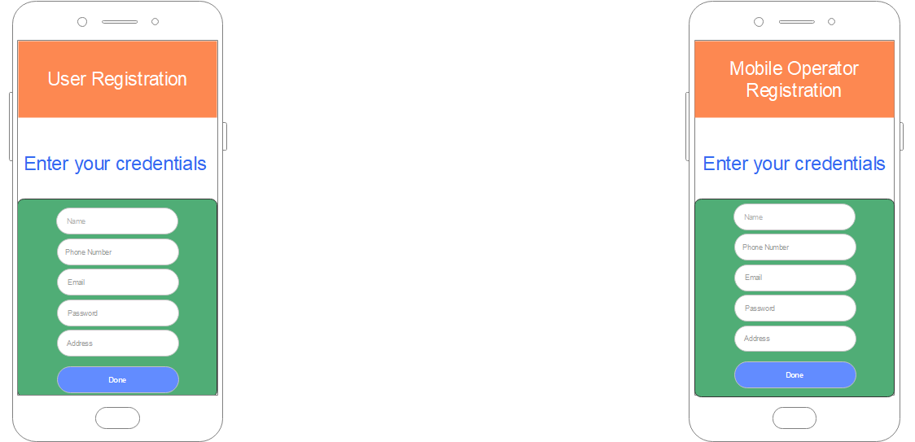
Unique Aadhar Services of India
Registration interface provided for registration of the user and the mobile operator for the first time:

Slide 25
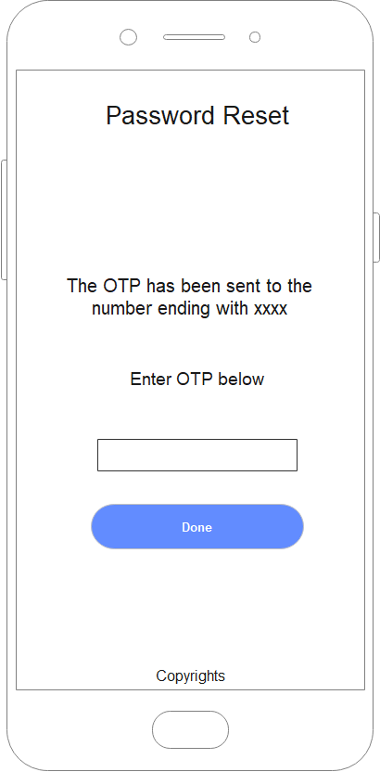
Unique Aadhar Services of India
Reset password interface in case when the user or mobile operator forgets the password.

Slide 26
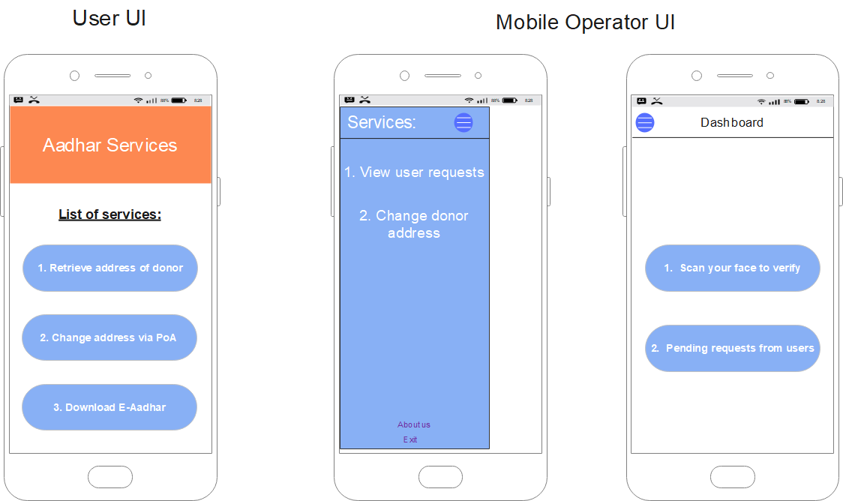
Unique Aadhar Services of India
Interface of services and actions provided by the app:

Slide 27
Unique Aadhar Services of India
Thank you

