Slide 1

Luvia
Comfort you trust.
Care they deserve.
A premium baby-care company designing healthier micro-environments for hot, humid life.
01

Slide 2
HUMAN STORY
A dry diaper can still leave a baby uncomfortable.
At 2:30 a.m., the parent is not optimizing absorbency. They are trying to restore comfort.
The diaper is dry.
The room is quiet.
The baby is still unsettled.
Luvia
03

Slide 3

PROBLEM
Heat + Moisture + Friction create discomfort.
The problem is not lack of absorption. It is the environment that forms after hours of wear.
Heat
+
Moisture
+
Friction
Discomfort
>
Category Default
Luvia wedge
Absorb more
Last Longer
Prevent Leaks
Cooler wear
Softer contact
Less rubbing
Cleaner disposal
Important, but incomplete
Design for what happens around the skin.
06

Slide 4
WHY NOW
Parents are ready for safer, online-discovered baby care.
The behavior shift is already visible. Luvia gives it a climate-specific product.
Indian Summer
Premium Parenting
Online Discovery
Hot and humid conditions make comfort more important.
Online discovery and premium parenting are rising.
Parents increasingly seek safer and gentler products.
18

Slide 5
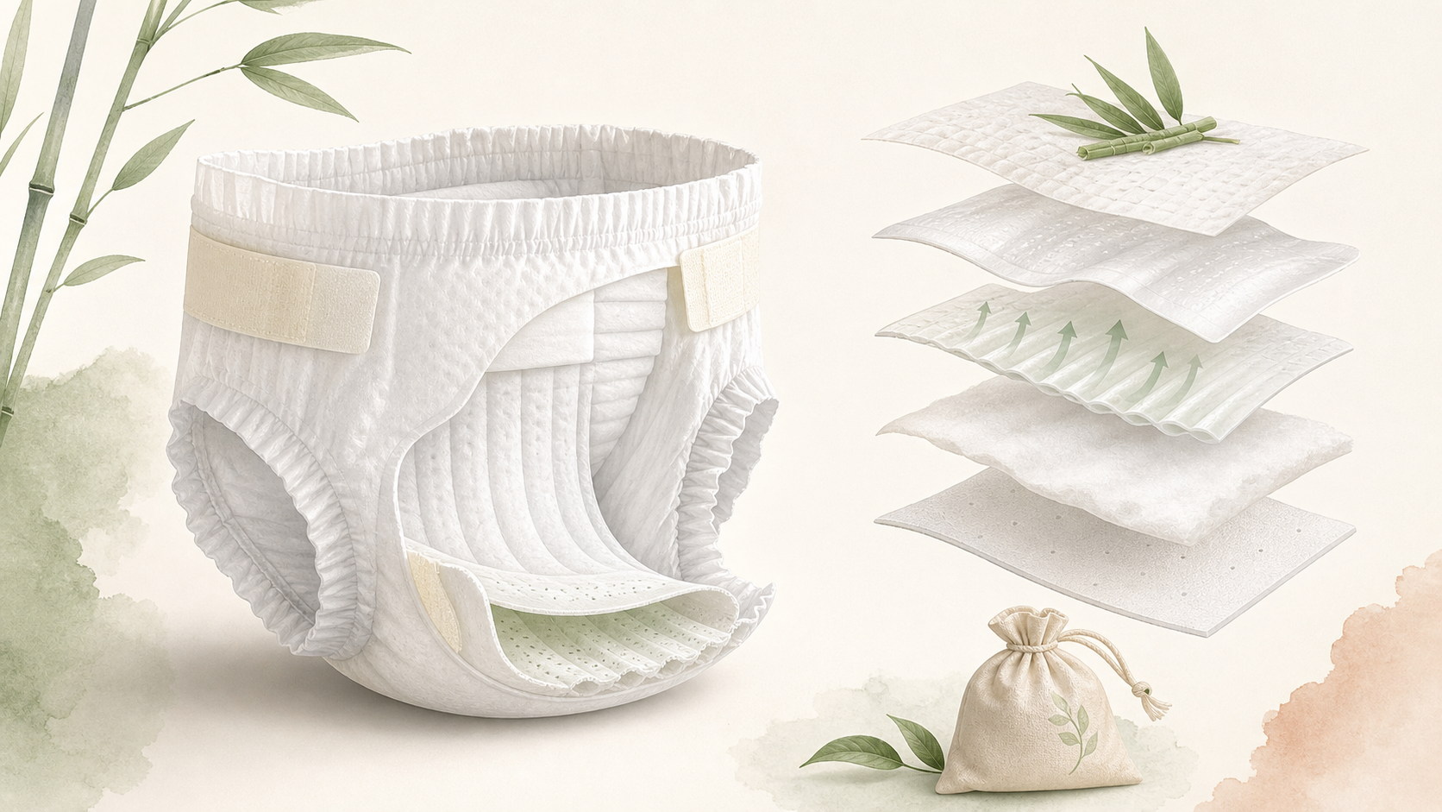
INTRODUCING LUVIA
Luvia designs the climate around baby skin.
A premium eco-friendly diaper engineered for
hot and humid markets.
Skin-health first
Climate-specific design
Eco-conscious materials
Parent convenience built in
07

Slide 6
PRODUCT SYSTEM
Comfort is designed layer by layer.
Comfort isn't one feature. It is a system.
Soft, breathable materials for
delicate skin.
Comfort matters the most .
Less friction, more flexible.
Ventilation that helps reduce heat build-up.
Prepared life for the nature
08

Slide 7
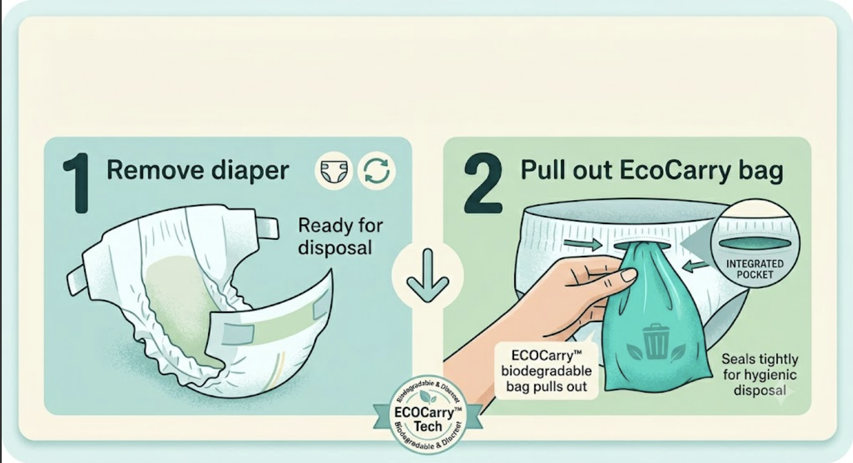


CLEANER JOURNEYS
Signature Innovation — EcoCarry™
Designed to easy dispose.
10

Slide 8
POSITIONING
Luvia chooses the skin-health and climate-specific axis.
The brand should not fight the absorbency war. It should own comfort in hot, humid life.
Climate specific
Absorbency
leaders
Luvia
comfort in tropical life
Low-price
private label
Eco-only
niche
Climate generic
Absorbency-led
Skin-environment led
17

Slide 9
CUSTOMER
The first customer is careful, urban and already researching trust.
They are not just buying diapers. They are buying peace of mind
>
>
>
Characteristics of Target Audience / Customers
Notices irritation
Searches ingredients
Looks for proof
Subscribes if trust holds
Age 24-40
Health-conscious parents
Premium urban household
Values safety and comfort
Willing to pay for peace of mind
12

Slide 10
MARKET
India offers scale before expansion.
23.2M
Urban entry wedge
estimated births per year in India
Nearly two-thirds of urban Indian households now buy baby-care products online, according to Economic Times reporting.
Source : UNICEF India 2025
Sources: World Bank WDI 2024 values; Economic Times citing Numerator/Kantar, Aug 2025.
13

Slide 11
BUSINESS MODEL
Start with recurring care, then expand through trusted channels.
The model begins direct, learns fast, and adds reach where parents already seek care.
Retail stores
Individual packs
Pharmacies + clinics
Recurring
care
Monthly subscription
E-commerce + Amazon
14

Slide 12
GO TO MARKET
Trust first. Distribution second.
Phase 2
Phase 4
Phase 6
Amazon
Subscription
Pharmacies
Easy access,
credibility
Convenience,
loyalty
Offline trust,
Mass reach
Phase 1
Phase 3
Phase 5
Instagram
Website
Community
Build trust,
spark interest
Own Story,
deeper info
Advocacy,
emotional bond
15

Slide 13
MANUFACTURING
Build the brand and customer system before owning factories.
Contract manufacturing keeps capital focused on product quality, learning and distribution.
Luvia
Contract manufacturer
Quality loop
Parents
Product specs
Brand
Customer learning
Skin-comfort tests
Fit feedback
Batch checks
D2C feedback
Subscriptions
Community proof
Tooling
Materials
Production run
16

Slide 14
ROADMAP
EXECUTION PLAN
Every stage earns the right to the next.
0-6 months
6 – 12 months
12 – 18 months
18 – 24 months
Long - term
Prototype + supplier lock
D2C pilot and first subscriptions
Clinics, retail and adjacent care
Product family expansion
Build a trusted baby-care ecosystem.
19

Slide 15
BEYOND DIAPERS
Diapers are the entry point into trusted baby care.
Luvia can become the calm shelf parents reach for during the first years.
Diapers
Rash creams
Feeding accessories
Wipes
Baby skincare
20

Slide 16
INVESTMENT ASK
We are raising to prove comfort at scale.
Target Raise
₹2-3 Cr
Pre-seed
🍼
Product Validation
35%
Prototype iterations
Dermatology testing
Comfort studies
Parent feedback
🏭
Manufacturing
30%
Supplier partnerships
Tooling
Initial inventory
Quality systems
📈
Go-To-Market
25%
Amazon launch
D2C website
Community building
Content and creator partnerships
👥
Team
10%
Operations
Customer experience
Technology and design
21

Slide 17
Luvia
Comfort you trust.
Care they deserve
A gentle product system for the earliest days of care.
22

