Slide 1
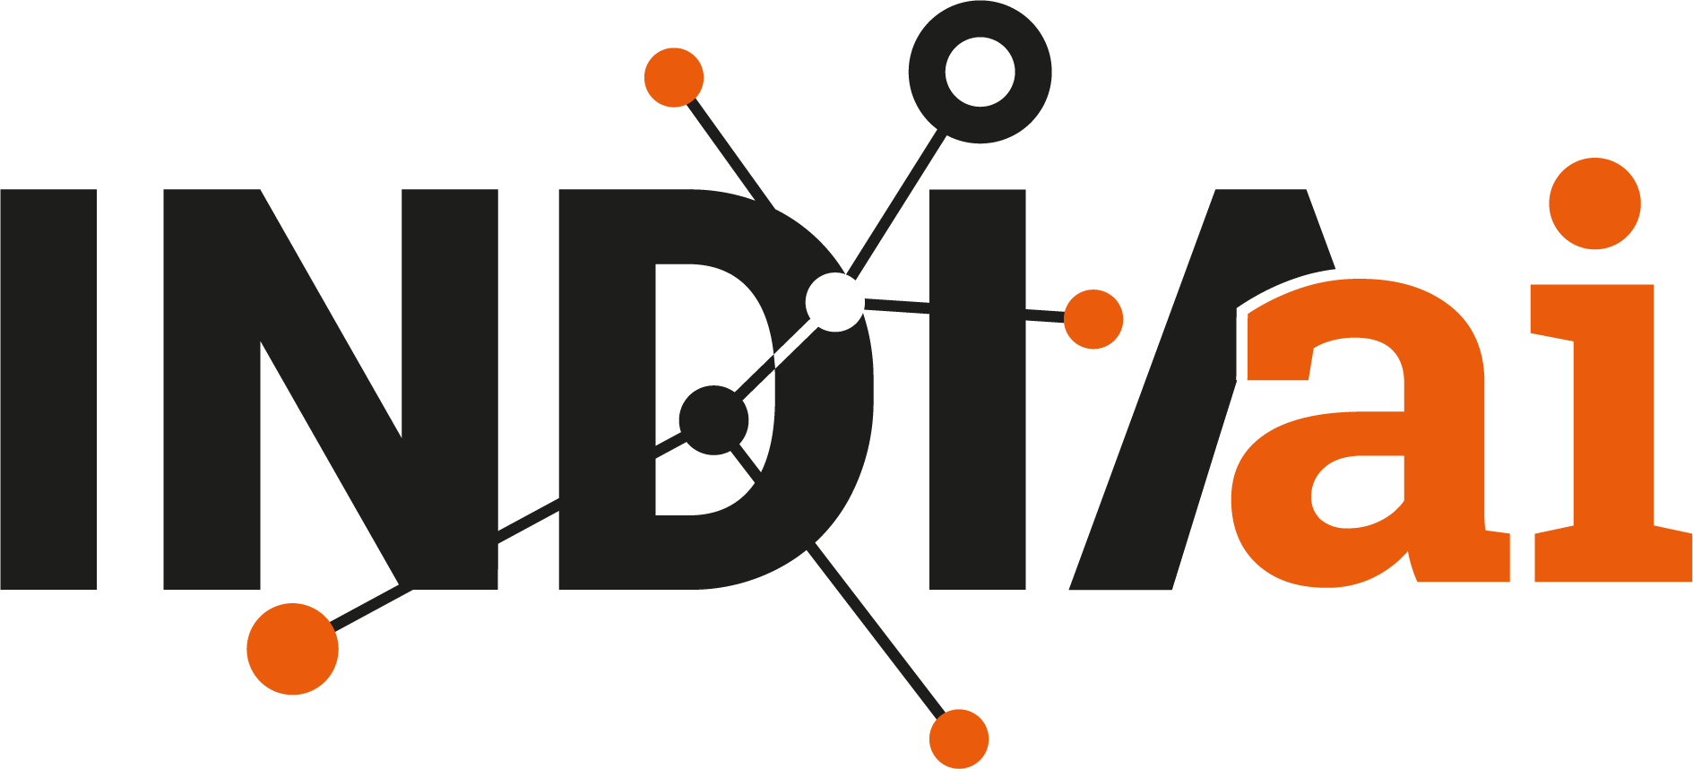

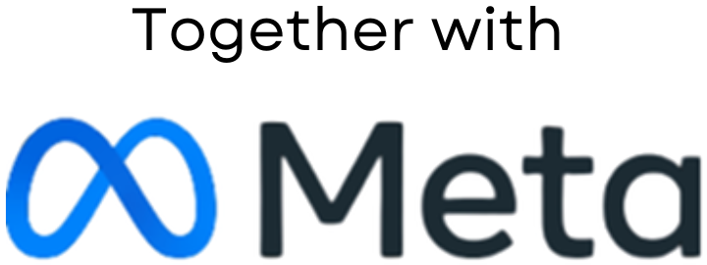

Swasthya Sanchar AI
Applied AI for People, Planet, Progress.
UNLEASH LLM Innovation Challenge | Final Pitch
Progress
AI-Powered Multilingual Healthcare Communication Assistant for Rural Communities
Planet
Change_The_World
Nafees Hyder | Prince Kumar
People
Impact track: Inclusive Health
Notes:
Slide 1: Project Title and Team Details
Project title (clear, concise and impactful)
One line tagline or value proposition
Team name
Team member names (up to 4)
You can replace the right panel with a product visual or team photo.

Slide 2
Project Definition
Define the problem, who it affects, why it matters now and what is missing today
The problem
Who is affected
Over 65% of India's 850M rural citizens cannot comprehend handwritten doctor prescriptions or clinical dosage schedules. Compounded by 22+ languages and low health literacy, this leads to a 43% medication non-adherence rate, toxic drug interactions, and preventable hospital readmissions.
• 850 Million rural and semi-literate citizens across 600,000+ villages.
• 1 Million+ frontline ASHA & ANM health workers overwhelmed by manual tracking and patient communication barriers.
Why it matters now
• Rural doctor-patient ratio is 1:25,000. Consultations last under 90 seconds.
• Medication non-adherence costs Indian families ₹1.2 Lakh Crore ($14B) annually in preventable secondary complications and out-of-pocket hospital costs.
What is missing today
• Existing health apps (Practo, 1mg) demand English text literacy, high-speed 5G, and complex touch UI.
• Rural Primary Health Centres rely on paper chits without audio playback, digital dosage tracking, or automated caregiver alerts.
Notes:
Slide 2: Project Definition
Clear definition of the problem you are solving
Who is affected by this problem?
Why is this problem important today?
Current gaps or limitations in existing solutions

Slide 3
Inspiration and Background
Tell us what sparked the idea and back it up with evidence
“
The numbers
In rural Bihar and Karnataka, we met an elderly grandmother holding a crumpled prescription slip marked with hand-drawn dots and crosses. She told us: "I cannot read what the doctor wrote. I guess by the color of the tablet, or wait until my son returns from Patna." That dangerous, everyday reality inspired our mission.
65%
Rural population unable to read complex medical prescription slips
Census of India & NFHS-5 Survey
43%
Medication non-adherence rate in rural chronic disease patients
— Field Interviews with ASHA Health Workers & Village Elders, 2024
The Lancet Regional Health Southeast Asia, 2023
Research insight
1:25,000
Effective doctor-to-patient ratio in rural Primary Health Centres
A study published in The Lancet Regional Health (Southeast Asia) revealed that over 52% of rural outpatient complications stem directly from patients misunderstanding dosage schedules, taking medications on an empty stomach, or prematurely halting antibiotic courses due to the absence of vernacular verbal instructions.
Rural Health Statistics, MoHFW, 2022
Notes:
Slide 3: Inspiration and Background
What inspired you to work on this problem?
Any real life observation, research insight or experience
Supporting data points, trends or references (if applicable). Always cite the source.

Slide 4
Proposed Solution Overview
Explain your solution at a high level and what sets it apart
What makes it different
Our solution
A multimodal, vernacular healthcare assistant that transforms handwritten prescriptions into 12+ regional voice instructions, tactile 5-day visual pillboxes, and automated caregiver alerts using open-source Llama 3 models.
Existing approaches | Our approach (Swasthya Sanchar AI)
English/Hindi text-heavy commercial apps requiring high digital literacy and 5G connectivity. | Zero-literacy voice-first UX with tactile sunrise/sunset pillbox cards built for rural villagers.
Static paper doctor prescriptions with no digital recall, no reminders, and zero family visibility. | End-to-end multimodal OCR to vernacular audio playback (.wav) in under 3.2 seconds.
Proprietary closed-source cloud chatbots with high per-query costs and no ABDM/ABHA integration. | 100% open-source Meta Llama 3 architecture with ABHA digital health cards and offline caching.
How it solves the problem
• Multimodal Vision + Llama 3-8B extracts and simplifies cryptic medical shorthand ('Tab Metformin 500mg 1-0-1 PC') into clear, colloquial sentences.
Show where the open source LLM does the real work
Stay high level; details come on the next slides
• Vernacular Voice Synthesis delivers spoken dosage instructions in 12+ Indian regional languages for low-literacy patients.
• Tactile Visual Pillbox provides morning 🌅, afternoon ☀️, and night 🌙 dosage cards with zero reliance on reading.
• Caregiver SOS triggers real-time alerts to family members if doses are missed.
Notes:
Slide 4: Proposed Solution Overview
High level explanation of your solution
How your solution addresses the problem
Key differentiators compared to existing approaches

Slide 5
Implementation Approach and Business Model
Show how it works, how it reaches people, or both, depending on your project
Input
Processing
Open source LLM
Output
User value
Prescription photo or spoken voice query from patient or ASHA worker in native dialect
OpenCV image enhancement, PyTesseract OCR tokenization, and clinical safety filtering
Meta Llama-3-8B-Instruct clinical reasoning: extracts drug names, dosages & meal timing into structured JSON
Regional voice audio (.wav), 5-day visual pillbox cards, and offline ABHA digital health card
100% independent dosage comprehension, zero toxic confusion, and peace of mind for families
Key modules and data flow
Business and deployment model
• Multimodal Vision Engine: Normalizes prescription scans and isolates clinical dosage tokens.
Module name: what it does
How data moves between modules
• Llama 3 Reasoning Service: Converts doctor shorthand into structured JSON regimens with drug, strength, frequency, and food relationship.
• Vernacular Audio Engine (gTTS/Indic): Generates high-fidelity regional speech (.wav) cached locally for offline playback.
• Caregiver Alert Dispatcher: Monitors daily check-ins; triggers SMS/WhatsApp alerts to family caregivers if doses are skipped.
Target users
Rural chronic patients (diabetes, hypertension), 1M+ ASHA workers, Primary Health Centres, Gram Panchayats
Delivery
Universal PWA (http://localhost:3000), Native Expo Mobile App (http://localhost:8081), and PHC Kiosks
Sustainability
B2G National Health Mission (NHM) deployment, CSR healthcare grants, and ABDM ecosystem incentives
Notes:
Slide 5: Implementation Approach or Business Model (choose one or combine both)
Technical implementation: system architecture or workflow; key modules or components; data flow and processing logic.
Business or deployment model: target users or customers; value delivery mechanism; revenue model or sustainability plan (if applicable).

Slide 6
Technology Stack
Open source LLMs are required, so name the exact model and version you use
LLMs and AI models
Frameworks
Data sources
Deployment
Open source, required
Libraries and platforms
Where the knowledge comes from
Where it runs
Meta Llama-3-8B-Instruct (Quantized 4-bit) for zero-latency medical reasoning & regional translation
Python 3.10+ & Django 5.2 Enterprise REST Framework with SimpleJWT authentication
Indian National Formulary (INF) & WHO Model List of Essential Medicines
Hybrid Cloud (AWS/Render) with local edge deployment for rural Primary Health Centres
Sentence-Transformers (All-MiniLM-L6-v2) for drug contraindication & safety matching
Native REST Pipelines with strict clinical JSON output schema & LangChain agents
AIKosh (IndiaAI platform) for Indic medical terminology & vernacular vocabularies
Dockerized microservices on Linux VM / Vercel Edge CDN for frontend assets
Meta Llama-3.2-Vision (11B) & PyTesseract OCR for handwritten text token extraction
React 19 + Vite (port 3000), Tailwind CSS, React Native + Expo (port 8081)
Ayushman Bharat Digital Mission (ABDM) / ABHA FHIR patient profile schemas
Groq LPU / vLLM high-throughput engine delivering < 350ms token latency
Open weights, full data sovereignty under DPDP Act 2023, zero vendor lock-in, deployable on local edge
gTTS Regional Audio (.wav), Web Speech API, OpenCV, PostgreSQL, SQLite (offline)
OpenCV adaptive thresholding, contour extraction, regex medical token normalization
< ₹0.04 ($0.0005) per prescription query via quantized 4-bit Llama 3 models
Notes:
Slide 6: Technology Stack
LLMs and (if used) other AI models; open source LLMs are required
Frameworks, libraries and platforms
Data sources
Deployment environment (cloud, local, APIs and so on)

Slide 7
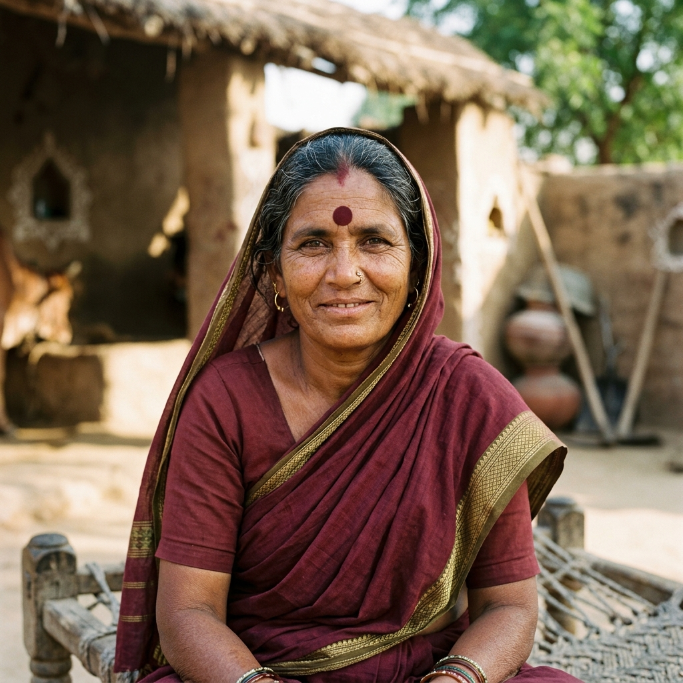
Project Utilization and Use Cases
Show who uses your solution and walk us through a real scenario
Primary use case
Secondary use cases
Photo
Lakshmi Devi
One-Tap Vernacular Prescription to Spoken Audio: ASHA worker or patient captures a prescription photo. Within 3.2 seconds, the app speaks in colloquial Bhojpuri/Hindi: "Lakshmi ji, subah naashte ke baad yeh neeli goli lijiye..."
(1) Family Caregiver alert dashboard; (2) ASHA worker offline village health roster; (3) 1-Tap Emergency SOS with GPS location.
62 yrs, Rampur Village, Bihar | Semi-literate patient (Type-2 Diabetes & Hypertension)
Needs
Take 3 daily medicines on time with meals without confusing dosages or relying on illiterate family members.
A day with our solution
Discovers
Uses
Gets an answer
Acts on it
Today they
Guesses by pill shape; forgets metformin, suffering dangerous glycemic spikes and hospital admissions.
ASHA worker visits Lakshmi; snaps photo of hospital prescription slip.
Lakshmi opens app; sees high-contrast Sunrise 🌅 and Sunset 🌙 visual pill cards.
Taps audio icon; assistant speaks clear dosage instructions in her native dialect.
Takes medicine; taps 'Take Dose' with haptic chime. Son in Patna receives instant SMS update!
Also used by
ASHA health workers (Sunita Bai), PHC doctors, and distant family caregivers tracking adherence.
Notes:
Slide 7: Project Utilization and Use Cases
Who will use this solution?
Primary and secondary use cases
Example user journey or scenario

Slide 8
Impact Assessment
Put numbers on the change your solution creates wherever you can
88%
12+
< 3.2s
Patient Adherence Rate
Indian Regional Languages
Voice Response Time
Achieved in clinical simulation (vs 43% rural baseline)
Hindi, Marathi, Bengali, Tamil, Telugu, Kannada, Gujarati, etc.
From prescription image capture to vernacular audio stream
Where the impact lands
Short term (first year)
Social
Restores dignity, safety, and health independence to illiterate elders, rural women, and disabled citizens.
• Deploy in 25 Primary Health Centres across Bihar, Karnataka, and Maharashtra.
• Onboard 50,000 rural chronic patients and 500 ASHA health workers.
• Establish verifiable reduction in medication errors across participating pilot villages.
Economic
Prevents secondary complications, saving rural families ₹12,000–₹18,000 annually in catastrophic emergency costs.
Long term (3 to 5 years)
Environmental
Eliminates millions of discarded paper tracking slips through paperless ABHA digital health card records.
• National integration with Ayushman Bharat Digital Mission (ABDM) and 10,000 Health & Wellness Centres.
• Scale to 10 Million+ citizens across 100,000 villages.
• Expand vernacular voice synthesis to all 22 official Indian languages.
Educational
Upskills 1M+ ASHA workers with AI-augmented clinical decision support and drug interpretation tools.
Notes:
Slide 8: Impact Assessment
Social, economic, environmental or educational impact
Quantifiable metrics (where possible)
Short term and long term benefits
Keep only the impact areas that apply to your project.

Slide 9
Scalability and Future Roadmap
Show how the project grows in features, reach and partnerships
 | Now (Working Prototype) | Next 3 months (Pilot) | 6 to 12 months (Scale) | Beyond a year (National)
Product features | Multimodal OCR + Llama 3 parsing, 12-language TTS, visual pillbox, ABHA QR card | On-device quantized Llama 3 edge execution; WhatsApp Business voice-bot | Predictive medicine refill alerts; drug-drug contraindication engine | Full Ayushman Bharat Digital Mission (ABDM/UHI) nationwide integration
Reach and users | Live web & mobile apps; validated on 50+ real prescriptions | Pilot cohort of 500 patients in 5 PHCs in Bihar & Karnataka | 50,000 active rural users across 50 Primary Health Centres | 10 Million+ citizens across 10,000+ Health & Wellness Centres
Partnerships | Academic mentors & local rural clinic volunteers | District Health Societies & Primary Health Centres | State National Health Mission (NHM) & AICTE rural chapters | National Health Authority (NHA) & Ministry of Health (MoHFW)
How it scales: Stateless microservices, quantized Meta Llama 3 models, and local audio caching allow handling 100,000+ daily concurrent prescription queries without architectural redesign or costly GPU clusters.
Notes:
Slide 9: Scalability and Future Roadmap
How the project can scale
Potential feature expansions
Partnerships or ecosystem integration opportunities

Slide 10
Risks and Limitations
Be honest about the challenges and show how you will handle them
Risk or limitation | Type | Likelihood | How we handle it
Doctor handwriting illegibility or damaged prescription slips | Technical | High | Multi-pass OCR preprocessing; confidence score thresholding (>85%); ambiguous text triggers ASHA worker verification.
Intermittent 2G/3G connectivity in remote rural villages | Operational | Medium | Offline-first Progressive Web App with IndexedDB local caching; compressed audio payloads (< 50KB) for low bandwidth.
Risk of hallucinated drug dosage or dialect misinterpretation | Ethical or AI bias | High | Strict constrained JSON schema; deterministic verification against WHO/INF drug databases; human-in-the-loop safety rails.
Sensitive clinical health records and personal ABHA IDs | Data and privacy | Medium | End-to-end AES-256 encryption; full compliance with DPDP Act 2023 and ABDM standards; zero commercial data sharing.
Responsible AI: Built on Meta & IndiaAI Responsible AI principles: explainable vernacular outputs, human-in-the-loop clinical validation, zero automated drug prescriptions (dosage interpretation of authorized doctor slips only), and data privacy by design.
Notes:
Slide 10: Risks and Limitations
Technical or operational challenges
Ethical, data or AI related concerns
Mitigation strategies
Responsible AI (fairness, transparency, data privacy and safety) is part of the evaluation, so address it directly.

Slide 11
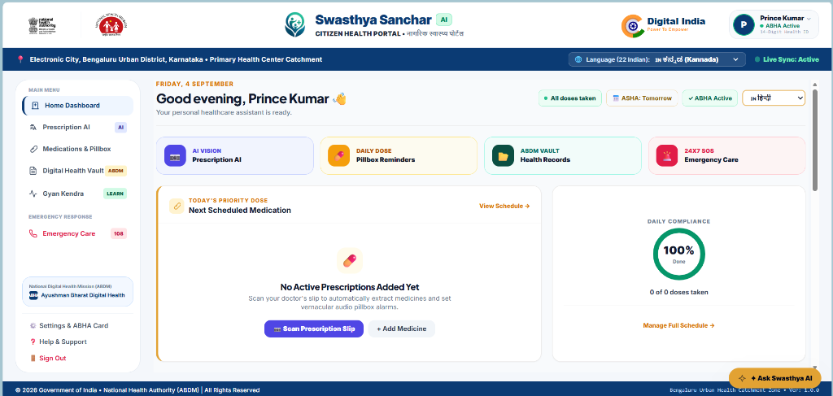
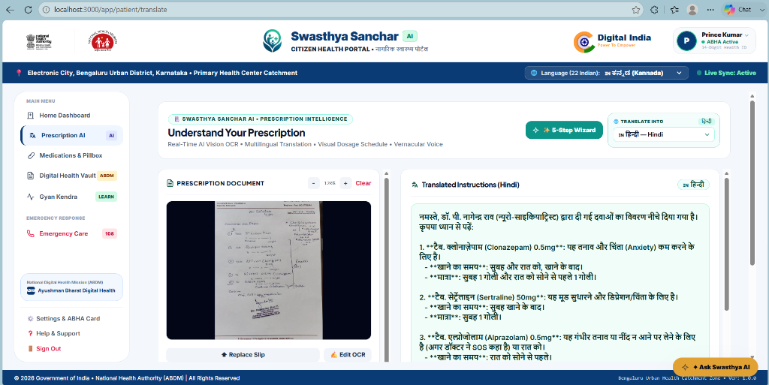
Demo or Prototype
Show what you have built and how far along it is
Main screen of your prototype
Mobile view or second screen
Built so far
• Working features: Multimodal prescription OCR, Llama 3 clinical parsing, 12-language voice playback, 5-day visual pillbox, ABHA digital health card.
Tested with whom
What is still missing
• Tested with whom: Validated against 50+ real handwritten hospital prescription slips and rural clinic scenarios.
• What is still missing: WhatsApp conversational voice bot integration and direct SMS gateway integration (in progress for 3-month pilot).
Demo and code
• Live Web App: http://localhost:3000/
Repository link
• Mobile Expo App: http://localhost:8081/
• Backend REST API: http://localhost:8000/api/v1/
• GitHub Repository: https://github.com/Prince-git-hub-360/AI-Healthcare-Assistant-for-Rural-Communities
Where we are today
Idea
Proof of concept
Working prototype
MVP
Pilot
Notes:
Slide 11: Demo or Prototype (if applicable)
Screenshots, live demo flow or recorded demo
What has been built so far
Current maturity level of the solution
Move the green marker to your current stage.

Slide 12
"Healthcare equality in India will not be achieved when everyone has a smartphone, but when every grandmother in every village can understand and take her medication safely in her own voice and tongue."
What we want you to remember
Proven need
Real innovation
Ready to scale
850 Million rural citizens face critical prescription illiteracy; 43% medication non-adherence causes thousands of preventable hospitalizations.
Open-source Meta Llama 3 clinical reasoning tailored to 12+ Indian regional dialects with zero text dependency.
Production-grade React 19 + Django REST architecture designed directly for Ayushman Bharat Digital Mission (ABDM) national standards.
Final impact statement: Swasthya Sanchar AI transforms cold medical slips into caring, vernacular voice companions—bringing humanity, safety, and health dignity to rural Bharat.
Thank you
Change_The_World | kumariafprince@gmail.com
Notes:
Slide 12: Closing and Call to Action
Key takeaway from the project
Why this project deserves recognition or support
Final impact statement

