Slide 1
LAB PRG-1
Design and implement C program using the Brute Force String Matching algorithm to find all occurrences of a given pattern in a text. Display the starting position(s) where the pattern occurs and analyze the time complexity of the algorithm.
B. Design and implement C program to determine whether all elements in a given array are unique (i.e., no duplicate elements are present) also analyze the time complexity of the algorithm. Run the program for varied values of n> 5000 and record the time taken. Plot a graph of the time taken versus n.

Slide 2
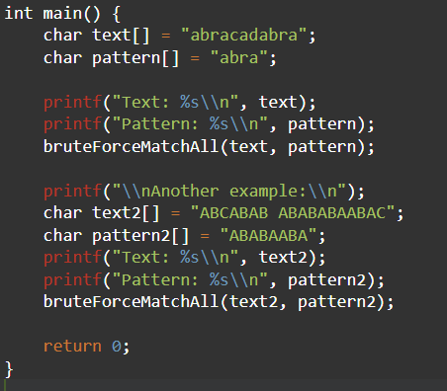

Slide 3
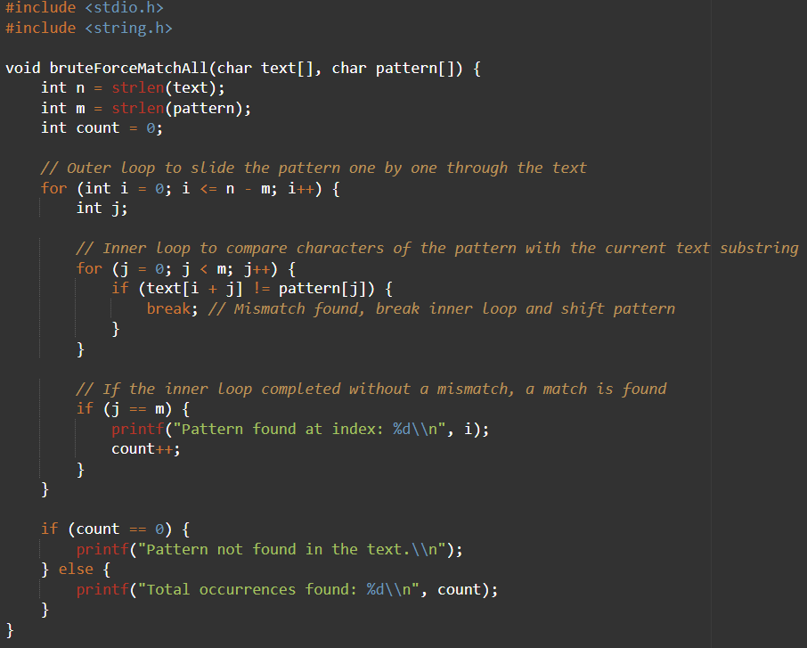

Slide 4
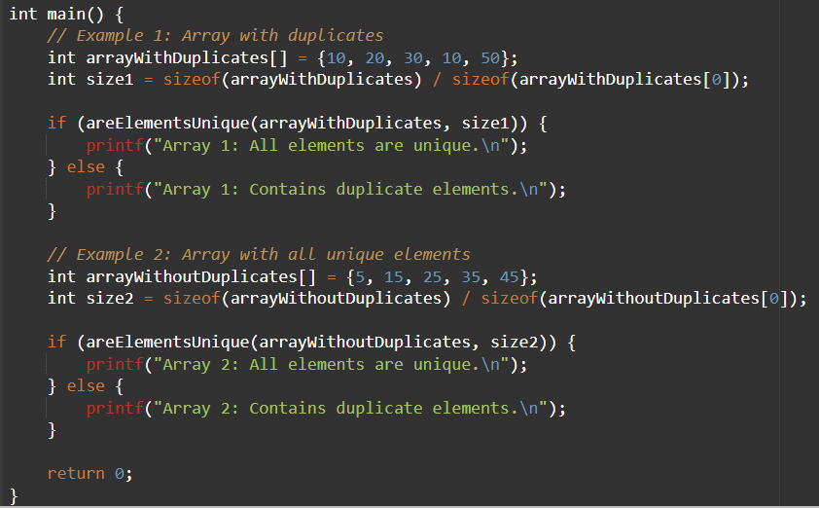

Slide 5
