Slide 1
Assignment for Ghost blog
By Prince Kumar

Slide 2
Content
Requirement
Approach
Architecture
Provisioning the Infrastructure via CloudFormation templates
Template for EC2, ALB, RDS
Installing Ghost via EC2 user data script
Implementing CI/CD for Continues Integration and deployment on different environments
Creating lambda script for deleting post hosted on ghostblog.

Slide 3
Approach
1. Classic Architecture (Infrastructure provisioning via CloudFormation scripts for ALB, EC2 and RDS automated deployments via implementing CI/CD)
2. Using Elastic beanstalk( provision the environment and Application at once with hosting blog on EC2.

Slide 4
Using Approach 1
Steps:
Provisioning of Infrastructure (Using CloudFormation templates)
Hosting of ghost blog (via user data of EC2)
Using CI/CD pipeline for automated deployments.
Creating lambda function to delete post on hosted ghost blog.

Slide 5
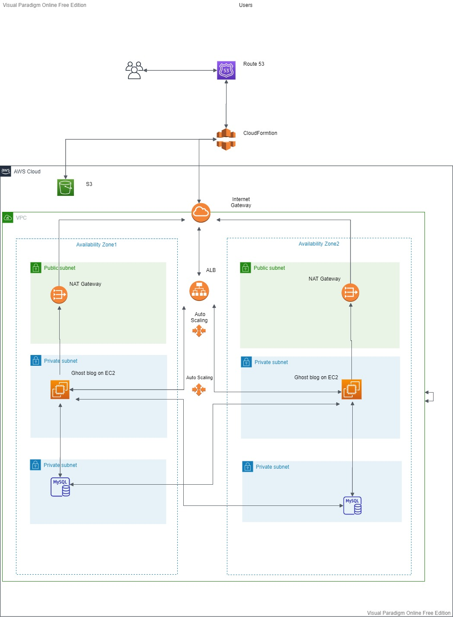
Architecture
1.Route53(DNS to resolve public domain and route it to IP of ALB)
2.CloudFront(for better latency based on geolocation traffic)
3.ALB with autoscaling in public subnet (Application load balancer to route traffic to Ghostblog Application hosted on EC2 instance and autoscaling to scale in and out the EC2 as per the demand fluctuates.)
4. EC2 instance having ubuntu based OS best suited for Ghost hosting.
5. NAT gateway and Internet gateway for communication to internet for instances in private subnet.
5. RDS/MySQL database for storing data related to blog

Slide 6
Working
A VPC with required subnets and other networking components.
An EC2 Auto Scaling group to self heal in case of hardware failure.
An Application Load Balancer to direct traffic to the active instance where ghostblog is running.
A RDS instance as our managed DB solution.

Slide 7
Thank You !

